Slide 1

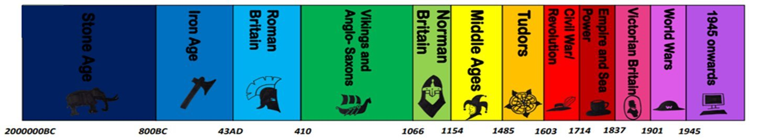
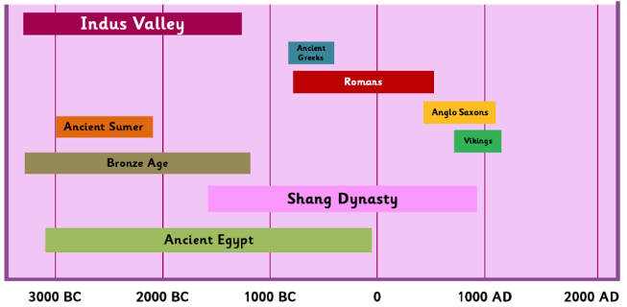

Year 5 Autumn 1: Ancient Civilisations
Timeline
ESSENTIAL VOCABULARY
Word | Definition
Civilisation | A society with its own organisation and culture
Chronology | The arranging of events or dates in the order they occurred
Adapt | To make something suitable for a new purpose
Inventions | An object which has not been made before to fulfil a purpose.
Ziggurats | A temple used by the Ancient Sumer tribe
Archeologists | A person who studies human history through the excavation of sites.
Legacy | Something important or lasting that comes from the past.
Timeline: Ancient Civilisations
What I will know at the end of the unit.
The main features of ancient civilisations
The importance of Science and technology and how they advanced ancient civilisations.
What everyday life was like for the Sumner tribe, the Shang dynasty of Ancient China and the Indus Valley civilisation.. .
How sources can be used to help us identify what life was like for ancient civilisations.
The legacy of ancient civilisations and how they have shaped the modern world.

