Slide 1

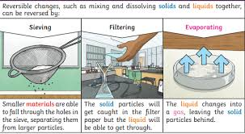
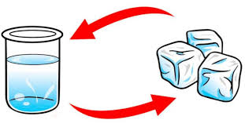
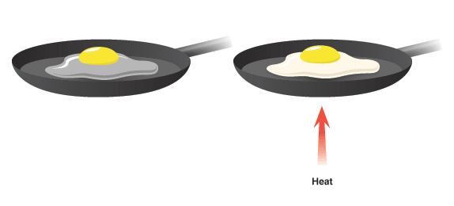
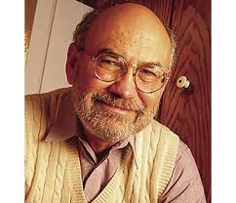
How do materials change?
Science Year 5 Autumn 1/ 2
Vocabulary you will know…
Irreversible | This means the change is permanent and cannot be undone. You cannot turn the new material made back into its original form. A new product is often made
Reversible | A reversible change is a physical change that can be undone. A final substance can be converted back to the original substance
Dissolve | To mix and become part of a liquid.
Soluble | It is able to be dissolved, especially in water.
Solute | The material which is being dissolved (eg the salt in the water)
Saturated | The maximum amount of solute in a solution
Vocabulary you will hear …
Suspension, thermal conductivity, solubility, transparency, absorbency, variable, filtering, sieving, evaporating, burning
Irreversible changes-
the egg is changed permanently by the heat
Reversible changes- the water can be frozen into ice, thaw and return to water.
What I will know at the end of the unit.
How to compare and group together everyday materials based on their properties.
How to create solutions by dissolving solutes and recover the solute from a solution.
How to separate solids, liquids and gases by filtering, sieving and evaporation.
Understand the difference between a reversible and non-reversible reaction
Scientist
Spencer Silver, an American chemist, invented the glue for sticky notes. This was incorporated into Post-it notes which we use these every day in school. Initially Silver's invention was considered a failure as he wanted to invent an incredibly sticky, permanent adhesive.

