Slide 1

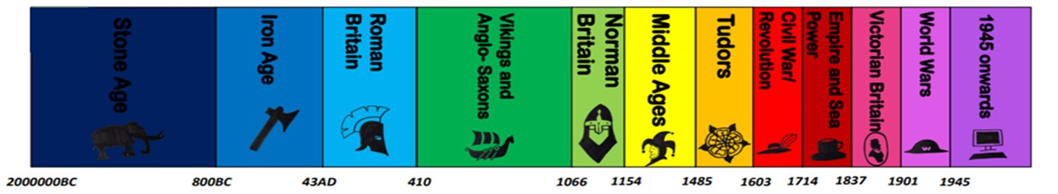
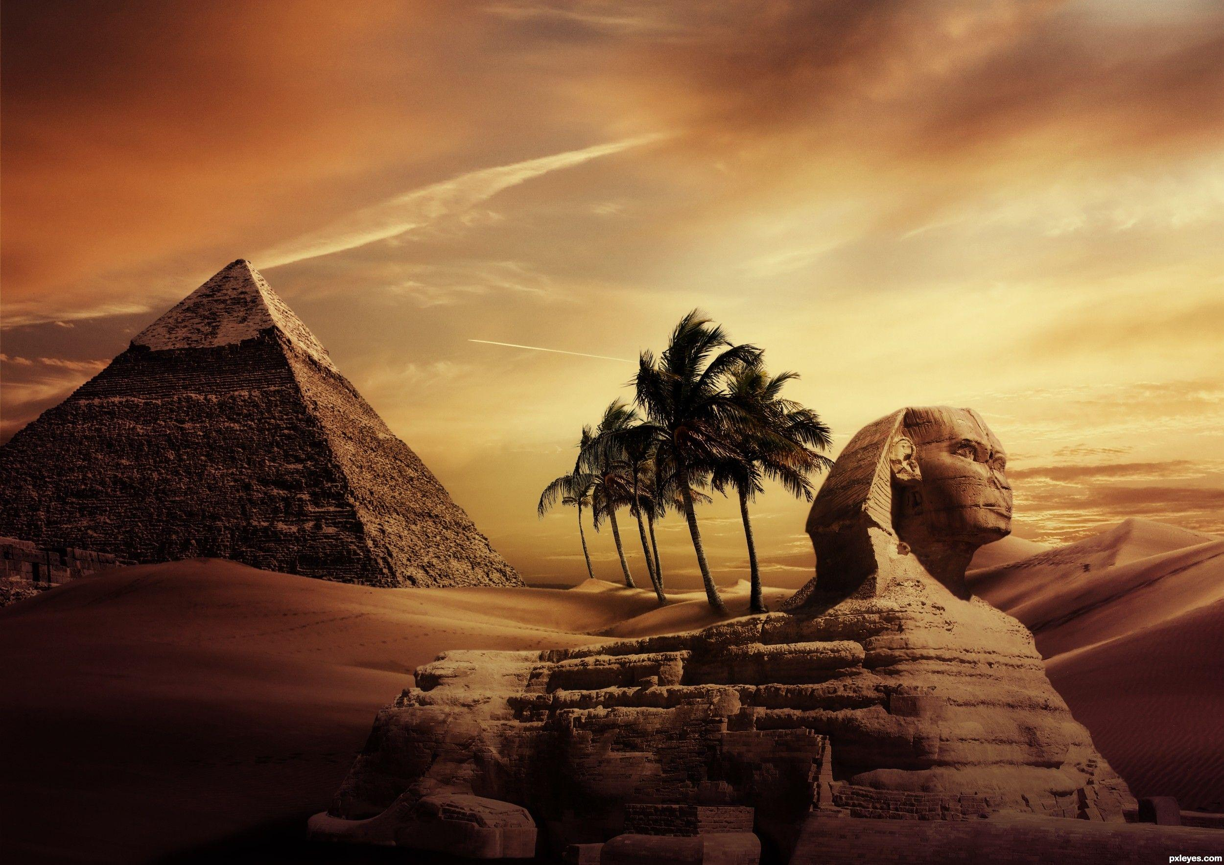
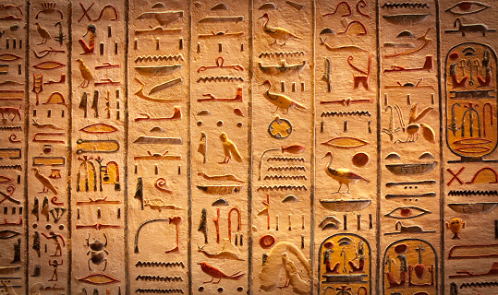
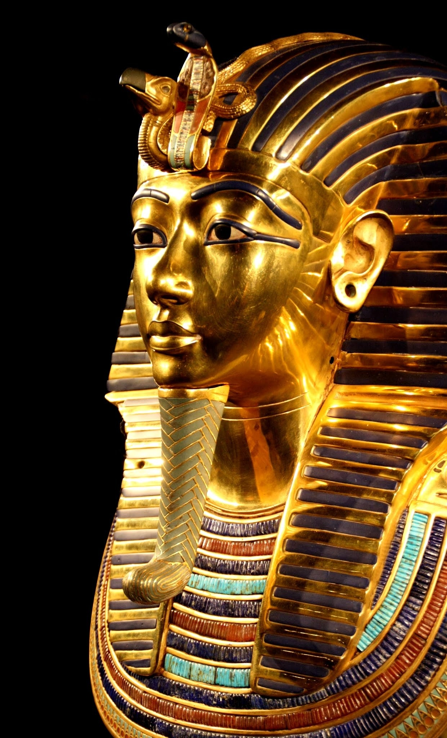
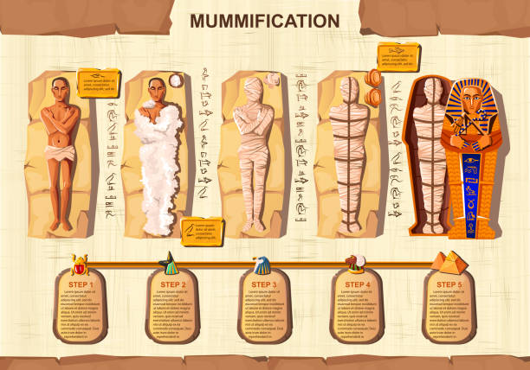

The Gift of the Nile
Year 4 Summer 2
Timeline
Images
ESSENTIAL VOCABULARY
Hierarchy | A system in which members of society are ranked according to status
Dynasty | The line of hereditary rulers of a country
Afterlife | Life after death
Embalming | Preserve a corpse from decay
Hieroglyphics | A system of writing that uses pictoral symbols
At the end of the topic, I will know…
What the importance of the river Nile was to Ancient Egyptians
The rulers of Ancient Egypt
The process of mummification.
The written method of communication
How and why the pyramids were built for the Pharaohs

