Slide 1

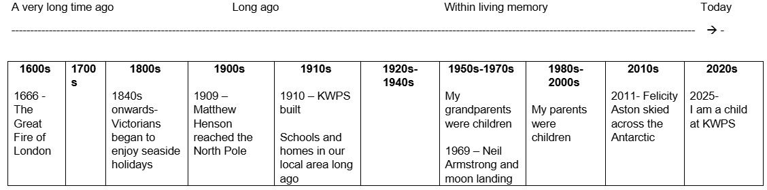
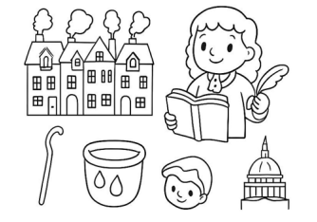
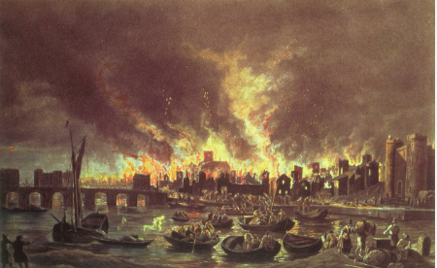

The Great Fire of London.
Year 1 Autumn 1
Timeline
Images – Image title
Key Concepts
Houses were made of wood and very close together.
The summer was hot, dry and windy, so the fire spread quickly.
There were no fire engines or hoses. People used leather buckets, fire hook and gunpowder to fight the fire.
Samuel Pepys wrote a diary that tells us what happened.
After the fire the houses were built from stone and brick, that were further apart.
ESSENTIAL VOCABULARY
Fire | Destructive flame that engulfed much of the city during the Great Fire of London. 1666
Bakery | The origin of the fire, Pudding Lane.
Leather Bucket | Essential tool made of leather, used to carry water.
Fire Hook | Tool used to pull down buildings to create fire breaks.
Diary | Personal record book used to record ‘first hand’ events.
Samuel Pepys | Man whose diary provided first hand insight.
St. Pauls Cathedral. | A key London landmark that was significantly affected by the fire.
At the end of the topic, I will know…
When the Great Fire of London happened.
Where the fire started and how.
Why it spread so quickly.
How people tried to stop the fire.
What changed after the fire.

