Slide 1

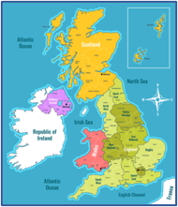
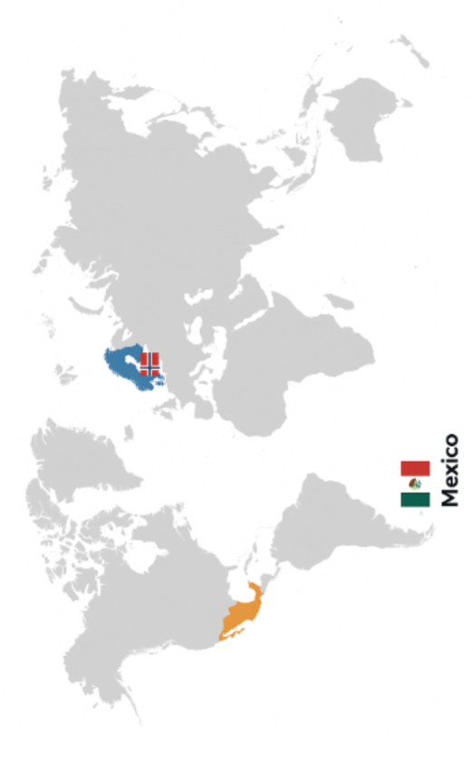
Knowledge Organiser: Hot and Cold Countries - Norway & Mexico
ESSENTIAL VOCABULARY
Earth | The planet where we live, land and ocean.
Climate | The usual / average weather of an area.
Hot | A sustained high temperature.
Cold | A sustained low temperature.
Continent | The land mass of an area of lots of countries.
Country | A land with boarders and a government.
Temperature | How hot or cold a place can be at a specific time.
Climate | Average weather measured over a longer period.
We live in the UK in European continent.
Geography
What I will know at the end of this unit.
I can name the continents.
I can name a hot / cold country.
I can identify Norway / Mexico on a map.
I can explain the difference between a hot and cold climate.

