Slide 1



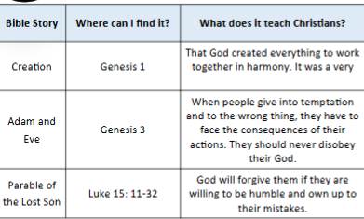
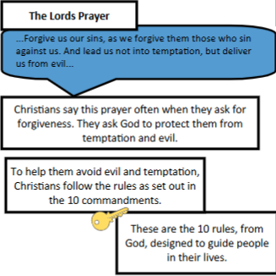
Religious Education Knowledge Organiser
Topic: Christianity | Key Question: Why is it sometimes difficult to do the right thing? | Autumn 1 Maple class
Vocabulary you will learn:
temptation | Desire to do something, especially something wrong or unwise.
forgiveness | The action of forgiving or of being forgiven
sin | A serious regrettable fault, offence omission.
moral | Concerned with the principles of right or wrong behaviour.
prayer | A solemn request for help or expression of thanks aimed at a God.
Religious Story/Religious Beliefs:
Key facts about Christianity:
What I will know at the end of the unit.
1 | To describe Christian beliefs about sin and forgiveness.
2 | To explain how Adam and Eve disobeyed God (Genesis 3).
3 | To explain how Christians use the Lord's prayer for guidance.
4 | To discuss how temptation can occur in the modern world and how we might resist it.
5 | To explain the moral and truths within a story.
6 | Understand what is 'true' and that there may be different versions of the truth.

