Slide 1

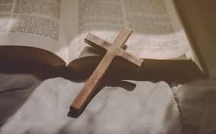
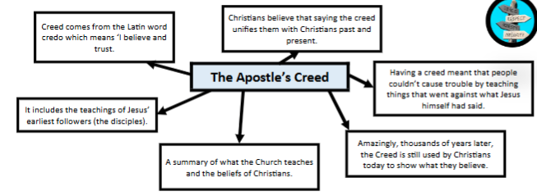
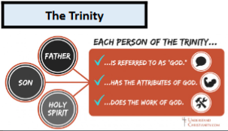
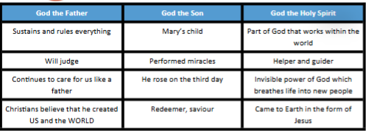


Religious Education Knowledge Organiser
Topic: Christianity | Key Question: How do people decide what to believe? | Summer 1 Maple class
Vocabulary you will learn:
Trinity | God seen in 3 ways : the son, Jesus Christ and the Holy Spirit.
Creed | A formal summary of the principles of the Christian faith.
Denomination | A religious group within a faith that has its own system of organisation.
Symbolism | The use of symbols to express meaning.
Insert Religious Symbol here
Religious Story/Religious Beliefs:
What I will know at the end of the unit.
1 | explain that religious communities often have sources of authority which guide them.
2 | describe what Christians mean when they talk about one God in Trinity.
3 | identify the beliefs contained within the Apostle’s Creed.
4 | describe and explain the meaning of a range of symbols that might be used for the Trinity.
5 | understand my own personal beliefs.
6 | compare different forms of Christian worship.
Key facts about Christianity:

