Slide 1

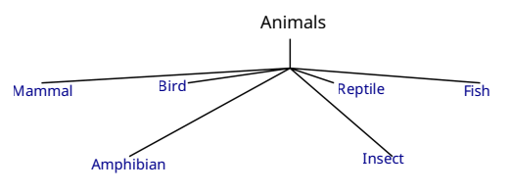

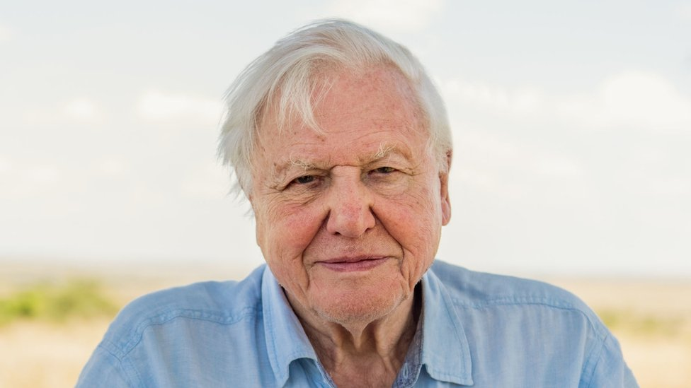
Enquiry Question?
ESSENTIAL VOCABULARY
Mammal | Has fur/hair, feeds babies milk, warm blooded, live babies.
Bird | Feathers, beak, wings. Lays eggs.
Reptile | Dry scaley skin, lays eggs, sun to warm.
Amphibian | Lives in water and land. Lays eggs, smooth wet skin.
Fish | Lives in water, scales, gills and fins.
Insects | Six plus legs, 3 body parts.
Food type | Carnivore, Omnivore, Herbivore
Science
Year 1 Autumn 1
Scientific Images
Scientist
Sir David Attenborough. David Attenborough is a natural history TV presenter and is known for introducing generations to the world’s furry and feathered friends. His programs have inspired people to care about nature and the environment. and allowed millions to see rare and wonderful creatures some of the world's rarest creatures.
What I will know at the end of the unit.
The names the main animal families.
Be able to describe features of mammals, birds, reptiles, amphibians, fish and insects.
Be able to sort animals into correct families.
That humans are mammals.
Be able to explain what carnivores, herbivores and omnivores eat.
That there are some exceptions of features (duckbill platypus / eggs, Whales / no hair)

