Slide 1

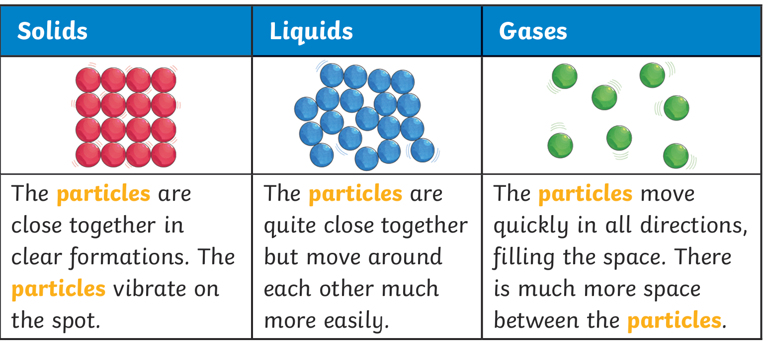
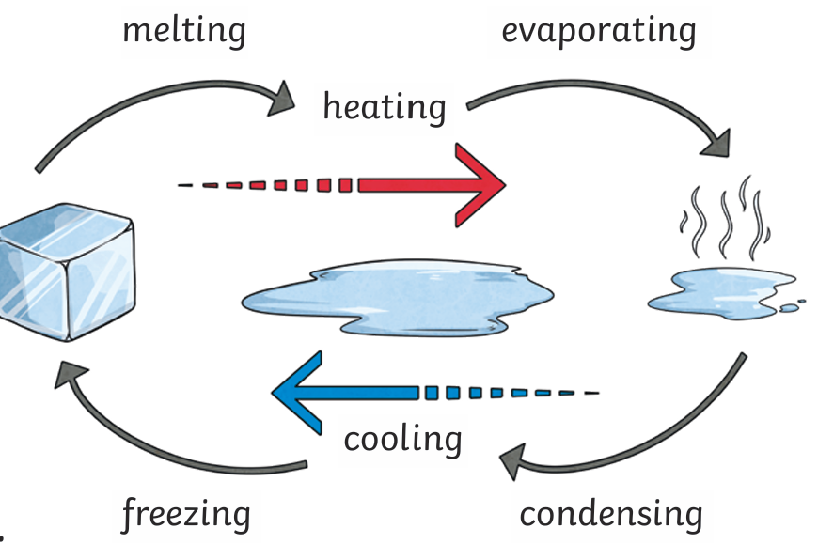
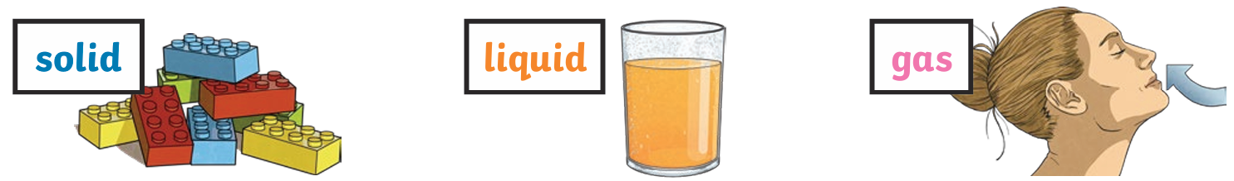
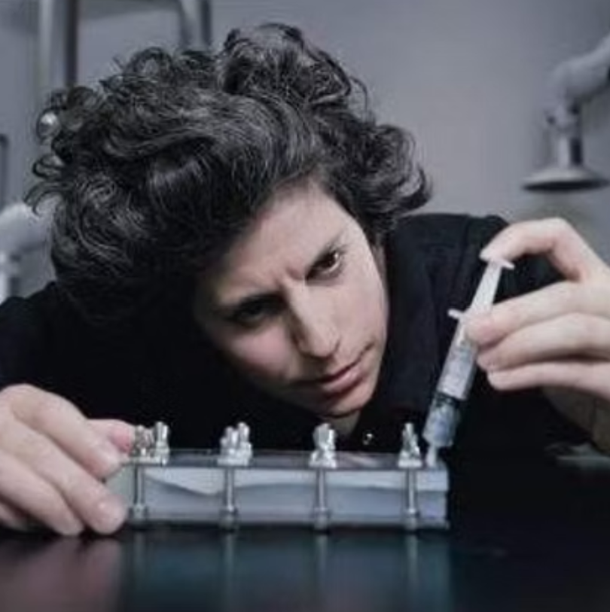
What are the three states of matter?
ESSENTIAL VOCABULARY
States of Matter | Materials can exist in any of three states: solids, liquids or gases. Some materials can change from one state to another and back again.
Solid | Solids are materials that keep their shape unless a force is applied to them. They can be hard, soft or even squashy. Solids take up the same amount of space no matter what has happened to them.
Liquid | Liquids take the shape of their container. They can change shape but do not change the amount of space they take up. They can flow or be poured.
Gas | Gases can spread out to completely fill the container or room they are in. They do not have any fixed shape but they do have a mass.
Particle | A particle is a small piece of matter that cannot be seen with the naked eye.
Melt | When a material melts, it changes from a solid into a liquid.
Freeze | When a material freezes, it changes from a liquid into a solid.
Condense | When a material condenses, it changes from a gas into a liquid.
Science
Year 4 Summer 1
Scientific Images
What I will know at the end of the unit.
To identify the three states of matter.
To know how matter can change from one state to another.
To describe characteristics of gases
To describe the characteristics of liquids
To describe the characteristics of solids
Dr Zoe Laughlin
Zoe Laughlin is a co-founder/director of the Institute of Making - a multidisciplinary research club for those interested in the made world: from makers of molecules to makers of buildings, synthetic skin to spacecraft, soup to diamonds, socks to cities. She holds an MA from Central Saint Martin's College of Art and Design and obtained a PhD in Materials within the Division of Engineering, King's College London. Working at the interface of the science, art, craft and design of materials, her work ranges from formal experiments with matter, to materials consultancy and large-scale public exhibitions and events with partners including Tate Modern, the Hayward Gallery, the V&A, the Design Museum and the Wellcome Collection

