Slide 1
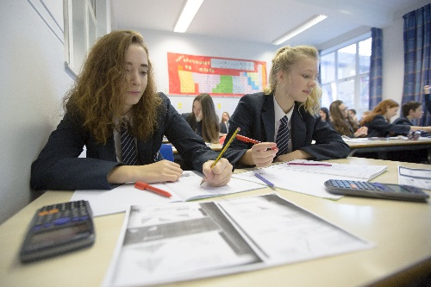
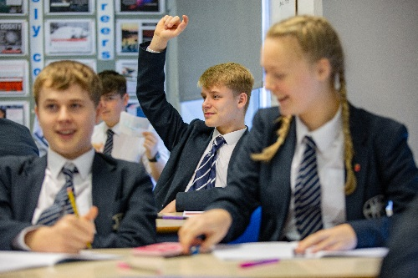
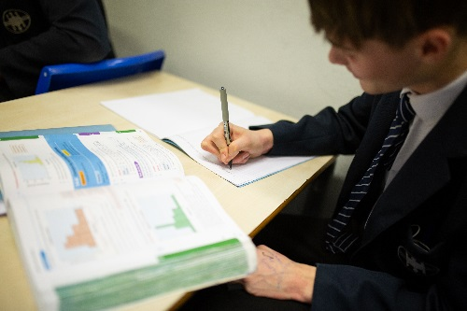
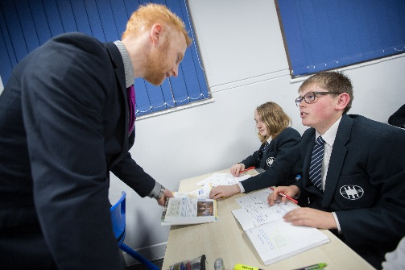

Year 9 into 10 Options
for September 2026
Cambridge National in
Sport Studies

Slide 2

Cambridge National in Sport Studies
Year 9 into 10 Options
Subject Overview
3 units over 2 years;
Contemporary Issues in Sport
Performance & Leadership in Sports Activities
Increasing awareness of Outdoor and Adventurous Activities

Slide 3
Cambridge National in Sport Studies
Year 9 into 10 Options
How is it assessed?
1 external exam, 1 hr 15mins, for unit 1 - Contemporary Issues in Sport
Remaining 2 units are internally assessed and externally verified​
Attainment at 5 levels;​
Level 1 pass
Level 1 Merit
Level 1 Distinction
Level 2 Pass ​
Level 2 Merit​
Level 2 Distinction​
Level 2 Distinction *

Slide 4
Cambridge National in Sport Studies v GCSE PE
Year 9 into 10 Options
GCSE – credit for practical ability – 30% of the course. Cambridge National – 50% of 1 unit.
GCSE PE – Significant weighting on final exams – 60%, Cambridge National – just 1 exam.
Cambridge National – Assignment based

