Slide 1
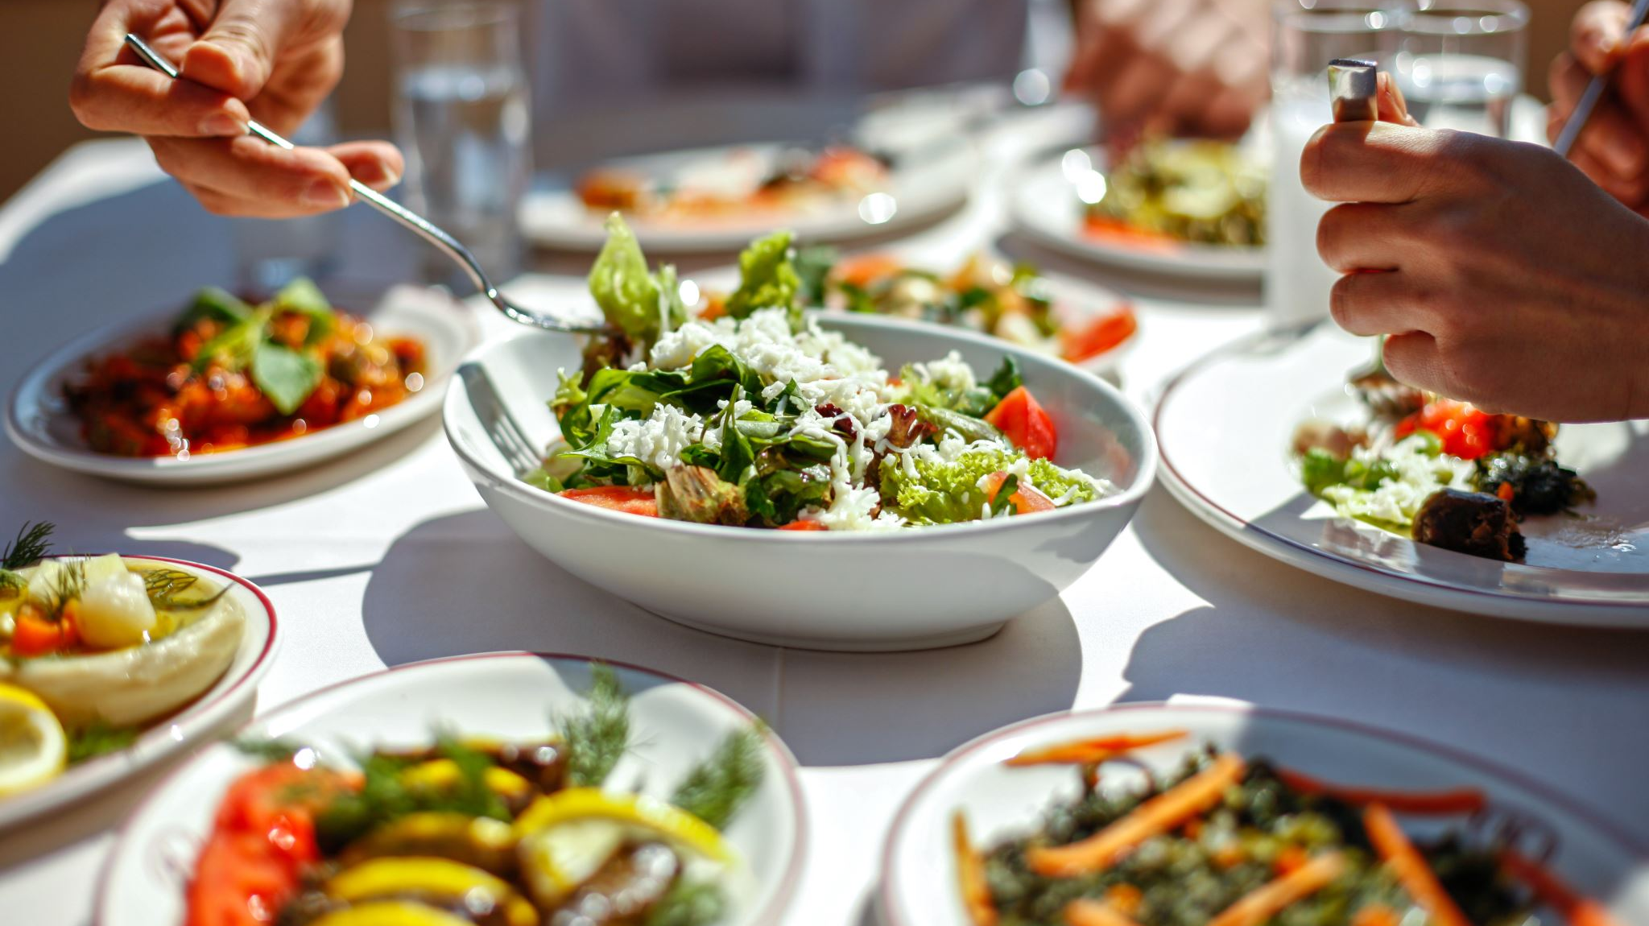
Hospitality and Catering

Slide 2
Course info
Two units
40% exam
60% coursework
Grades available – L1P, L1M, L1D, L1D*, L2P, L2M, L2D, L2D*
5 lessons per fortnight
2 x practical
3 x theory
Coursework- September/October Year 11
Exam- June Year 11

Slide 3
Topics we will cover:
UNIT 1:
Learn about the hospitality and catering industry, the types of hospitality and catering providers and about working in the industry. Learn about health and safety, and food safety in hospitality and catering, as well as food related causes of ill health.
UNIT 2:
Learn about the importance of nutrition and how cooking methods can impact on nutritional value. Learn how to plan nutritious menus as well as factors which affect menu planning. You will learn the skills and techniques needed to prepare, cook and present dishes as well as learning how to review your work effectively.

Slide 4


Slide 5

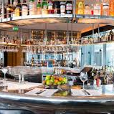

What is hospitality? - GCSE Hospitality (CCEA) - Video - BBC Bitesize
Roles and responsibilities - Careers in hospitality - GCSE Hospitality (CCEA) Revision - BBC Bitesize
The H&C sector includes all businesses that provide food, beverages, and/or accommodation services.
This includes restaurants, hotels, pubs and bars.
Also airlines, tourist attractions, hospitals and sports venues; businesses who are growing increasingly dependent on H&C for success.
Fourth largest industry in Britain and accounts for around 10% of the total workforce.
Lots of H&C jobs are given to 18-24 year olds

Slide 6
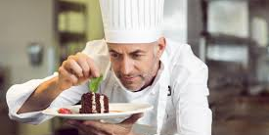
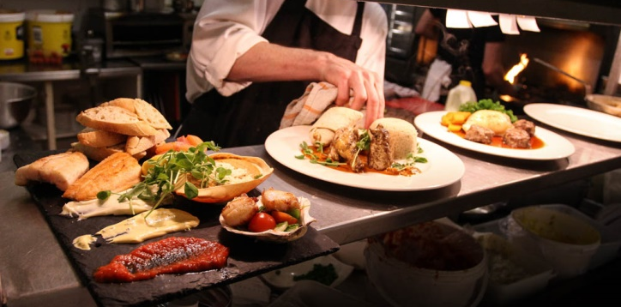

The course has been designed to support people like YOU who want to learn about this vocational sector and the potential it can offer them for their careers or further study.
Employment in hospitality and catering can range from waiting staff, receptionists and catering assistants to chefs, hotel and bar managers and food technologists in food manufacturing.
All of these roles require further education and training either through apprenticeships or further and higher education.

Slide 7
Dishes we will be making in Year 10...
Knife skills
Soup and bread
Arancini with tomato sauce
Profiteroles
Tarte tatin
Savoury pie
Lemon meringue pie
Chicken mayo burgers
Layered fruit and chocolate mousse
Pretzels with dips
BBQ pulled chicken nachos
Chelsea buns
Ravioli
Chicken ballotine
Fraisier cakes

Slide 8
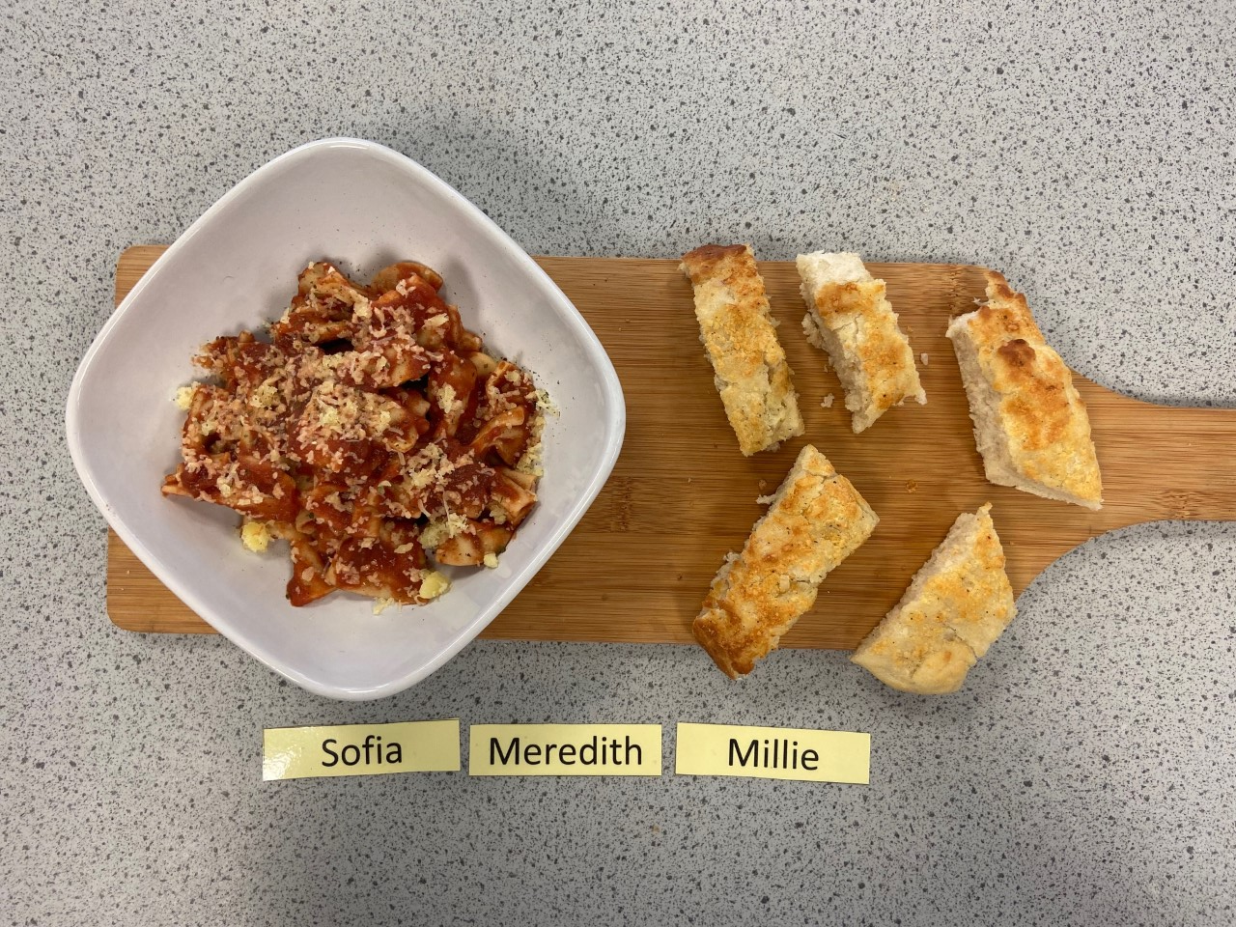
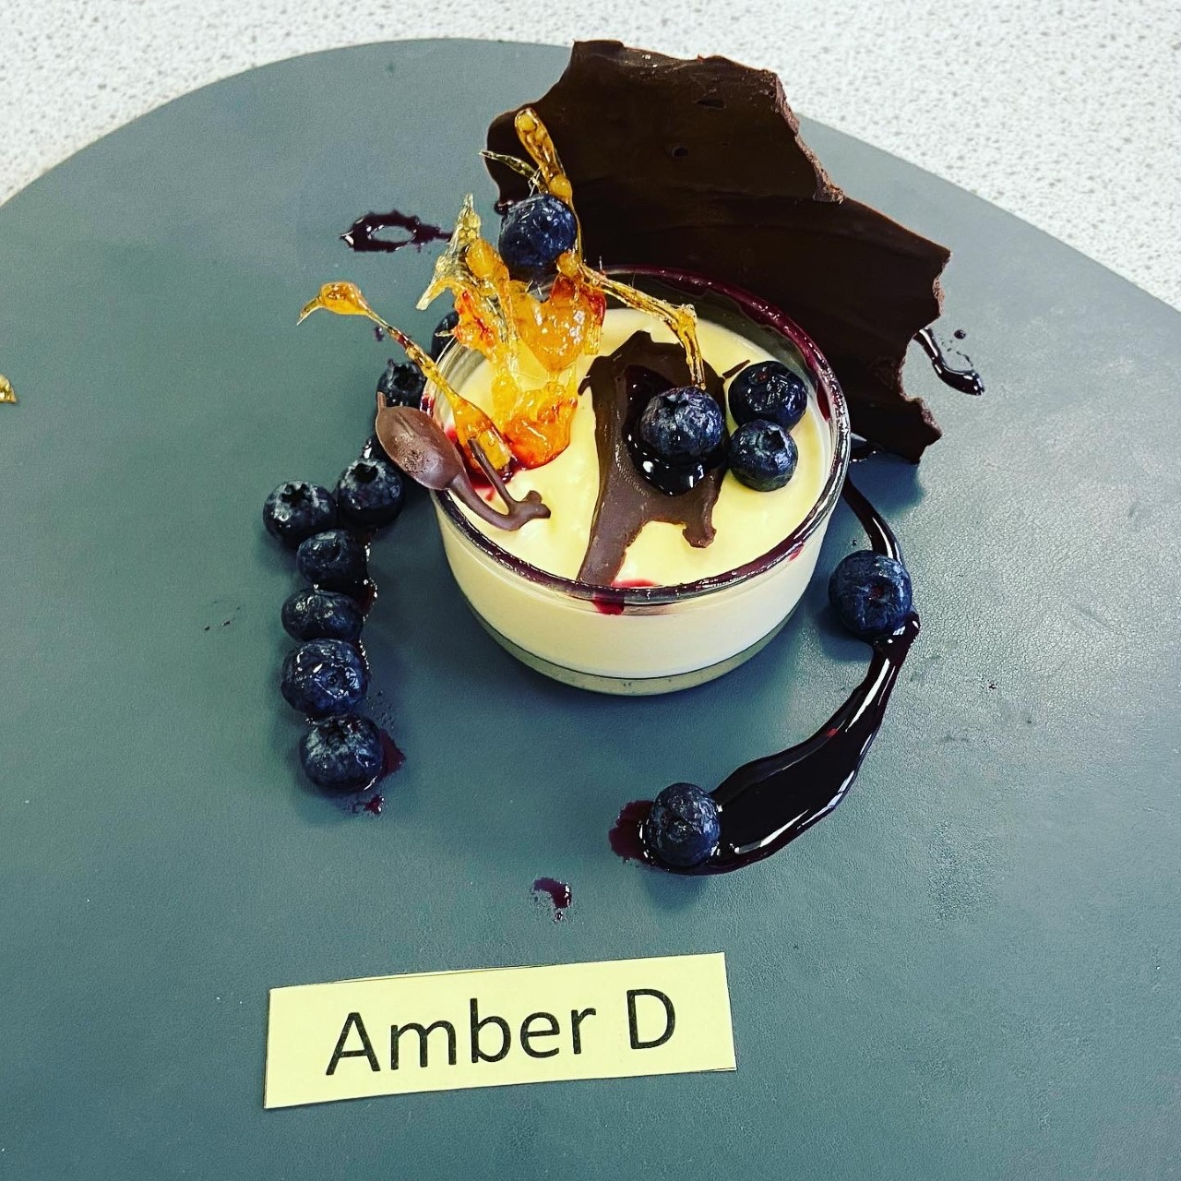
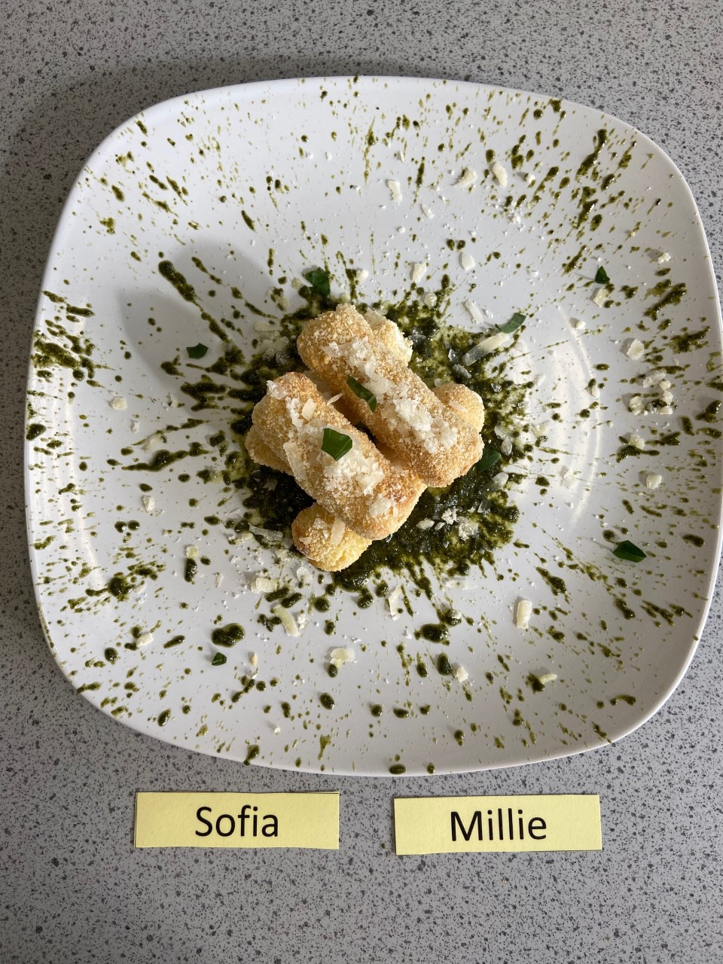
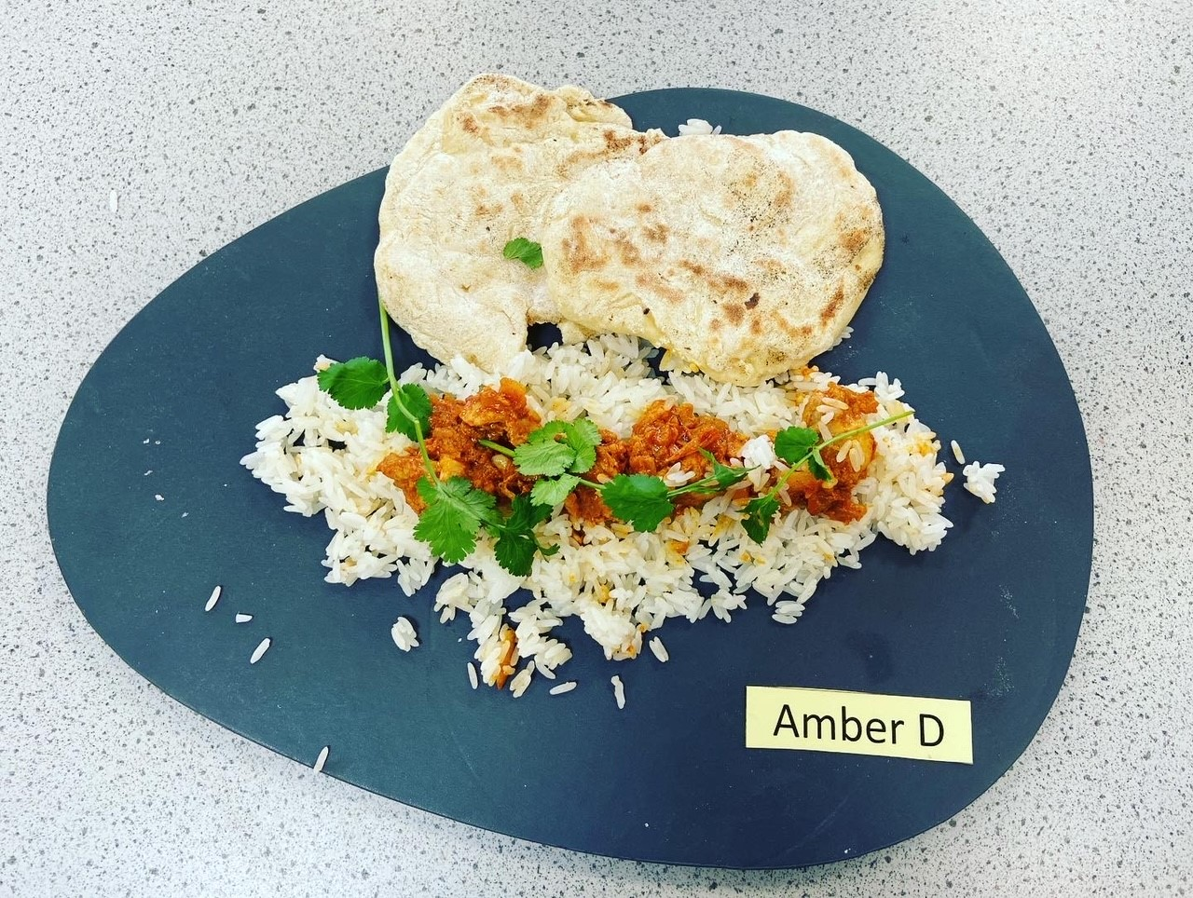
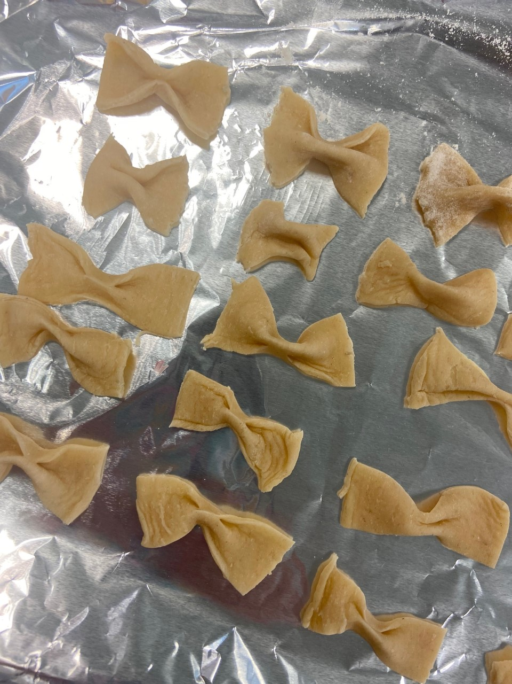
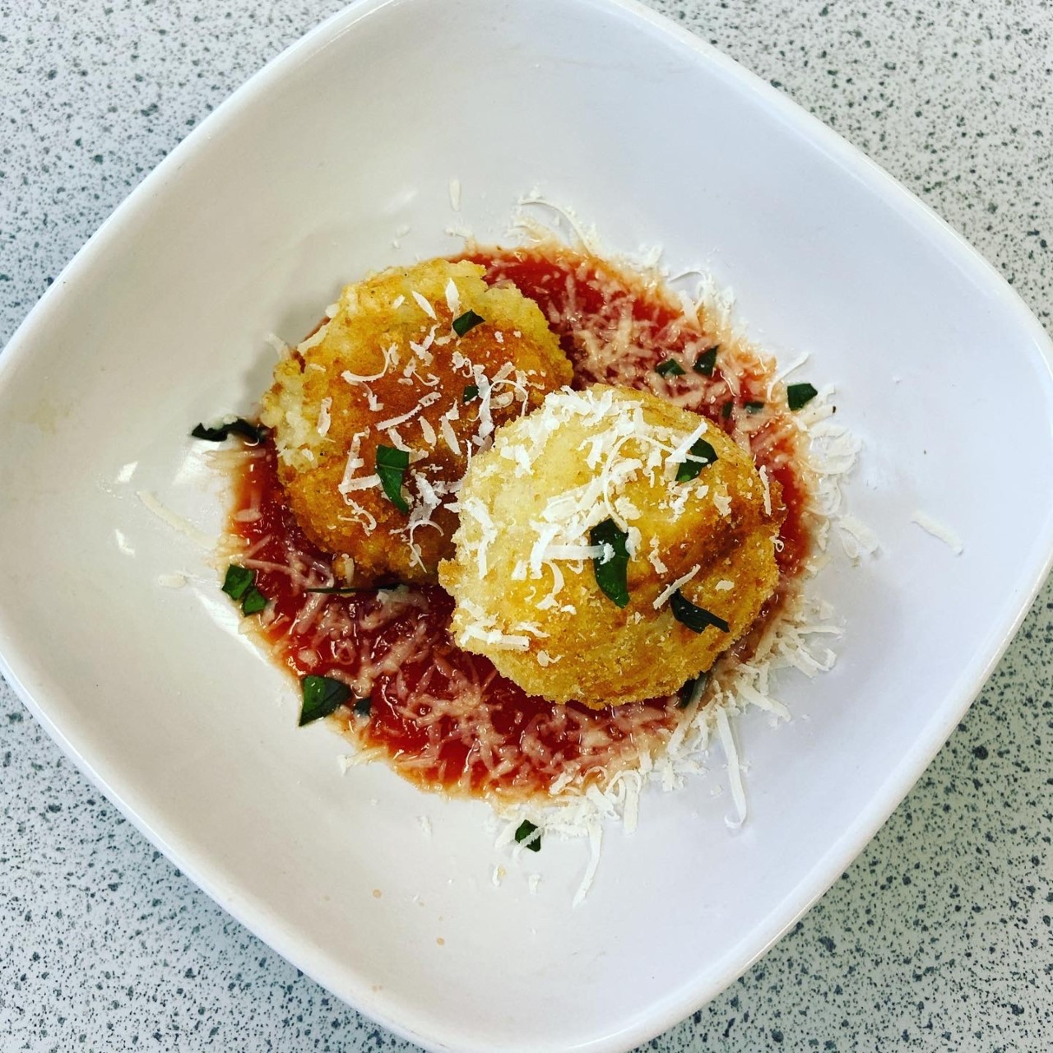
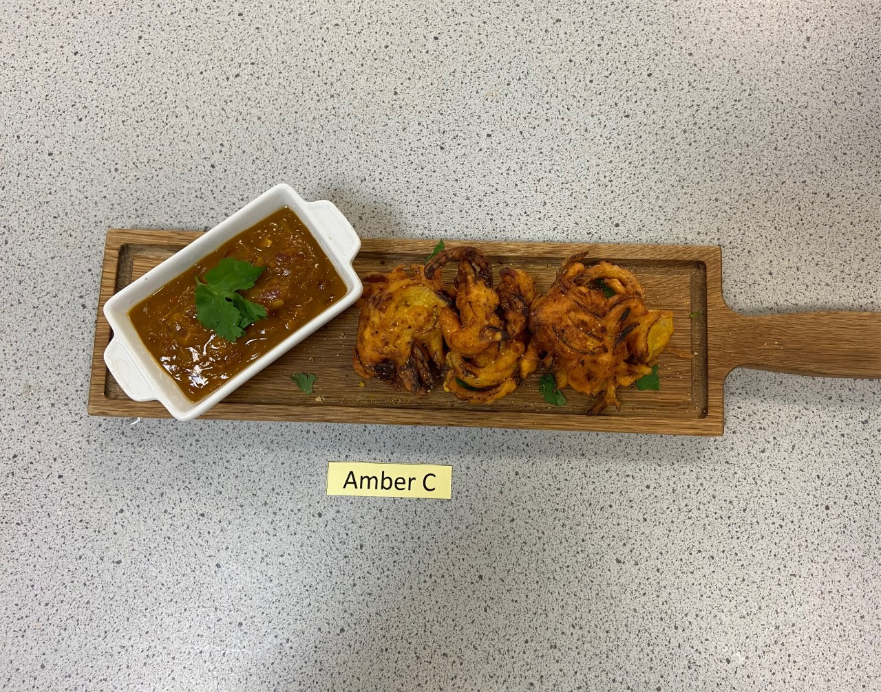
Current students' classwork:

Slide 9

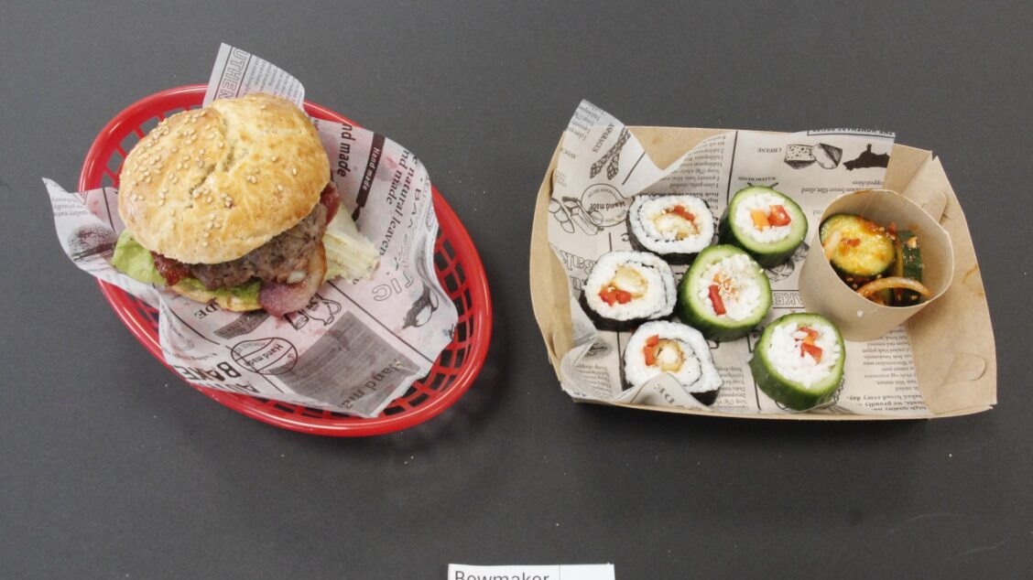
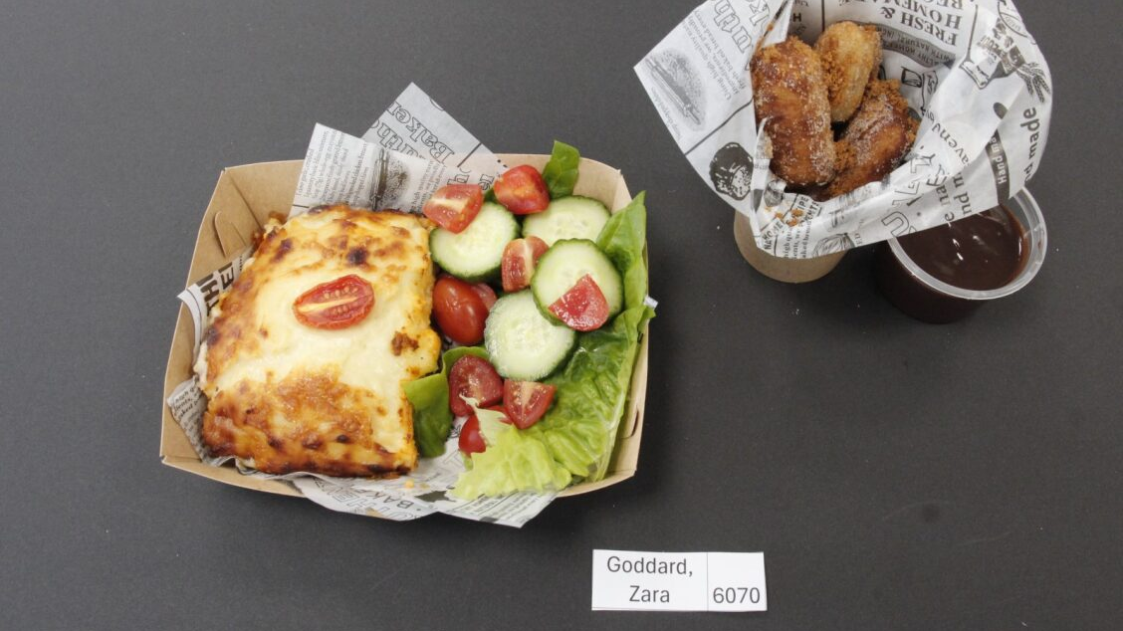
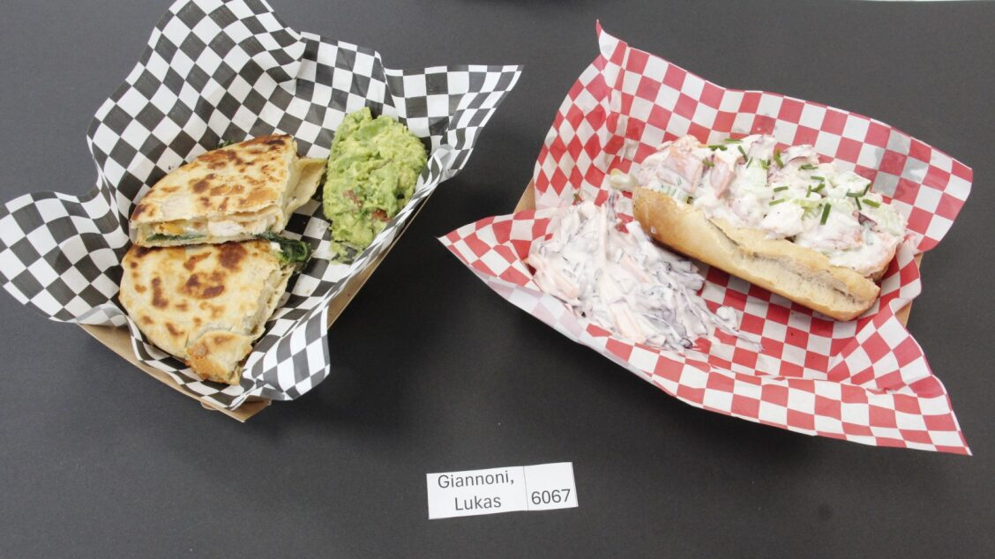
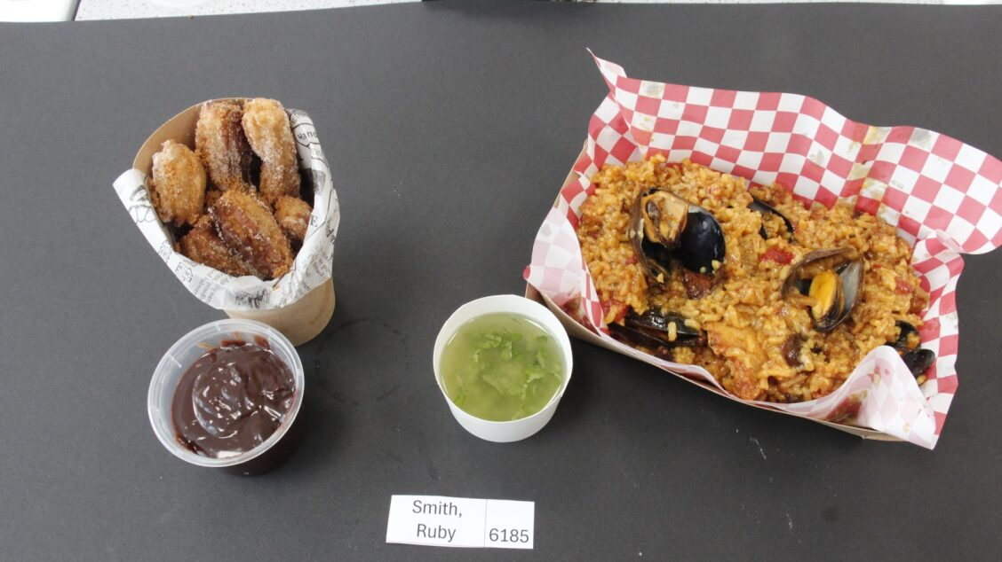
Exam dishes:

Slide 10
Basic | Medium | Complex
Blending Beating Grating Hydrating Juicing Marinating Mashing Melting Proving Shredding Sieving Tenderising Zesting Chopping Peeling Trimming Basting Boiling Chilling Cooling Dehydrating Freezing Grilling Skimming Toasting | Creaming Folding Kneading Measuring Mixing Pureeing Rubbing in Rolling Skinning Toasting (nuts/seeds) Weighing Baton Chiffonade Dicing Slicing Deseeding Spatchcock Baking Blanching Braising Deglazing Frying Griddling Pickling Reduction Roasting Sautéing Setting Steaming Stir-frying Water bath (sous-vide) | Crimping Laminating (pastry) Melting using bain-marie Piping Shaping Unmoulding Whisking Deboning Filleting Segmenting Baking blind Caramelising Deep fat frying Emulsifying Poaching Tempering

Slide 11
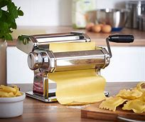


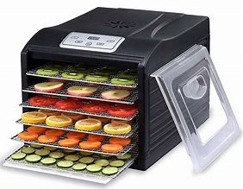
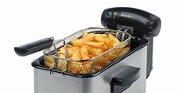
Equipment we will be using
Deep fat fryer
Pasta machine
Dehydrator
Blow torch
Piping bags

Slide 12
Trips/talks/additional
Master classes from local chefs e.g. Cottons Hotel Knutsford
Visits to local hotels/venues/restaurants

Slide 13
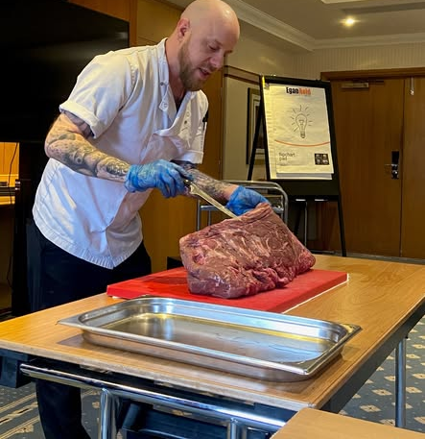
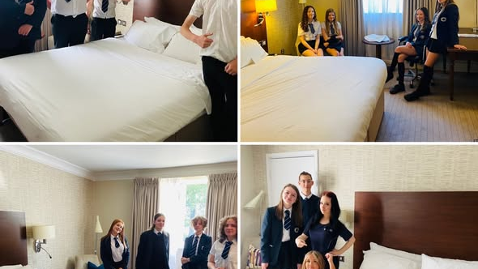
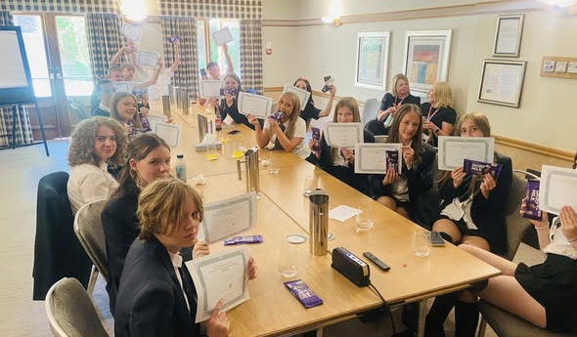
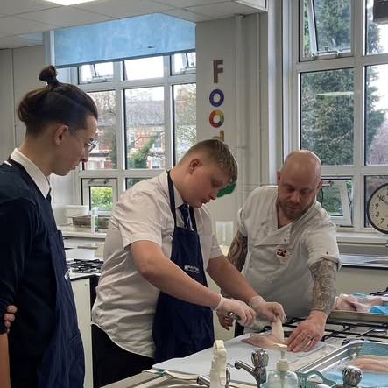
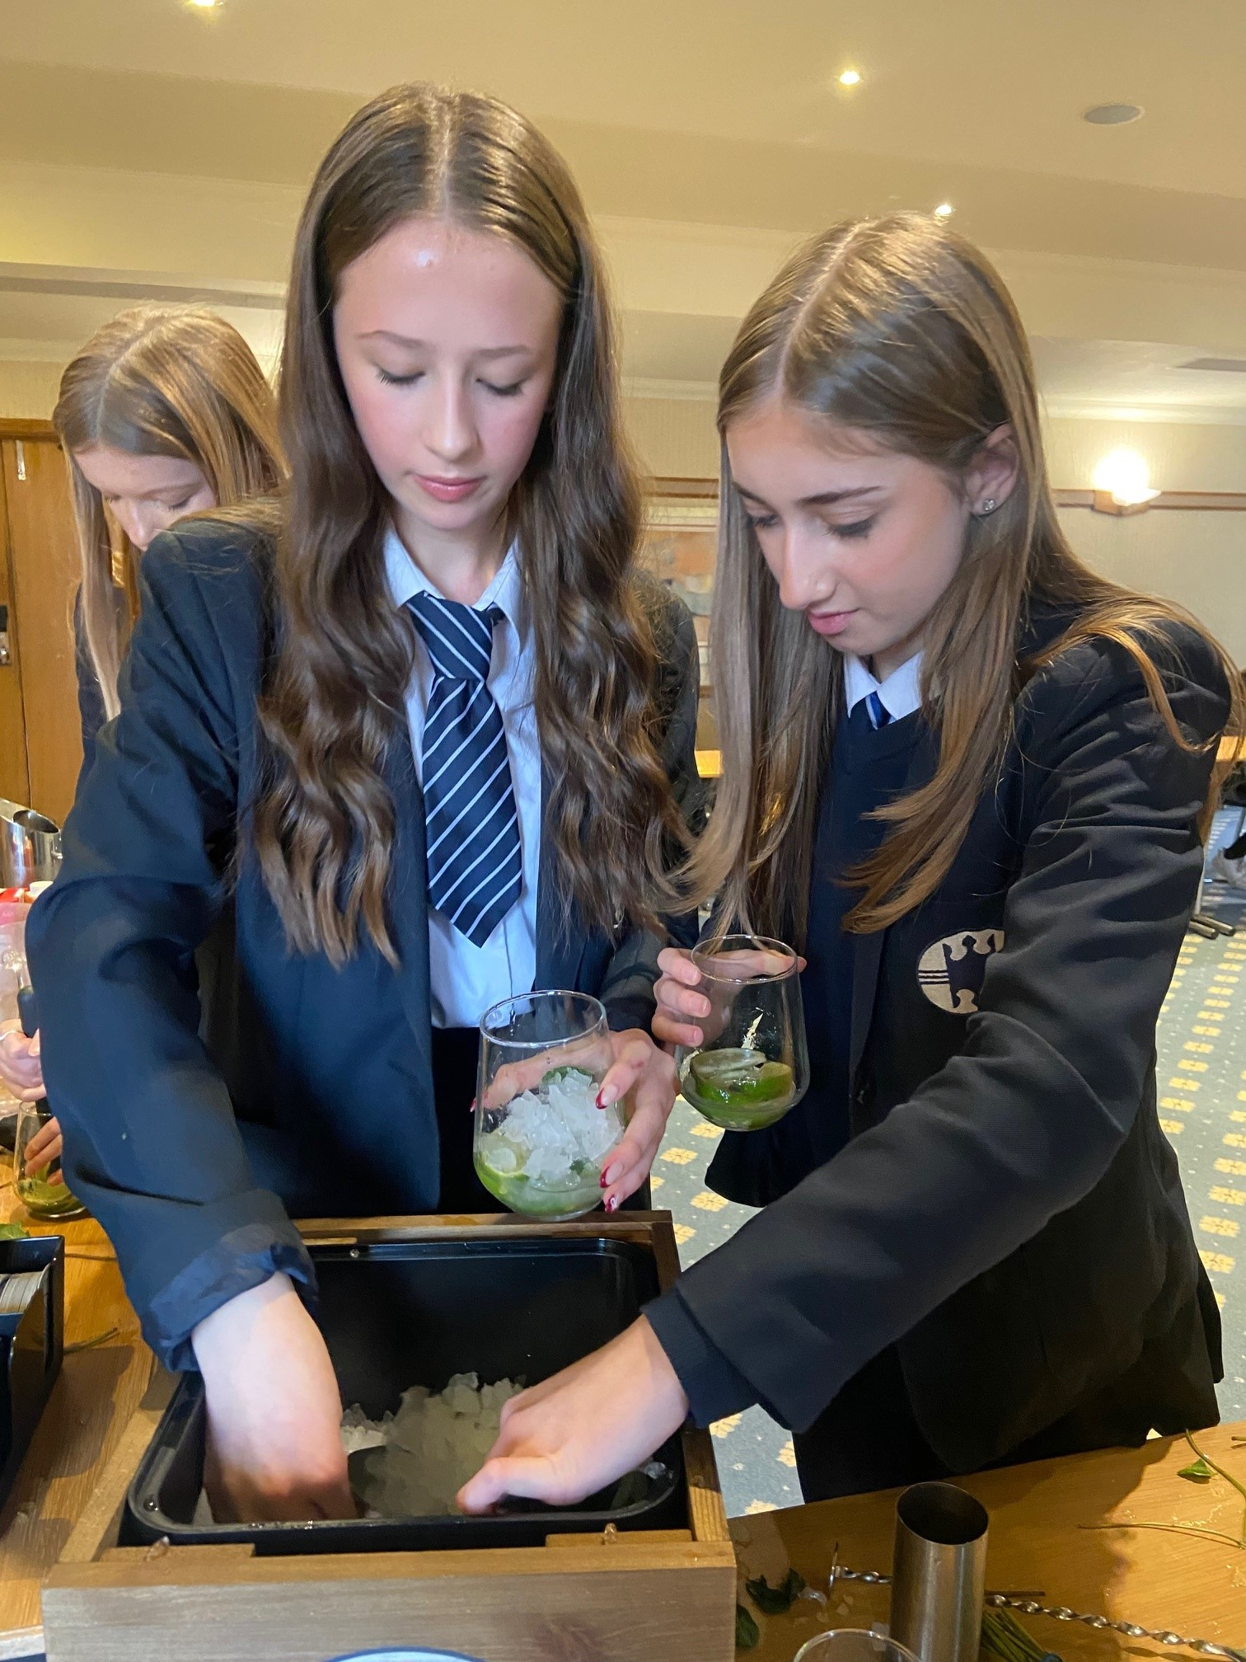
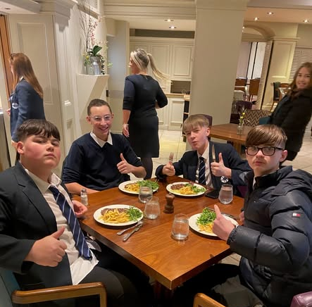
Partnership with Cottons Hotel Knutsford

