Slide 1
Year 10 Introduction to GCSEs Parent Information Evening

Slide 2
Welcome
Key dates for Year 10
Overview of core subjects: English, Maths and Science.
Our Study Skills Curriculum
Homework and GCSE Pod
SEND support
How you can help

Slide 3
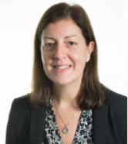
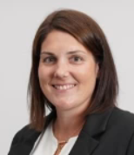
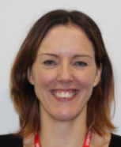
Staff Introductions
Mrs K Key Headteacher
Mrs A Thatcher Deputy Headteacher
Mr D Cole Associate Assistant Headteacher
Mr T Horner Head of Year 10
Mr R Foster Head of English
Mrs A McGeehan Head of Maths
Mr T Swan Head of Science
Mrs Wollen
Senior SENCO

Slide 4
Key Dates
Progress Point 1 – week commencing 16th December.
Year 10 exams – 10th March – 21st March.
Progress Point 2 – week commencing 21st April.
Parents Evening – 1st May.
Languages speaking trial exams – 23rd June – 27th June.
Progress Point 3 – week commencing 14th July
Notes:
Discuss Academic Review process – concerns at progress points.

Slide 5
English Language – Course Overview
PAPER 1 - FICTION
PAPER 2 – NON-FICTION
Section A – Reading Analysis
Q1 – Retrieval Skills
Q2 – Language analysis
Q3 – Structural analysis
Q4 - Evaluation
Section A – Reading Analysis
Q1 – Retrieval Skills
Q2 – Comparative summary
Q3 – Language analysis
Q4 – Comparison of writer’s attitudes
Section B – Writing Skills
Q5 – A choice between writing a story or a description based on an image
Section B – Writing Skills
Q5 – Letter, speech or article to argue/persuade/inform

Slide 6
English Literature – Course Overview
Year 10
Year 11

Slide 7
English – Assessment
English Language
HT1: Paper 1 Section B
HT2: Paper 2 Section A
HT3: Paper 1 Section A
HT4: Trial Exams
HT5: Paper 2 Section B
HT6: Speaking and Listening
English Literature
HT1: Jekyll – Language analysis
HT2: Thematic analysis
HT3: Macbeth language analysis
HT4: Trial exams
HT5: Macbeth Thematic analysis
HT6: Introduction to Poetry

Slide 8
Top Revision Tips for English
Re-read / listen to the lit texts – again and again – know them so well.
Practice analysing the language in sections of the literature texts.
Revise language/structure terminology to use in both lit and lang.
Read lots of non-fiction in preparation for the language texts.
Practice producing both creative and persuasive writing.

Slide 9
Top Tips: English Language
The questions for the two papers are the same each year and so the most important thing is to, KNOW THE QUESTIONS and WHAT THEY WANT.
Use the AQA website to remind yourself what's on each paper.
Pupils should create revision material around what each question requires of them. e.g
Skills / phrases for language analysis
Skills / phrases for evaluation
Skills / phrases to compare viewpoints

Slide 10
Top Tips: English Literature
Know the texts!
The most important thing is to know Jekyll and Hyde, Macbeth, An Inspector Calls and their conflict poems really well as we move through the year.
Know the questions!
Be secure on the part A part B difference.
Do the homework!
Our literature homework this term is focussed on revising the key texts we did in year 10 – we have produced bespoke revision materials for each chapter / act to help guide pupils through their revision.

Slide 11
Maths – Course Overview
The GCSE Mathematics syllabus is created around the general topics of
Number
Algebra
Ratio, proportion and rates of change
Geometry and measures
Probability
Statistics
The exam has two levels
Foundation tier – Grades 1 to 5
Higher tier – Grades 4 to 9.
Students have to sit three GCSE Maths papers in the same tier.
Paper 1 is non-calculator and Papers 2 and 3 are calculator.
Content can be assessed across ANY of the three papers

Slide 12
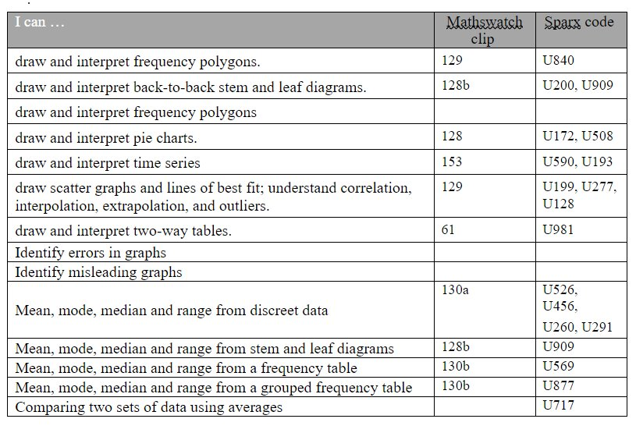
Maths – Assessment
Students will have exam practice after each unit of study.
They are graded according to the difficulty of the question and the percentage accuracy.
Homework is lagged so that they have a chance to practice, and Maths watch tasks are set for revision.
Learning Overviews are given before and after each assessment. These include revision codes for SPARX and Mathswatch.

Slide 13
Maths – Top Tips for Success
Mathematics is a subject that requires a lot of practice.
One of the best ways to practise for the examination is to use GCSE topic questions and GCSE Maths past papers (Year 11)
Students must take care to document all the steps taken to reach the solution.
Videos can be watched to get the 'in'.
Useful websites
Maths Genie
Vlemathswatch
Corbett Maths
SPARX....

Slide 14
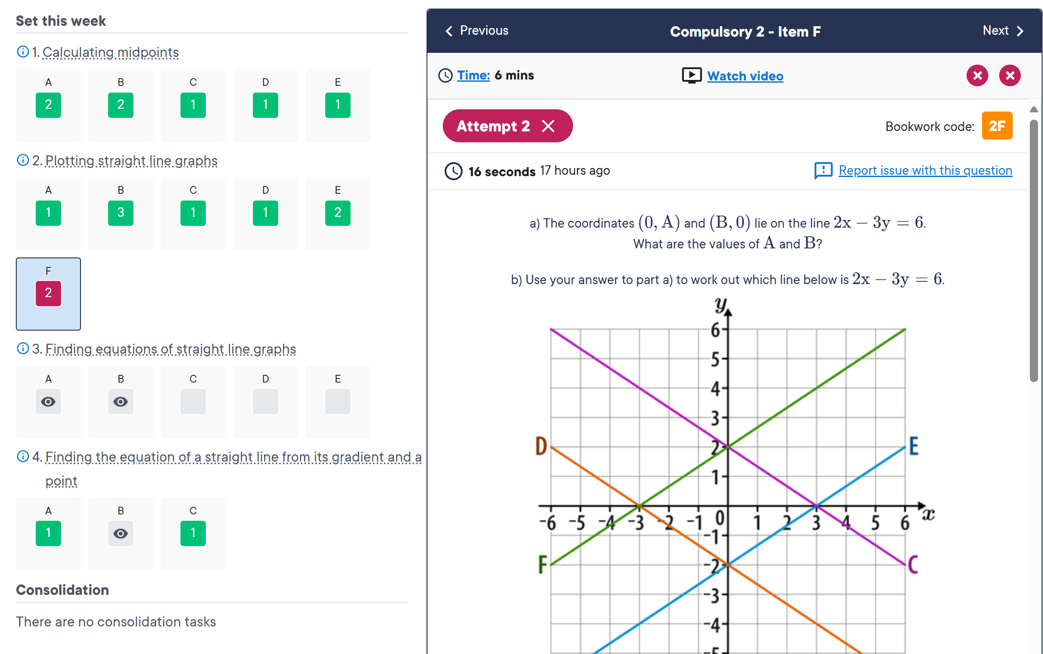
Maths – SPARX
Notes:
This kind of practice is also best taken by simulating, as much as possible, the conditions during the actual exam, including the time limits set. By practising under pressure, a student will be better able to handle the stress of the actual exam. Some teachers organise mock exams at the end of each year of the course of the GCSE programme. Some even organise mid-term simulated exams of the syllabus covered up to that point. All these practice exams are valuable in helping the student face the actual papers confidently.
Past GCSE maths papers and sample papers are available on the internet. Some sites also provide solutions. The student must avoid the temptation to simply read the problems and their solutions. Instead, the student must use the valuable resources of past papers and sample papers by attempting to solve them. These attempts must be made within the time limits set for the actual exam. This trains the student to be quick without sacrificing accuracy. It also mentally toughens the student so that he or she is able to handle the stress of the actual papers well.
First of all the student must be aware of which exam he or she is attempting, the Foundation Tier or the Higher Tier. The student must download the appropriate test papers and past papers for those modules. The following steps are of great help in using past papers and sample papers to prepare for the GCSE Maths exam:
Ensure that you are downloading the correct papers.
Check the time provided for each paper at the actual test.
Approach the practice as you would approach the actual test; set time aside to solve the papers and keep family and friends away for the duration of the practice.
Find out the mark scheme for each paper. Examiner’s notes are also very useful in preparing for the test. These tell you what the assessor is looking for and the distribution of marks for various aspects of each problem.
Look for GCSE maths online practice resources. The BBC and Khan Academy have excellent resources to help you prepare for the maths examination.
Videos are another great way to brush up on various topics in maths. Ensure that you are watching the correct video for the topic.
Parents can try to get an expert GCSE maths tutor on board to get their child a better pathfinder on their expedition of the GSCE Maths exam.

Slide 15
Science – Course Overview
AQA GCSE Combined Science: Trilogy
Biology
1. Cell biology
2. Organisation
3. Infection and response
4. Bioenergetics
5. Homeostasis and response
6. Inheritance, variation and evolution
7. Ecology
Chemistry
Atomic structure
9. Bonding
10. Quantitative chemistry
11. Chemical changes
12. Energy changes
13. The rate and extent of chemical change
14. Organic chemistry
15. Chemical analysis
16. Chemistry of the atmosphere
17. Using resources
Physics
18. Energy
19. Electricity
20. Particle model of matter
21. Atomic structure
22. Forces
23. Waves
24. Magnetism and electromagnetism

Slide 16
Science – Course Overview
AQA GCSE Biology
AQA GCSE Chemistry
AQA GCSE Physics
Biology
1. Cell biology
2. Organisation
3. Infection and response
4. Bioenergetics
5. Homeostasis and response
6. Inheritance, variation and evolution
7. Ecology
Chemistry
Atomic structure
Bonding
Quantitative chemistry
Chemical changes
Energy changes
The rate and extent of chemical change
Organic chemistry
Chemical analysis
Chemistry of the atmosphere
Using resources
Physics
Energy
Electricity
Particle model of matter
Atomic structure
Forces
Waves
Magnetism and electromagnetism
Space physics

Slide 17
Science – Assessment
Formative assessment (ongoing assessment)
Class activities and homework assignments.
Low-stakes.
Provide valuable insights into students’ grasp of the material and highlight areas where they may require further support.
Summative assessment (end-of-unit tests)
Measure a student's overall understanding of the material covered in a topic.
Usually include questions from previous topics, encouraging students to engage in long-term revision and supporting knowledge retention.

Slide 18
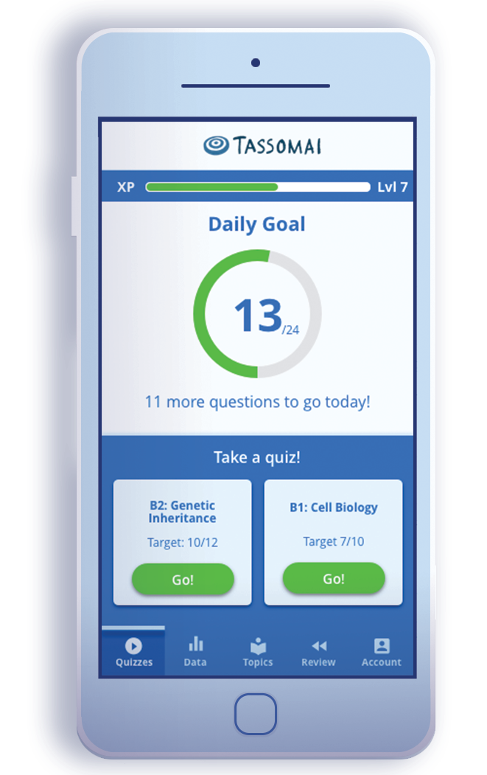
Science – Top Tips for Success
Active Engagement
Use flashcards and quizzes: These tools can help your child review key terms and concepts in a fun, interactive way. We use Tassomai. Our top Tassomai Year 11 user last year completed 262 daily goals…
Target grade 4-4
Actual grade 9-8
Ask questions: After they study a concept, ask them to explain it to you. Teaching someone else is an excellent way to reinforce learning.

Slide 19
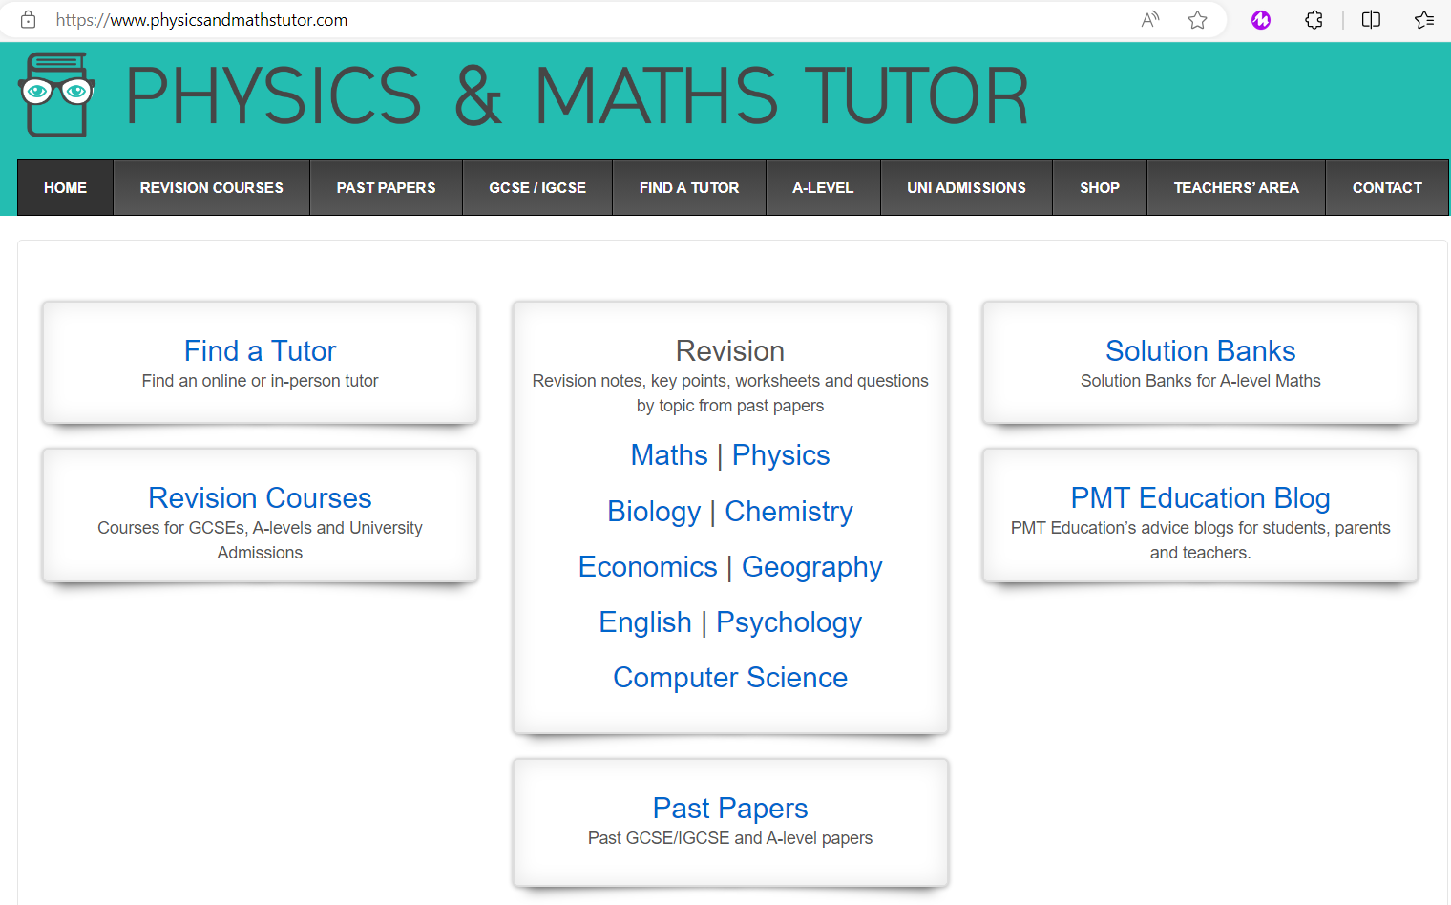
Science – Top Tips for Success
Practice with past papers: Encourage your child to answer questions from past science papers. This builds familiarity with exam formats and improves time management skills.
https://www.physicsandmathstutor.com/

Slide 20
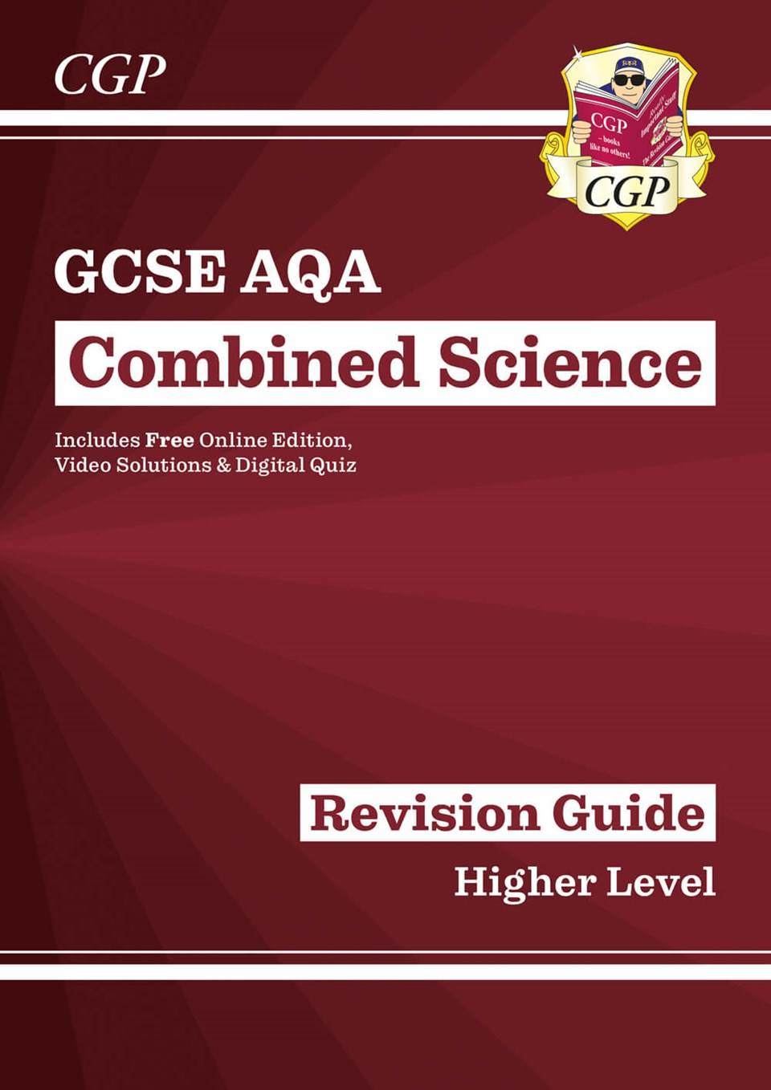
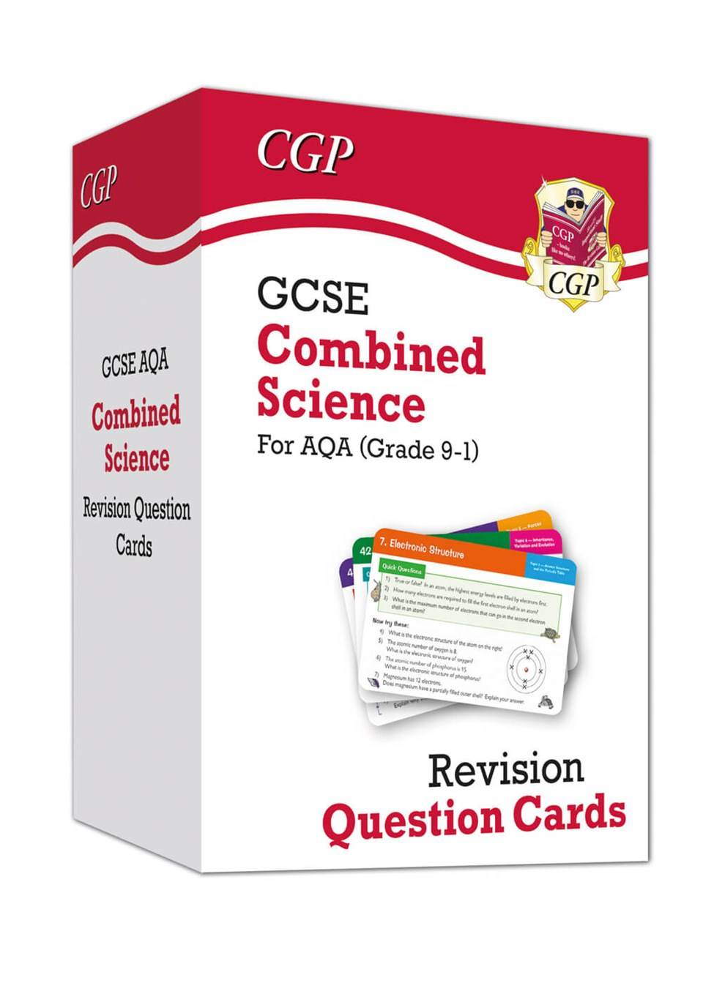
Science – Top Tips for Success
Revision resources available through the school – Combined Science

Slide 21
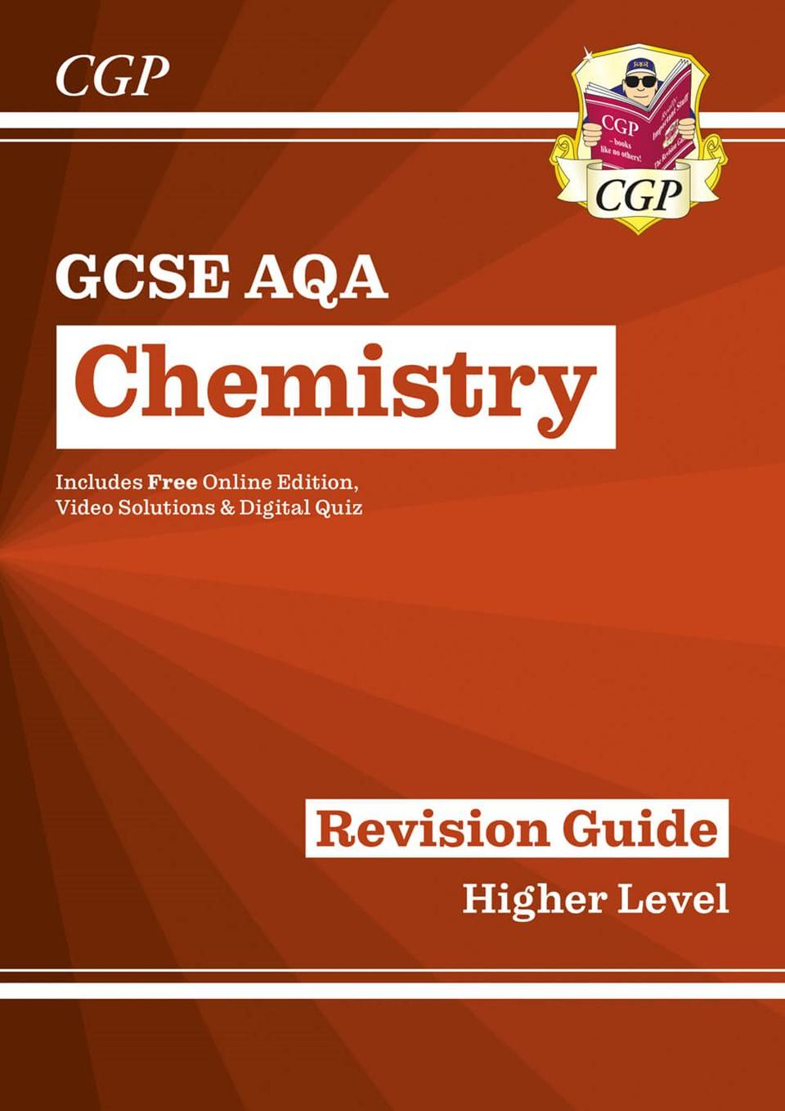
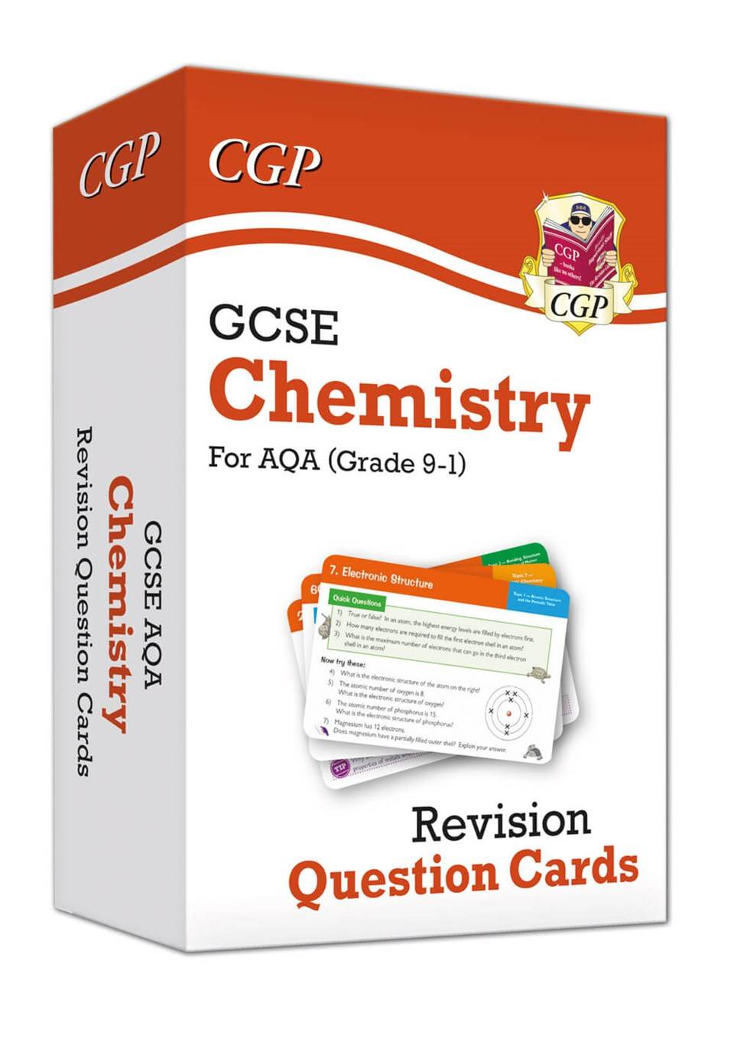
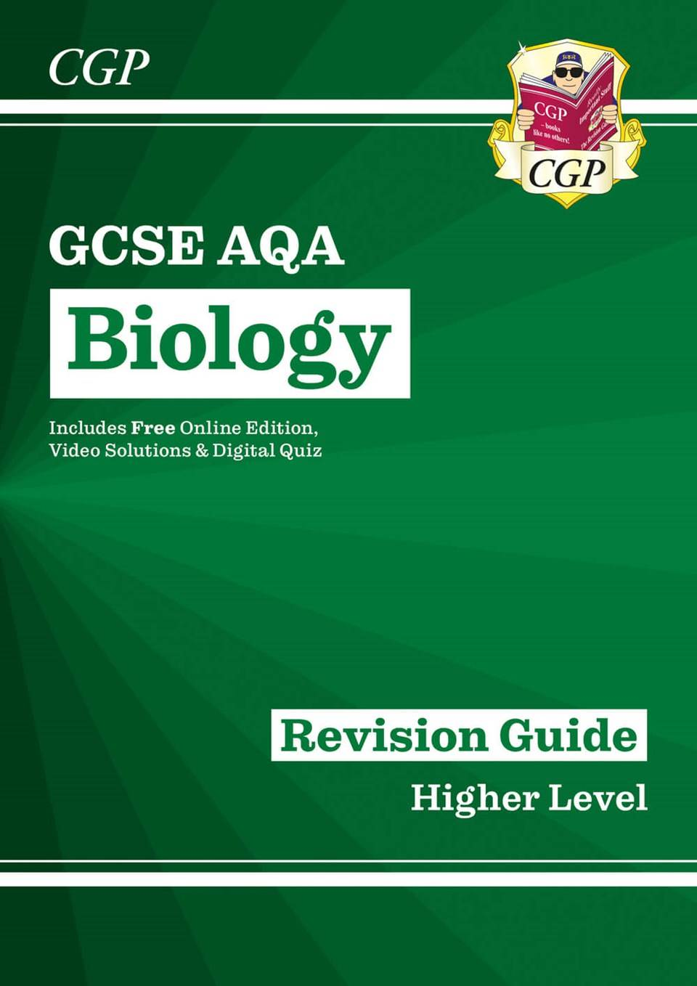
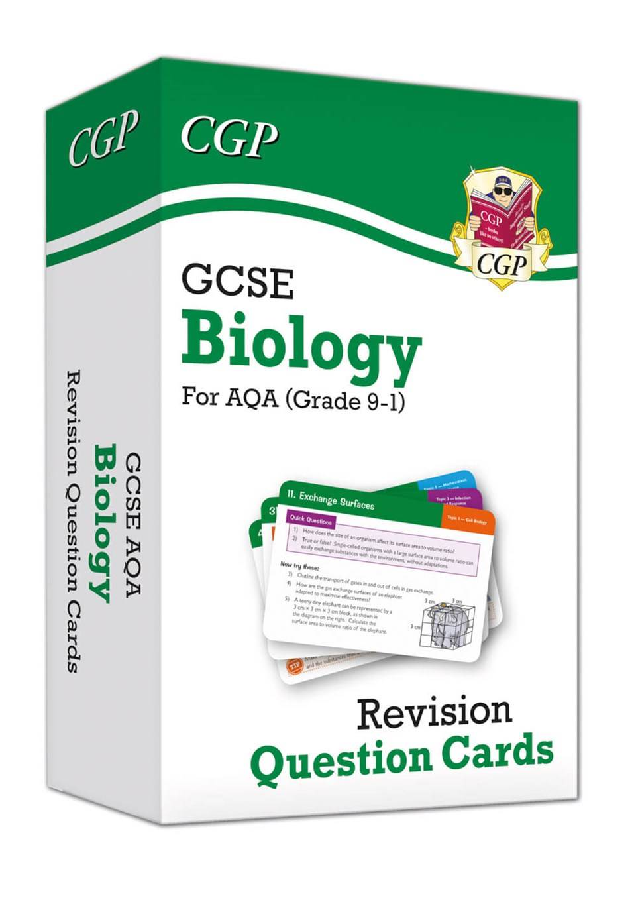
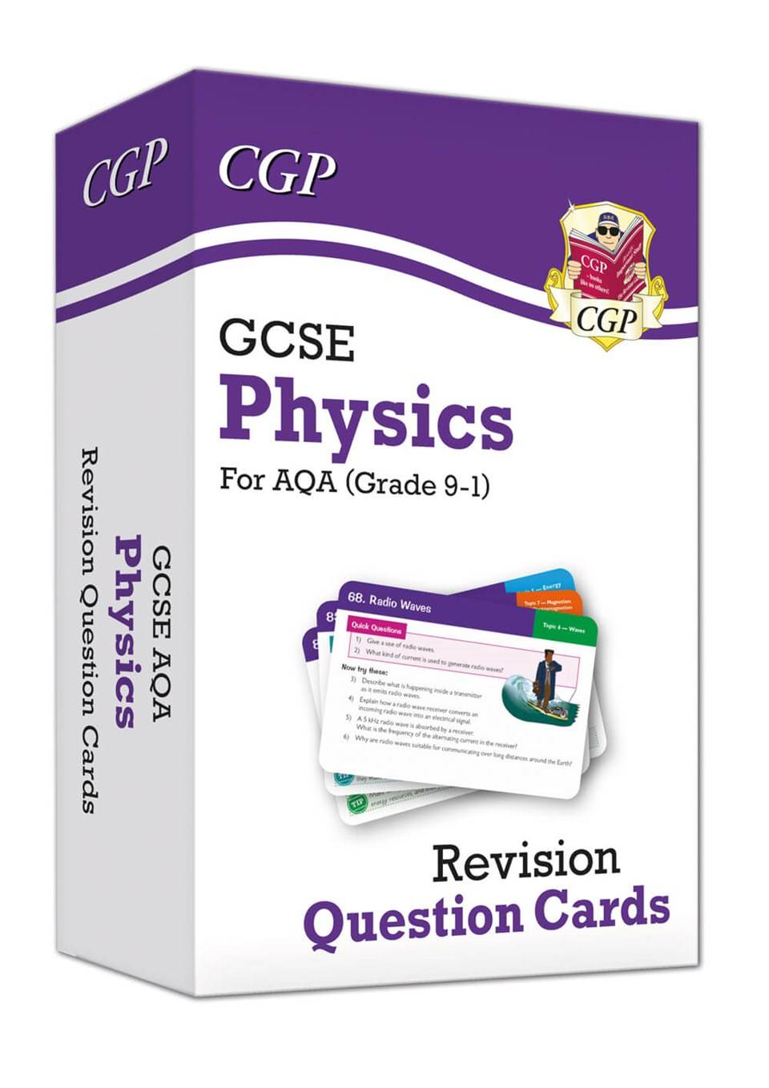
Science – Top Tips for Success
Revision resources available through the school – Triple Science

Slide 22
Our Study Skills Curriculum

Slide 23
Our Study Skills Curriculum
The following strategies are being explicitly taught to improve students' ability to study independently, revise effectively and remember more.
Flash Cards
Mind maps
Dual Coding
Cornell Note Taking

Slide 24
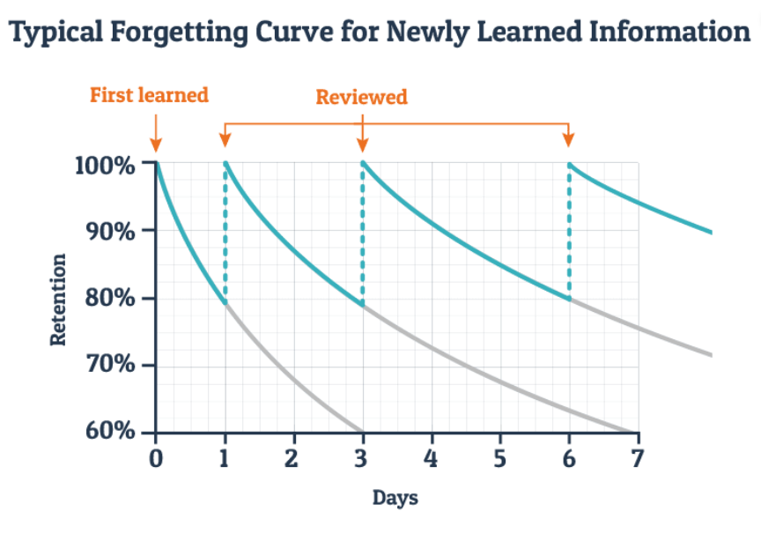
Why do we need to revise?
In the early 1880s, Hermann Ebbinghaus, a German psychologist, conducted a series of experiments on the human ability to “remember.” Ebbinghaus found,
By day 2, if you do not think about or review your work, you will lose 50%-80% of what you learned.
By day 30, if you do not think about or review your work, you remember only 2% - 3% of what you learned on day 1
His findings are represented in what’s called a “forgetting curve.”

Slide 25
Encoding
The Classroom
Our Working Memory
Our Long-Term Memory
In lessons students are given lots of knowledge to store in our working memory.
The working memory is much smaller than the long-term memory, so we need to learn it (encoding) to move it into the long-term memory.
Notes:
The working memory is much smaller than the long term memory and pieces of information don’t stay in their for very long. (About 18 seconds). We want to move as much information as possible to the long term memory, this is ENCODING.

Slide 26
Flash Cards

Slide 27
Why do we use Flash Cards?
Work well for things you must memorise such as:​
Definitions of keywords​
Important dates​
Equations​
Names of equipment/parts of a diagram ​
Quotes​
A great way to summarise your work so that somebody can test you
Easy to take with you when you go places
Can be used as a question or as a prompt
Health Check: You can buy ready-made flash cards – but making the flash card is
an important part of the revision strategy!
Notes:
Quizlet also does flash cards on an app. Great for students who aren't as creative or as neat.

Slide 28
How do we make Flash Cards?
Q&A
Big Writing
Readable in a ‘FLASH’
General Topic
Summary of a topic
Key words or short sentences
Bullet points
Health Check: Keep it simple; one card, one piece of information
Notes:
We are going to focus on the two more simplistic flash cards. Q&A and prompt. Try to think of ideas for your own subject and include these as examples
Question and Answer are probably the quickest and easiest way to test knowledge. Best to be used with facts.
Summary statements can be used when a prompt to key information is needed.

Slide 29
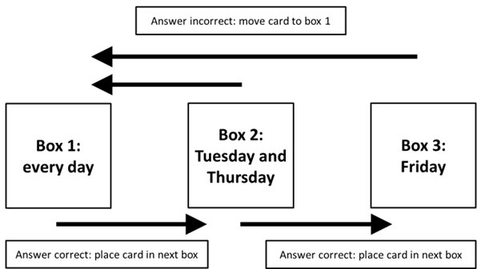
The Leitner Method for Flashcards
Red pile
Amber pile
Green pile
Health Check: Always shuffle the cards so you don’t just learn the order.
Notes:
Once you are confident the class have understood interleaving and quizzing, demonstrate the Leitner method.
Every flashcard will start in Box 1. As you answer a flashcard correctly, move the card into Box 2. If you incorrectly answer a flashcard, place the card back in Box 1. Follow this method for each flashcard in Box 1. At the end of this round, you will notice that some concepts remain in Box 1—that means that these concepts are more difficult for you and require frequent studying. The cards that have graduated to Box 2, on the other hand, are concepts with which you are more familiar, so you do not have to study them as frequently.
Each time you get a card correct, you move it to the next box. Each time you get a card wrong, you move it back to the previous box. Once you have finished studying for the day, you will see which concepts are ones that you need to study more frequently, and which concepts may only require you to study them once a week.
Follow the same method on each study day until all of your cards have been moved to the last box. If it turns out that you have forgotten some concepts in Box 3 by the time that study day rolls around, move the cards to the previous box. Depending on how you have labeled your boxes and created your study calendar, you may only study one box of flashcards on certain days and multiple boxes on others.

Slide 30
Mind Maps

Slide 31
Why do we use Mind Maps?
A great way to find the gaps in knowledge
They link key words and ideas
They help with longer process that you need to remember
Fact 1
Fact 2
Mind Maps
They help explain/break down ideas or concepts
Fact 3
Titles
They organise facts visually
Colours, diagrams and position can help
Key Words
Examples
Health Check: Mind maps are great at the START of revision when you are trying to summarise a topic.

Slide 32
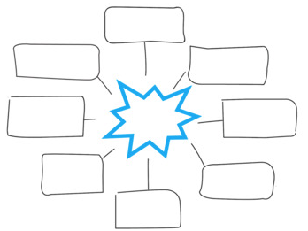
How do we make a mind map?
Have everything you need to revise for that topic.
Think about how you want to lay this out.
Split the page into the sections you want
Think about using colours or capitals for key words
Notes:
There is no wrong way to create a mind map, however below are some guidelines you may wish to follow:
Put your main idea or topic in the middle of page and draw a circle around it. This will be your starting point
Add related keywords or phrases all around this, then use lines to connect these ‘first level branches’ to the starting point
As needed, connect further keywords and phrases to the first level branches (these are called child branches)
If needed, add further branches to your child branches
Remember:
Use keywords and short phrases, not full sentences
Use images, icons and colour as you see fit. These are really helpful memory triggers
Try to create a sense of hierarchy as you break down the information
Keep the mind map to one side of paper
Don’t worry about your artistic skills, it’s not a competition

Slide 33
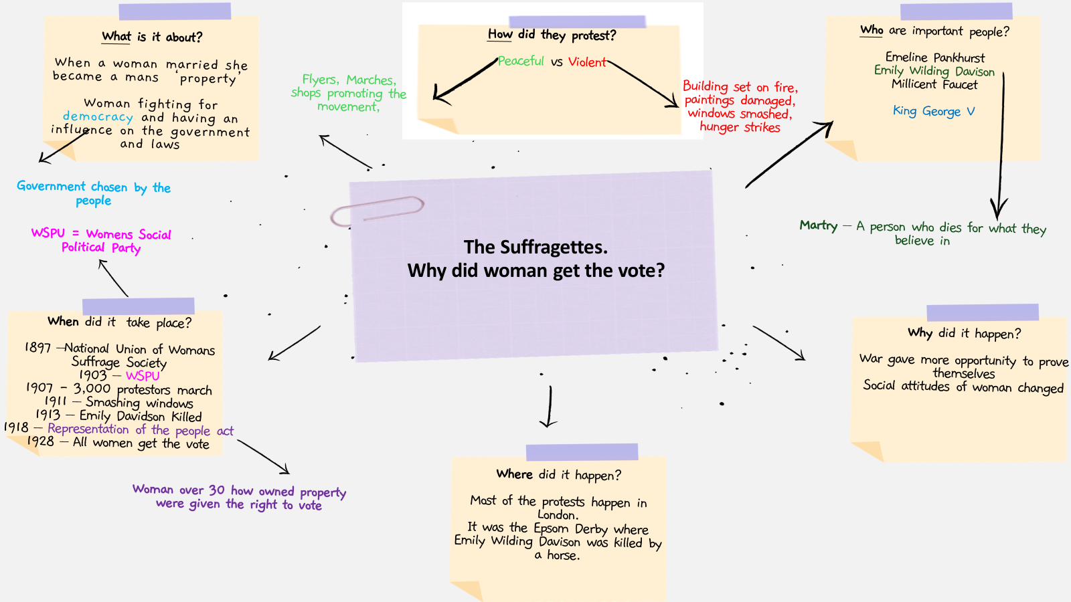

Slide 34
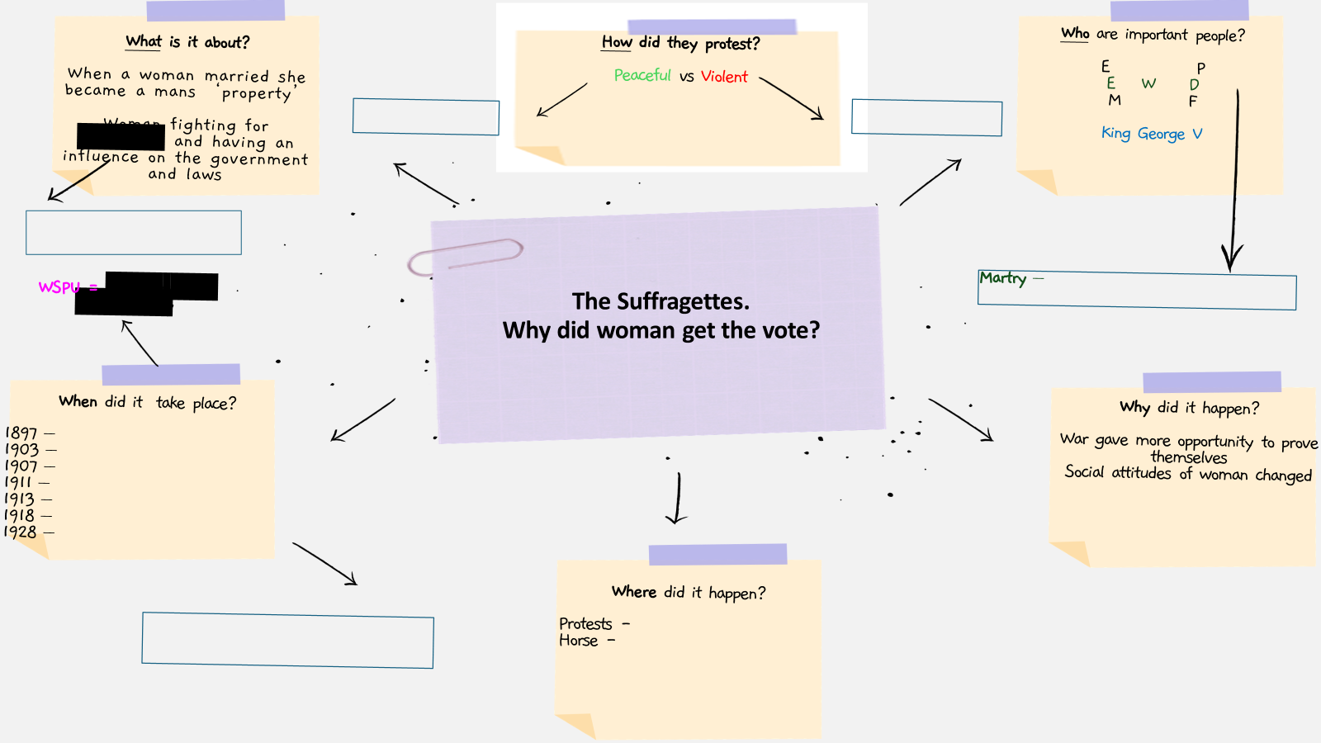

Slide 36
Dual Coding

Slide 37
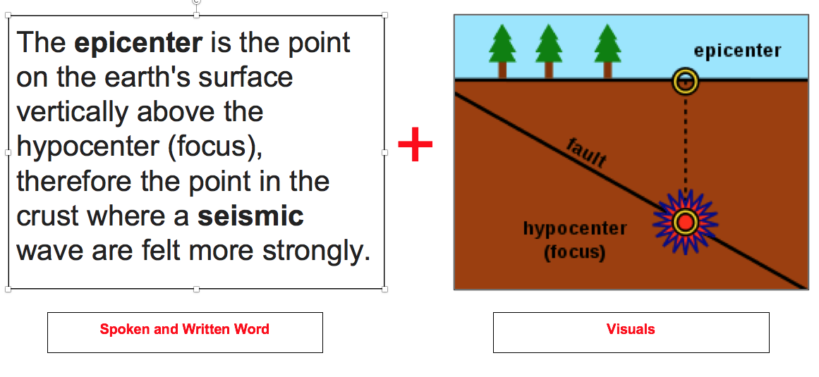
What is dual coding?
Dual Coding is the process of blending words and pictures whilst learning.
Teachers will use it all the time!
Your visual and verbal pathways to the brain are not the same, and so supplementing them together allows us to create a different pathway that is ‘dual coded’.

Slide 38
Why use dual coding?
As a study skill, dual coding speeds up the process of moving information to the long term memory by using more pathways.
Dual Coded
The Classroom
Working
Memory
Our Long-Term Memory
Notes:
This visual is to demonstrate to students how we learn.
Working memory is carried around with them.
Dual coding is the process that put the books on to the shelf for storage.

Slide 39
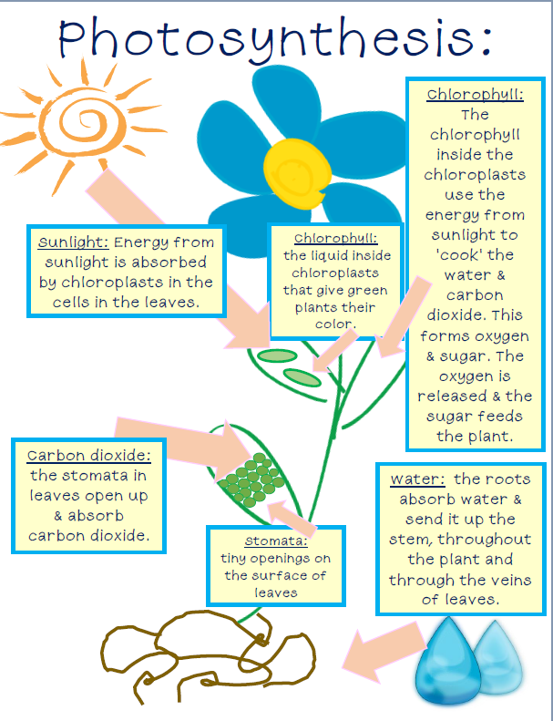
How to use dual coding.
Read over classroom materials.
Use relevant images to support key words
Use students words to make connections to the visuals.
Health Check: Don’t draw any old picture.
The diagram has to relate to the words

Slide 40
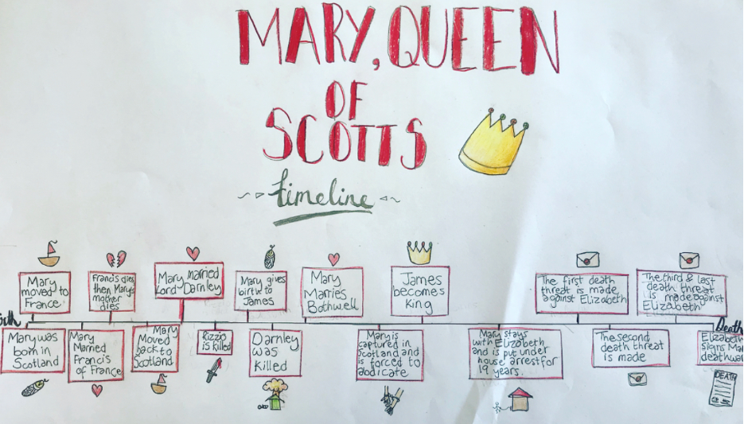
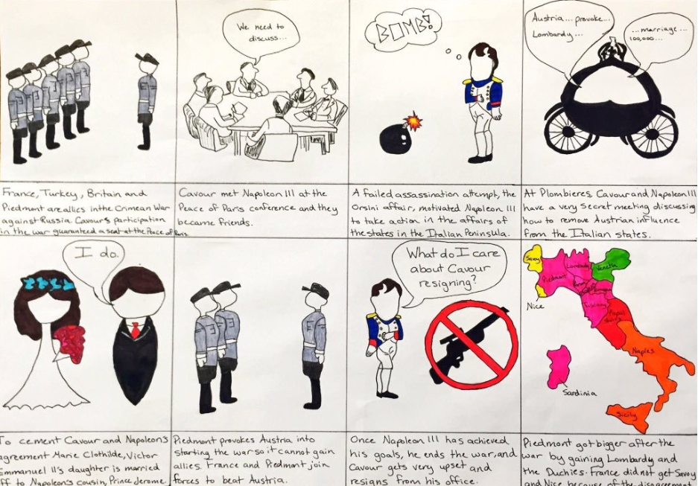
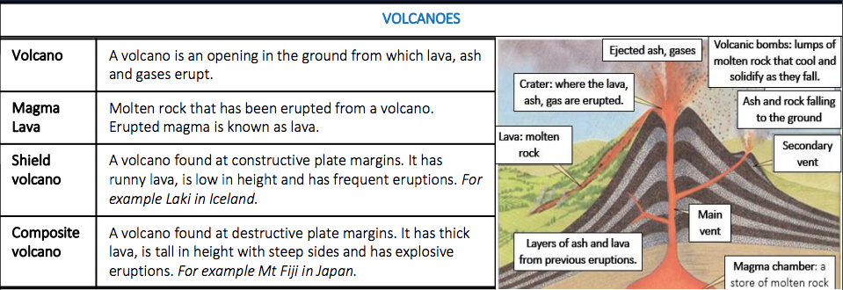
How to use dual coding.
Represent the detail in a variety of ways: timelines, cartoons, story boards, diagrams.
5. Work your way up to drawing what you know from memory.
Health Check: Don’t draw any old picture. The diagram has to relate to the words.

Slide 41
Cornell Note Taking

Slide 42
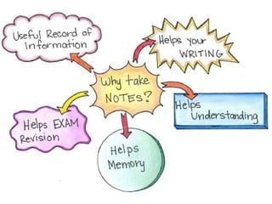
Why do we take notes?
Simply reading through your notes is considered passive revision.
Taking notes in class or when reading text, helps you to concentrate and listen effectively making your learning more active.
Revision notes help organise and structure information, which in turn helps your memory
Notes:
Active learning requires students to think, discuss, challenge, and analyse information. Passive learning requires learners to absorb, assimilate, consider, and translate information. Decades of educational research have confirmed that passive learning isn't as effective as active learning.

Slide 43
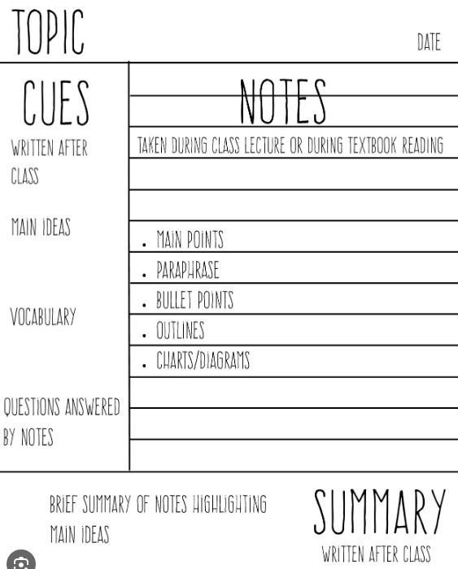
What are Cornell notes?
The Cornell method helps counteract “forgetting” with spaced repetition. Every time you revisit a note to add cues, create a summary, or make other edits, you effectively refresh what you’ve learned.
Split the page into 3 sections;
Write down notes in the right-hand column.
Add cues or questions in the left-hand column.
Summarise notes in the 3rd.
When writing the notes, use abbreviations and symbols to increase speed and accuracy.
Be selective about facts and ideas, writing down only what’s essential.
Notes:
All students need to do if they have these in their exercise books is cover over the notes section and look at the queues as a form a retrieval self quizzing, or hand to parents or peers for the to quiz them using the queues.
The larger Notes section can be folded over to meet the cue line if this has been done on individual paper.

Slide 44
Topic :
Cues
Notes
Summary

Slide 45
Supporting other subjects

Slide 46
Supporting other subjects

Slide 47
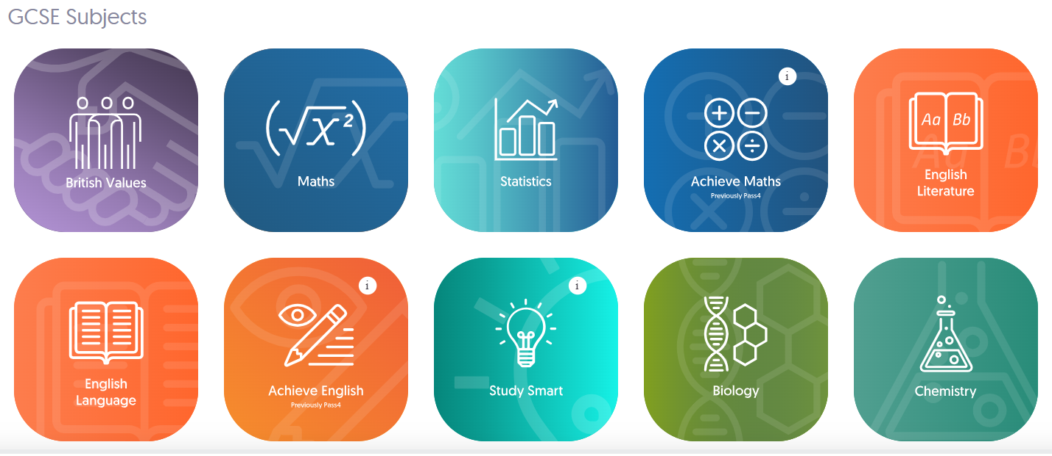
GCSE Pod is a platform available to all our students.
It enables students to watch a variety of 'pods' for different subject areas.
It is clear and engaging and can 'check and 'challenge' students' knowledge.
GCSE Pod

Slide 49
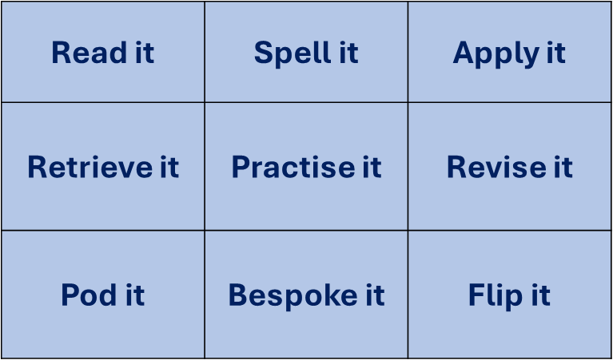
Homework

Slide 50
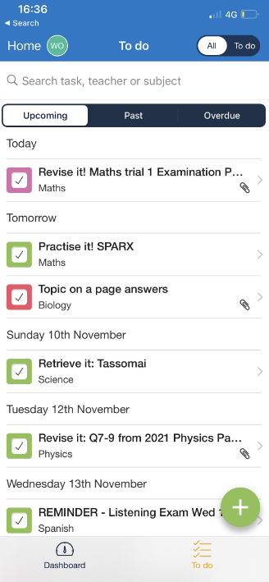
Satchel Homework

Slide 51
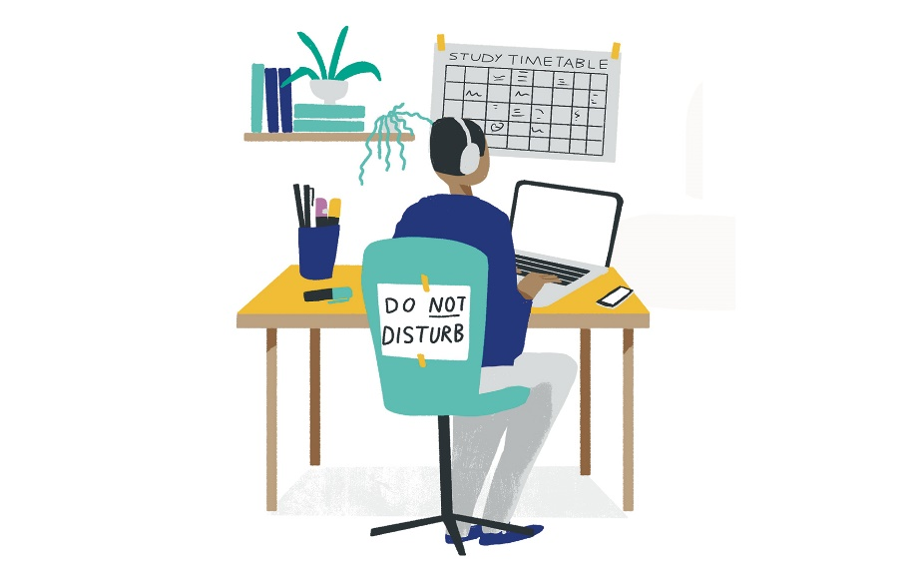
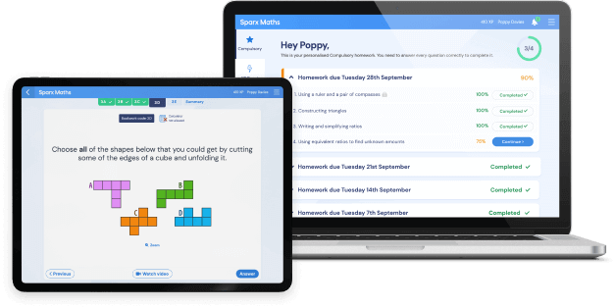
Creating the right study environment
Notes:
Time
Space
Quiet
The stuff
Support
Technology

Slide 52
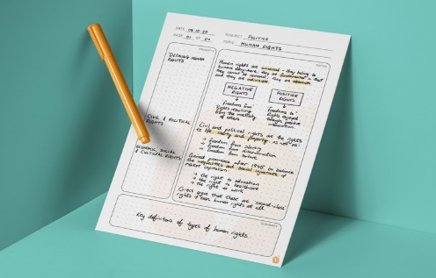
How you can help
Monitor (Satchel One)
Study space
Value study
Encouragement
Expectations, deadlines and organisation
Time for three meals a day
Time to be outside/exercise
Time to take a break in your study session
Time to prepare for the next day
An hour before bed to relax

Slide 53
SEND Support
Students' current SEND support will continue into GCSE
If your child has extra time for exams on the basis of cognition and learning (dyslexia, processing speed etc) then we will need to reassess them in the run up to the GCSE exams to ensure that they still meet the criteria.
The level of demand goes up at GCSE – this requires some adjustment from students but can also highlight areas of need. If you have any concerns please start by contacting your child's subject teacher or form tutor.
All exam access arrangements need to be:
established as 'normal way of working'
supported by teacher and specialist evidence
based on a clear history of need according to the JCQ guidelines
They cannot be put in at the last minute.

Slide 54
Next Steps
Find the most effective study skills for your child.
Create the 'right study environment'.
Create a homework timetable – starting tomorrow!
Browse GCSE Pod – search the parental support sections.
Be positive, supporting and encouraging.
Year 10 Trial 1 exams start on Monday 10th March 2025 and finish on Friday 21st March.

