Slide 1
Year 8 Parent Information Evening
Thursday 6th March 2025

Slide 2
Welcome
We aim to provide you with:
An insight into Year 8 so far.
Key dates upcoming for Year 8.
Information on how to support your child.

Slide 3
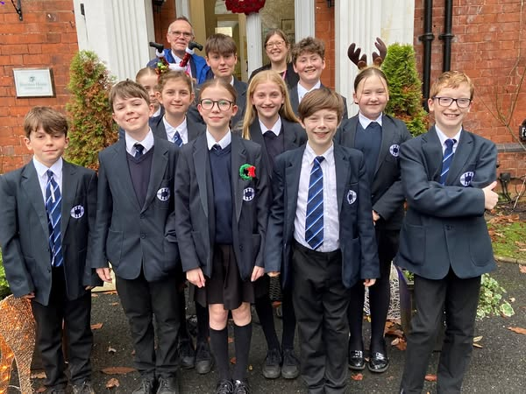
Our Year 8 Student Ambassadors
Our ambassadors have visited Sharston House to give out mince pies and sing carols to the residents.
Our ambassadors have donated to the charity Street Buddies in Manchester to help the homeless.

Slide 4
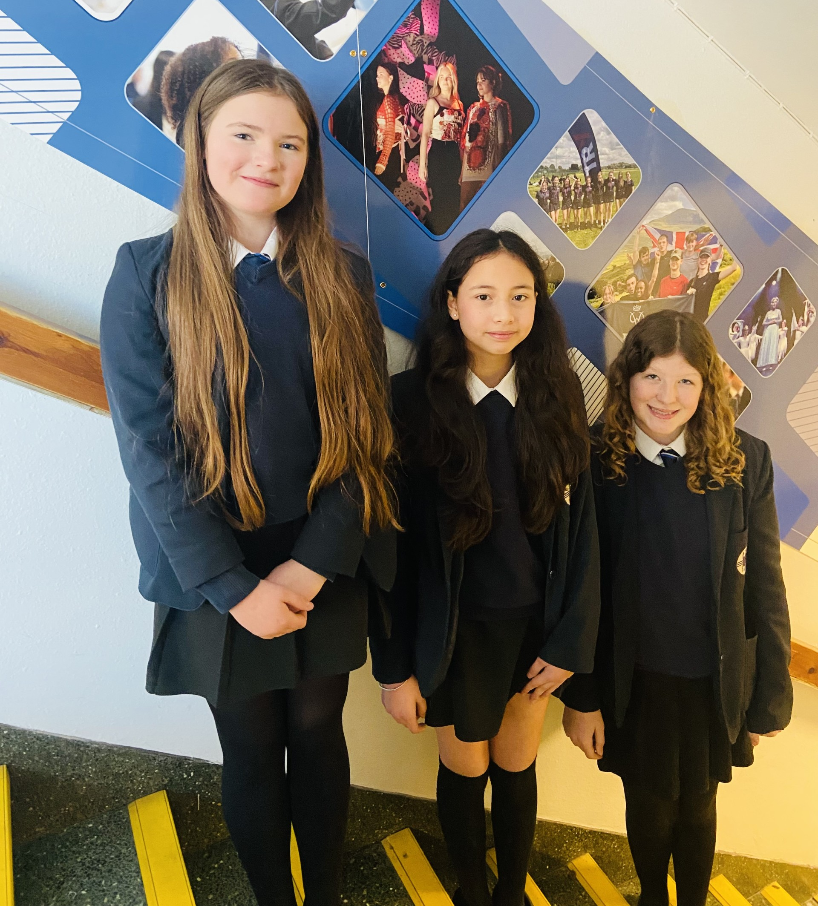
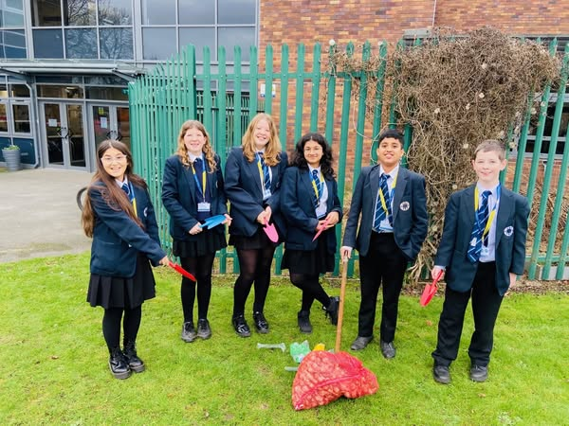
Our Year 8 Student Ambassadors
Year 8 ambassadors have led an assembly to introduce our Easter collection for Street Buddies.
Year 8 Environmental Officers have planted daffodils around the Westfield Drive site.

Slide 5
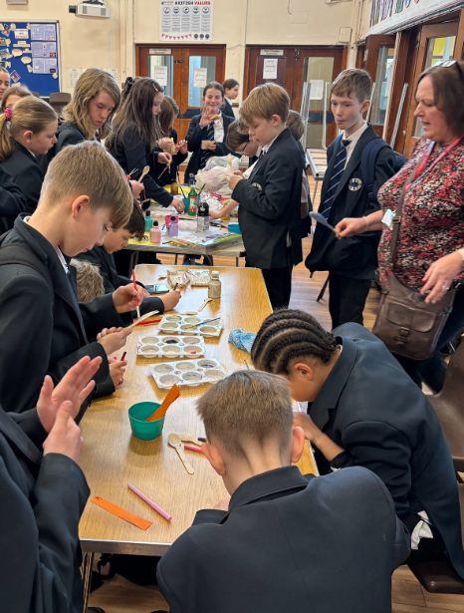
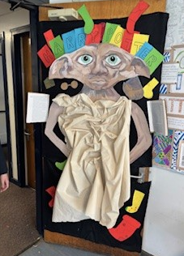
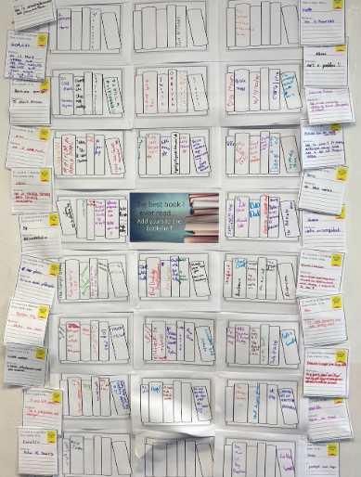
World Book Day
As part of our on-going reading strategy, today we have supported World Book Day. Students have decorated doors, completed quizzes and described their favourite books.

Slide 6
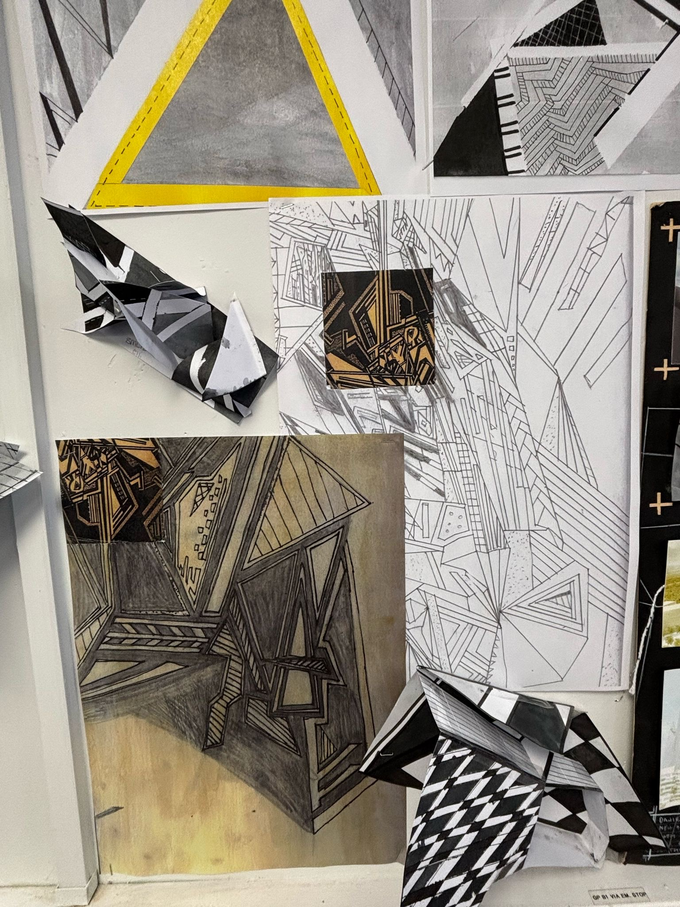
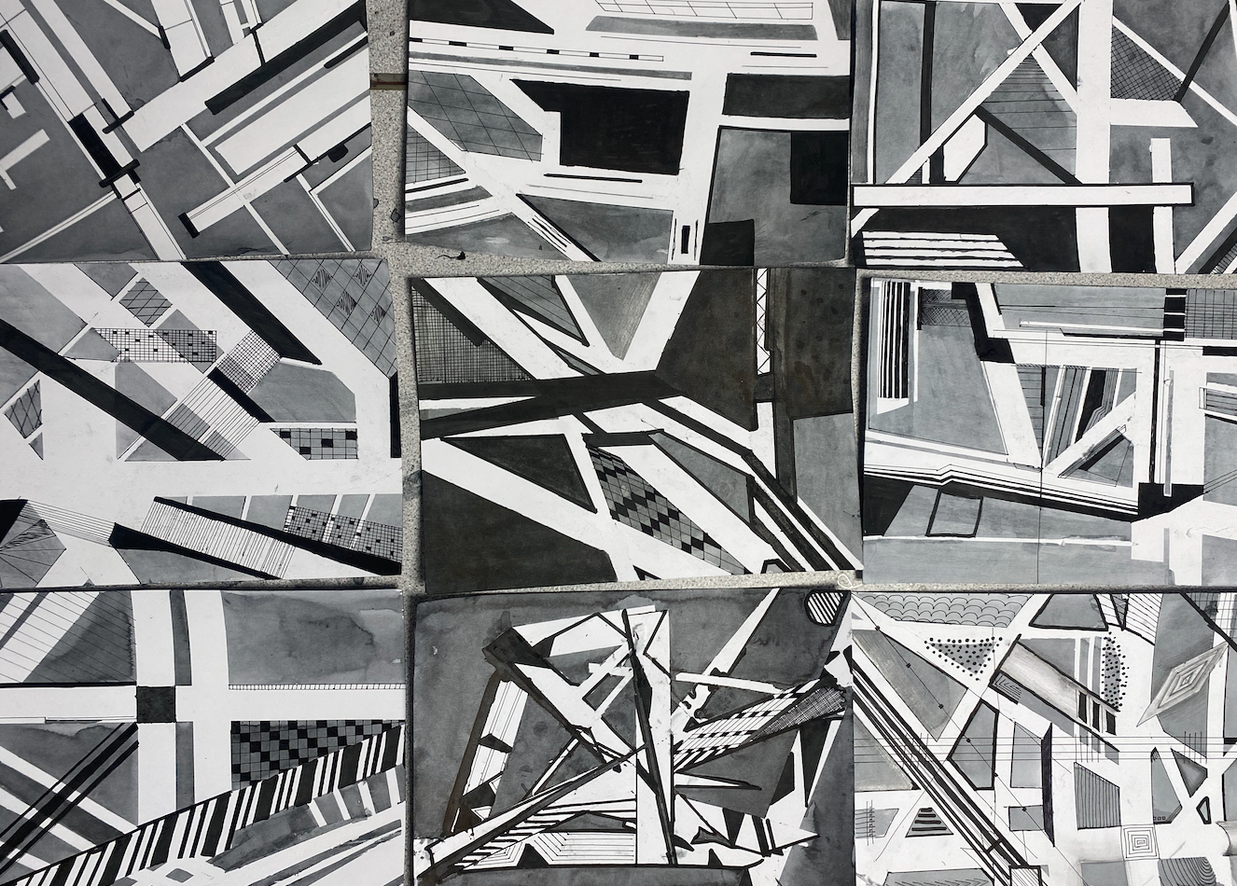
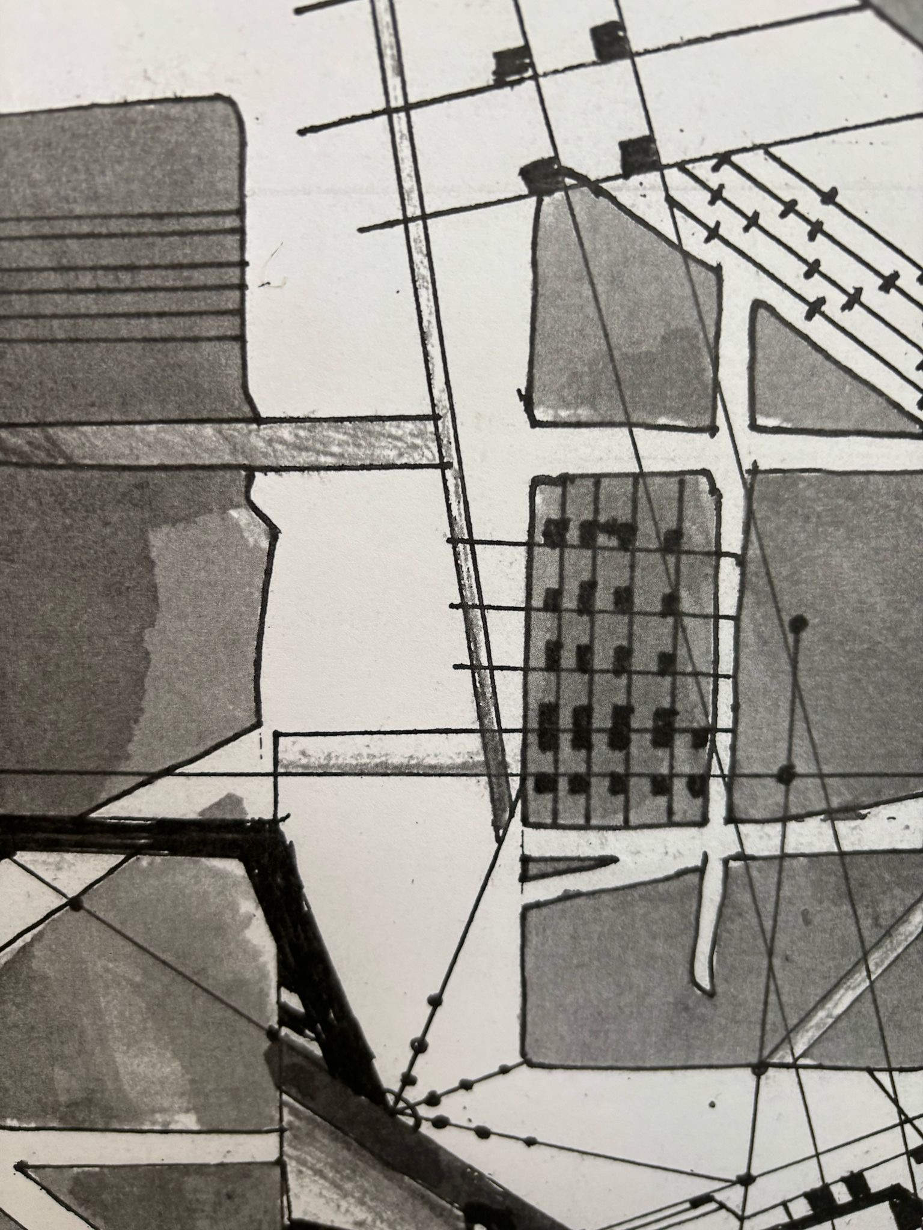
Art and Design
In 3D design students have been studying Vorticism; known for its bold geometric shapes, dynamic lines, and industrial influence.
Students created their own 2D outcomes and 3D sculptures or relief pieces, incorporating angular forms and abstract compositions.

Slide 7
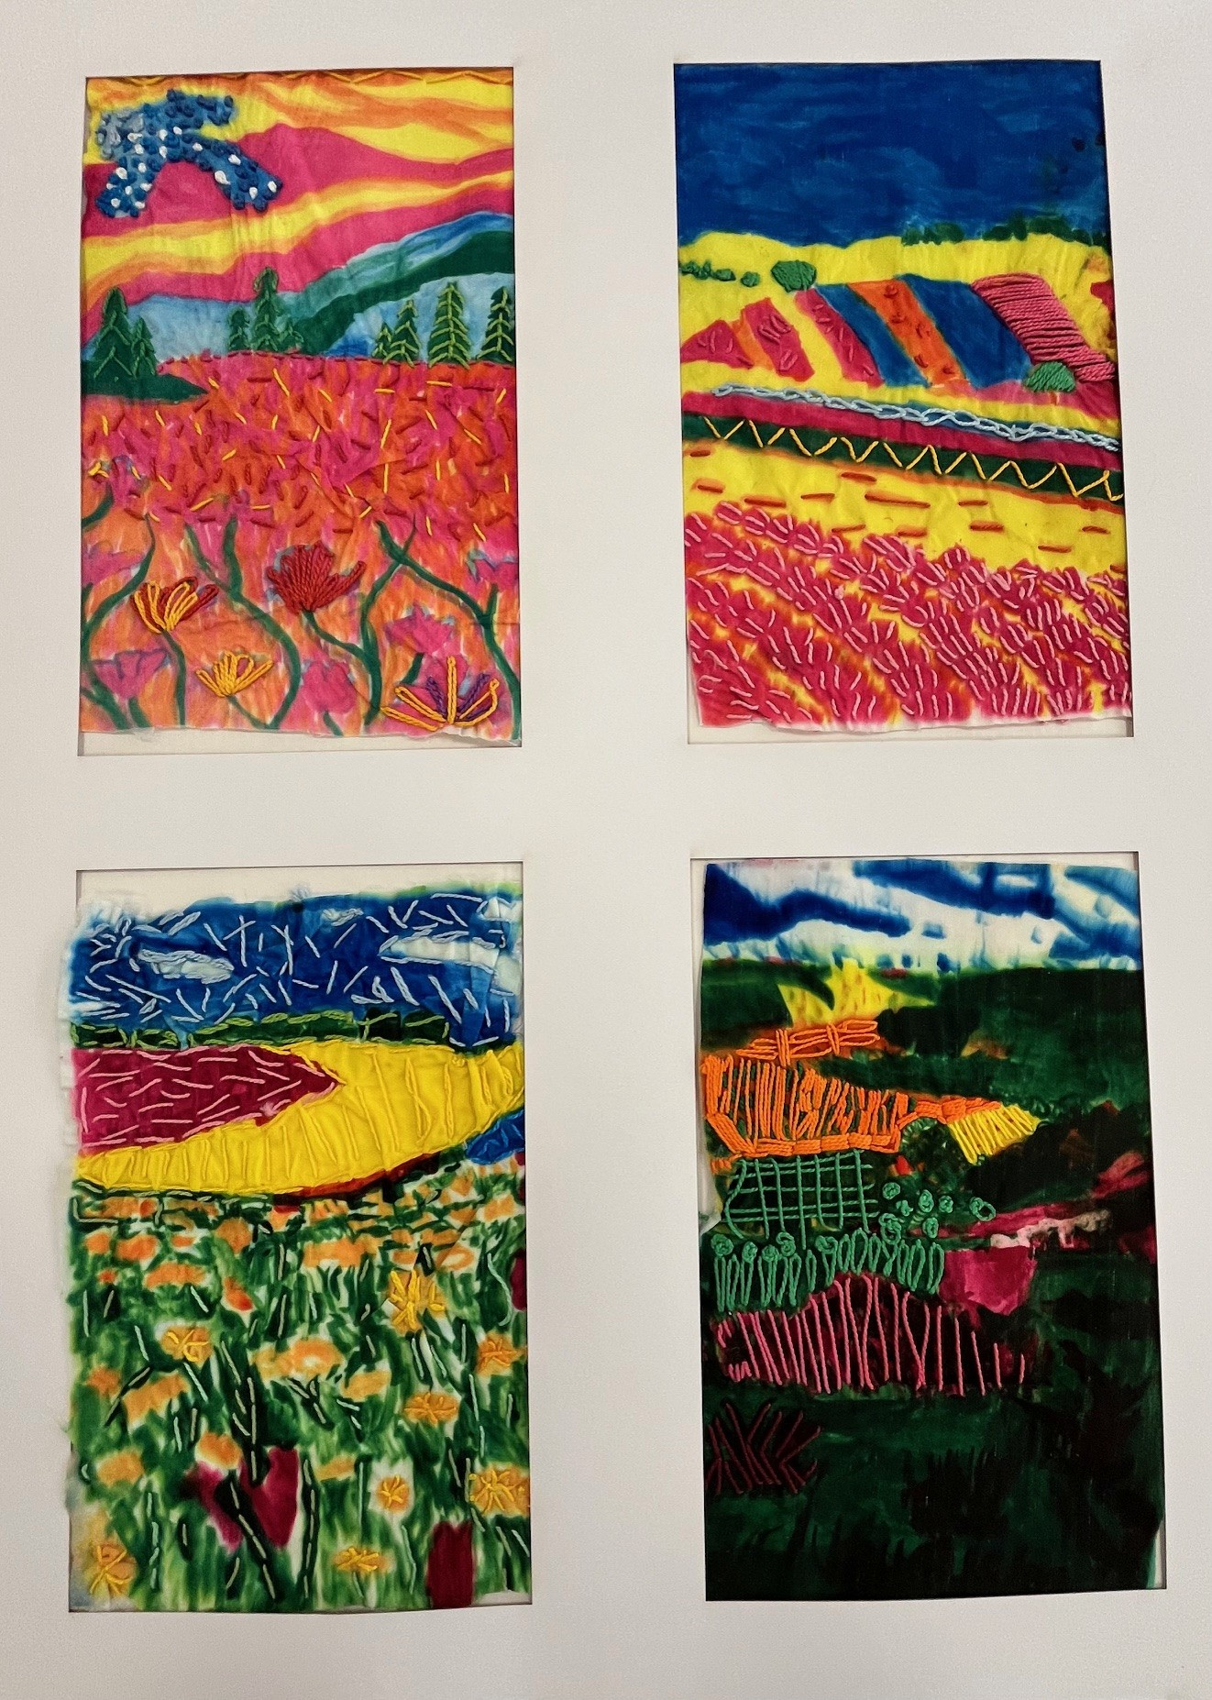
Art and Design
In Textiles, students have been looking at the work of David Hockney's 'I pad’ paintings of the British landscape.
Students responded to this with their own textile landscape. They transformed the grey skies of Knutsford into a bright colour pallet using transfer printing and a range of hand embroidery stitches to create these amazing pop art style pieces.

Slide 8
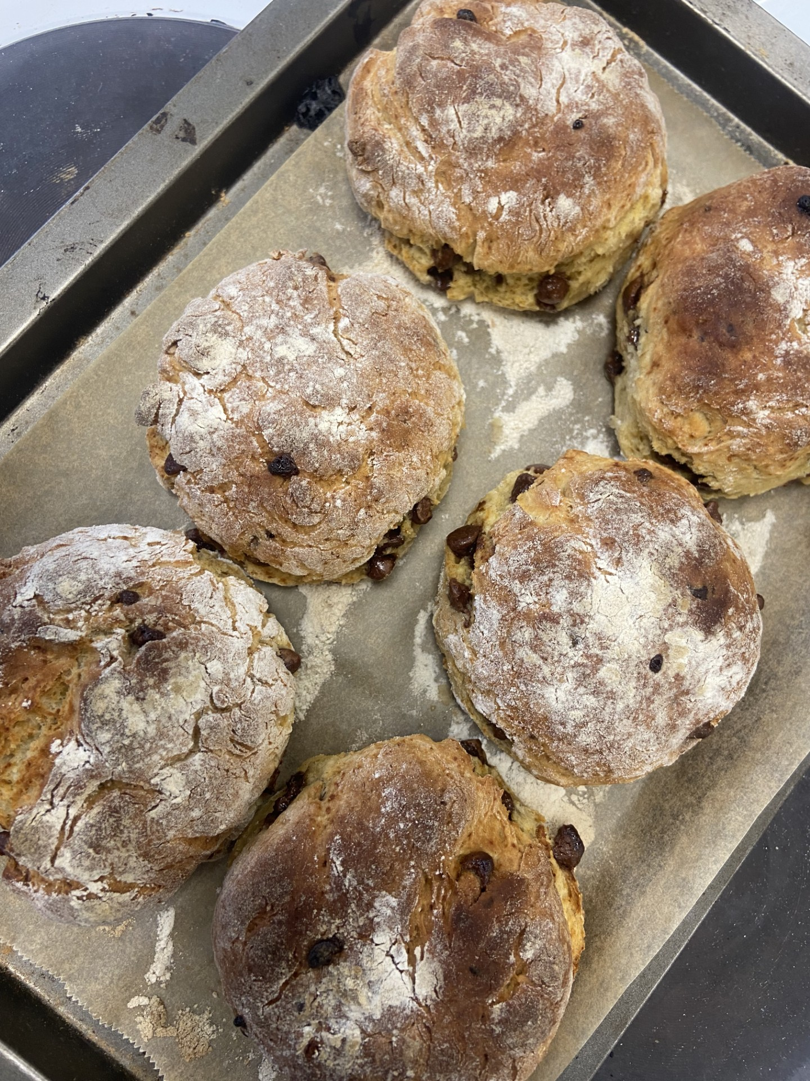
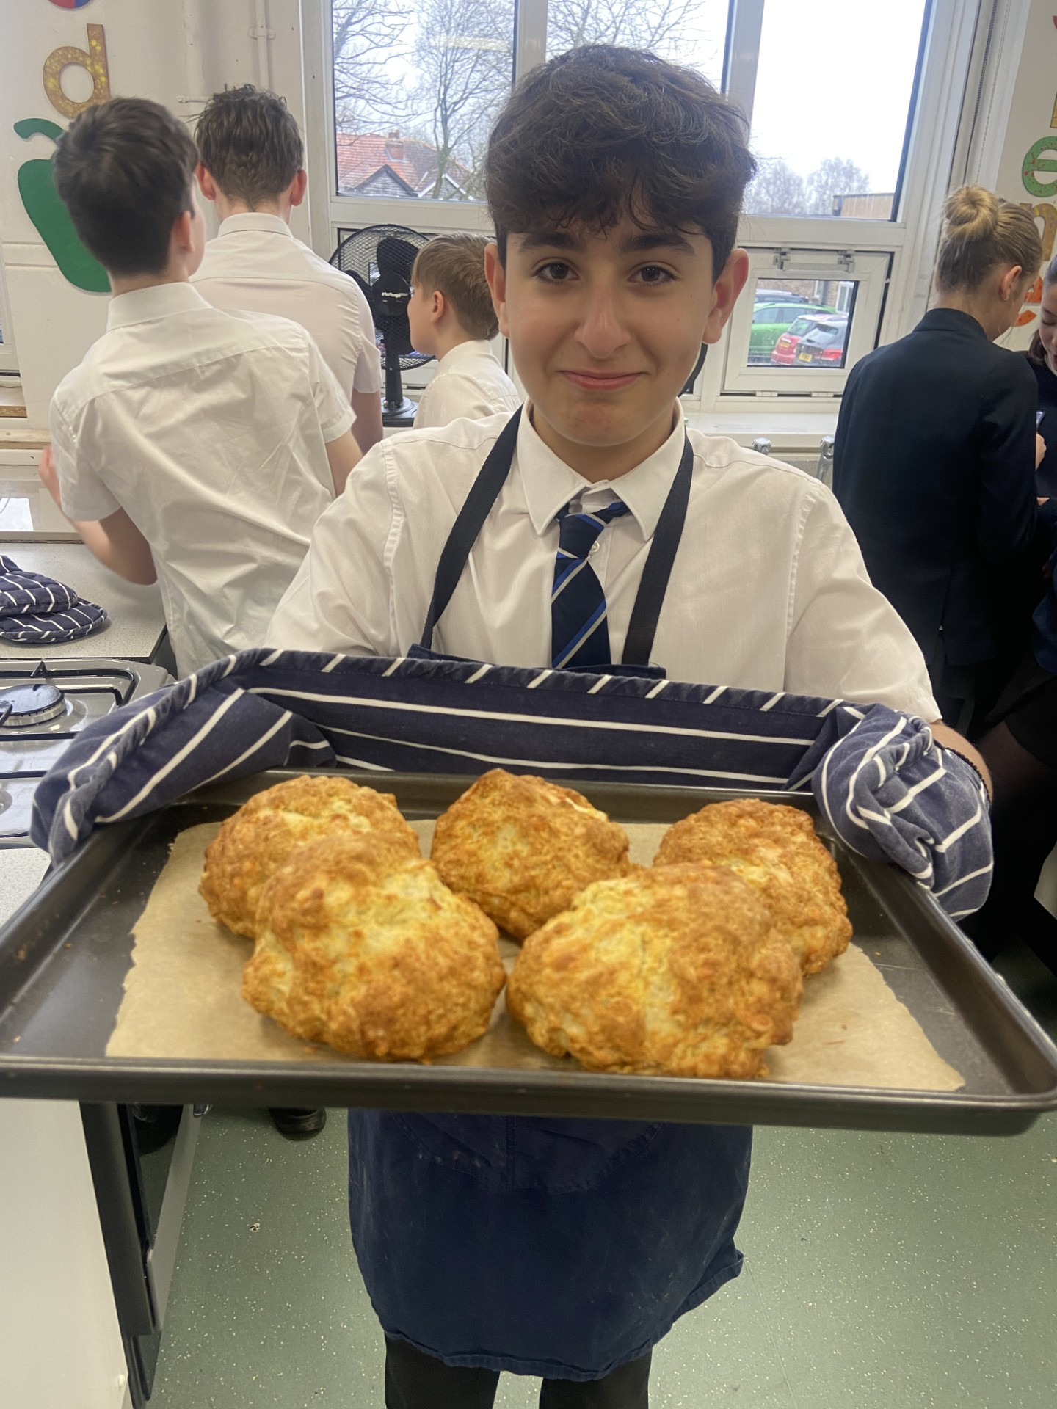
Art and Design
In Food and Nutrition, students have been learning about food science and seeing how raising agents work.
They then put this into practice to make some delicious soda bread!

Slide 9
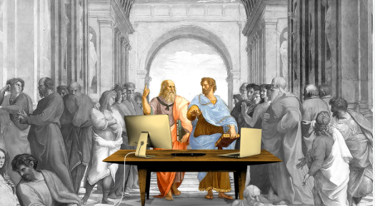
English
Year 8 pupils explore The Power of English – how language is used to provoke and create impact. Our Year 8 students started the year studying rhetoric – the power of the spoken word from Aristotle through to Malala​.
​
Pupils have also been studying Animal Farm, George Orwell's tale of animals who rise up and take over their farm from humans.
This term, we move on to Powerful Poetry, exploring poems from contemporary poets including Simon Armitage and Carol Ann Duffy.

Slide 10
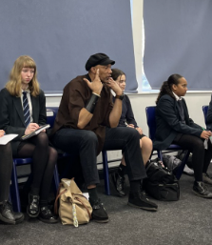
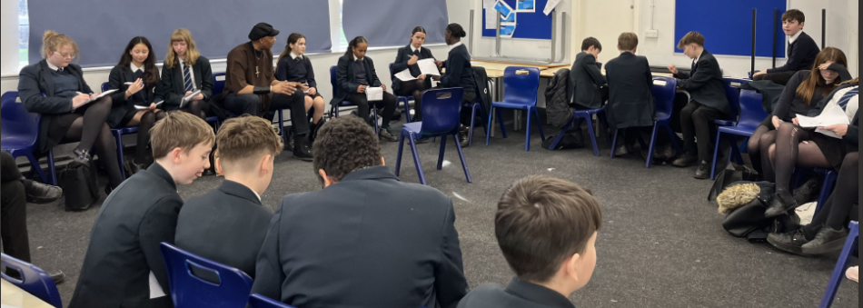
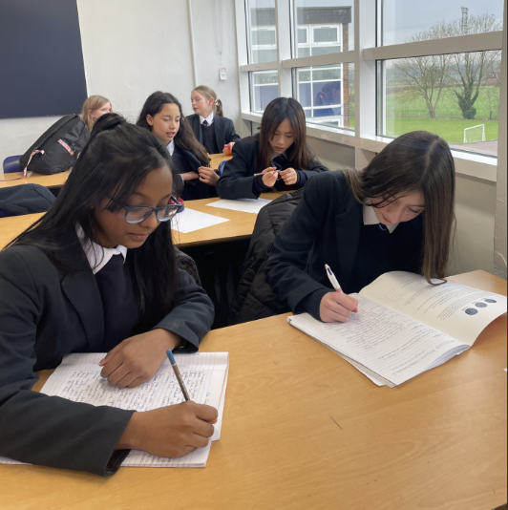
In English, students were visited by the poet 'Adisa the Verbalizer’.
Students were introduced to performance poetry and worked with Adisa to create and perform their own poetry.
There is a creative writing club running at lunchtimes – all Year 8 students are welcome to attend.

Slide 11
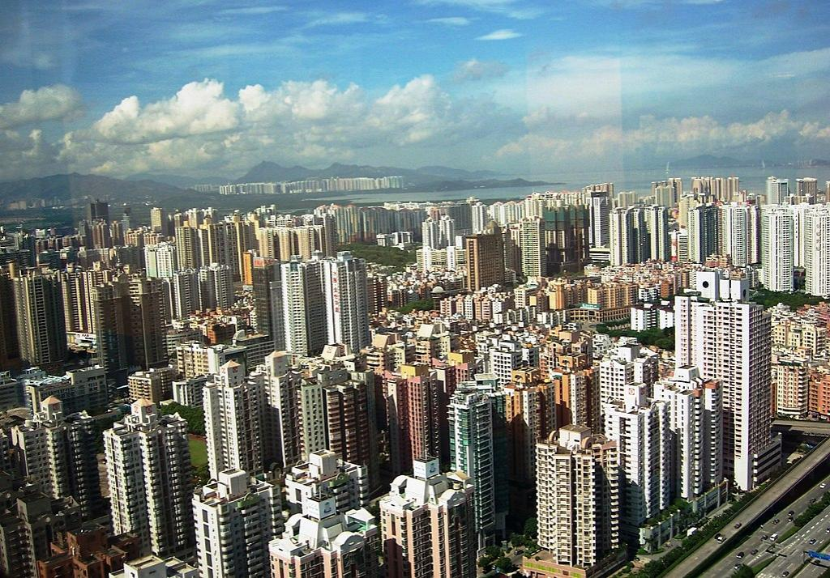
Humanities - Geography
In Geography, students have been exploring the issues created from rapid urban growth in some parts of the world, compared to the challenges of an ageing population in others.
Key geographical terminology has included globalisation and interdependence.
We finish the year looking at how the UK Economy has changed and the environmental impacts of a changing workforce.

Slide 12
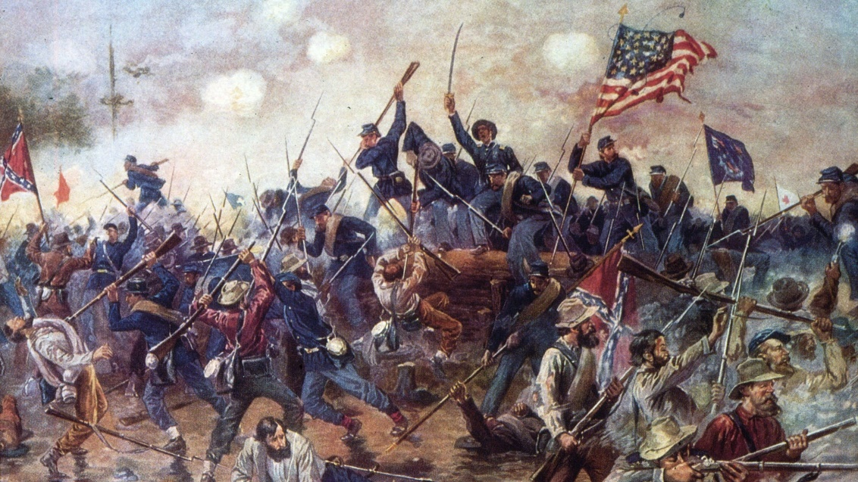
Humanities - History
Historians have been looking at the themes of power, ideas, industry and empire.
Pupils have been considering the following questions:
-How and with what consequences did England become a Protestant nation?
-What happened in the civil war?
-Was the Stuart monarchy challenged and with what consequences for the people of Britain?

Slide 13
Humanities – Religious Studies
Students have been looking at Abrahamic Religions.
Pupils have learned about Judaism; studying the beliefs and practices of this religion.
They are now studying the New Testament (Christianity) and will then explore Islam.

Slide 14
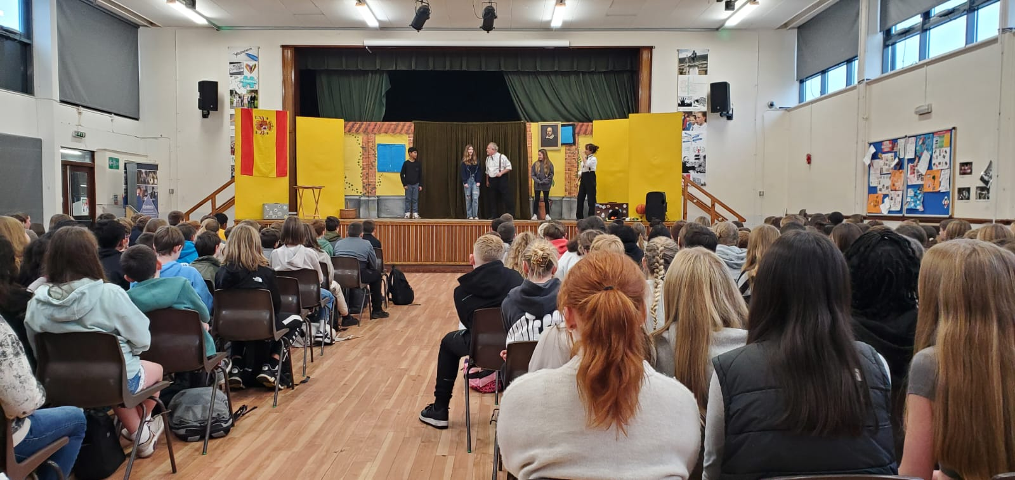
Languages
Bringing Languages to Life
Theatre Magic! 🎭 Year 8 stepped into the spotlight with the Flying Theatre Company, practicing their French and Spanish in an interactive performance!
Celebrating Languages! 🌍 European Day of Languages saw students racing through a scavenger hunt and testing their knowledge in quizzes!
Lunchtime Linguists! 🏆 Year 8 put their spelling skills to the test in our Enrichment Spelling Competition, with a top team heading to Liverpool University this term!

Slide 15
Languages
Food, Glorious Food! 🥖🌮 From ordering in restaurants to talking about meal times and specialities, Year 8 have been getting a taste of French and Spanish culture!
Home Sweet Home! 🏡 This term, they’ve been learning to describe their home, their routine, and where they live – even designing their ideal home!
Global Connections! ✉️ Some students have been making pen pal friendships with Réunion Island, while others have been busy in the kitchen, bringing recipes to life!
A fantastic year of learning, culture, and fun! 🎉

Slide 16
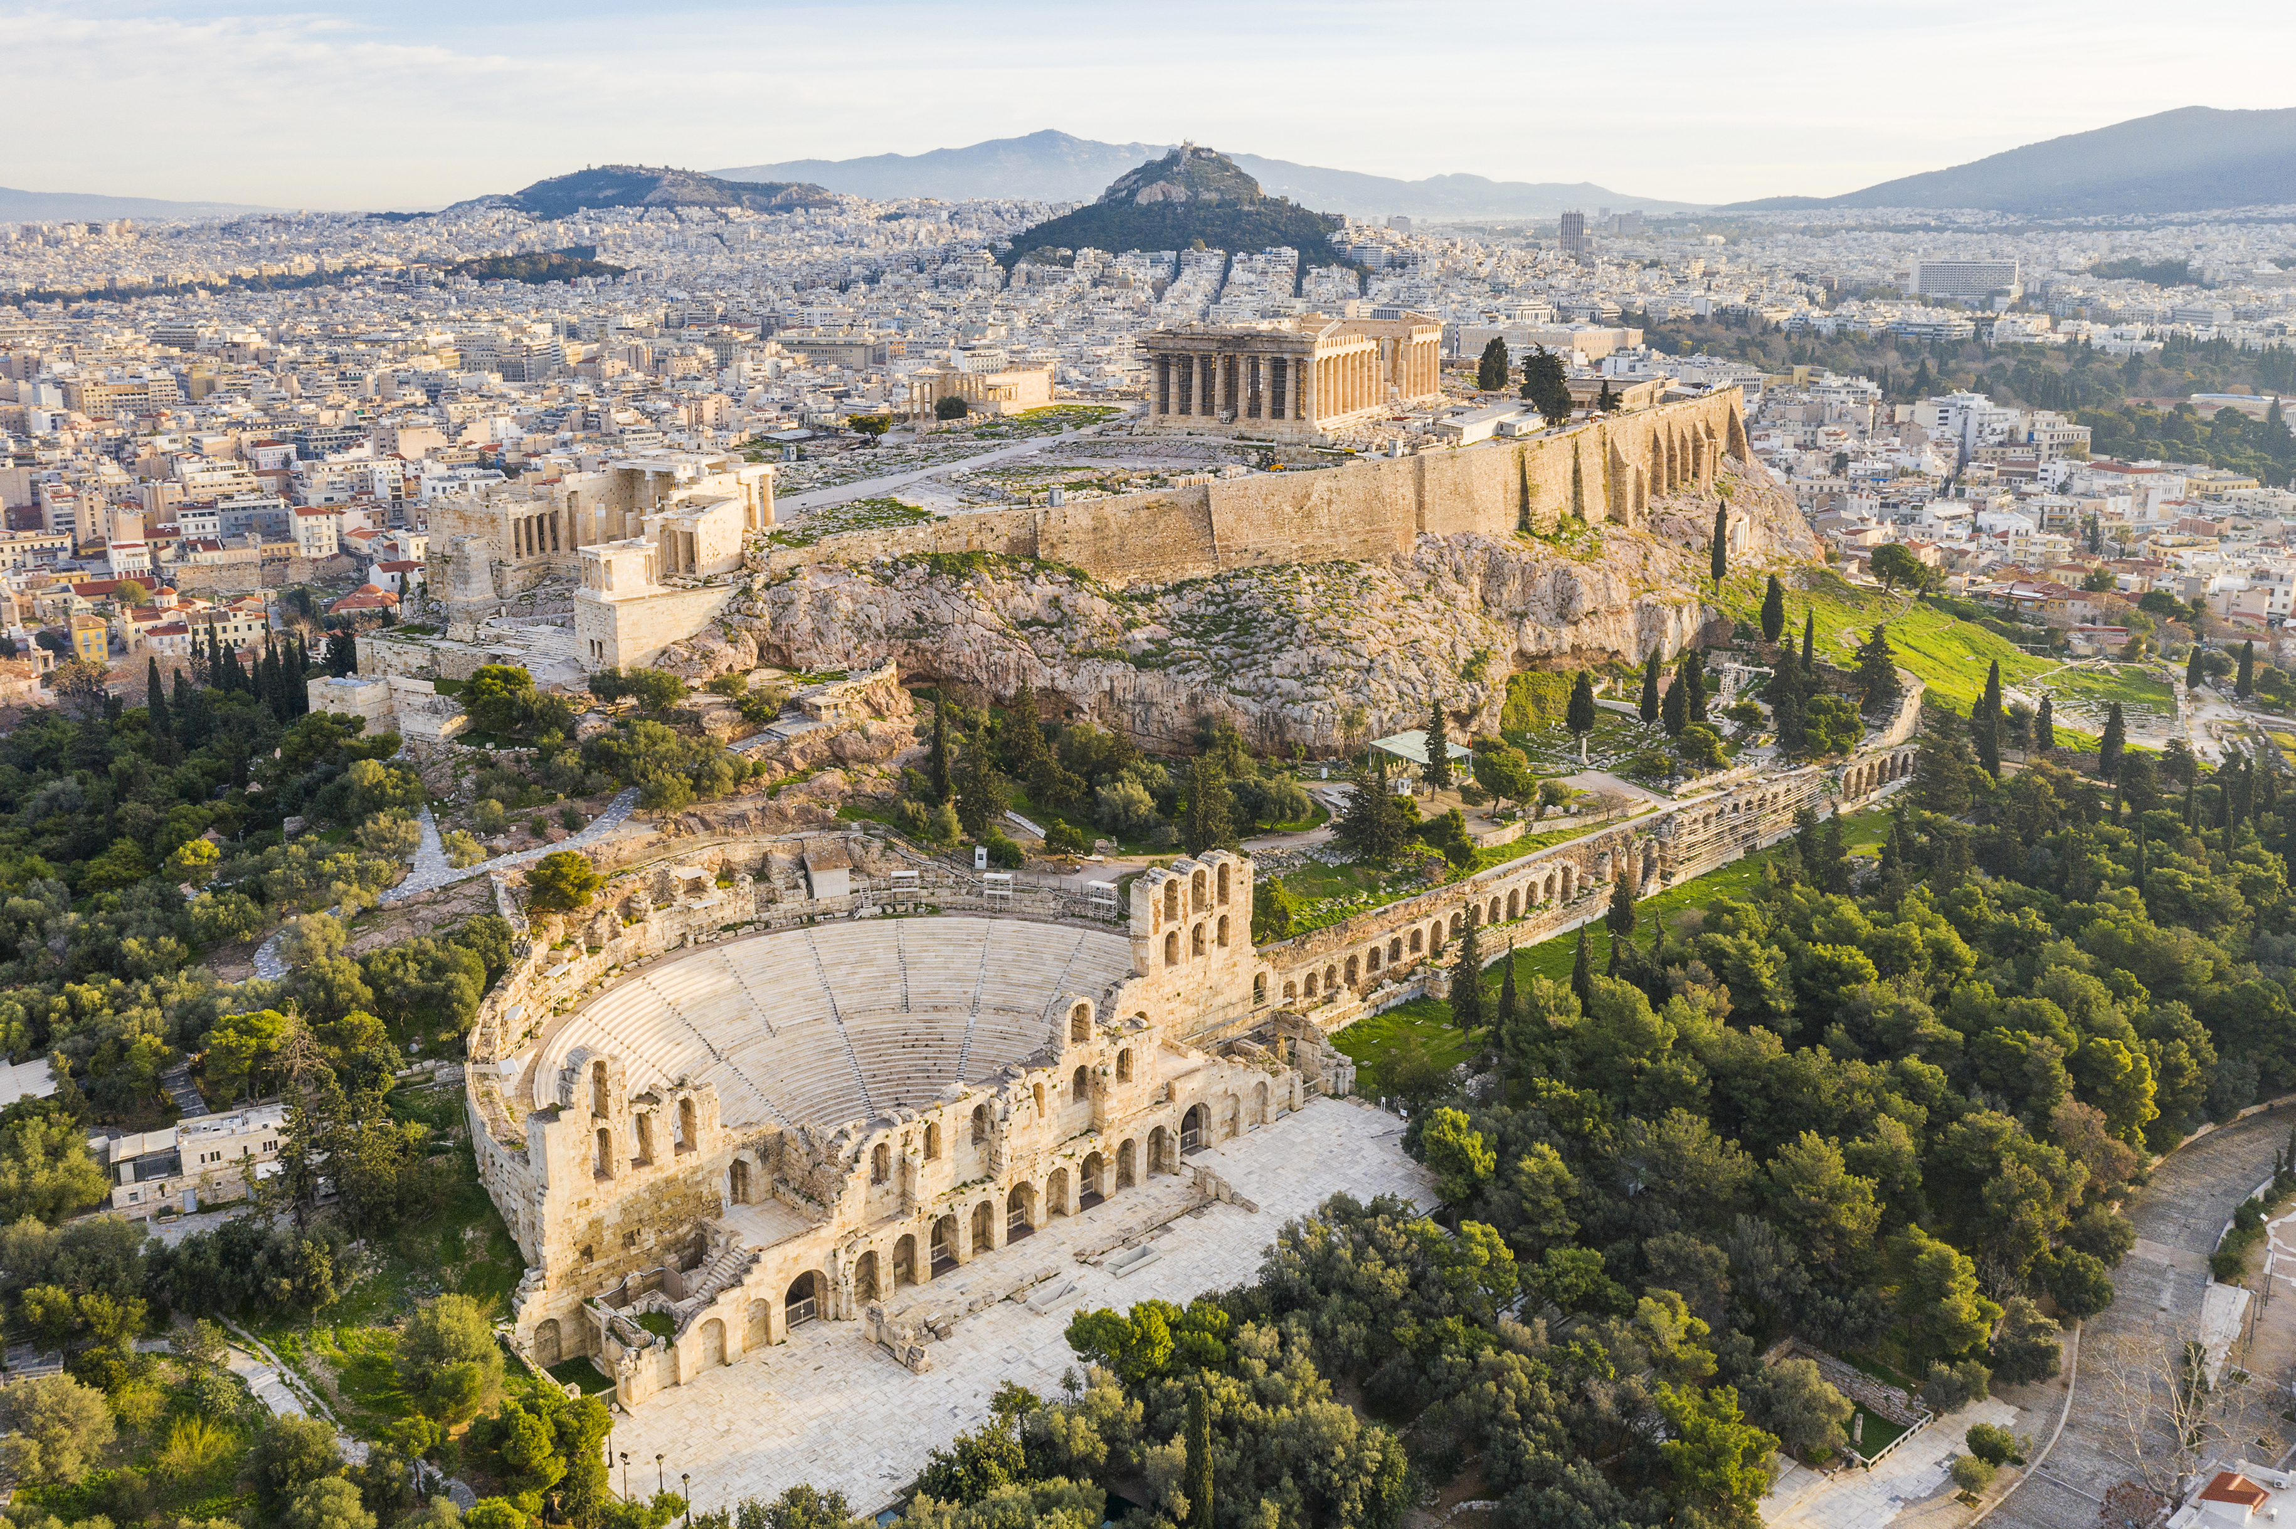
Performing Arts
In Drama, students have used a range of creative strategies including role on the wall, marking the moment and conscience alley. This term we are investigating theatre history and Miss Merriman has reported some outstanding Greek Theatre performances!
In Musical Theatre, students started the Year in 1960's Baltimore learning about the civil rights movement alongside our work on the musical Hairspray.
This term we are in 1920's New York investigating the gangsters and flappers of Bugsy Malone before ending the year in Edwardian London with the chimney sweeps and kite fliers of Mary Poppins.
In Performance Review, students have studied The Sorcerer's Apprentice, our current production is Treasure Island and in the final term we will look at Matthew Bourne's The Nutcracker.

Slide 17
Performing Arts
In Dance, students have practiced and performed dance in the styles of Rock n Roll, Street dance and African dance.
In music, students have been experimenting with digital music learning and production.
They have also been excited to start working in our new specialist music room on the Westfield drive site.

Slide 18
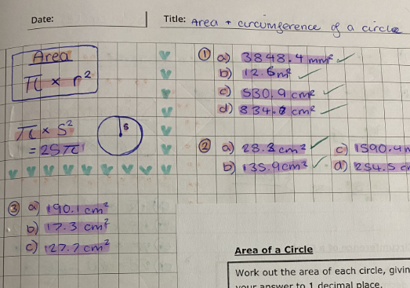
Maths
In Maths, students have been working on proportional reasoning tasks and Algebra.
Students have also studied shape topics and calculations with circles – Miss Wheatcroft's class used edible resources!
Watch out for Mr Touhey's Pi day (March 14th) where you can win the chance to 'Pi' your Maths Teacher.

Slide 19
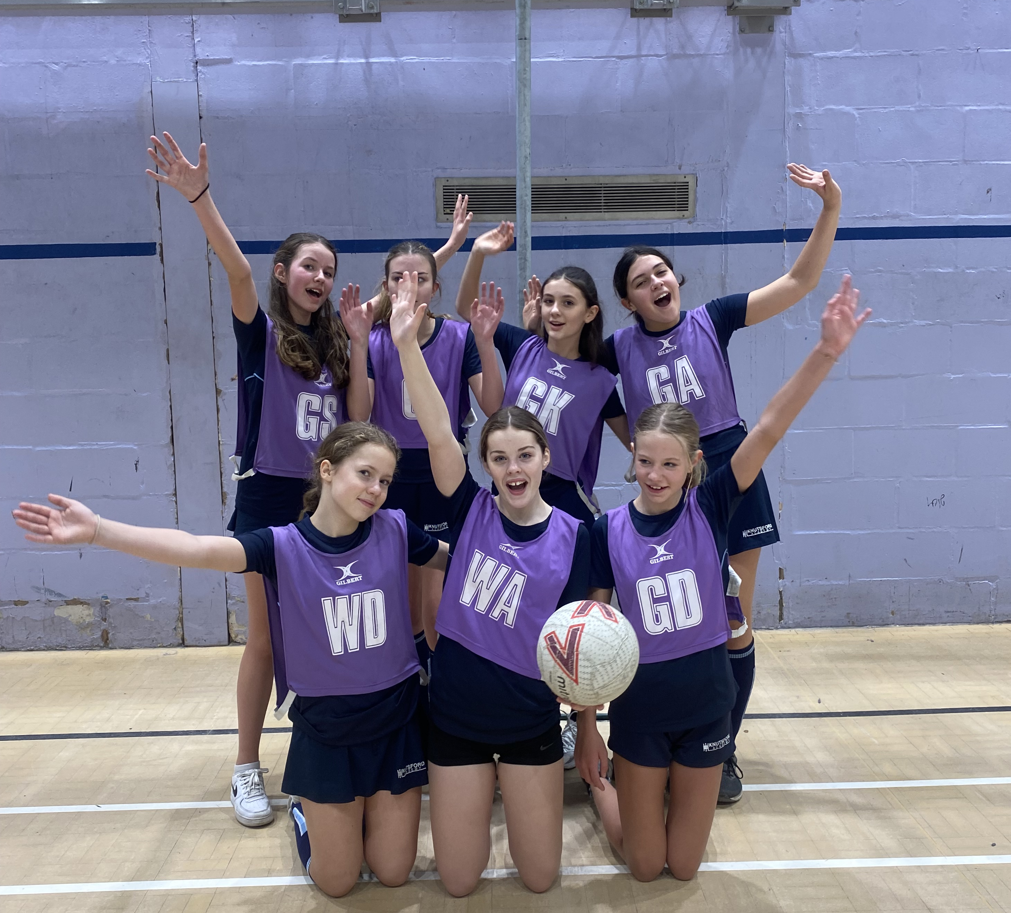
Physical Education
In PE, students have been participating in trampolining, fitness and rugby.
Lots of success for Year 8 in:
Cross Country
Football
Hockey
Netball.
We have loved seeing so many attend after school basketball, badminton and self-defence too!

Slide 20
Science
🔬 Scientists of the future! 🚀
Year 8 are on an incredible journey through the wonders of science, uncovering the secrets of the world around (and inside) them!
🦴 The marvel of organisms – The have explored the astonishing human skeleton, a true masterpiece of nature that gives us support, protection, and movement—and even works as a blood cell factory to keep us alive and thriving!
💨 The mysteries of matter – They have unlocked the power of particles in motion, discovering how scents travel through the air and how oxygen spreads through your lungs. Whether its popcorn filling a room or life-giving breath, these invisible particles shape our world!
🔥 The energy of the Universe – They have dived into the science of heat and temperature, uncovering the science of thermal equilibrium and what controls the rate of cooling — from snuggly winter coats to the cutting-edge technology of spacecraft!

Slide 21
What is next for Year 8?

Slide 22
Key Dates
Thursday 15th May = Year 8L Parents Evening
Thursday 22nd May = Year 8R Parents Evening
Monday 9th – Friday 13th June = Year 8 Exams

Slide 23
How can you support your child?
At Knutsford Academy, we promote a Study Skills Curriculum.
The following strategies are being explicitly taught to improve students' ability to study independently, revise effectively and remember more.
At Key Stage 3
Flash Cards
Mind maps
Dual Coding

Slide 24
How can you support your child?
Encoding
The Classroom
Our Working Memory
Our Long-Term Memory
In lessons students are given lots of knowledge to store in our working memory.
The working memory is much smaller than the long-term memory, so we need to learn it (encoding) to move it into the long-term memory.

Slide 25
Flashcards
Work well for things you must memorise such as:​
Definitions of keywords​
Important dates​
Equations​
Names of equipment/parts of a diagram ​
Quotes​
A great way to summarise your work so that somebody can test you
Easy to take with you when you go places
Can be used as a question or as a prompt
Health Check: You can buy ready-made flash cards – but making the flash card is an important part of the revision strategy!

Slide 26
How do we make and use flashcards?
Q&A
Big Writing
Readable in a ‘FLASH’
General Topic
Summary of a topic
Key words or short sentences
Bullet points
Health Check: Keep it simple; one card, one piece of information

Slide 27
Mind Maps
A great way to find the gaps in knowledge
They help with longer process that you need to remember
They link key words and ideas
Fact 1
Fact 2
Mind Maps
They help explain/break down ideas or concepts
Fact 3
Titles
They organise facts visually
Key Words
Colours, diagrams and position can help
Examples

Slide 28
How do we make and use mind maps?
Have everything you need to revise for that topic.
Think about how you want to lay this out.
Split the page into the sections you want
Think about using colours or capitals for key words

Slide 30
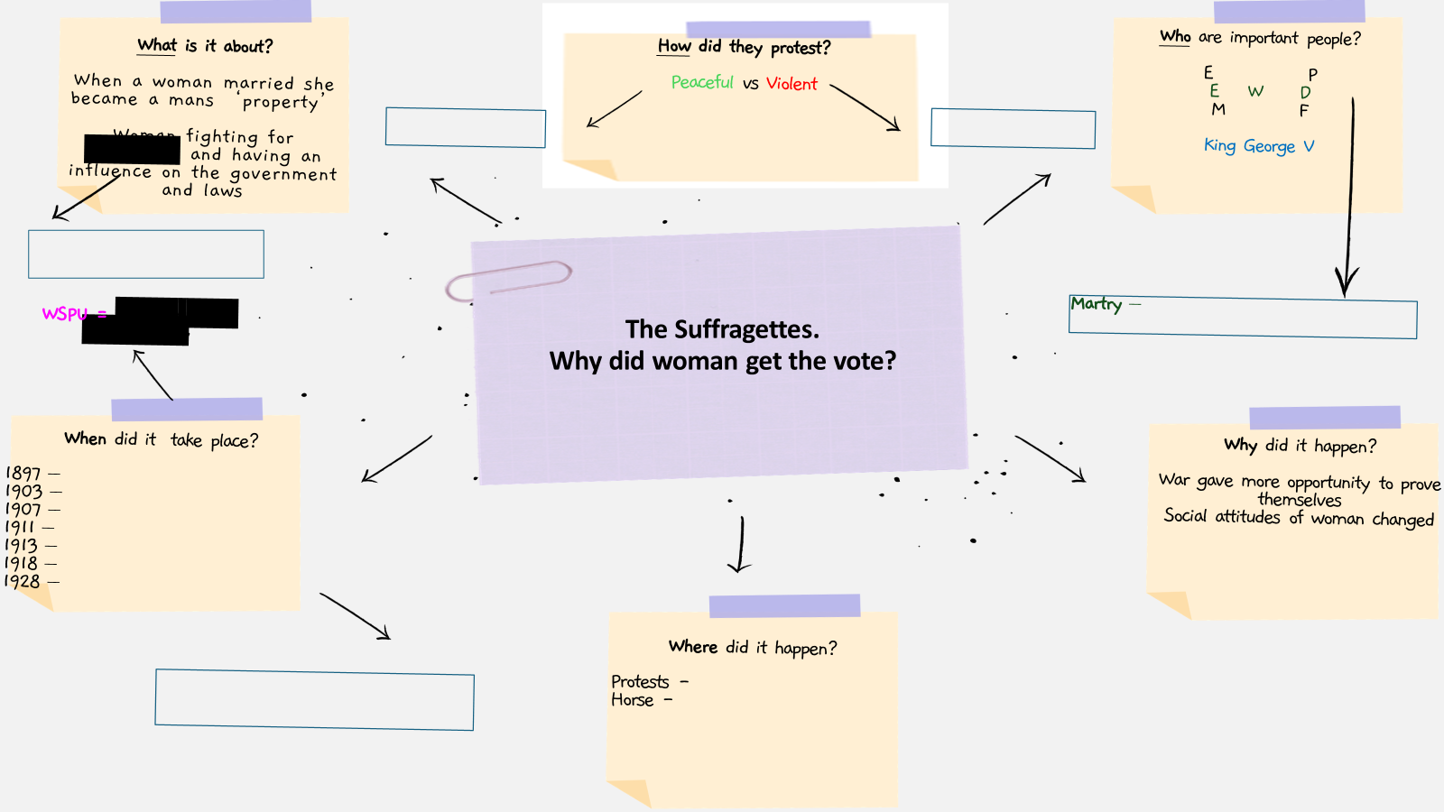

Slide 32
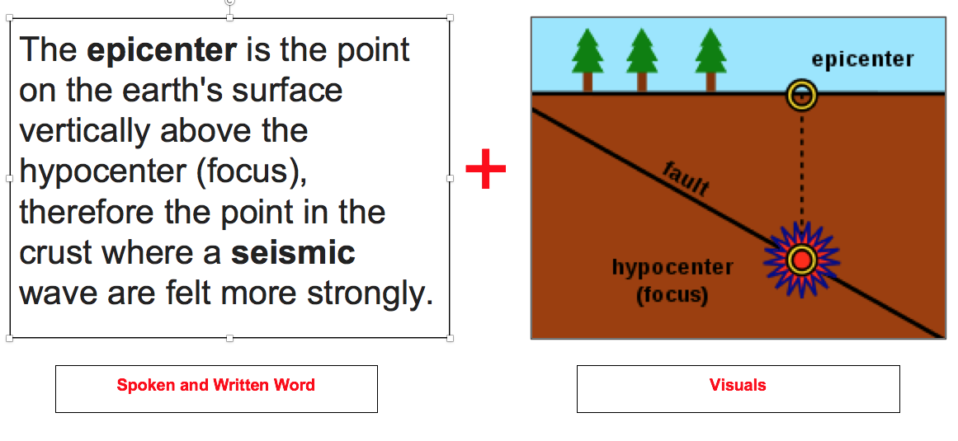
Dual Coding
Dual Coding is the process of blending words and pictures whilst learning.
Teachers will use it all the time!
Your visual and verbal pathways to the brain are not the same, and so supplementing them together allows us to create a different pathway that is ‘dual coded’.

Slide 33
Dual Coding
Dual coding speeds up the process of moving information to the long-term memory by using more pathways.
Dual Coded
The Classroom
Our Long-Term Memory

Slide 34
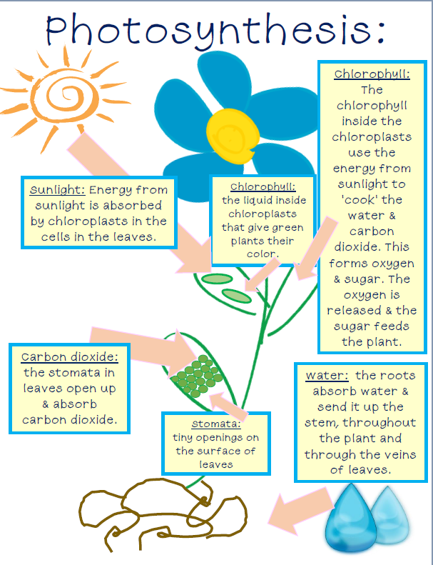
How do we use dual coding?
Read over classroom materials.
Use relevant images to support key words
Use students words to make connections to the visuals.
Health Check: Don’t draw any old picture.
The diagram must relate to the words

Slide 35
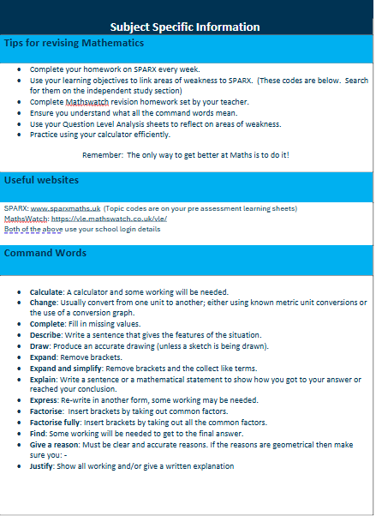
Key Stage 3 Revision Guide
Your child will be revisiting these strategies next half term.
A booklet of key revision information will be shared in this lesson.
Command words will be introduced to your child. These are important words that they should know, understand and be able to use in an examination.
Top tips will also be included for each subject.

Slide 36
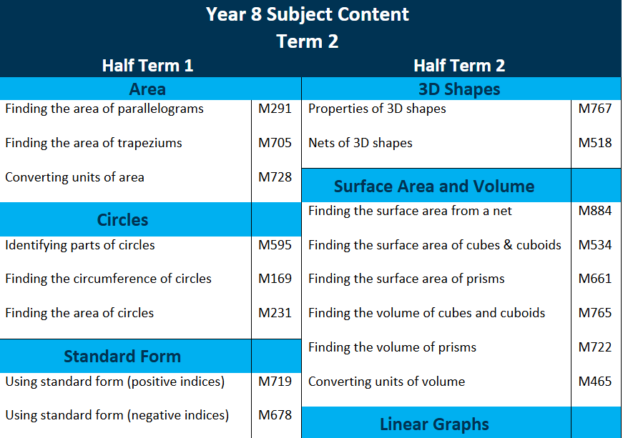
How else can you support your child?

Slide 37
Thank you
We hope that you have found that information useful.
We look forward to seeing you again at Parents Evening.
For any more information about anything we have discussed, please visit our website:
www.knutsfordacademy.org.uk

