Slide 1
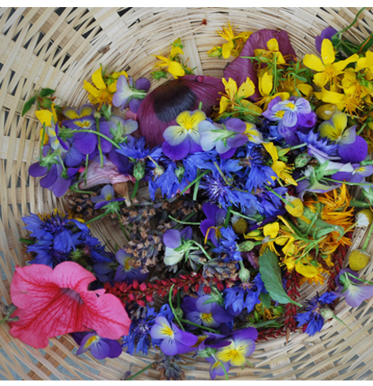
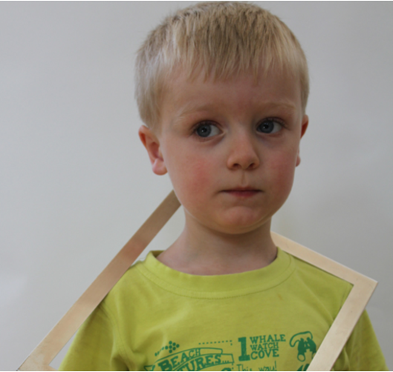
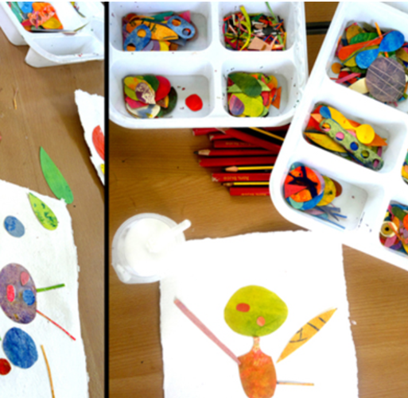








Laceby Acres Primary Academy Art Big Ideas –EYFS-Phase 1
Autumn Term
Spring Term
Summer Term
Understanding Identity and Exploring Relationships
Exploring the Power of Creativity
Exploring the Natural World
Select/collect examples
Art
Vocabulary
Fine motor skills
Observation
Share views and opinions
Similarities &
differences
Emotions
Technique
Generating ideas
Making
Evaluating
Visual
Language
Exploration
Cause and consequence
Different versions
Ask & answer questions
Similarities &
differences
Sources of evidence created by the greats
Drawing and sketchbooks
Print, colour and collage
Working in three dimensions
Collaboration and community
Paint, surface and texture

Slide 2
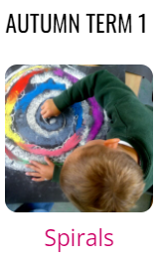
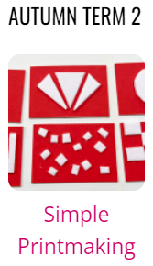
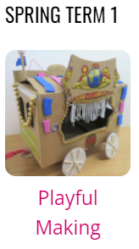

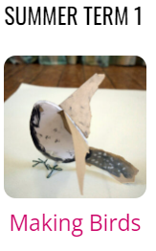
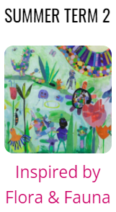
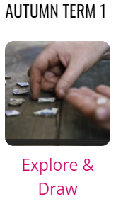

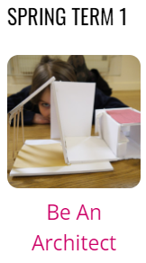

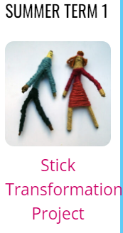

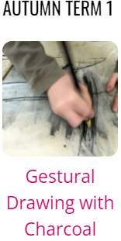





Laceby Acres Primary Academy Art Big Ideas- Phase 2
Select/collect examples
Art
Vocabulary
Fine motor skills
Observation
Share views and opinions
Similarities &
differences
Emotions
Evaluating
Technique
Generating ideas
Exploration
Making
Different versions
Sources of evidence created by the greats
Ask & answer questions
Visual
Language
Similarities &
differences
Cause and consequence
Paint, surface and texture
Drawing and sketchbooks
Print, colour and collage
Working in three dimensions
Collaboration and community

Slide 3
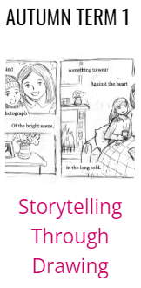







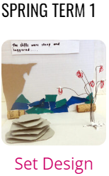
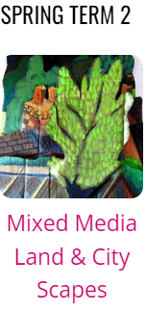


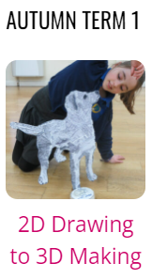





Laceby Acres Primary Academy Art Big Ideas- Phase 3
Select/collect examples
Visual
Language
Fine motor skills
Observation
Share views and opinions
Similarities &
differences
Ask & answer questions
Exploration
Evaluating
Technique
Generating ideas
Making
Sources of evidence created by the greats
Art
Vocabulary
Similarities &
differences
Cause and consequence
Emotions
Different versions
Paint, surface and texture
Drawing and sketchbooks
Print, colour and collage
Working in three dimensions
Collaboration and community

Slide 4



















Laceby Acres Primary Academy Art Long Term Plan
Year Groups | Autumn 1 | Autumn 2 | Spring 1
Reception
Year 1
Year 2
Year 3
Year 4
Year 5
Year 6
Middlethorpe Primary Academy History Long Term Plan

Slide 5


















Laceby Acres Primary Academy Art Long Term Plan
Year Groups | Spring 2 | Summer 1 | Summer 2
Reception
Year 1
Year 2
Year 3
Year 4
Year 5
Year 6
Middlethorpe Primary Academy History Long Term Plan

