Slide 1
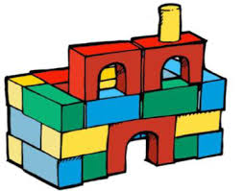
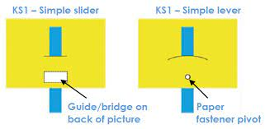
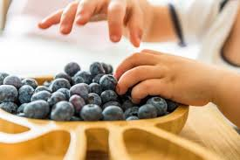
Laceby Acres Primary Academy Design and Technology Big Ideas – Year One
Autumn Term
Free Standing Structures
Spring Term
Mechanisms
Sliders and Levers
Summer Term
Cooking and Nutrition
Preparing Fruit and Vegetables
‘Something, Somebody, Some Purpose’
Body of knowledge and understanding specific to Design and Technology
Generate, develop, model and communicate ideas
Select from a range of tools, materials and components
Making increasingly sophisticated judgements about their own ideas and products against design criteria
Where does food come from? How is it grown, reared or caught? Seasonality?
Technical Knowledge
Designing
Making
Evaluating
Cooking and Nutrition
through …
Develop practical skills and techniques, working with increasing accuracy
e.g. in KS1 children refer to what their product should do, who it is for and how it will work
Healthy Eating
Preparing and Cooking Safely and Hygienically,
Using a Range of Techniques.
e.g. children in KS1 know that free standing structures can be made stronger, stiffer and more stable
Speaking, drawings, templates, mock-ups, prototypes and pattern pieces
Six Design and Technology Principles
User
Purpose
Functionality
Design Decisions
Innovation
Authenticity
Pupils should have a clear idea of who they are designing and making products for, considering their needs, wants, values, interests and preferences. The intended users could be themselves or others, an imaginary or story-based character, a client, a consumer or specific target group
Pupils should be able to clearly communicate the purpose of the products they are designing and making. Each product they create should be designed to perform one or more defined tasks. Pupils’ products should be evaluated through use.
Pupils should design and make products that work/function effectively in order to fulfil users’ needs, wants and purposes.
Pupils need opportunities to make their own design decisions. Making design decisions allows pupils to demonstrate their creative, technical and practical expertise, and draw on learning from other subjects. Through making design decisions pupils decide on the form their product will take, how their product will work, what task or tasks it will perform and who the product will be for.
When designing and making, pupils need some scope to be original with their thinking. Projects that encourage innovation lead to a range of design ideas and products being developed and are characterised by engaging openended starting points for learning.
Pupils should design and make products that are believable, real and meaningful to themselves and others

Slide 2
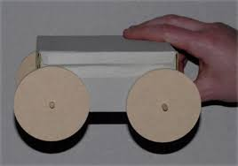
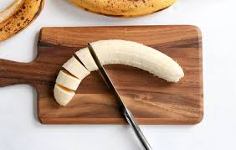
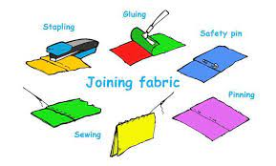
Laceby Acres Primary Academy Design and Technology Big Ideas – Year Two
Autumn Term
Mechanisms
Wheels and Axles
Summer Term
Textiles
Templates and Joining Techniques
Spring Term
Cooking and Nutrition
Preparing Fruit and Vegetables
‘Something, Somebody, Some Purpose’
Body of knowledge and understanding specific to Design and Technology
Generate, develop, model and communicate ideas
Select from a range of tools, materials and components
Making increasingly sophisticated judgements about their own ideas and products against design criteria
Where does food come from? How is it grown, reared or caught? Seasonality?
Technical Knowledge
Designing
Making
Evaluating
Cooking and Nutrition
through …
Develop practical skills and techniques, working with increasing accuracy
e.g. in KS1 children refer to what their product should do, who it is for and how it will work
Healthy Eating
Preparing and Cooking Safely and Hygienically,
Using a Range of Techniques.
e.g. children in KS1 know that free standing structures can be made stronger, stiffer and more stable
Speaking, drawings, templates, mock-ups, prototypes and pattern pieces
Six Design and Technology Principles
User
Purpose
Functionality
Design Decisions
Innovation
Authenticity
Pupils should have a clear idea of who they are designing and making products for, considering their needs, wants, values, interests and preferences. The intended users could be themselves or others, an imaginary or story-based character, a client, a consumer or specific target group
Pupils should be able to clearly communicate the purpose of the products they are designing and making. Each product they create should be designed to perform one or more defined tasks. Pupils’ products should be evaluated through use.
Pupils should design and make products that work/function effectively in order to fulfil users’ needs, wants and purposes.
Pupils need opportunities to make their own design decisions. Making design decisions allows pupils to demonstrate their creative, technical and practical expertise, and draw on learning from other subjects. Through making design decisions pupils decide on the form their product will take, how their product will work, what task or tasks it will perform and who the product will be for.
When designing and making, pupils need some scope to be original with their thinking. Projects that encourage innovation lead to a range of design ideas and products being developed and are characterised by engaging openended starting points for learning.
Pupils should design and make products that are believable, real and meaningful to themselves and others

Slide 3

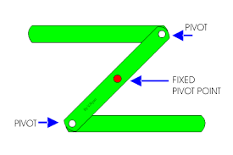
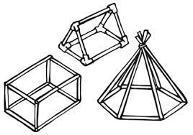
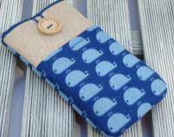
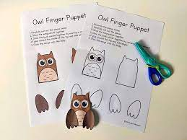
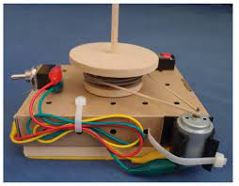
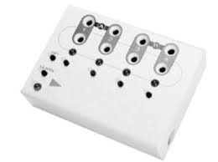
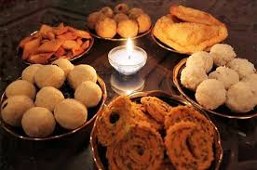
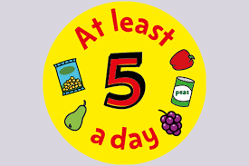
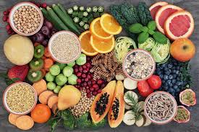
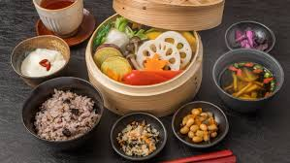
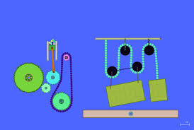
Laceby Acres Primary Academy Design Technology Big Ideas- KS2
Y3
Y4
Y5
Y6
Structures
Shell Structures
Mechanical Systems
Levers and Linkages
Structures
Frame Structures
Textiles
Combining Different Fabric Shapes
Textiles
2D Shapes to 3D Products
Electrical Systems
Programming and Control
Electrical Systems
More Complex Switches and Circuits
Cooking and Nutrition
Celebrating Culture and Seasonality
Cooking and Nutrition
A Healthy Varied Diet
Cooking and Nutrition
A Healthy Varied Diet
Cooking and Nutrition
Celebrating Culture and Seasonality
Mechanical Systems
Pulleys and Gears
Body of knowledge and understanding specific to Design and Technology
Generate, develop, model and communicate ideas
Select from a range of tools, materials and components
Making increasingly sophisticated judgements about their own ideas and products against design criteria
Where does food come from? How is it grown, reared or caught? Seasonality?
Technical Knowledge
Designing
Making
Evaluating
Food and Nutrition
e.g. in UKS2 children should know how mechanical systems such as cams, pulleys or gears create movement
through …
Healthy Eating
Preparing and Cooking Safely and Hygienically,
Using a Range of Techniques.
Speaking, drawings, templates, mock-ups, prototypes and pattern pieces
Develop practical skills and techniques, working with increasing accuracy
e.g. in KS1 children refer to what their product should do, who it is for and how it will work
Six Design and Technology Principles
User Purpose Functionality Design Decisions Innovation Authenticity
Pupils should have a clear idea of who they are designing and making products for, considering their needs, wants, values, interests and preferences. The intended users could be themselves or others, an imaginary or story-based character, a client, a consumer or specific target group.
Pupils should be able to clearly communicate the purpose of the products they are designing and making. Each product they create should be designed to perform one or more defined tasks. Pupils’ products should be evaluated through use.
Pupils should design and make products that work/function effectively in order to fulfil users’ needs, wants and purposes.
Pupils need opportunities to make their own design decisions. Making design decisions allows pupils to demonstrate their creative, technical and practical expertise, and draw on learning from other subjects. Through making design decisions pupils decide on the form their product will take, how their product will work, what task or tasks it will perform and who the product will be for.
When designing and making, pupils need some scope to be original with their thinking. Projects that encourage innovation lead to a range of design ideas and products being developed and are characterised by engaging open ended starting points for learning.
Pupils should design and make products that are believable, real and meaningful to themselves and others.

Slide 4





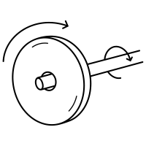






Laceby Acres Primary Academy Design and Technology Long Term Plan
Year Groups | Autumn 1 | Autumn 2 | Spring 1 | Spring 2 | Summer 1 | Summer 2
Reception
Year 1
Year 2
Year 3
Year 4
Year 5
Year 6
Structures
Junk Modelling
Mechanisms
Christmas Cards
Textiles
Shadow Puppets
Structures
Scarecrows
Cooking and Nutrition
Celebrating Culture
Cooking and Nutrition
Summer Food
Structures
Free Standing
Mechanisms
Sliders and Levers
Cooking and Nutrition
Preparing Fruit and Vegetables
Mechanisms
Wheels and Axles
Cooking and Nutrition
Preparing Fruit and Vegetables
Textiles
Templates and Joining Techniques
Structures
Shell Structures
Textiles
2D Shapes to 3D Products
Cooking and Nutrition
A Healthy Varied Diet
Mechanical Systems
Leavers and Linkages
Electrical Systems
Programming and Control
Cooking and Nutrition
A Healthy Varied Diet
Middlethorpe Primary Academy History Long Term Plan
Structures
Frame Structures
Electrical Systems
More Complex Switches and Circuits
Cooking and Nutrition
Celebrating Seasonality and Culture
Textiles
Combining Different Fabric Shapes
Cooking and Nutrition
Celebrating Seasonality and Culture
Mechanical Systems
Pulleys and Gears

