Slide 1






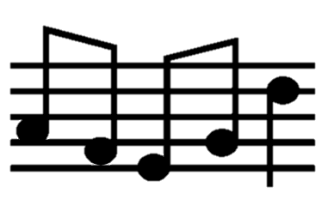

















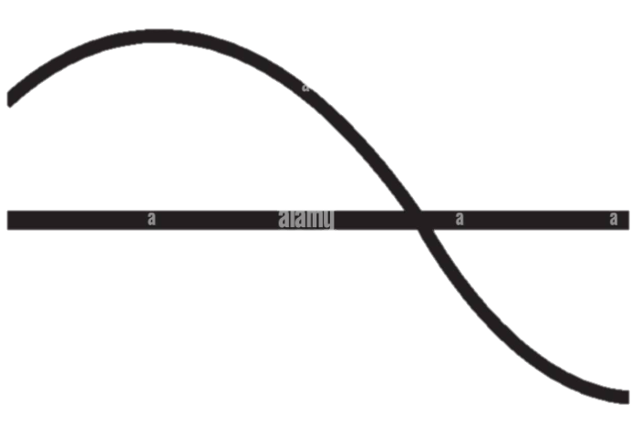










Laceby Acres Primary Academy Music Big Ideas
Build an Overview
Togetherness
Past Connections
World Music
Community
Music of Life
Environment
Beat
Rhythm
Pitch
Tempo
Dynamics
Pulse
Improv
Patterns
Feelings
Stories
Dance
Notation
Compose
Sharing
Style
Time
Combine
Melody
Tech
Chords
Structure
Perform
Methods of Enquiry
body percussion
improvisation
analyse
rehearse
rhyme
rehearse
perform
rap
Musicianship
Creating
Listening
Singing
Performing
Playing
instruments
voices
chant
create
record
composing
respond
choir
present

Slide 3



Laceby Acres Primary Academy
Music Long Term Plan
Year Groups | Autumn 1 | Autumn 2 | Spring 1 | Spring 2 | Summer 1 | Summer 2
EYFS
Year 1
Year 2
Year 3
Year 4
Year 5
Year 6
Middlethorpe Primary Academy History Long Term Plan

