Slide 1
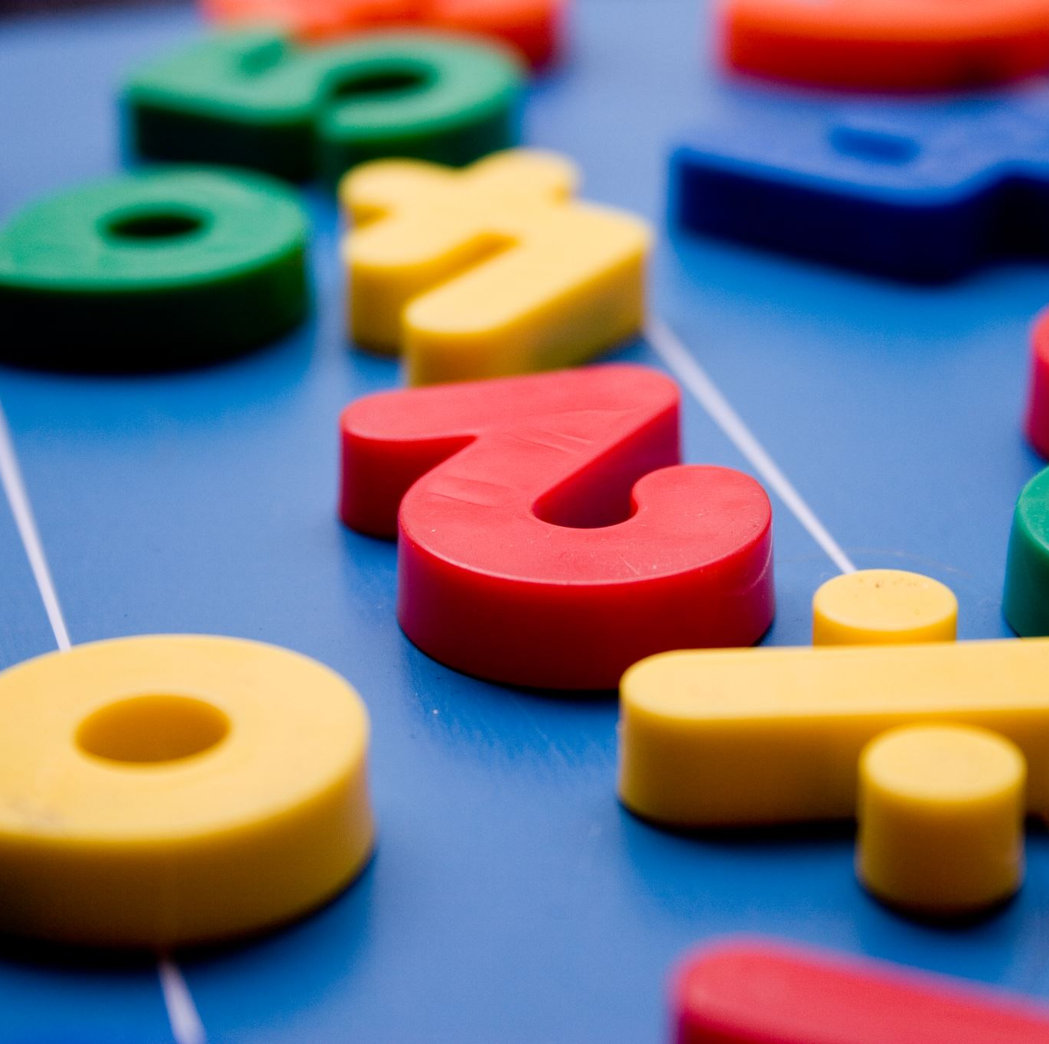

Maths workshop- March 2024
Beautiful Mistakes
Fluency in maths
Mental Strategies
Spend time with your child looking at maths

Slide 2

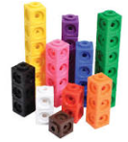
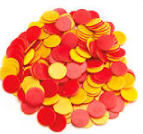
But firstly…
Thank you!
Number fun day- half the money raised helped to buy resources for the teaching of maths.

Slide 3
Beautiful mistakes…
A display that promotes ‘beautiful mistakes’ as a good thing (e.g. 10+4=104, put on post-it and add to display with quick explanation of error) – who made the best mistake this week?
Promoting ‘trial and improvement’. If children know we expect them to try things out, make mistakes and then try again, their perception of the costs of failure will likely change.

Slide 4
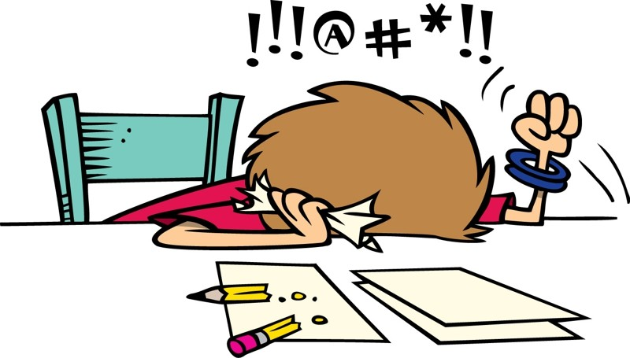

Is this us?
I can’t do maths!?!!
We can’t do maths!!

Slide 5
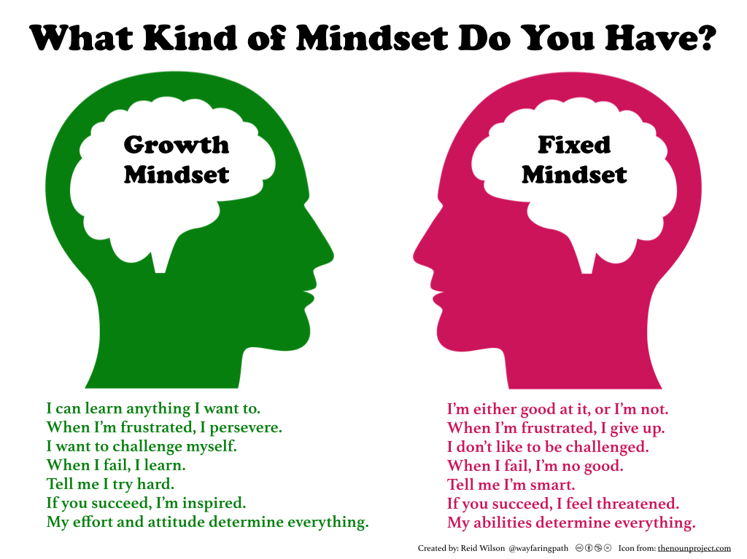

Slide 6
A few mind shifting tips for cultivating a growth mindset at home
AVOID LABELS
Don’t label yourself in ways that model a ‘fixed mindset’ (e.g. I’m a terrible cook….I was never good at Maths)
HELP CHILDREN GET CURIOUS ABOUT MISTAKES
Help them reframe a mistake as new information or as a step in the process of learning. Self-correct.
HELP CHILDREN TALK BACK TO NEGATIVE SELF-TALK WITH A GROWTH MINDSET VOICE
e.g I get better and better with practise. This is hard, but will get easier with practise.
GET CURIOUS ABOUT YOUR CHILD’S WORK THROUGH QUESTIONS
How did you figure that out? What’s another way you could have done that? What could you try differently next time?
HELP CHILDREN LEARN TO HEAR THEIR OWN FIXED MINDSET ‘VOICE’
Some examples: “That guy is brilliant; he never tries and he gets it” “I got it wrong again, I’ll never get this.”
Some children don’t even realise how fixed their mindset can be. Discuss and challenge their opinions and attitudes.

Slide 7
Next steps in maths…
What we have noticed…
Excellent maths results (above national)
Group of children who find fluency in maths challenging
Counting on fingers
Using long written methods to work out quick mental questions

Slide 8
So what did we do…
Number Fun training with Dave Godfrey
Rapid recall- what are the key facts we want children to know and remember- Fluency
Extra maths sessions aside from the main maths lesson with a focus on rapid recall/mental calculation
Introduced different strategies for mental recall

Slide 9

Exploring
FLUENCY
Notes:
Study the progression grid:

Slide 10
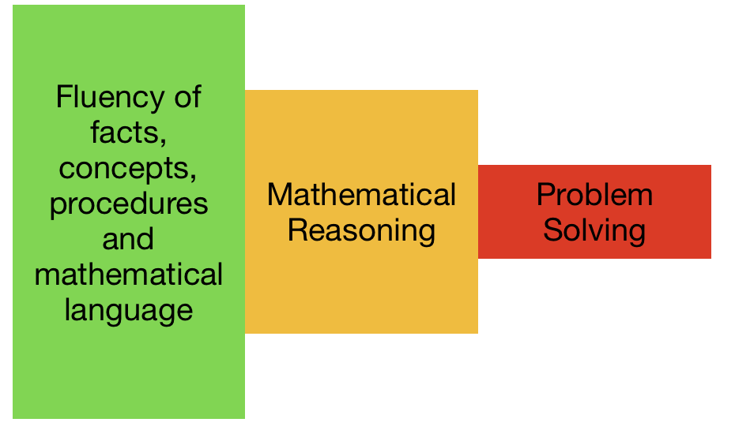
The three aims of the mathematics NC

Slide 11
Defining fluency (Russel, 2000)
Efficiency
Accuracy
Flexibility
Notes:
Read Russell article

Slide 12
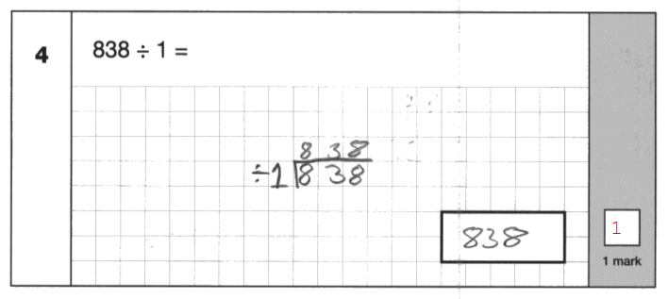
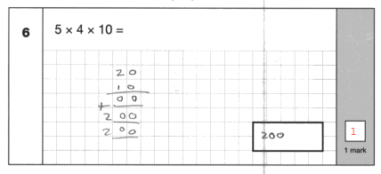
Efficiency?

Slide 13
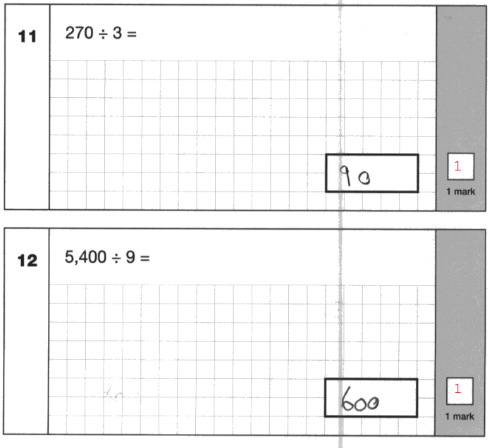
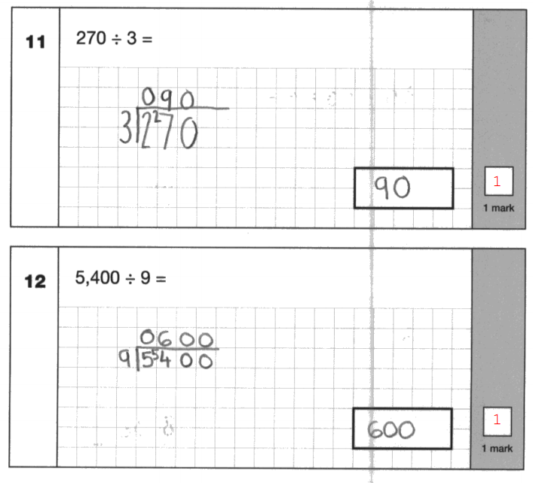
Two children with the same score (38/40):

Slide 14
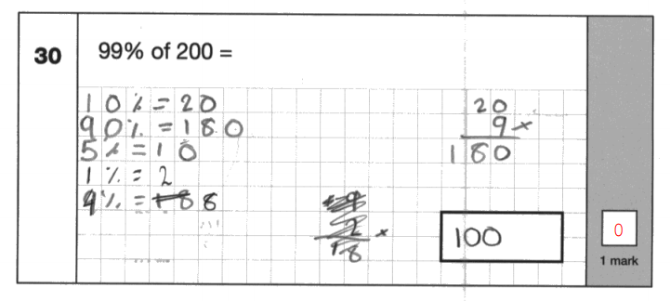
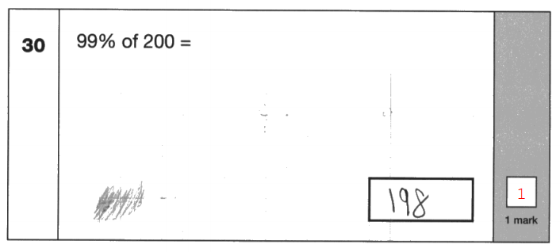
Two children with the same score (38/40):

Slide 15

Rapid recall
Please see leaflet
3 minute maths- see sheet- Homework

Slide 16
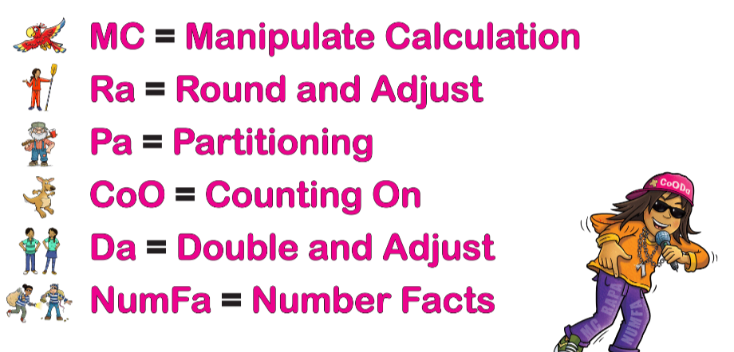
Mental Strategies

Slide 17
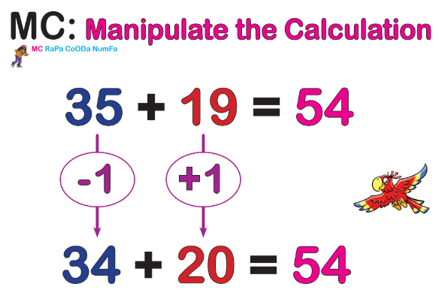

Slide 18
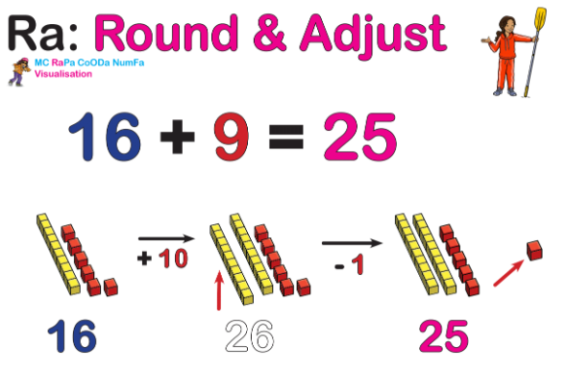

Slide 19
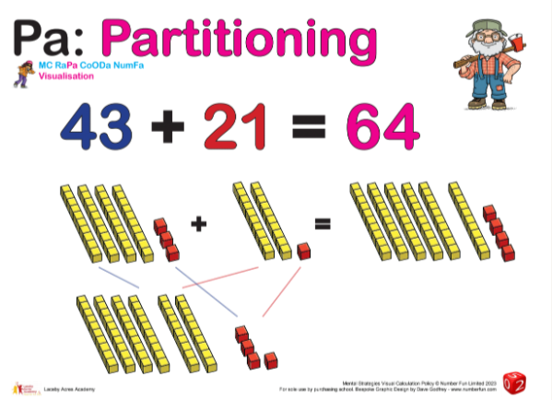

Slide 20
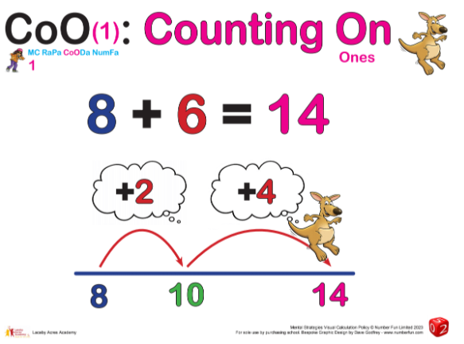

Slide 21
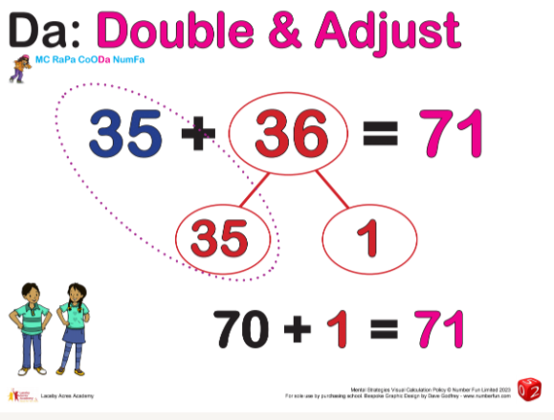

Slide 22
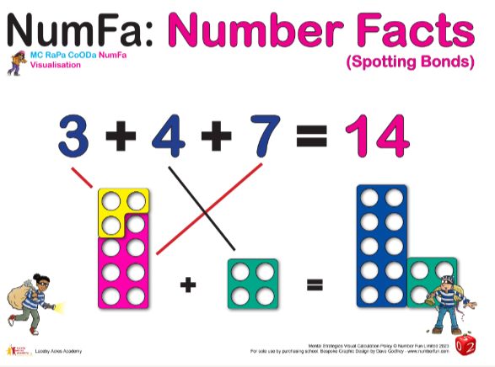

Slide 23
Maths in class
A chance to join in a typical maths activity to change the perception of maths
A chance to look at your child’s maths book and see what they have been learning so far.
A chance to look at the maths working wall for model and images.
An opportunity to talk with the class teacher about maths for your child

Slide 24
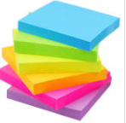
Post It notes…
Please write down any feedback or questions you have linked to maths, growth mind-set and making mistakes.
Please feel free to suggest things you would like us to try in school.

