Slide 1


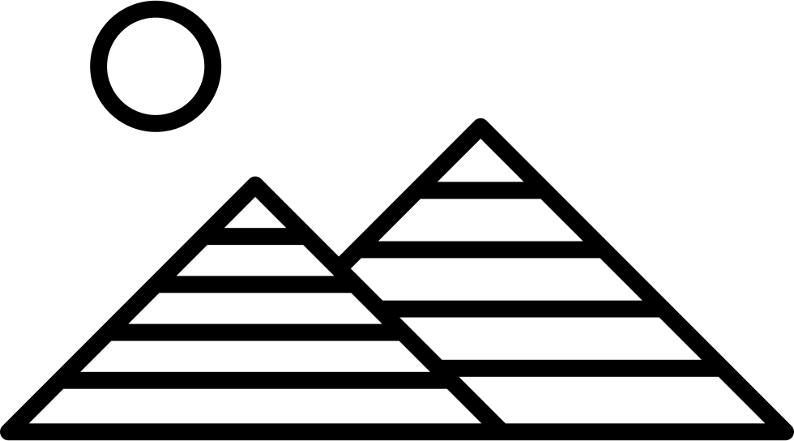





Y4: Unit 1: Ancient Egypt – How much did the Ancient Egyptians Achieve?
Unit 2: Roman Britain
National Curriculum Objectives |  | Substantive Knowledge |  |  |  | Vocabulary
Study the achievements of the earliest civilisations Develop a chronologically secure knowledge and understanding of British, local and world history Identify connections, contrasts and trends over time Develop the use of historical terms Understand how our knowledge of the past is constructed from a range of sources Address and devise historically valid questions about similarity, difference and significance Construct informed responses that involve thoughtful selection and organisation of relevant historical information. |  | Know that there were three ley periods in Ancient Egypt; the Old Kingdom: 2649–2150 BC, Middle Kingdom: 2134–1783 BC and New Kingdom: 1550–1070 BC. Know that during this period three other ancient civilisations existed; the Sumer (3200 BC to 1792 BC), the Indus Valley (2600 BC to 1900 BC) and the Shang Dynasty (1760 BC to 1046 BC). Know that we understand more about Ancient Egypt due to plenty of evidence about who they were and how they lived. Know that the River Nile at 4,187 miles/6,738 kilometres long and how and where it is formed. Know that The River Nile was important as it provided the Egyptians with fresh water to sustain the life of many Egyptians. Know that the Egyptians worshipped the god of the Nile (Hapy), and made sacrifices to him to ensure the waters rose every year. Know that The Rosetta Stone was found in 1799 by French Soldiers and is named after the place it was found. Know that it is a huge slab of black granite weighing 762 kg. It is 28 cm thick, 114 cm high and 72 cm wide. Know that the hieroglyphs on the stone were translated and referred to Ptolemy V, a King from Ancient Egypt. Know that in 1815 the stone was brought to the British Museum in London where it can still be seen today. Know that it was a significant archaeological discovery as it showed writing and communication within a society. Know that Book of the Dead is also in the British Museum and contains texts made up of spells and magic to protect the dead in the afterlife. Know that in 1922 the archaeologist Howard Carter discovered the tomb of the pharaoh Tutankhamun in the Valley of the Kings. Know that the dig was funded by Lord Carnarvon and that it took seven years to find the tomb. Know that the discovery was significant because the seal to the tomb was intact meaning it had not be raided by grave robbers. Know that Carter found around 5,000 untouched artefacts in the tomb and this caused great excitement. Know that the discovery told historians about society in Ancient Egypt around the time of King Tuts rule. Know that some people think that it was unfair to remove the artefacts from Egypt and they should be returned. Know that agriculture was a vital part of Ancient Egyptian economy and the Nile valley was fertile soil for growing crops. Know that the River Nile provided a regular water supply. However, care had to be taken to avoid the land flooding, and irrigation had to be used to ensure the water reached the crops. Know that farmers faced many problems such as flash flooding and plagues of insects, which could easily destroy their crops. Know that the Ancient Egyptians grew many different crops, including emmer wheat for bread and barley for beer. Know that farming was important for society to function and that different groups had a role to play to achieve a well-ordered society. Know that a pyramid was a tomb to hold the body of a dead pharaoh and that they had previously been built with flat top. Know that the earliest pyramid is the Step Pyramid at Saqqara, which was built for King Djoser in 2650 BC. Know that the most well-known is the Great Pyramid of Khufu (Also known as the Great Pyramid of Giza). Know that it was built around 2589–2566 BC, and that between 20,000 and 30,000 people were employed to build the pyramid. Know that earlier theories that slaves built the pyramids are now dismissed, and it is thought that mainly farm labourers built the pyramids during the flooding season. Know that The Book of the Dead was a collection of magic spells placed in the tombs of wealthy people to give them a safe journey to the afterlife. Osiris was the ruler of the land of the dead and would welcome every person into the Field of Reeds (the afterlife) Know that Osiris’ brother Set murdered him and Osiris’ body was embalmed and restored which led to the belief in mummification. Know that every person had to have their heart weighed against the feather of Maat (the goddess of justice and truth). Know the word ‘mummy’ is from the Arab word for bitumen. This is a black tarry substance because the mummies looked blackened. Know that the mummification process was important to Egyptians as they believed only a preserved soul could make the journey to the afterlife. |  |  |  | Ancient, civilisation, fertile, shaduf, irrigation, achievement, hieroglyph, archaeologists, cartouche, antiquities, scribes, society, seals, sarcophagus, excavation, inscription, papyrus, mummification, role, achievement, hierarchy, priest, farmer, agriculture, scribe, pharaoh, pyramid, engineering, technology, stonemason, ramp, construction, lever, sphinx, creation, mummification, canopic jar, shabti, time capsule.
 |  |  |  |  |  | Key People | Linked Texts
 |  |  |  |  |  | Akhenaten Hapy Jean-Francois Champollion Ptolemy V Howard Carter Tutankhamun Lord Carnarvon Sir Ernest A. T. Wallis Budge | The Time Travelling Cat and the Egyptian Goddess by Julia Jarman The Egyptian Cinderella by Shirley Climo Secrets of a Sun King by Emma Carrol Ancient Egypt by Rachel Minay (The History Detective Investigates) Ancient Egypt by Anita Ganeri (Writing History)
Future Learning
Year 6 Unit 1: The Maya Civilisation – Why should we remember the Maya? Year 6 Unit 2: The Ancient Greeks – What did the Greeks do for us?
 |  |  |  |  |  | Disciplinary Knowledge
 |  |  |  |  |  | To be able to order a timeline related to Ancient Egyptian and similar civilisations. To be able to identify main sources of archaeological evidence about Ancient Egypt and their significance. To be able to ask and answer historically valid questions about the achievements that shaped Ancient Egypt. To be able to identify the significant discoveries that led to the understanding of Ancient Egyptian civilisation.
Teaching Ideas
Historical Enquiry Interpret Historically | Historical Enquiry Interpret Historically |  | Historical Enquiry Understand Chronology | Communicate Historically Interpret Historically | Historical Enquiry Understand Chronology |  | Understand Chronology Communicate Historically
Why were people able to prosper in the desert land of Ancient Egypt? | Why do we know so much about the Ancient Egyptians and their achievements? |  | Why do we know so much about the Ancient Egyptians and their achievements? | How did different groups of people contribute to the achievements of Ancient Egyptian society? | What can we learn about the Ancient Egyptians from the Great Pyramid? |  | Are you surprised by Ancient Egyptian religion?
How much did the Ancient Egyptians achieve?

