Slide 1
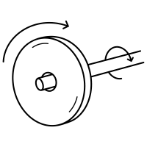
Laceby Acres Primary Academy Design and Technology Plan Summary
Year Groups | Autumn 1 | Autumn 2 | Spring 1 | Spring 2 | Summer 1 | Summer 2
Reception
Year 1
Year 2
Year 3
Year 4
Year 5
Year 6
Structures
Junk Modelling
Mechanisms
Christmas Cards
Textiles
Shadow Puppets
Structures
Scarecrows
Cooking and Nutrition
Celebrating Culture
Cooking and Nutrition
Summer Food
Structures
Free Standing
Mechanisms
Sliders and Levers
Cooking and Nutrition
Preparing Fruit and Vegetables
Mechanisms
Wheels and Axles
Cooking and Nutrition
Preparing Fruit and Vegetables
Textiles
Templates and Joining Techniques
Structures
Shell Structures
Textiles
2D Shapes to 3D Products
Cooking and Nutrition
A Healthy Varied Diet
Mechanical Systems
Leavers and Linkages
Electrical Systems
Programming and Control
Cooking and Nutrition
A Healthy Varied Diet
Middlethorpe Primary Academy History Long Term Plan
Structures
Frame Structures
Electrical Systems
More Complex Switches and Circuits
Cooking and Nutrition
Celebrating Seasonality and Culture
Textiles
Combining Different Fabric Shapes
Cooking and Nutrition
Celebrating Seasonality and Culture
Mechanical Systems
Pulleys and Gears

