Slide 1
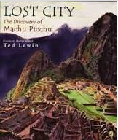
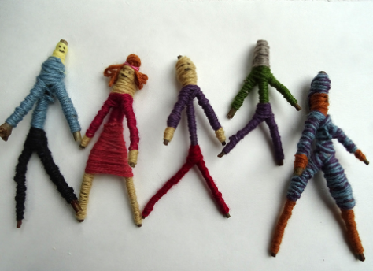
Geography Focus- Our Wonderful World. Enquiry Question: What are the wonders of our world? | Year 2 – The Day the Crayons Quit. | The Curriculum – Threshold Concepts
Geography: • Name, locate and identify characteristics of the seven continents and oceans. • Use world maps, atlases and globes. • Understand geographical similarities and differences when studying both human and physical geography. • Identify the locations of hot and cold areas around the world. • Use basic vocabulary to refer to physical and human features. • Develop knowledge about the world. Science Animals including Humans. . Notice that animals, including humans, have offspring which grow into adults. • Find out about and describe the basic needs of animals, including humans, for survival (water, food and air). • Describe the importance for humans of exercise, eating the right amounts of different types of food, and hygiene. | English focus test: Extended writing outcomes: The children will produce a persuasive letter addressed to the children in a year 2 classroom from the perspective of a piece of stationary that the children do not use well /treat with respect. Link Reading: Maths – White Rose Fractions, Time, Statistics and Position and Direction. | P.E: Striver- Tag Rugby I.C.T: Taking and using photos. RE: Religion: Judaism Theme- The Covenant Key Question: How special is the relationship Jews have with God? PSHE: Jigsaw: Relationships. Music: Music Express. Weather and Pattern. MFL: Language Angels. Los animales (The animals)
 |  | The Curriculum: Access Art Pathway- Stick Transformation Project In this pathway children are enabled to use their imagination and transform a familiar object (a stick) into new forms. DT: Textiles. Templates and Joining Techniques.

