Slide 1
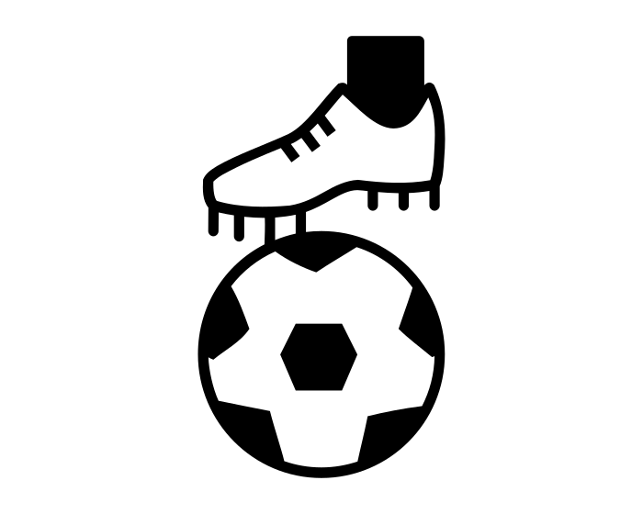
Laceby Acres Primary Academy Physical Education Big Ideas
Sports, activities and games.
Gymnastics
Dance
Athletics
Jumping
Athletics
Running
Athletics
Throwing
Football
Hockey
Basketball and Handball
Tag Rugby
The Four Aspects of Physical Education.
Balancing
Movement
Running
Handball
Basketball
Jumping
Throwing
Dance
Games
Gymnastics
Athletics
Football
Routines and sequences
Strength
Performance and appreciation
Choreography
Hockey
Catching
Jumping
Tag Rugby
Progression of skills.
Year group specific activities.
Year 4
Swimming
Year 6
Outdoor
Adventures
Strength.
Flexibility.
Endurance.
Coordination.
Teamwork.
Competition.
Health.

Slide 2
Laceby Acres Primary Academy Physical Education Long Term Plan
Year Groups | Autumn | Spring | Summer
Reception | Cooperation games i.e. parachute games. Climbing – outdoor equipment Different ways of moving to be explored with children Changing for PE / Help individual children to develop good personal hygiene. Acknowledge and praise their efforts. Provide regular reminders about thorough handwashing and toileting. Ball skills- throwing and catching. Crates play- climbing. Skipping ropes in outside area dance related activities Provide a range of wheeled resources for children to balance, sit or ride on, or pull and push. Two-wheeled balance bikes and pedal bikes without stabilisers, skateboards, wheelbarrows, prams and carts are all good options | Ball skills- aiming, dribbling, pushing, throwing & catching, patting, or kicking Ensure that spaces are accessible to children with varying confidence levels, skills and needs. Provide a wide range of activities to support a broad range of abilities. Dance / moving to music Gymnastics ./ Balance Balance- children moving with confidence dance related activities Provide opportunities for children to, spin, rock, tilt, fall, slide and bounce. Use picture books and other resources to explain the importance of the different aspects of a healthy lifestyle. | Obstacle activities children moving over, under, through and around equipment Encourage children to be highly active and get out of breath several times every day. Provide opportunities for children to, spin, rock, tilt, fall, slide and bounce. Dance / moving to music Races / team games involving gross motor movements dance related activities Allow less competent and confident children to spend time initially observing and listening, without feeling pressured to join in. Gymnastics ./ Balance
Year 1
Year 2
Year 3
Year 4
Year 5
Year 6
Games 1
Nutrition
Dance 1
Gymnastics 1
Games 2
Yoga
Games 3
Athletics
Games
Hockey
Dance 1
Gymnastics 1
Games 2
Ball Games
Games
Football
Athletics
Games
Hockey
Games
Tag Rugby
Games
Football
Dance 1
Gymnastics 1
Athletics
Games
Basketball
Dance 1
Gymnastics 1
Games
Handball
Swimming
Athletics
Games
Hockey
Dance 1
Gymnastics 1
Games
Tag Rugby
Games
Football
Athletics
Games
Basketball
Dance 1
Gymnastics 1
Games
Handball
Outdoor
Adventures
Athletics

