Slide 1


Parents’ Meeting – Phonics Screening Check
Notes:
welcome

Slide 2
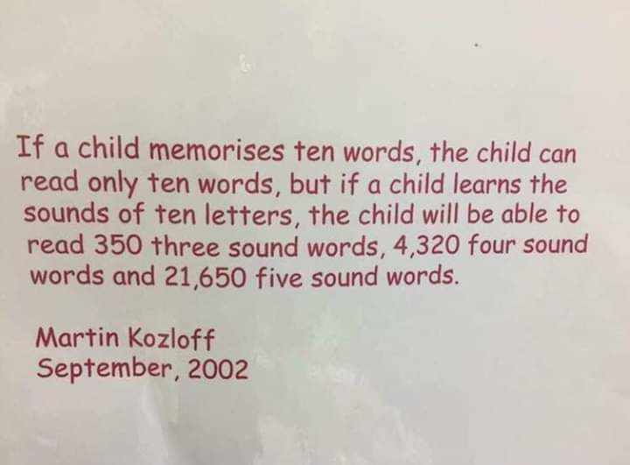
What is the Phonics Screening Check?
Notes:
In England children learn to read primarily through a phonics approach.
At Linaker we use the RWI phonics scheme.
All our staff our staff from Nursery to Y6 are trained in the teaching of phonics , recent up to date teaching and coaching sessions are held in school

Slide 3
What is the Phonic Screening Check?
Children complete a word-reading check at the end of Year 1. Children read 40 words, it takes between five and ten minutes.
If they do not manage to read 32 of the words, they are given extra support, and repeat the check at the end of Year 2.
It means that all children will be able to read accurately before they begin Year 3.
In our school, we aim to make sure that every child learns to read accurately by the end of Year 1 so they are set up for success in school and in life.
Notes:
The PSC is taken by pupils in Y1 throughout the country in the same week at the beginning of June each year.
This year the children will take the test in the week beginning 9th June.

Slide 4
Speed Sounds Set 3
Notes:
Children learn all of the sounds on this chart.
Once they know all of these sounds, they will be able to read any unfamiliar word.

Slide 5
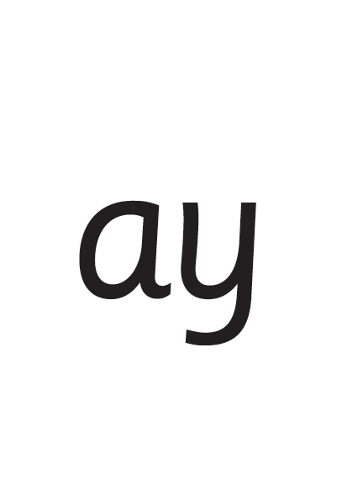
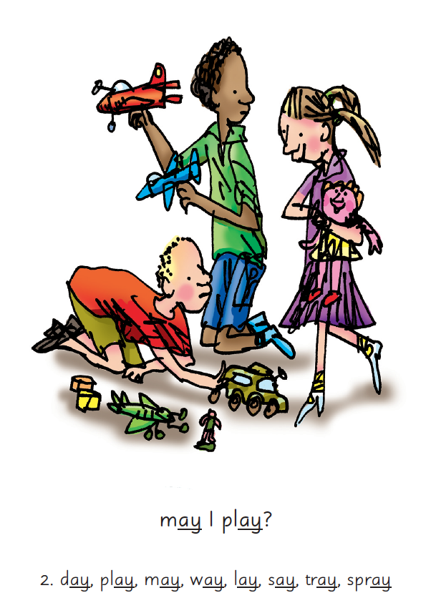

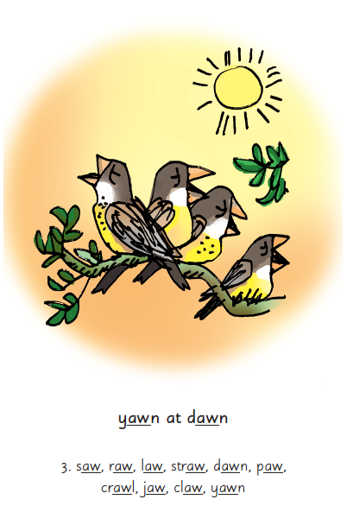
Notes:
RWI lessons are daily and last for around 45 minutes - extra phonic blasts in the afternoons
We teach children sounds using a picture phrases to help them remember.
For example, ay, may I play? aw, yawn at dawn.
Some sounds are represented by one letter but many sounds are represented by two or more letters. In our phonics lessons we call these ‘Special Friends’.

Slide 6

‘Special Friends’, ‘Fred Talk’, read the word
Notes:
We teach children to read both real and nonsense words using the routine ‘Special Friends’, ‘Fred Talk’, read the word’.
Children spot the ‘Special Friends’ (two or more letters that make one sound), Fred talk the word, and then read the word as a whole.
For example, ‘sh’, sh-i-p, ship.

Slide 7
What will the check look like?
The Check is divided into two sections (20 words each).
Section 1 - The words in section 1 will have a variety of simple word structures using single letters (a, b, c, d, e, f, g, h, I, j, k, l, m, n, o, p, q(u), r, s, t, u, v, w, x, y, z), some consonant digraphs (ch, ck, ff, ll, ng, sh, ss, th, zz) and frequent and consistent vowel digraphs (ar, ee, oi, oo, or)
Section 2 - The words in section 2 will have a variety of more complex word structures (for example CCVCC, CCCVC, CCCVCC and two syllable words) with some additional consonant digraphs (ph, wh), some less frequent and consistent vowel digraphs, including split digraphs (a-e, ai, au, aw, ay, ea, e-e, er, ew, i-e, ie, ir, oa, o-e, ou, ow, oy, ue, u-e, ur) and trigraphs (air, igh).
C = consonant
V = vowel

Slide 8
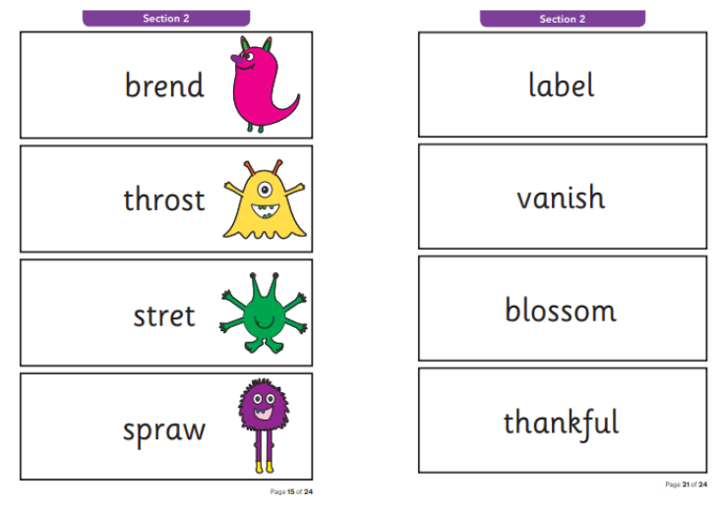
The Check is completed on a 1:1 basis. Children have to read 20 words and 20 nonsense words. They are represented with an alien. The Check is designed to assess whether children know their phonics and can decode words.
How do we assess?
Notes:
This is an example from a past paper.
Half of the words in the check are real words.
Half are nonsense words. For example, brend…
There is a picture of an alien next to each word to remind the children that it isn’t a real word.
The 40 words and non-words are divided into two sections – one with simple word structures of three or four letters, and one with more complex word structures of five or six letters.
The teacher administering the check with your child will give them a few practice words to read first – including some non-words – so they understand more about what they have to do. Each of the non-words is presented with a picture of a monster / alien, as if the word were their name (and so your child doesn’t think the word is a mistake because it doesn’t make sense!).
Nonsense words check that children will be able to read sounds they know in unfamiliar words.
Children who can read nonsense words will, very soon, be able to read any new word – for example – gargantuan, flailing, raucous, anticipation;
Reading new words increases children’s vocabulary rapidly.

Slide 9
How can you help?
Help your child to use the routine ‘Special Friends’, ‘Fred Talk’, Read the Word.
Practise reading sounds speedily.
Watch the Virtual Classroom films together (QR codes sent home)
Listen to your child read their Storybook every day.
Notes:
Help your child to use ‘Special Friends’, ‘Fred Talk’ to read words.
Practise reading sounds speedily.
Watch the Virtual Classroom films together – QR codes sent out early Jan
Listen to your child read their Storybook every day.

Slide 10
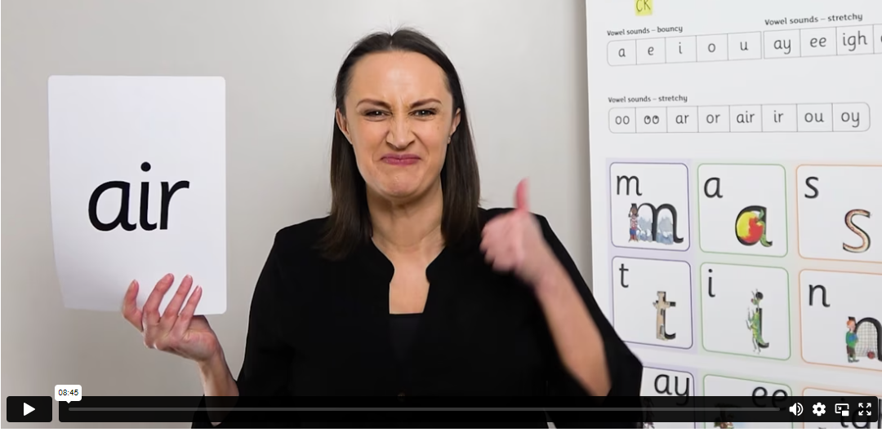
Virtual Classroom films
https://schools.ruthmiskin.com/training/view/N2TUnMV2/lLXFoWgd
Notes:
Watch these films with your child to help them to practise reading the sounds and words until they can read them speedily.
The more they practise using these films, the quicker they’ll learn to read.
Simply scan the QR code and click the link and watch on a tablet or phone.
Let’s have a look at one of these films on the Virtual Classroom. Play a lesson film from the virtual classroom.
Each lesson follows the same format
Say the sound
Read the sound
Spot the sound
Read words containing the sound
Review words
Final challenge

Slide 11
How else can you help?
The check will take place during the week beginning 9th June. Please make sure…
Your child has a good night’s sleep.
Your child has had breakfast.
Your child is in school everyday and on time.

Slide 12
Helpful links
Ruth Miskin Parents’ Page:
https://www.ruthmiskin.com/parents/
Free e-books for home reading:
http://www.oxfordowl.co.uk/Reading/
PhonicsPlay
https://www.phonicsplay.co.uk/
Ict games
https://ictgames.com/mobilePage/literacy.html
Topmarks
https://www.topmarks.co.uk/english-games/5-7-years/letters-and-sounds
Notes:
For more information and free parent resources visit www.ruthmiskin.com
For free online reading books visit https://home.oxfordowl.co.uk/
And for free games that will support your child to learn phonics have a look at the Phonicsplay website

Slide 13
Reading changes everything
Teach a child to read and keep that child reading and we will change everything.
And I mean everything.
Jeanette Winterson
Notes:
Remember that all parents have the power to change outcomes for their children.

Slide 14

Any questions?
Notes:
Parents to leave the hall before the children are dismissed from class.
Parents are to wait in the usual place to collect their child.
Thank you for coming.
Will make sure PPT Is on the website for anyone who missed it

