Slide 1
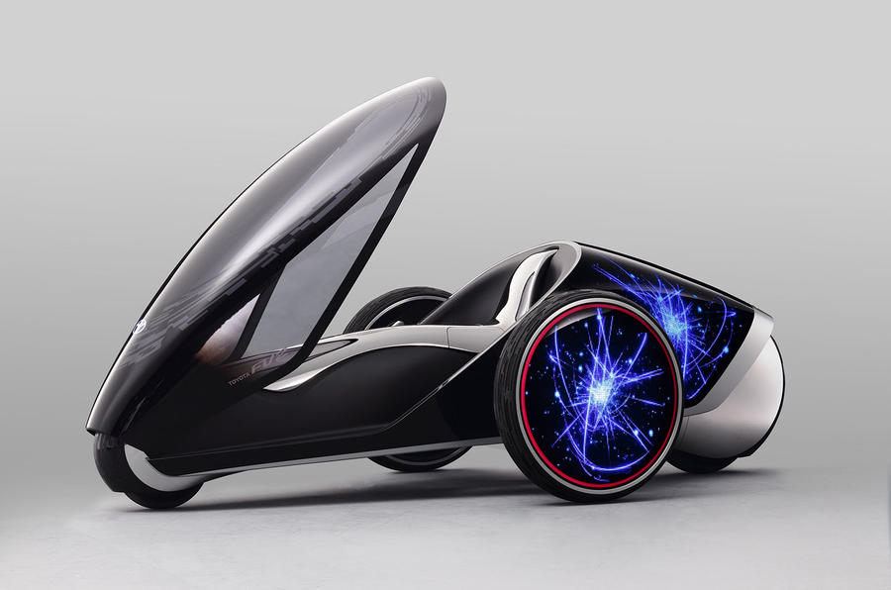
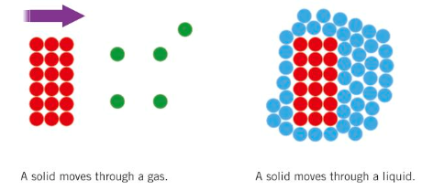
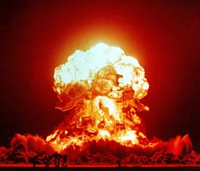
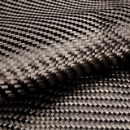
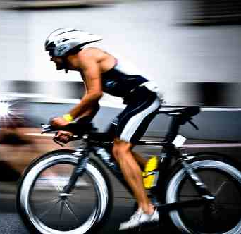
What will cars of the future look like? Knowledge organiser
Drag (friction and air resistance)- slow objects down.
to reduce drag we can streamline objects and use lubricants (oil)
Forces are measured in newtons (N) with a newton meter
When the overall (resultant force) is unbalanced the object accelerates (speeds up/ slows down)
Paired forces- Forces come in interactive pairs.
For every action there is an equal but opposite reaction (newton’s 3rd Law)
Examples of forces- tension, push, pull, upthrust, weight, gravity, air resistance, friction, normal reaction
When forces are in equilibrium (balanced) the object is stationary or moving at a constant speed.
Energy is found in these energy stores:
Kinetic
Gravitational potential
Thermal
Elastic
Vibrational
Nuclear
Chemical
Electrical/ magnetic
When forces are not in equilibrium (unbalanced) the object will accelerate in the direction of the resultant (overall) force.
Kinetic energy= ½ x mass x velocity²
Energy is often wasted in energy transfers as (heat and sound)
Carbon fibre is a light weight alternative to steel.
Efficiency = useful energy ÷ total energy supplied
Energy is measured in joules (J)
Alternative fuels/sources of energy can be provided by plants/ hydrogen/electricity.

