Slide 1
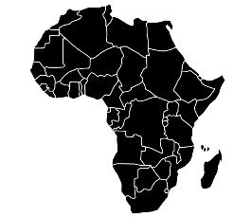
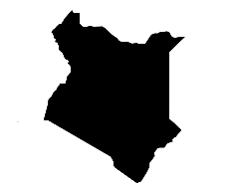
Africa: A continent of contrast
HOTS question: Evaluate whether tourism is good or bad for Kenya
Key terms and definitions | Biome | A geographical area with similar weather and environments
 | Conflict | A disagreement or expression of different opinions
 | Culture | The ideas, customs and social behaviour of a particular people or society
 | Diversity | A range of different things (such as weather, religion or race)
 | Drought | A long period of low rainfall, leading to a shortage of water
 | Ethnic | A group of a certain religion or culture within a larger group
 | Famine | A severe shortage of food
 | Infrastructure | Roads, buildings and power supplies
 | Population | The size and characteristics of the people living in a certain area
 | Sustainability | Sustainability is meeting the needs of the present without compromising the needs of the future.
 | Technology | Machinery and equipment often used to achieve a goal
Case Study | Zimbabwe | Kenya
 | Zimbabwe is located in the south of Africa. It is experiencing its worst drought in 40. Half of its population (7.7 million people) is currently facing extreme drought and famine. | Kenya is a country in the east of Africa, located along the equator. It has a coastline on the Indian Ocean. It’s capital is Nairobi. Kenya was once a colonial nation, ruled by the British. Kenya has a growing population and makes a lot of money through tourism.
Kenya’s population is growing rapidly. Most of its population live in the cooler and wetter areas. The capital Nairobi is home to 3.5 million people. The population is very unequal. 60% of the people in Nairobi live in slums.
Africa’s history is still impacting it today. During colonisation European countries took over and ruled many countries in Africa. They often took natural resources like gold and diamonds. At the end of colonisation Africa was carved into 54 countries forcing different ethnic groups together which has caused lots of conflict.
Africa is home to lakes, mountains, rivers, volcanoes, rainforests, deserts, savanna’s and semi-deserts. Africa’s climate changes depending on where you are within the continent.
Drought in Africa is made worse by climate change meaning that it is very hard to stop droughts but lots can be done to help people who are experiencing it such as fixing faulty pipes, helping farmers to grow crops that need less water and buying food from other countries.
Drought is very common in Africa. Around half of all countries in Africa have experienced below average rainfall in recent years and around 6 are experiencing extreme droughts.
Africa is one of the 7 continents. It is the 2nd largest by size and has the most countries within it (54). It also has the 2nd largest population.
Kenya is home to lakes, rivers, mountains, volcanoes, deserts and savanna's. It is located on the Great Rift Valley which creates volcanoes and earthquakes. Some areas of Kenya are very dry and hot all year, but some have more rainfall.
Kenya is a very popular tourist destination. In 2018 over 2 million people visited Kenya, mainly for Safaris. Tourism can create conflict between different groups such as local people, the government and the animals.
Kenya is leading the way in sustainable tourism. It is working hard to make tourism better for the local environment and local people.

