Slide 1
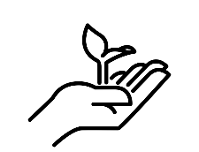
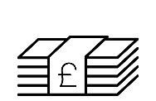
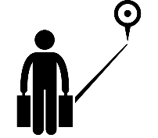
Our Unequal World
HOTS question:
Key terms and definitions | Colonisation | Where a country takes over and rules another country, often taking resources and people.
 | Development | A process of change to improve people’s lives.
 | Gross National Income (GNI) | The total income earned by a country from its goods and services.
 | High Income Country (HIC) | A country with a GNI of $12,000 per person or more.
 | Human Development Index (HDI) | A measure of a countries development based on social and economic factors including life expectancy, number of years in education and GNI.
 | Inequality | An uneven distribution of wealth between or within countries.
 | Low Income Country (LIC) | A country with a GNI of less than $1,000 per person.
 | Migration | Movement from one place to another.
 | Newly Emerging Economy (NEE) | A country that has begun to experience higher rates of economic development.
 | Poverty Line | The minimum amount of money you need in order to afford essential items.
 | Slavery | Being owned by someone and having to work for no pay often in poor conditions.
 | Standard of living | The level of goods, services and comfort available to people.
 | Quality of life | The standard of health, comfort and happiness experienced by people.
Case Studies | Malawi | Singapore
 | Malawi is located in Africa, it has a population of 17 million. In 1891 Britain colonised Malawi and set up plantations. The country gained independence in 1964. Today 90% of its population earn a living through farming. They make very little money when they sell their goods. Only 61% of adults are literate and the life expectancy is 55 years. Malawi has a HDI of 0.4 (172nd out of 189 countries) and a GNI of $1,159. | Singapore is an island off the tip of Malaysia. It is half the size of Greater London and has nearly 4 million citizens. Singapore was once a British colony, during WW2 Japan destroyed most of the island and in 1965 Japan gained its independence. As it is an island Singapore has very few natural resources including water so almost everything has to be imported. Singapore is a shipping hub and has the busiest transhipment port in the world. It has a HDI of 0.935 (the 9th in the world) and a GNI of $83,793.
One way to help a country develop, and to help the people within a country escape poverty, is to pay a fair price for the goods they sell. This is called Fairtrade. A good example of Fairtrade is chocolate. Lots of companies like Cadburys now use Fairtrade coco beans so that the farmers earn a better salary for growing them.
Development can be measured in many ways. It is most commonly measured by the amount of wealth a country has but this often does not take into account the inequalities that exist within a country.
There is a large development gap between countries. This has grown for a number of reasons including; colonisation, geographical challenges, levels of health and education, conflict and war, access to resources and many more. Countries who face these challenges may often take longer to develop to similar levels of other countries.
Escaping and ending poverty is very challenging. Some people may migrate to find a better quality and standard of life, however this is often very dangerous and doesn’t always make life better. Other ways to help people escape poverty is to help countries develop. This can be done through donating aid, building factories and paying a fair price for goods bought from less developed countries, such as clothes or vegetables.
As a country tries to develop this can often be done in ways that damage the environment. For example, building lots of factories is good as it gives people jobs and they can earn more money, but the pollution from factories is bad for the environment. Many countries are not trying to find ways to develop sustainably.
Poverty is not just found in LICs. People in any country, even the most developed like the UK and Japan can experience poverty. 22% of people in the UK have experienced poverty at some point.

