Slide 1
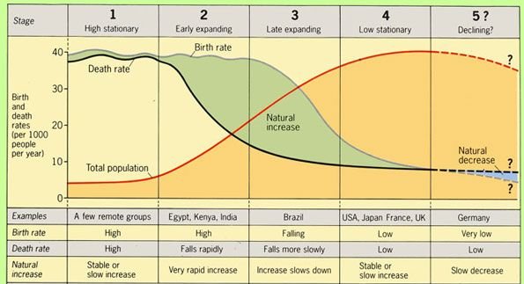
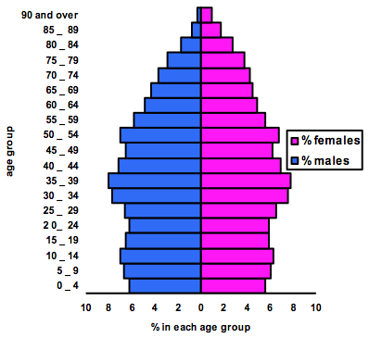
Population
HOTS question: How can growing populations be sustainable?
Key terms and definitions | Ageing Population | A population that has a rising average age.
 | Birth Rate | The number of births a year per 1,000 of the total population.
 | Death Rate | The number of deaths a year per 1,000 of the total population.
 | High Income Country (HIC) | A country with a GNI per capita higher than $12,376
 | Life Expectancy | The average number of years a person is expected to live.
 | Low Income Country (LIC) | A country with a GNI per capita lower than $1,025
 | Migration | The movement of people from one place to another
 | Natural Change | The difference between the number of births and deaths (can increase or decrease)
 | Newly Emerging Economy (NEE) | Countries that have just begun to experience high rates of economic development.
 | Population | The total number of people living in a country or region and their characteristics
 | Population density | The number of people living in a certain area (usually per square mile)
Case Studies | Japan | China
 | Japan has an ageing population. People are choosing to marry later and have fewer children meaning the birth rate is low. Life expectancy in Japan is 84 years meaning that people are living longer. The ageing population causes problems such as more money needs to be spent on healthcare and homes for elderly people. | Around 1950 the population of China was growing rapidly. The Government were worried that it would not be able to look after the large population. To control it, the government created a 1 child policy, each couple were only allowed to have 1 child (with some exceptions). In 2016 the couple changed it to a 2 child policy over fears of an ageing population.
The world’s population has increased gradually over thousands of year. Since the start of the 20th Century it has begun to rise rapidly. This is mainly because healthcare is better and people are living longer.
Today, some countries populations are growing much quicker than others. Some highly developed countries like Japan have negative population growth (meaning that their populations are decreasing). Other countries, like Mali and Chad in Africa have very rapidly growing populations.
Countries often try and manage their population if they are facing challenges. If a population is starting to shrink Governments might try to encourage people to have more children through increasing maternity leave, making childcare cheaper or encouraging migration of young people.
The population of a country is not spread out evenly. Most people around the world (around 60% of the world’s population) lives in urban areas. Urban-rural migration is increasing quickly in most places around the world.
A growing population will take more resources and space for everyone. New cities are being built and current cities are growing rapidly to make space for everyone. New farmland is being created to grow food for everyone, sometimes by deforesting tropical rainforests or other ecosystems.
Population pyramids show the age and gender characteristics of a population. Using population pyramids you can see the age of a population and how the population has changed over time.
The Demographic Transition Model (DTM) shows how the population, birth and death rate changes as a country develops. Most countries tend to follow a similar trend. Birth rate and death rate start of very high, death rate starts to decrease, then birth rate. Eventually, very highly developed countries start to see their death rate rise again as they develop an ageing population.

