Slide 1
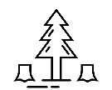
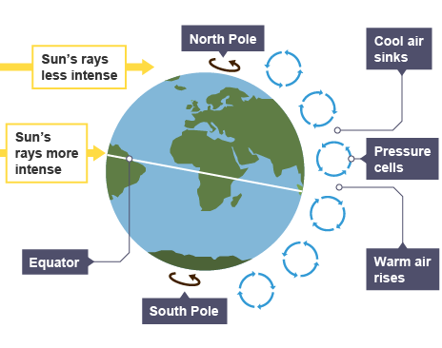
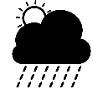
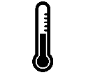
Ecosystems Knowledge Organiser
HOTS question: Should we be allowed to exploit ecosystems to benefit humans?
Key terms and definitions | Ecosystem | A community of biotic and abiotic organisms
 | Biome | A large scale ecosystem
 | Abiotic | Non-living components of an ecosystem
 | Biotic | Living components of an ecosystem
 | Biodiversity | The number and variety of species in a location
 | Biomass | The total amount of organic material both above and below the ground and in water
 | Biosphere | The regions of the surface and atmosphere of Earth that are occupied by living organisms
 | Conservation | The protection of aspects of the environment for the future benefit of people
 | Sustainability | Actions that meet the needs of the present without reducing the ability of future generations to meet their own needs
 | Tropical Rainforest | A forest found between the Tropic of Cancer and Tropic of Capricorn where there is no dry season. Annual precipitation is around 2,000mm and they have an average temperature of around 28°C.
 | Hot Desert | Found between 15° and 30° north and south of the equator where air is descending. Day time temperatures can exceed 40°C with nighttime temperatures as low as 0°C. Annual precipitation is as little as 250mm per year.
 | Cold Environments | Found in high latitudes or mountainous regions with long winters and average temperatures below 0°C. Examples of cold environments are polar regions, the tundra and glacial landscapes.
Case Studies | Amazon Rainforest | Sahara Desert | The Tundra
 | The Amazon is the largest rainforest in the world and spans 8 countries in South America including Brazil, Bolivia, Peru and Ecuador. One in ten species found on Earth are found in the Amazon. More than 30 million people live in the rainforest. The rainforest is under threat from deforestation. | The Sahara is the largest desert in the world and covers around 10% of Africa. The Sahara is the hottest desert in the world and half of the desert receives less than 1 inch of rain every year. The population of the Sahara is around 2 million. Due to desertification the Sahara has expanded by around 10% since 1920 which impacts communities around the Sahara. Global warming is leading to even less rainfall and higher temperatures. | The Tundra is located in the very north of the northernmost landmasses in the world including Canada, Greenland and Russia. It covers 1/5th of the Earth's surface. The ground remains frozen year round. The landscape is quite bare, with little vegetation. The permafrost in the Tundra is beginning to thaw due to rising air temperatures potentially impacting the 4 million people who live in the Tundra.
Ecosystems
Many cultures have developed around or nearby to ecosystems. For example indigenous people in the Amazon Rainforest or nomads in the Sahara Desert. The variety of organisms found within them provide food and shelter for many populations
Competition will occur between organisms in an ecosystem when their needs overlap. Animals may compete for food, water and space to live. Plants compete for light, water, minerals and root space.
The distribution of large-scale ecosystems (biomes) is determined by climate. Latitude, air pressure and wind are important factors that determine the climate of a place
As human populations have grown we have started to overtake many ecosystems. In the Amazon thousands of acres of land has been cleared for farmland, housing and industry. In the UK more than half of all woods that are more than 400 years old have been lost in the last 80 years.
In lower latitudes (like the tropics) temperatures are higher, in higher latitudes like polar regions temperatures are lower as solar radiation spread over a wider distance. Low pressure areas are created when air rises, these areas are associated with cloud and precipitation. Tropical rainforests are found in low pressure areas. High pressure areas are created when air sinks, they have dry and warm weather. Deserts tend to be found in high pressure areas.
Ecosystems contain a complex web of biotic and abiotic organisms which are interdependent on each other. A change in the size of one population can affect all other organisms within the ecosystem.

