Slide 1
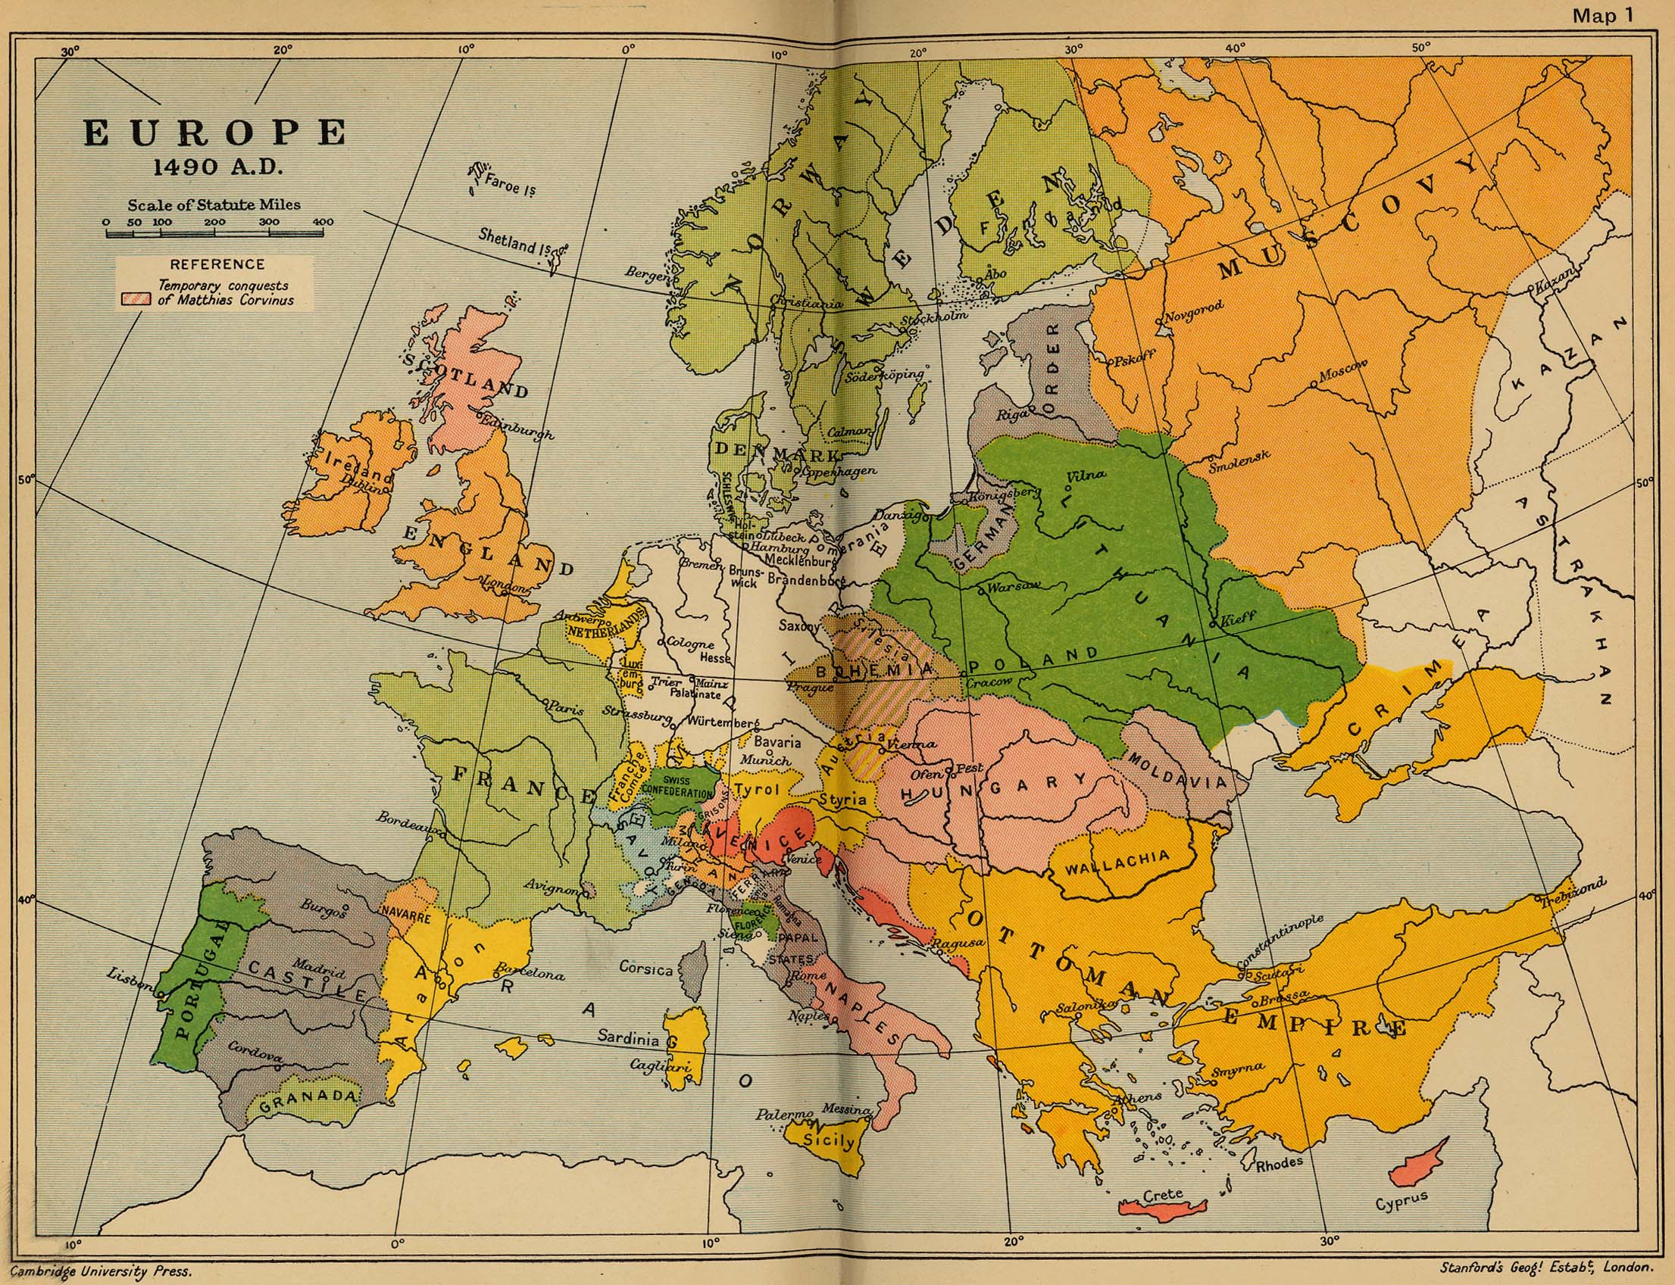
Options Assemblies History, Geography and RE
What is the difference between this map of Europe (from 1490) and a modern map of Europe?
See if you can spot 5 differences – for example – what we now would recognise as Greece is called the Ottoman Empire.

Slide 2
Background…
Traditionally most students would take at least one of the Humanities (History, Geography or RE).
It is an Ebacc subject although that is less important these days
Some of our students choose to take 2 (or 3!) of the subjects
They all involve writing extended answers and there is no coursework component
They are ALL amazing…
Remember – when choosing your options it’s important to consider what you enjoy and not worry about which teacher you might have or what your friends are doing!

Slide 3
History
Paper 1 – Medicine through Time | Paper 2 – Elizabeth I and the Cold War | Paper 3 – Weimar and Nazi Germany
What have people believed about the cause of disease and illness since the Romans. How have people treated disease and illness since the Romans. The development of public health. | Elizabeth’s reign and problems The nature of Superpower relations after the Second World War including the Berlin Wall, the Cuban Missile Crisis, Vietnam and a lot more! | The Weimar Republic and its problems. Hitler’s rise to power Life in Nazi Germany
1 hour 15 minute exam 30% | 1 hour 45 minute exam 40% | I hour 20 minute exam 30%
Careers for students of History include:
Journalism, Law, Teaching, Civil Service, Voluntary sector, Diplomacy, anything really!
Mrs Eastham worked in the city for an Investment Bank before training as a teacher!
Content heavy but a great understanding of history and foundation for further study of many things. Extended answers and source evaluation.

Slide 4
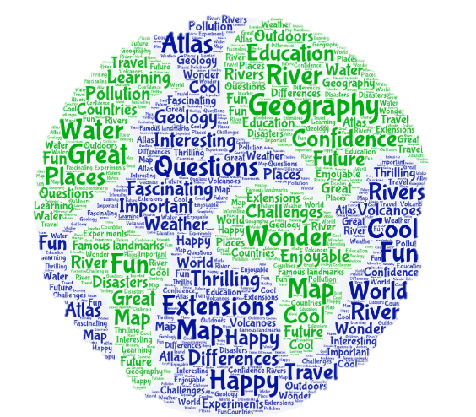
Geography
Can you name a country?
Careers for students of Geography include:
Journalism, Law, Teaching, Civil Service, Voluntary sector, Diplomacy, Travel Guide, Sustainability related jobs (big at the minute!) anything really!
Who should study geography?
Anyone who is interested in learning about the world, people, places and life on Earth. If you want to work abroad geography could be a good option!
Paper 1 – Living with the physical environment | Paper 2 – Challenges in the human environment | Paper 3 – Geographical applications
The challenge of natural hazards – including tectonic hazards, weather hazards and climate change The living world – including tropical rainforests and cold environments Physical landscapes in the UK – including coasts and rivers | Urban issues and challenges – including a urban challenges and opportunities and urban change in the UK The changing economic world – the global development gap, changing economies in the UK Resource management – food, water and energy | Issue evaluation – critical thinking and problem solving element using a resource booklet Fieldwork – two geographical enquiries which will involve the gathering of data and testing of hypotheses.
90 minutes 35% of GCSE | 90 minutes 35% of GCSE | 60 minutes 30% of GCSE

Slide 5
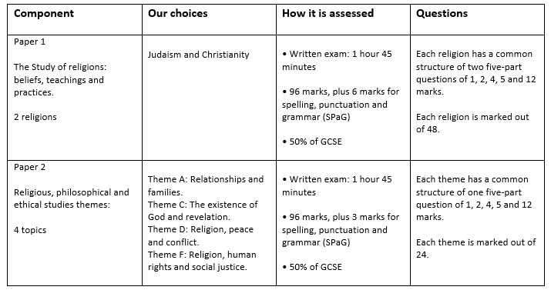
Religious Studies
Careers for students studying RE:
Teaching, national and local government, civil service, social work, law, journalism, NGOs, voluntary service… and many, many more!
Great course – well respected in terms of academic study and provides understanding of importance of religion (or lack of it) in modern society.
Don’t need to be religious to study it!

Slide 6
Any questions?
Speak to anyone in the Humanities Department
Good luck with your choices!!

