Slide 1
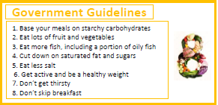
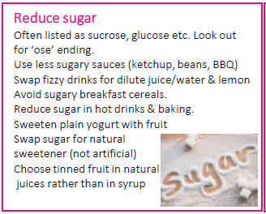
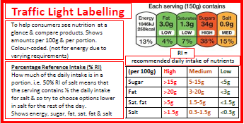
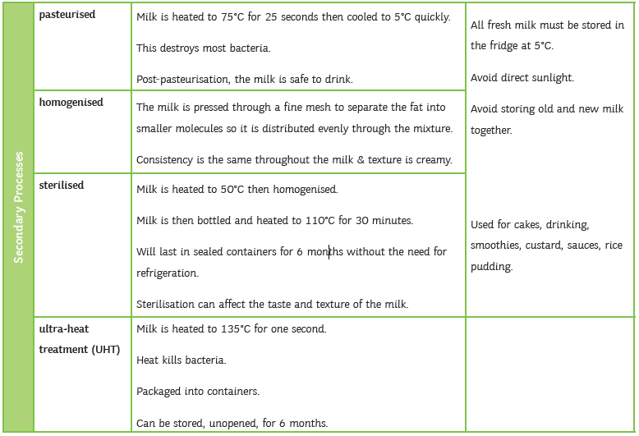
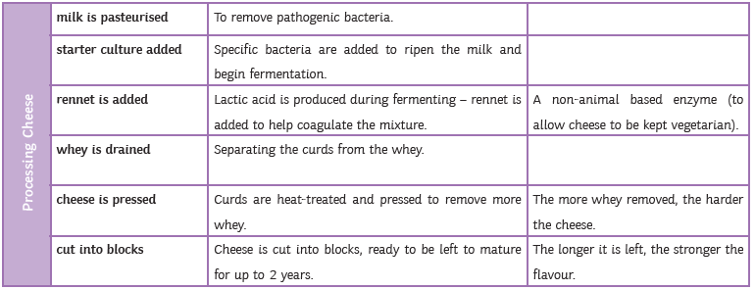
Year 8 Knowledge Organiser (2)
Tier 2 Vocabulary
State
Describe
Identify
Explain
Develop
Expand
Compare
Evaluate
Analyse
Reason
Justify
Tier 3 Vocabulary
Hygiene (food and personal)
Sensory Analysis
Target Group
Environment
Culture
Commodity
Process
Technique
Sustainability
Intolerance
Elasticity – ‘stretchiness’ – the ability to resume its normal shape after being stretched / compressed
Coagulation – when denatured proteins join together, changing from a liquid to a solid
Cholesterol – a fatty substance – too much cholesterol in a person’s blood can cause heart disease
Kcals – unit to measure energy
Gelatinisation – when starch molecules swell and burst to thicken a sauce
Gel – when a gelatinised sauce sets on cooling, useful in desserts such as custard
Dextrinisation – the browning of starch foods by dry heat – the breakdown of starch into dextrin's
Caramelisation – the browning of sugar, resulting in a sweet nutty flavour and brown sugar
Chemical raising agent – something added to a food which creates gas bubbles which makes a food rise (baking powder/bicarbonate of soda)
Websites to visit
https://www.foodafactoflife.org.uk/11-14-years/food-commodities/dairy/
https://www.foodafactoflife.org.uk/11-14-years/healthy-eating/nutrition-labels/
https://www.foodafactoflife.org.uk/14-16-years/food-science/functional-and-chemical-properties-of-food/

