Slide 1
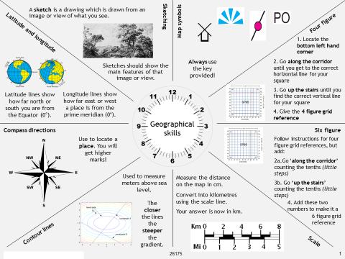
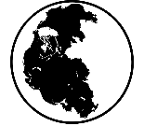
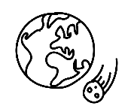
This is our World - Map Skills
Co | Cartographer | A person who designs and makes maps
 | Continent | One of several very large landmasses on Earth and is usually made up of different countries.
 | Contour | Orange lines on a map representing height above sea level
 | Co-ordinate | point on a map or graph where two sets of numbers or letters meet
 | Country | A nation with its own government, occupying a particular territory
 | Grid references | Method of describing a location using vertical and horizontal grid lines,
 | Latitude | Lines showing how far north or south you are from the Equator
 | Longitude | Lines showing how far east or west a place is from the prime meridian (zero degrees)
 | Map symbols | Maps often use symbols instead of words to label real-life features and make the maps clearer
 | Orientation | Means that the map faces the same way you do
 | PO | Map symbol used for a post office
 | Scale | Shows how much you would have to enlarge your map to get the actual size of the piece of land you are looking at.

