Slide 1
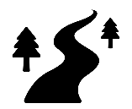
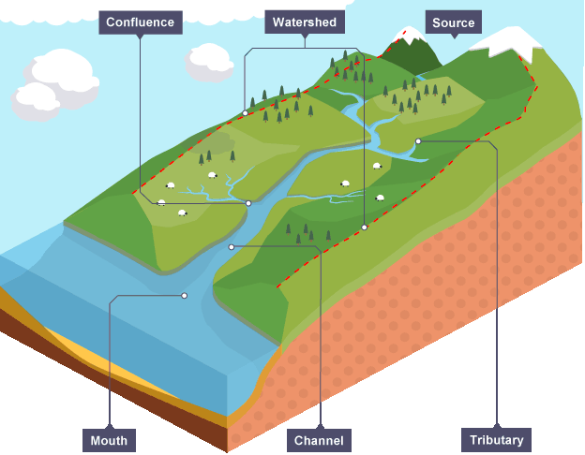
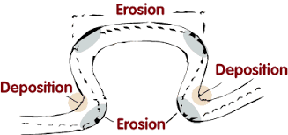
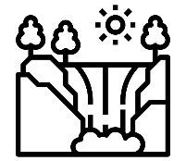
Rivers Knowledge Organiser
Enquiry question: Can we protect ourselves from flooding?
Key terms and definitions | Abrasion | Pebbles and rocks being wearing away the bed and banks of a river
 | Attrition | Particles within a river knocking into each other and wearing each other away
 | Bedload | The material carried by a river
 | Deposition | When a river drops its bedload, usually as it runs out of energy
 | Discharge | The amount of water
 | Erosion | The wearing away of the bed and banks of a river channel.
 | Flood plain | The wide, flat floor of a river valley
 | Hydraulic action | The sheer force of water that can erode the bed and banks of a channel
 | Mouth | Where a river ends at a lake or the sea
 | River Basin | Precipitation falling within a river basin will end up within its river
 | Source | Where a river starts, usually in the mountains
 | Saltation | Material bounced along the bed of a river
 | Solution | Rocks that have been dissolved in the water and carried along within the river
 | Transportation | The movement of bedload along a river
 | Tributary | A smaller river which joins a larger one
Case Studies | Storm Dennis | The River Nile
 | Storm Dennis hit the UK in February 2020. It brought a month’s worth of rain in 48 hours. The storm killed 4 people in the UK and caused major disruption. | The River Nile flows through 10 countries in Africa including Egypt and Ethiopia. Ethiopia is building a dam to generate electricity and reduce flooding risk but it is also reducing how much water flows through the Nile into Egypt leading to conflict.
Rivers
Precipitation (rain, snow, hail or sleet) makes its way to rivers either over the ground (as surface run off) or underground (as groundwater)
Erosion occurs as the river, and its bedload, wear away the river bed and bank and change the shape of the valley itself. Material eroded by the river is transported along in the river. When the river loses energy it deposits its material, usually on the inside of river bends of when the river reaches its mouth.
Rivers create many landforms as they move from the source to the mouth. V-shaped valleys, waterfalls, interlocking spurs and gorges are found in the upper course of a river. Meanders and ox-bow lakes are found in the middle or lower course of a river.
Floods happen when water overflows the river’s channel. There are physical and human factors which contribute to flooding. For example, heavy rain, steep land and hard rock like granite prevent rain from having a chance to soak into the ground. When humans cut down trees and build large cities this can also lead to greater flooding. Climate change can cause more rainfall and is creating more storms around the world.
Rivers are very important physical landforms. Many cities have been built around cities to provide water supplies and transport links. Now, rivers can be used to generate electricity, to provide water for farms and factories and for leisure. However, humans massively impact rivers through pollution and removing too much water for our own use
Rivers travel from their source, usually high up in mountains, to their mouth either on a river or lake. Along the way they are joined by smaller rivers called tributaries. As the river moves downstream it gets wider and deeper meaning that it can carry more water.

