Slide 1
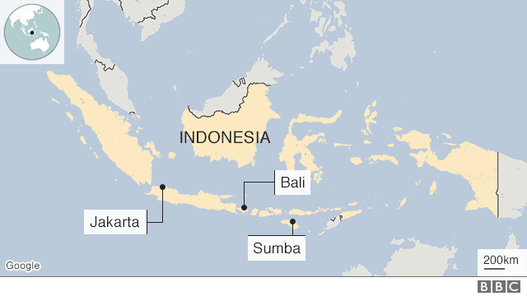
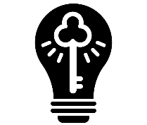
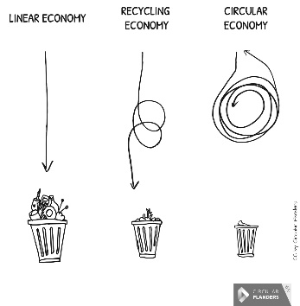
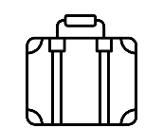
The problem with plastic
Enquiry Question: Is there plastic pollution at LECA?
Key terms and definitions | Non-biodegradable | Not able to be broken down by natural organisms.
 | Gyre | A circular pattern of ocean currents.
 | Landfill | Disposing of waste by burying it in large holes.
 | Linear Economy | When raw materials are used to make a product and then throw it away after it is used.
 | Micro-plastic | Fragments of plastic that are sometimes invisible to the human eye.
 | Plastic | A synthetic material that can be moulded into different shapes.
 | Recycling | The process of converting waste into something new.
 | Risk Assessment | The process of evaluating the potential risks in a specific activity.
 | Single-use plastic | Plastic that is only used once and then disposed of.
 | Sustainable | Meeting our own needs without compromising the needs of future generations.
Case Studies | Indonesia
 | Indonesia is the world’s second-biggest contributor of plastic waste in oceans. Many remote villages lack waste management schemes and have no ways to properly dispose of plastic and there is a growing use of single-use plastic in the country. Bali, an Indonesian island, has banned plastic bags and plastic straws.
Once you have conducted fieldwork you need to analyse the results and present the data. This helps you to make conclusions about the fieldwork you have conducted.
Before conducting fieldwork you have to do a risk assessment to find out if it is safe to do the fieldwork. When you do conduct fieldwork it is really important to reduce risks as much as possible.
Only 9% of all plastic produced has been recycled
To help understand the issues of plastic pollution we can conduct fieldwork.
The garbage patch was created when plastic entered large gyres (currents) in the ocean and became trapped.
Recycling is widely used and is thought of as an effective way to help deal with plastic pollution. However most plastic recycling from the UK is sent abroad to other countries where it is not actually recycled..
The problem with plastic
The Great Pacific Garbage Patch is an area 3 times the size of France in the North Atlantic Ocean which contains 79,000 tonnes of floating plastic and micro-plastic.
There are lots of different potential solutions to reducing plastic waste. One of these is to create a recycling or circular economy where raw materials are reused multiple times rather than being thrown away after one use.
Most plastics are made from materials like natural gas, oil and crude oil. Plastic as we know it was first created in 1907.
As plastic is very tough, it lasts for a really long time. This is good for certain plastic objects like laptops. But other plastic items like water bottles can take 450 years to break down.
Plastic can come in lots of different forms and is designed specifically for different uses. Most plastic is tough, lightweight and easily shaped into whatever shape is needed.
Oceanographer | Average Salary: £40,000
Oceanographers study the ocean and help to understand and predict how the world’s oceans and sea’s work.

