Slide 1
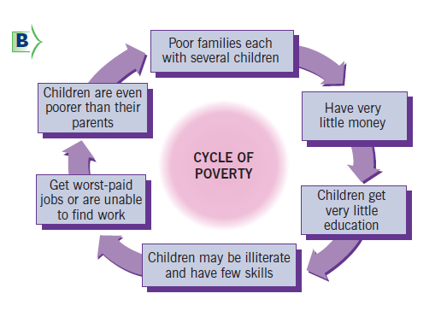
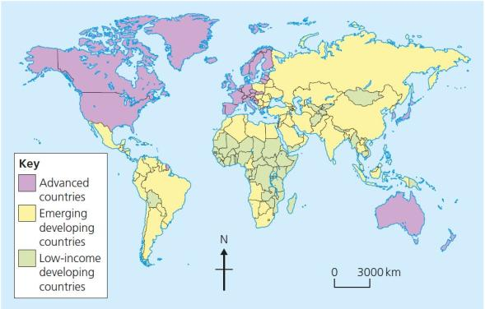
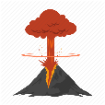
What is development?
Development is an improvement in living standards through better use of resources.
Economic | This is progress in economic growth through levels of industrialisation and use of technology.
Social | This is an improvement in people’s standard of living. For example, clean water and electricity.
Environmental | This involves advances in the management and protection of the environment.
Variations in the level of development
LICs | Poorest countries in the world. GNI per capita is low and most citizens have a low standard of living. Ethiopia, Libya
NEEs | These countries are getting richer as their economy is progressing from the primary industry to the secondary industry. Greater exports leads to better wages. Brazil, India
HICs | These countries are wealthy with a high GNI per capita and standards of living. These countries can spend money on services. Eg: UK, France, USA
Reducing the Global Development Gap
Microfinance Loans This involves people in LICs receiving smalls loans from traditional banks. + Loans enable people to begin their own businesses - Its not clear they can reduce poverty at a large scale. | Foreign-direct investment This is when one country buys property or infrastructure in another country. + Leads to better access to finance, technology & expertise. - Investment can come with strings attached that country’s will need to comply with.
Aid This is given by one country to another as money or resources. + Improve literacy rates, building dams, improving agriculture. - Can be wasted by corrupt governments or they can become too reliant on aid. | Debt Relief This is when a country’s debt is cancelled or interest rates are lowered. + Means more money can be spent on development. - Locals might not always get a say. Some aid can be tied under condition from donor country.
Fair trade This is a movement where farmers get a fair price for the goods produced. + Paid fairly so they can develop schools & health centres. -Only a tiny proportion of the extra money reaches producers. | Technology Includes tools, machines and affordable equipment that improve quality of life. + Renewable energy is less expensive and polluting. - Requires initial investment and skills in operating technology
Measuring development
These are used to compare and understand a country’s level of development.
Economic indictors examples
Employment type | The proportion of the population working in primary, secondary, tertiary and quaternary industries.
Gross Domestic Product per capita | This is the total value of goods and services produced in a country per person, per year.
Gross National Income per capita (GNI) | An average of gross national income per person, per year in US dollars.
Social indicators examples
Infant mortality | The number of children who die before reaching 1 per 1000 babies born.
Literacy rate | The percentage of population over the age of 15 who can read and write.
Life expectancy | The average lifespan of someone born in that country.
Mixed indicators
Human Development Index (HDI) | A number that uses life expectancy, education level and income per person.
KS3 KO: Development
Causes of uneven development
Development is globally uneven with most HICs located in Europe, North America and Oceania. Most NEEs are in Asia and South America, whilst most LICs are in Africa. Remember, development can also vary within countries too.
Factors affecting uneven development
Economic reasons | Environmental reasons
Fuel sources such as oil. Minerals and metals for fuel. Has to rely on imports. Access to safe water. | Risk of tectonic hazards. Benefits from volcanic material and floodwater. Frequent hazards undermines redevelopment.
Environmental Reasons | Historical Reasons
Reliability of rainfall to benefit farming. Extreme climates limit industry and affects health. Climate can attract tourists. | A civil war (war within same country) has been going on The people who colonised the country built no factories The slave trade meant millions of healthy adults were forced to leave their countries

