Slide 1
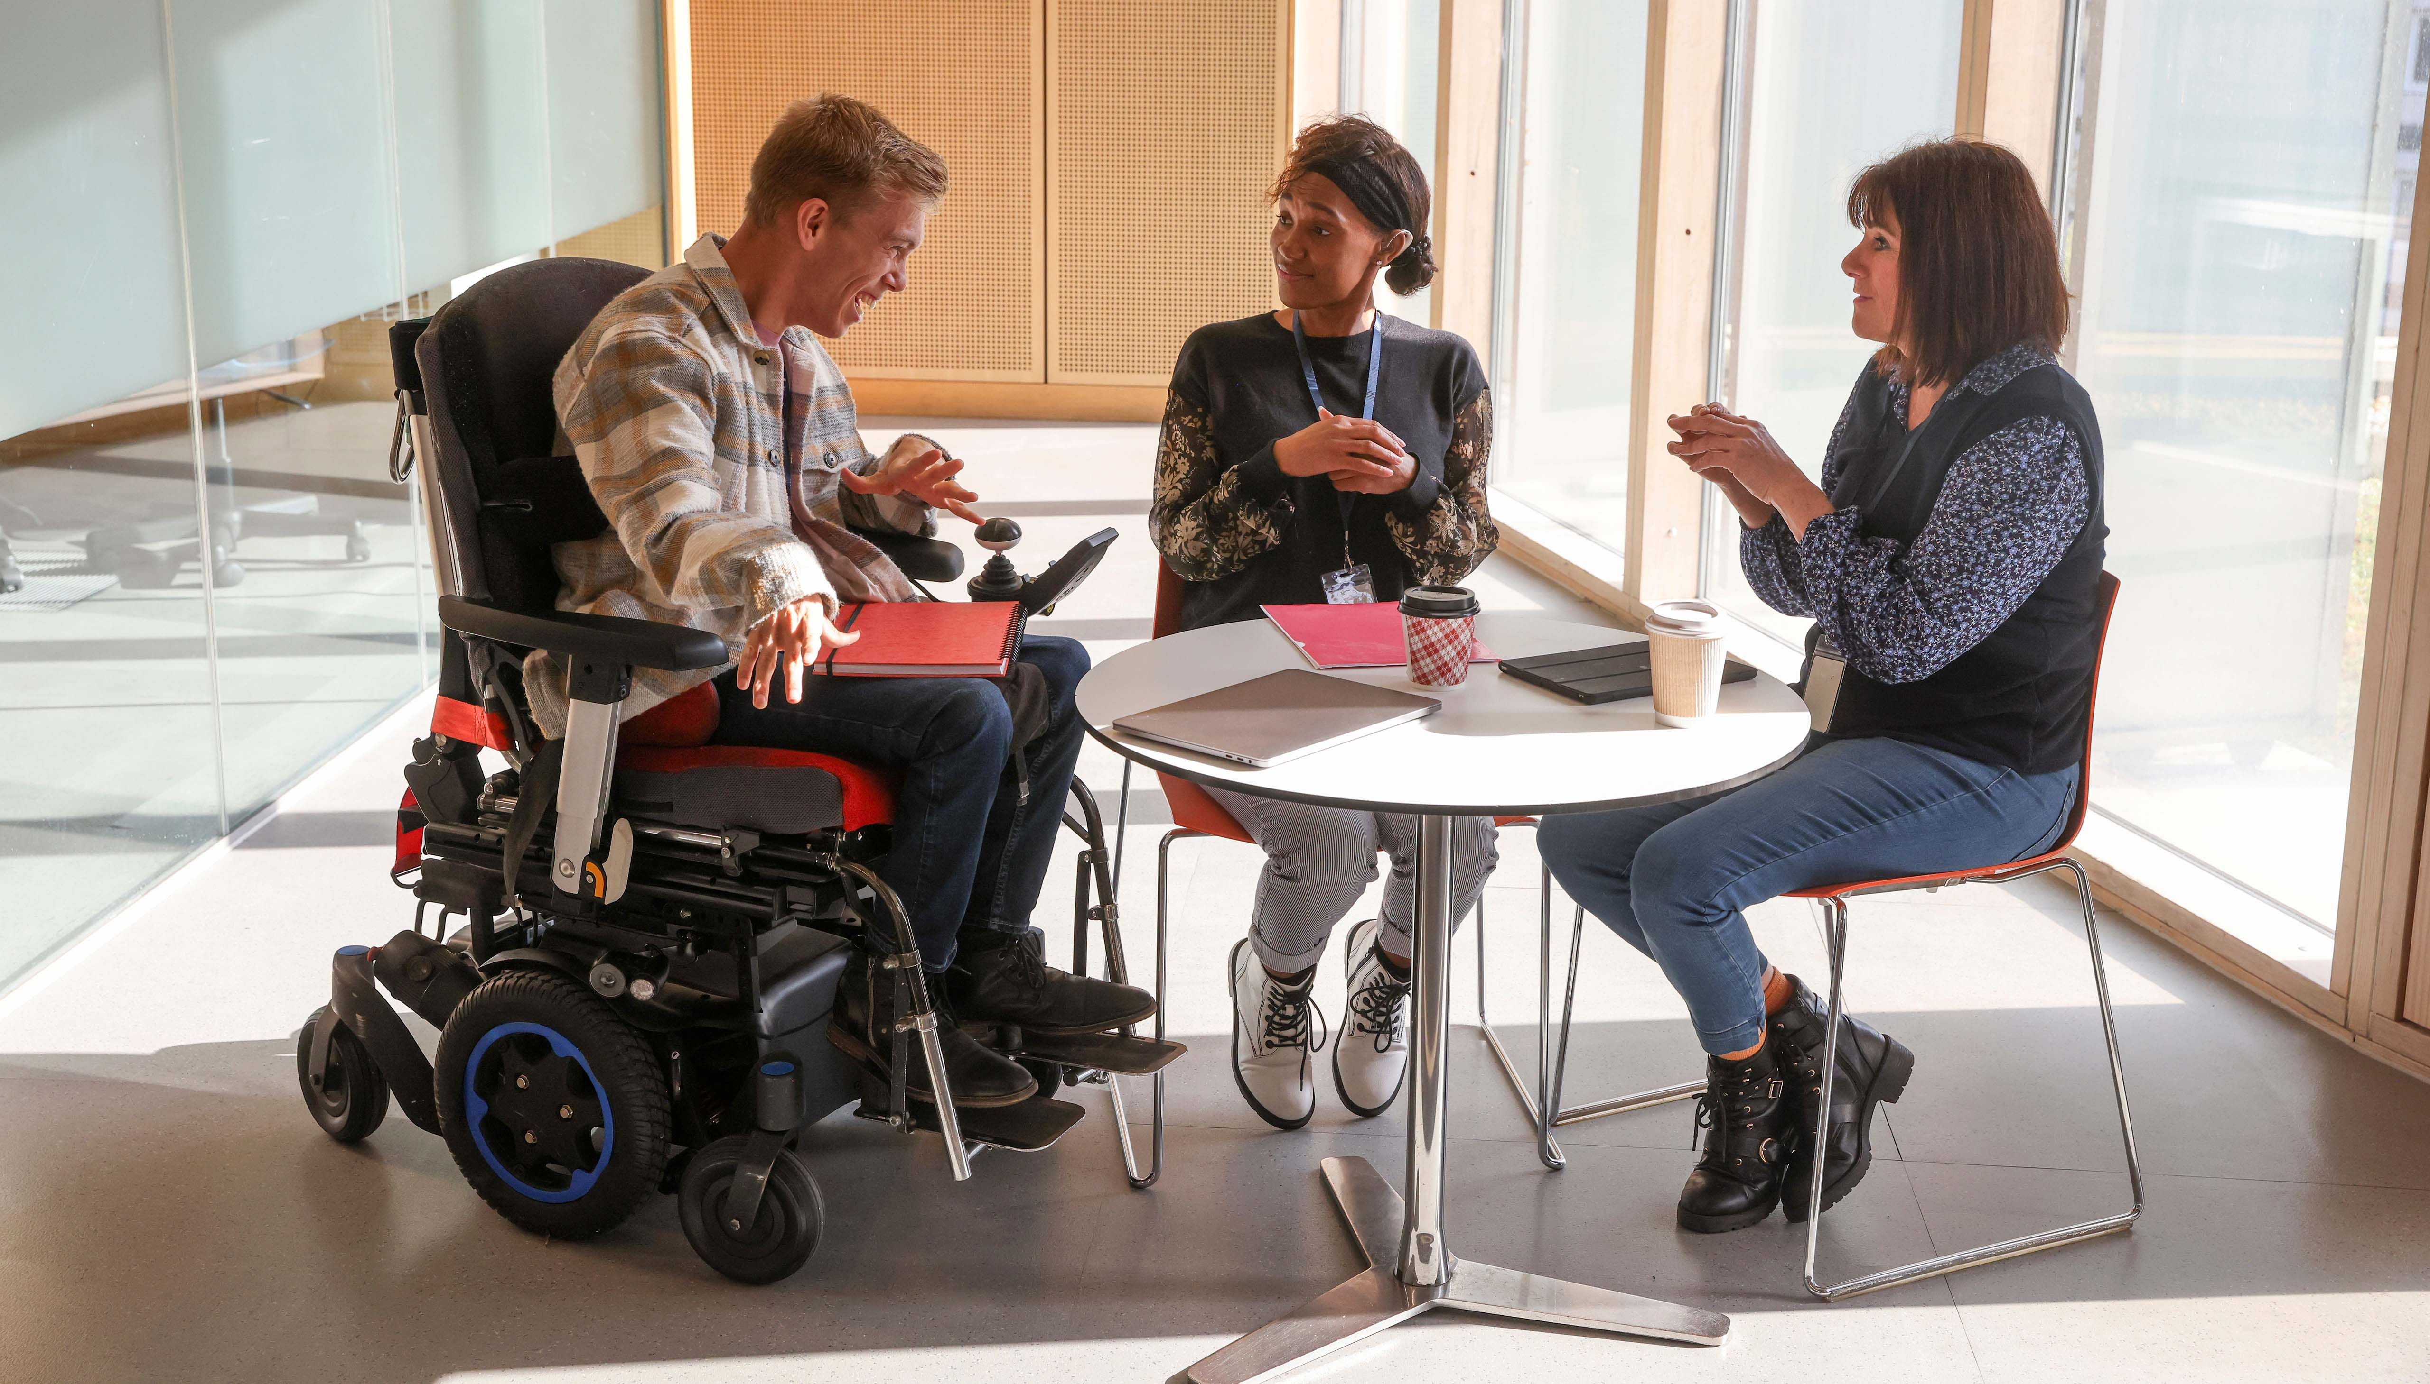


SUPPORTED EMPLOYMENT THROUGH CONNECT TO WORK

Slide 2
What is Connect to Work?
1
2
3
4
Voluntary
Connect to Work is a locally led, voluntary Supported Employment programme to help disabled people, people with health conditions and those with complex barriers to employment who want to work, to get into and on in work.
Evidence-based
It is based on the ‘place, train and maintain’ Supported Employment model, evidenced to be effective for those with disabilities, health issues and multiple barriers to employment, to find and fulfil their potential to work.
Locally-led
Local Authorities are designing their own Connect to Work programmes, to tackle economic inactivity and expand employment opportunities for those outside the workforce and facing greater labour market disadvantages.
Intensive support
Connect to Work will provide out of work participants with intensive employment support for up to 12 months. It will also include support for up to 4 months for people in-work who are at risk of losing their job.

Slide 3
Why Connect to Work?
Over 1.9m people in the UK would like to work but are not participating in the labour market.
The most common reason for non-engagement in the labour market is long-term sickness.
In the last ten years the working age disabled population has increased at around 15x the rate of the total working-age population.
Disabled People and people with health conditions often also have multiple and complex barriers to work.
The period November – January 2025 shows the UK labour market has 819,000 vacancies.

Slide 4
What does Connect to Work mean for Employers?
1
2
3
Job Matching
A dedicated Employment Specialist will work with an employer to match participants with suitable open market jobs, which are paid at, at least, minimum wage.
Partnership Building
The Employment Specialist will continue to support the participant and employer to navigate their working relationship. This allows strong partnerships to be built which will empower individuals and employers at every stage of the employee lifecycle.
Access to Expertise and Support
Connect to Work will support the employer by offering guidance on adapting workplaces, communication strategies and understanding the needs of individuals with disabilities or other needs, as well as providing the practical in work support needed to ensure everyone can flourish.

Slide 5

Benefits to the business
Studies of SUPPORTED EMPLOYMENT have found employing disabled people to be associated with: | POTENTIAL INCREASED PRODUCTIVITY INCREASED CUSTOMER DIVERSITY REDUCED STAFF TURNOVER IMPROVED WORK ENVIRONMENT REPUTATIONAL GAINS

Slide 6
Connect to Work
1
2
3
4
Recruitment
A Connect to Work Employment Specialist will work in partnership with employers to match participants to suitable job opportunities, saving time and recruitment costs.
Job retention and inclusive practices
The Employment Specialist will provide comprehensive support for the employee and employer to create a diverse and inclusive workplace.
On and Off job support
Connect to Work participants will be provided with up to 12 months Employment Specialist support (up to 4 months if already in work), supporting induction, training, career planning and identifying potential reasonable adjustments, if required.
Stronger links to support networks
Employment Specialists can direct employers to useful services, for example, starting their disability confident journey by registering to become a Disability Confident Employer through to progressing employers on that journey.

Slide 7
Participant support package
Engagement
Opportunity for a potential participant to learn about Supported Employment to decide whether it is right for them.
Employer engagement
The participant learns about the job and can work out a plan with the employer on how they can best be supported through recruitment and in the workplace.
Vocational profiling
A planning process allowing participants to identify what they want to achieve and create a plan to get there.
On and Off job support
The participant is supported to learn the job and sustain employment; this may include job coaching, training and support from a mentor and workplace reviews.
Job finding
The participant is supported to find vacancies by matching their skills to a role that meets their employment goals.

Slide 8

Benefits to the business
Getting started For more information on employing through Connect to Work contact your Local Authority. | What happens next?
 | Once connected with your local area, an Employment Specialist will complete a job analysis to understand the tasks and attributes associated with the role to match to the profile of a Connect to Work Participant. An Employment Specialist can walk you through the recruitment process, support with adjustments and guide your recruiting managers. The Employment Specialist will also provide individually tailored support for your employee, support workplace culture and empower team members to provide natural support.

Slide 9
FAQs
Can any sized employer take part?
There is an increasing number of employers using supported employment and the size of an organisation should not prevent them from taking part in Connect to Work.
We don’t have time to provide support
A key benefit of Connect to Work is the access to Employment Specialists who can work in partnership with you and the participant to understand your business requirements whilst working to build the confidence and capability of the wider workforce.
What about increased sick leave?
Studies show there is little to no difference between the amount of sick leave taken by employees on supported employment programmes vs not. Any concerns can be shared with the Employment Specialist and solutions formulated.
Are reasonable adjustments costly?
Reasonable adjustments are a legal requirement for all employers, often cost very little and can improve efficiency. For example, providing flexible working patterns may allow an individual to work the hours they are most productive.

Slide 10
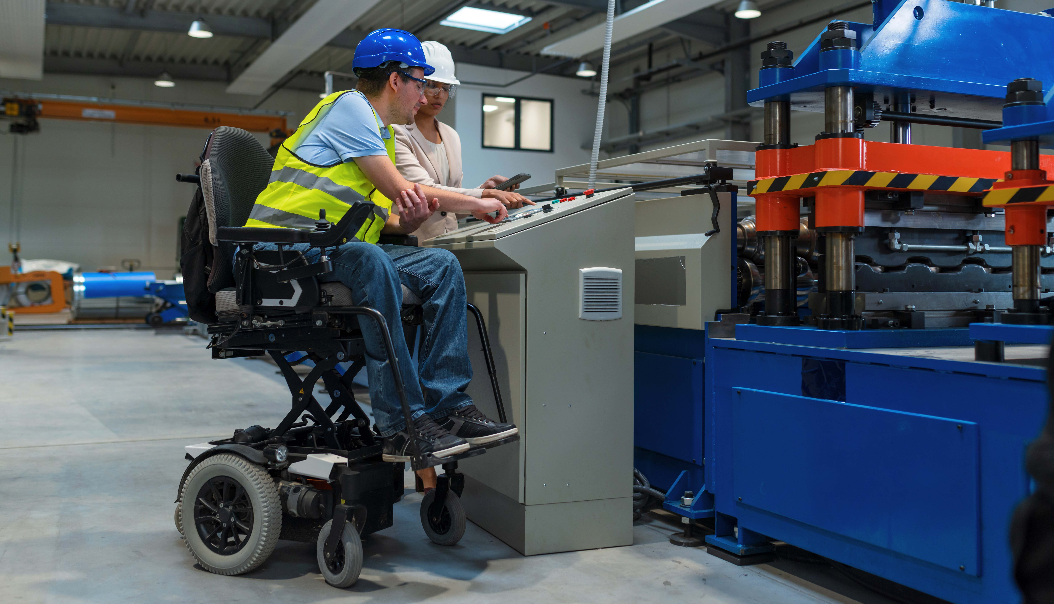
ANNEXES

Slide 11
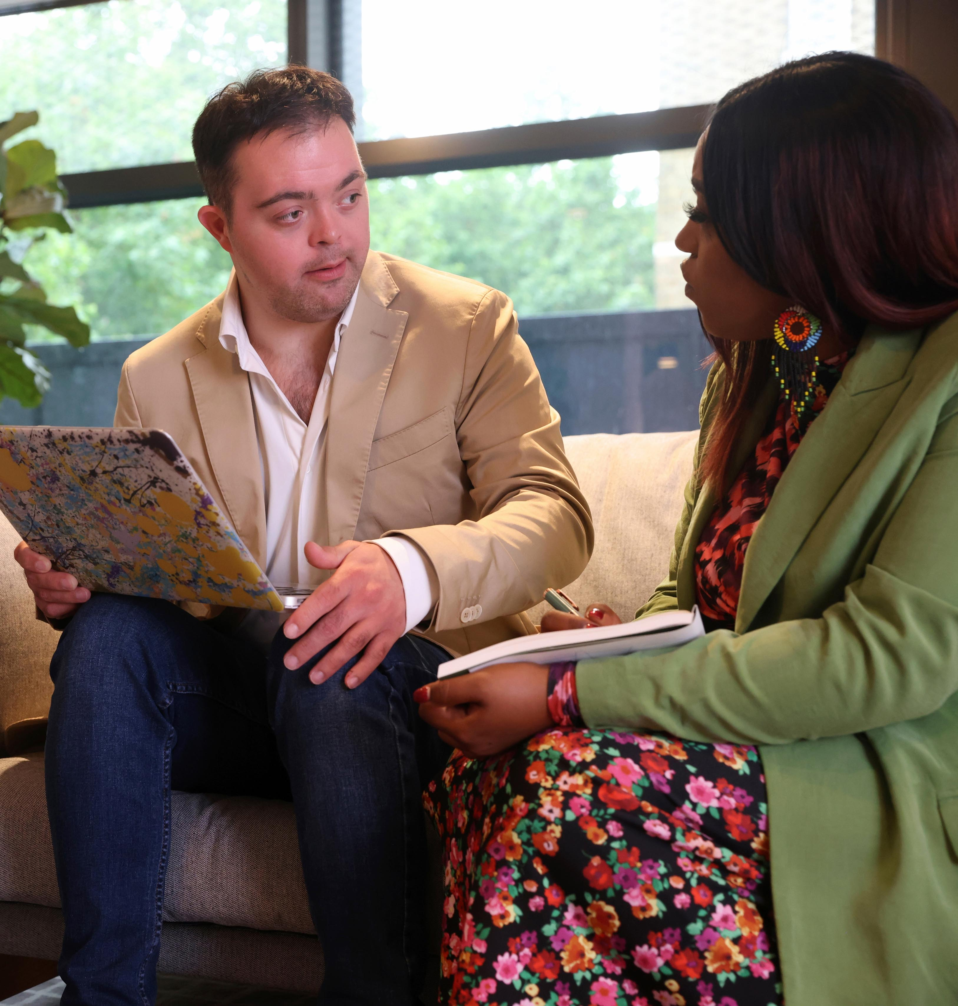
Reasonable adjustments
Reasonable adjustments are changes an employer makes to remove or reduce a disadvantage related to someone's disability.
They are:
Specific to an individual person.
They can be for any disability (physical or mental health) including long term health conditions.
They can cover any area of work.
What is reasonable depends on each situation.
The Employment Specialist will help Employers and Employees to identify and implement any adjustments.
These are often of no or low cost and can be simple to set-up.

Slide 12

Reasonable adjustments examples
Providing equipment, services or support
Providing additional or adapted equipment like a chair or offering 1-1 support to help manage workload. Changing someone's working arrangements
Allowing someone to work from home or to change their working pattern. Finding a different way to do something
Introduce different training methods for different ways of learning or distribute tasks differently within a team.
Making changes to the workplace
Providing an accessible parking space or changing the layout of an office space.

Slide 13

Employer case study
One of our most successful experiences involved hiring a participant with a learning disability. The process began with an in-depth job analysis conducted by an Employment Coach, ensuring they understood both the role and the unique needs of the candidate. This analysis… defined the job expectations and [suggested] how best to accommodate the employee’s requirements... This personalised approach ensured that our new employee felt empowered and confident in their role.
The continual support provided to both the employee and our team has been instrumental in fostering an environment conducive to growth and productivity... this ongoing support ensures that both the individual and the team benefit from a well-rounded understanding of each other's needs and expectations.
The loyalty displayed by our supported employee has not only strengthened our team but has also instilled a deeper commitment to diversity and inclusion across the organisation.
“
Engaging with Supported Employment not only provided us access to a diverse talent pool but also enriched our team’s environment and enhanced our reputation as an inclusive employer.
Sodexo is a large sized employer in the food services and facilities and management industry.

Slide 14

Tips for getting started
GET TO KNOW THE CLIENT
Understand their needs, triggers, and what their “normal” looks like. This insight can make a world of difference.
ENGAGE EARLY
Schedule site visits or virtual meet-and-greets in advance. This helps the individual to feel more familiar and less overwhelmed when they start.
SUPPORT MANAGERS AND TEAMS
Provide them with relevant training and information about the client’s condition. This fosters a more welcoming and accommodating environment.
We wish we had known… the importance of preparing both the client and the team… early engagement and thoughtful preparation can significantly enhance the experience for everyone involved.
Apogee is a large sized employer that specializes in designing and developing metal and glass products and services for commercial buildings, displays and framing art.

