Slide 1
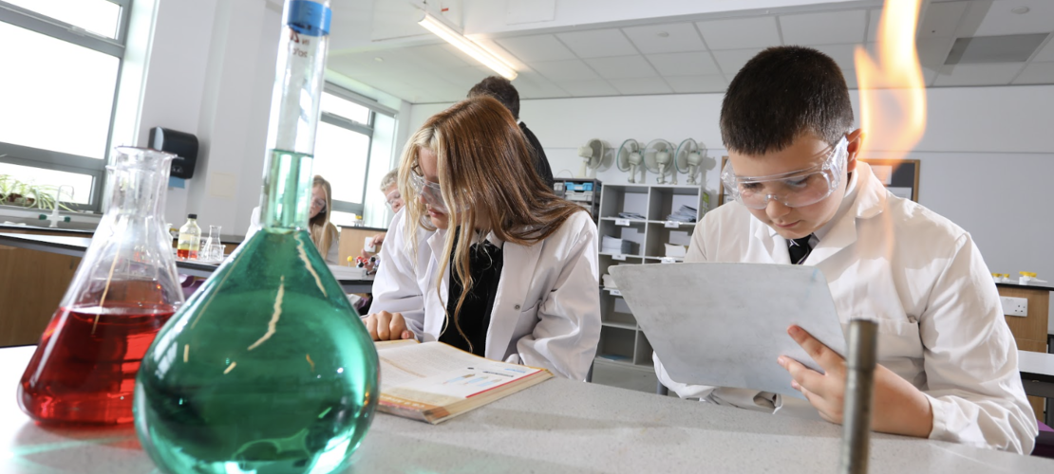


Key Stage 4 Options

Slide 2
Core Curriculum
All students will study :
GCSE English Language
GCSE English Literature
GCSE Maths (tiered entry Higher or Foundation)
GCSE Statistics (tiered entry Higher or Foundation)
GCSE Science (all students will study three separate Sciences - Biology, Chemistry, Physics - this will lead to either 2 or 3 GCSEs depending on the pathway which is best for each student)
Core PE
PSHE
Notes:
KM instead of miles

Slide 3
Sciences an explanation…
(tiered entry Higher or Foundation)
Combined Science
All three Sciences studied
6 exams sat
Slightly less content
2 GCSE grades achieved
4-4 , 5-4, 5-5 etc…
Separate Science
All three Sciences studied
6 exams sat
More content
3 GCSE grades achieved
Biology
Chemistry
Physics
Notes:
KM instead of miles

Slide 4
Ebacc qualifications
Students who choose to study a certain combination of subjects achieve the Ebacc.
This would mean studying History or Geography and French or Spanish as two of their three GCSE options. Alongside Maths, 2 x English and 2 x Science (Computer Science is also included here).
The government has a target of a significant proportion of students following this curriculum however we recognise that it is not the best curriculum choice for all students. We do ask that students choose one from History, Geography, Computer Science, French or Spanish to ensure they have a broad, balanced curriculum.
Notes:
KM instead of miles

Slide 5

Art GCSE (AQA)
Design Technology GCSE (AQA)
Subjects offered…
(Click the link to access the specification)
Hospitality and Catering (WJEC)
Spanish GCSE (Pearson)
Photography GCSE (AQA)
Drama GCSE (AQA)
Computer Science GCSE (Pearson)
Music GCSE (Pearson)
Business and Enterprise (NCFE)
Geography GCSE (AQA)
Imedia Cambridge National (OCR)
PE GCSE (OCR)
Childcare Cambridge National (OCR)
History GCSE (AQA)
Religious Studies GCSE (AQA)
French GCSE (Pearson)
Sport Studies Cambridge National (OCR)
22

Slide 6
Option subjects that are offered
GCSE
Languages - Spanish and French (tiered entry Higher or Foundation) we can offer entry for other languages on an individual basis but not teaching towards this
Creative subjects - Music, Drama, Art, Photography, Design Technology
Sport - Physical Education
Humanities - History, Geography, Religious Studies
IT - Computer Science
Applied course
Creative subjects - Hospitality and Catering, Child development
Sport - Sport Studies
IT based - Business and Enterprise, Creative Imedia
Notes:
KM instead of miles

Slide 7
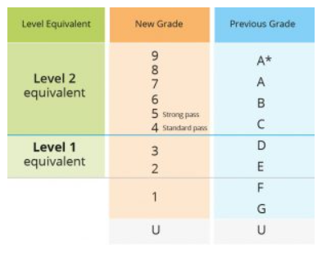
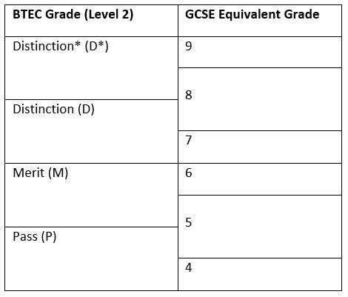
Grading of courses
Notes:
KM instead of miles

Slide 8

How do i make choices?
What do I enjoy?
What careers might I be interested in?
What do I think I will do well in?
Find out about the subjects - talk to teachers and students in y10/11 doing the course
Make sure you know what the assessment is like (all exam, some NEA, practicals)
Notes:
KM instead of miles

Slide 9

How do i make choices?
Do I like the teacher?
What are my friends doing?
Choose one because you think you might like it without finding out what it actually involves
Notes:
KM instead of miles

Slide 10
How does the process work?
Not every combination will be possible
Read all of the information in the booklet and talk to teachers
Google form for top 5 choices (you will only do 3) remember you must do either History, Geography, Computer Science, French or Spanish
Option blocks will be created
Some subjects will be in more than one block
Notes:
KM instead of miles

Slide 11
Example blocks
Block A | Block B | Block C
History | History | Geography
French | Geography | Spanish
PE | Computer Science | DT
Sport Studies | Art / 3D Design | Photography
Art / 3D Design | Music | Drama
Hospitality and Catering | RS | Business and Enterprise
iMedia | Business and Enterprise | Hospitality and Catering
Notes:
KM instead of miles

Slide 12

1
2
3
4
Course choice
Read our options booklet and
research the subjects
you are interested in.
Speak to current year 10 and 11 students about their options. Talk to teachers about what you will learn in each subject.
Options Evening
Monday 23rd March
5.30pm
Apply
Complete the Google Form that will be shared on your pastoral google classroom.
You will make three choices and two reserve choices
DEADLINE: Wednesday 22nd April
Guidance discussions
If your top 3 subject choices don’t work as a combination you will be asked to meet with Mr Harold, Mrs McPherson or Mrs Willis to discuss the pathways which do work.
Options timeline
4

Slide 13
Further information
NCS
The National Careers Service provides information, advice and guidance to help you make decisions on learning, training and work opportunities.
Careers box
This is a free online library of careers related films, news and information
ICould
This website has lots of videos you can explore by employment sector or life theme.
24

