Slide 1
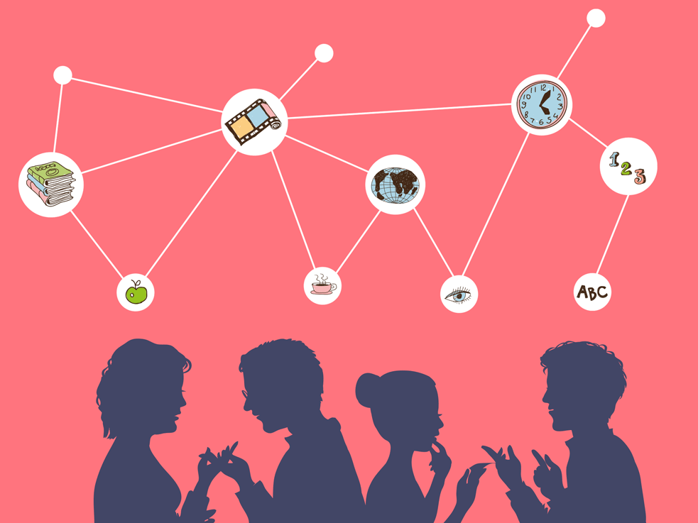
Welcome to English Language A-level!

Slide 2
Let’s warm ourselves up with a quick quiz!
How many languages are spoken worldwide today?
What are the three most widely spoken languages in the world?
Which book has been translated in to the most languages?
What was the first language spoken in outer space?
How many countries have Spanish as their official language?
What language is spoken in Brazil?
Which language has the most speakers in Europe?
Which country has the most languages spoken today?
Where might you find people speaking Gaelic?
How many words do you think there are for rain in Hawaiian? Closest guess wins!

Slide 3
Let’s warm ourselves up with a quick quiz!
How many languages are spoken worldwide today? Roughly 7,100
What are the three most widely spoken languages in the world? English, Mandarin Chinese and Hindi
Which book has been translated in to the most languages? The Bible
What was the first language spoken in outer space? Russian
How many countries have Spanish as their official language? 20
What language is spoken in Brazil? Portuguese
Which language has the most speakers in Europe? Russian
Which country has the most languages spoken today? Papua New Guinea (839 languages)
Where might you find people speaking Gaelic? Scotland
How many words do you think there are for rain in Hawaiian? Closest guess wins! 200

Slide 4
What do we study in English Language A-level?
This A-level is very different from your GCSE course! It’s more about linguistics: the study of language itself.
We explore how language is linked to:
Gender
Power
Occupation
Social class
Age
Sexuality
We study how children acquire language - how they learn to speak, read and write.
We explore how language creates meanings and representations.

Slide 5
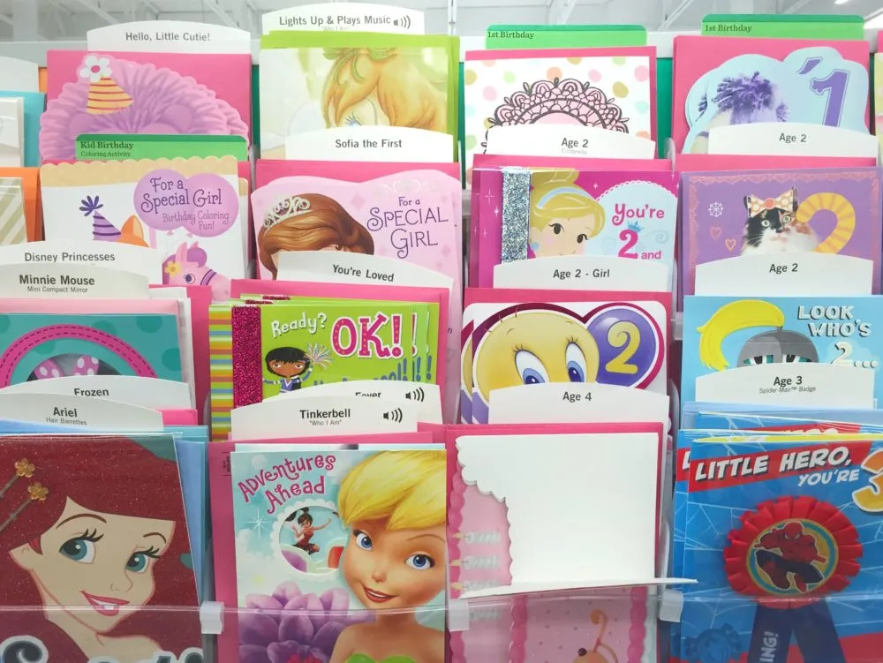
Language study: how is language used in greetings cards?
In English Language A-level, we think about the power of language and how language is used to represent different people in different ways.
Often, greetings cards utilise a number of stereotypes and cliches.
Why do you think this might be?

Slide 6
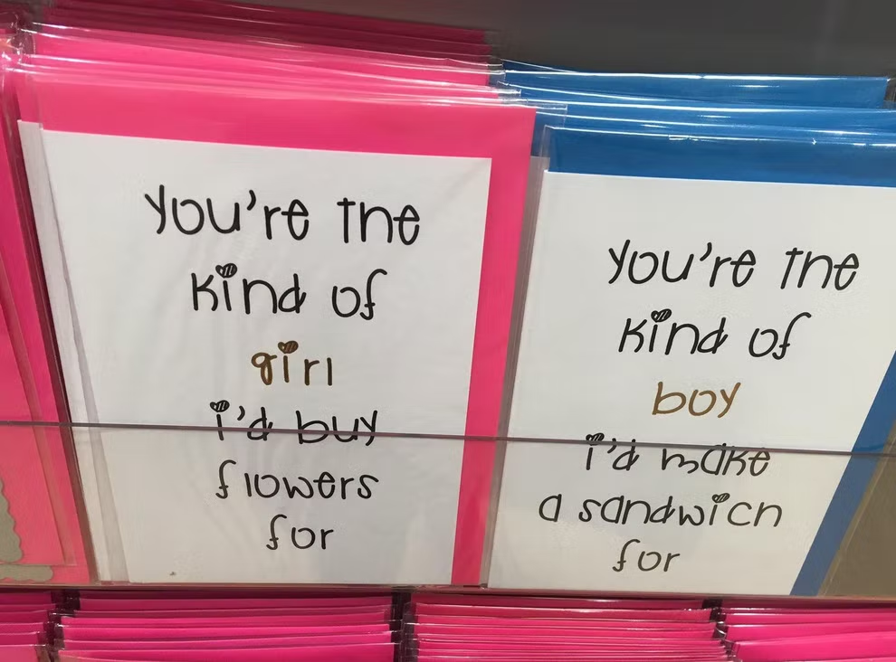
Language study: how is language used in greetings cards?
What stereotypes can you identify?
How do these cards represent men?
How do these cards represent women?

Slide 7
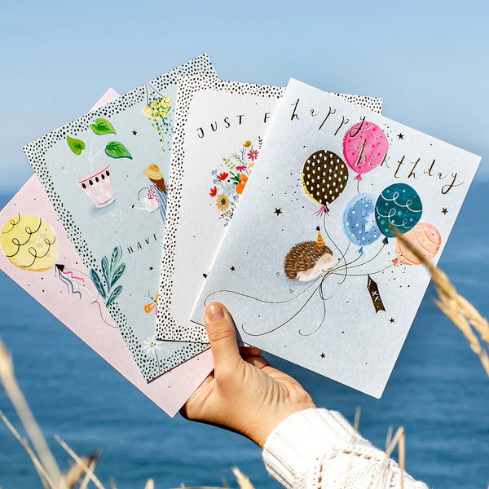
Language study: how is language used in greetings cards?
Study your selection of cards and complete your information grid.
In five minutes, we will swap cards.

Slide 8
Card 1 | What stereotypes does your card refer to? | How are different genders represented? | How is age represented? | Any other interesting observations?
Card 2 | What stereotypes does your card refer to? | How are different genders represented? | How is age represented? | Any other interesting observations?
Notes:
Print double-sided with next slide

Slide 9
Card 3 | What stereotypes does your card refer to? | How are different genders represented? | How is age represented? | Any other interesting observations?
Card 4 | What stereotypes does your card refer to? | How are different genders represented? | How is age represented? | Any other interesting observations?
Notes:
Print double-sided with next slide

Slide 10
Let’s regroup and discuss our findings…
What stereotypes did you identify when studying these cards?
How were men represented overall?
How were women represented overall?
How were different ages represented?
Did you make any other interesting observations?

Slide 11
Creative Challenge!
You work for Hallmark and have been tasked with designing a gender-neutral Valentine’s Day card.
What images will you put on your design? Why?
What colour scheme will you use? Why?
What text will you add? Why?

