Slide 1
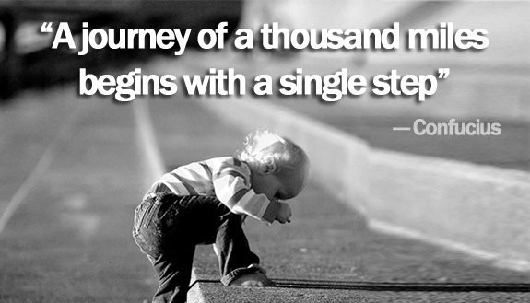

Slide 2


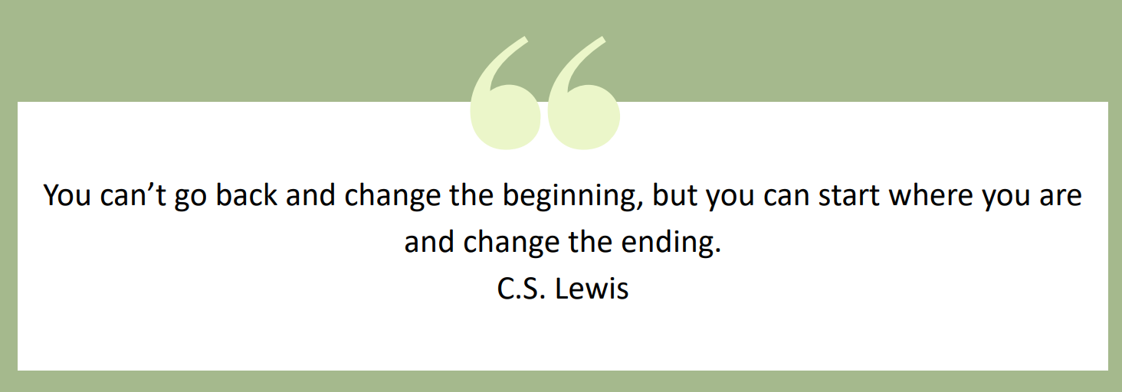

Slide 3

Aim of this session
Revision guidance
Well-being during the exams
What you need to know about the exams
The goal is short, pragmatic and actionable tips
Kindness | Integrity | Determination | Manners | Ambition | Positivity

Slide 4
Step 1 is Key!
What do I need to know for my exams…
Supporting My Child at Home | Longbenton High School
Kindness | Integrity | Determination | Manners | Ambition | Positivity

Slide 5

Top 10 revision tips
Make a revision timetable
Make sure you know which topics are being assessed
Practise lots of exam style questions
Get someone test you on key facts / formulas
Sleep well and eat well
Take regular breaks
Vary the topics and subjects you revise
Go back more regularly to topics you find harder
Block time out for the things you enjoy other than revising
It’s never too early to start!
Kindness | Integrity | Determination | Manners | Ambition | Positivity

Slide 6

  How did I do in my last assessments?
  What went well?
  What didn’t go well?
  What shall I do next time?
  What have I learnt from doing these tests?
  How will I adapt my planning/revision for next time?
  Do I need to improve my organisation and if so how?
Evaluating

Slide 7
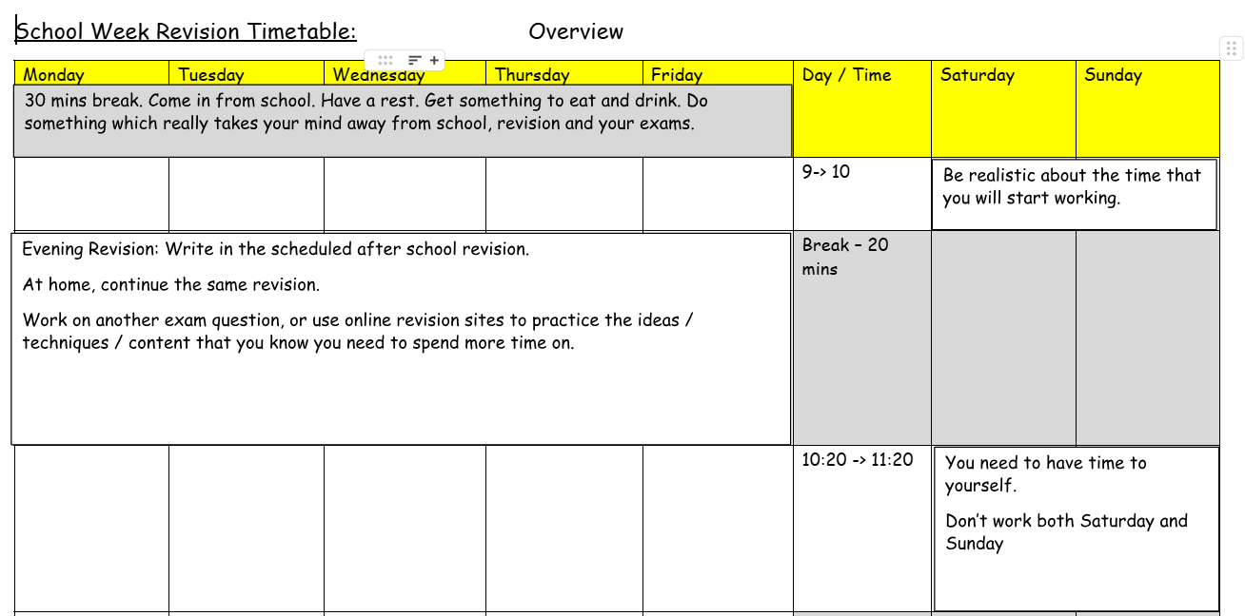

Slide 8
Exam timeline
Mock exams (Y11)
23rd February - 4th March 2026
Mock exams (Y10)
16th March - 20th March (6 school weeks + half term)
22nd June - 1st July 2026 (17 school weeks)
Kindness | Integrity | Determination | Manners | Ambition | Positivity

Slide 9
Exam timeline
Written exams
Thursday 7th May - Wednesday 17th June (11 school weeks)
Speaking / Art / Photography exams
Completed prior to written exams starting
Contingency Day - Wednesday 24th June
Kindness | Integrity | Determination | Manners | Ambition | Positivity

Slide 10

Exam success relies on…
Knowledge AND technique
Kindness | Integrity | Determination | Manners | Ambition | Positivity

Slide 11
Top 10 revision tips
Make a revision timetable
Make sure you know which topics are being assessed
Practise lots of exam style questions
Get someone test you on key facts / formulas
Sleep well and eat well
Take regular breaks
Vary the topics and subjects you revise
Go back more regularly to topics you find harder
Block time out for the things you enjoy other than revising
It’s never too early to start!
Kindness | Integrity | Determination | Manners | Ambition | Positivity

Slide 12
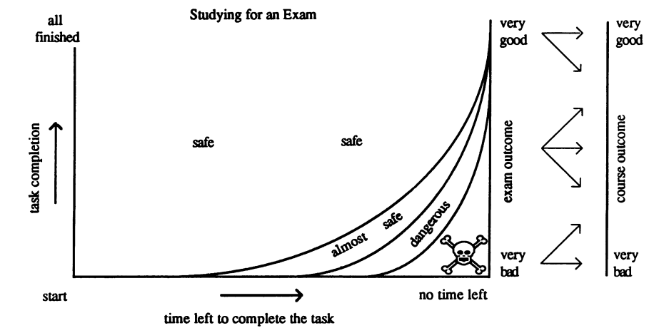
The procrastination scallop

Slide 13
Overcoming the procrastination scallop
Identify the core knowledge needed to understand a topic
Set a short deadline to learn material and strategies to do so
Assess core knowledge, set a high pass mark
Identify areas of concern and ‘re-learn’

Slide 14
Main Activity 1: What are the stumbling blocks to my revision?
What might get in the way of you revising?
Problems Solutions

Slide 15


Slide 16
Main Activity 3: 10 Revision Tips
 | Strategy | Rank order of current usage for me/ my child
1 | Question Cards
2 | Mind-maps
3 | Practise papers
4 | Testing yourself
5 | Revision sessions/support
6 | Revision videos
7 | Revision podcasts
8 | Revision Apps (GCSE Pod)
https://www.youtube.com/watch?v=VL2EBmknPpg Watch the clip and make notes. Your teacher will pause as after each strategy.

Slide 17

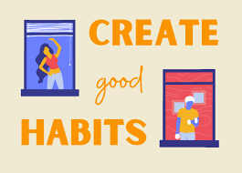
Habits are key…

Slide 18
Atomic Habits
Small Gains, Big Results: Improving by just 1% every day results in being 37 times better by the end of the year
Focus on Systems, Not Goals: Goals are about the results you want to achieve; systems are about the processes that lead to those results
The "Who" over the "What": Instead of saying "I want to get an A," say "I am the type of student who never misses a study session.
Every Action is a Vote: Each time you perform a habit, you are casting a vote for the type of person you want to become
Make it Easy (The Two-Minute Rule: start with a version that takes less than two minutes)

Slide 19

Atomic Habits
Focus on Systems, Not Goals: Goals are about the results you want to achieve; systems are about the processes that lead to those results

Slide 20
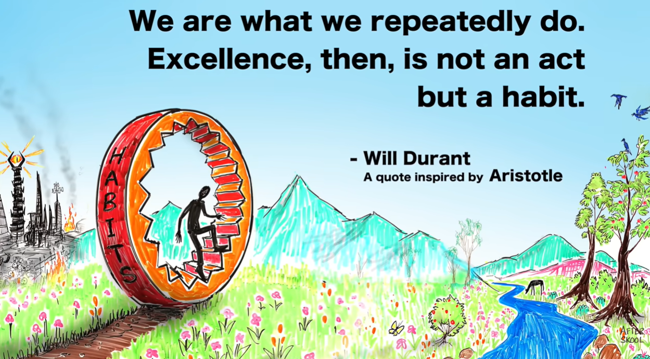

Habits are key…

Slide 21
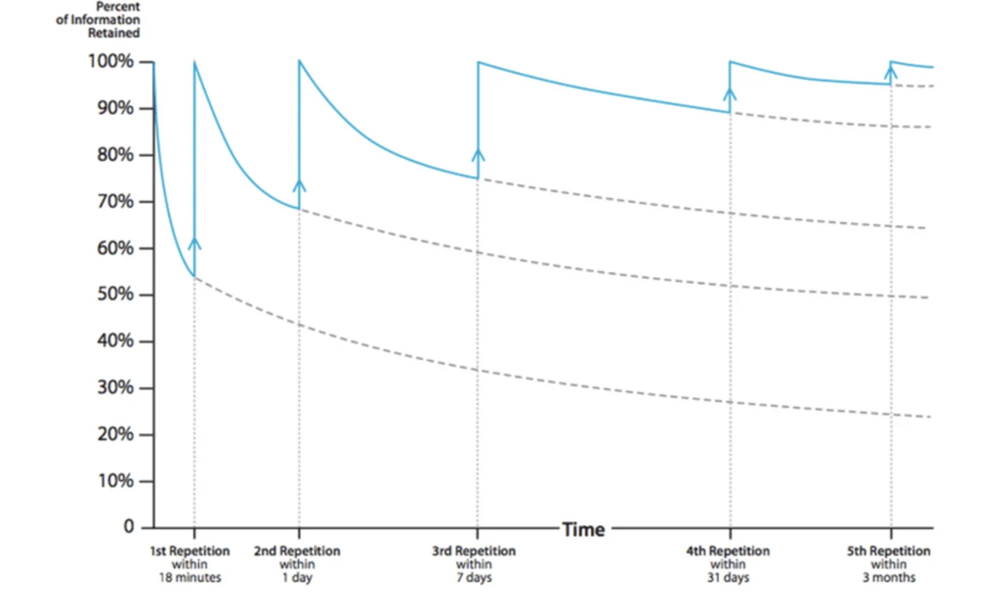
Ebbinghaus’ Forgetting Curve
Visual representation of the forgetting process
Loss of memory over time is exponential
Spaced practice is more effective than massed practice (cramming)
Notes:
The Forgetting Curve is a visual representation of the forgetting process, showing that the loss of memory over time is exponential. After a couple of days around 75% of what we have learned is forgotten. If we use spaced learning, we can overcome the forgetting curve. This spaced practice is more effective than massed practice (or cramming). If we repeat the information at strategically spaced intervals, it increases the level of information retained in the long-term memory. The more you review and revise what you have learned the less is forgotten.
Memories weaken over time and the biggest drop in retention happens soon after learning.
We are more likely to remember if the new knowledge has meaning or is linked to our current knowledge.
Reviewing regularly reduces the rate at which you forget.
How the information is presented has an impact on memory.
Stress, hunger, anxiety and a lack of sleep play a part in how well we retain information.

Slide 22
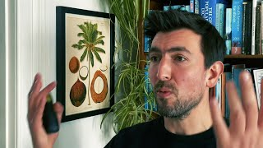
Model Maps
Kindness | Integrity | Determination | Manners | Ambition | Positivity

Slide 23

GCSE Pod

Slide 24
Flash cards as
practice testing

Slide 25

Things to remember
Ensure flashcards are not overloaded
Be clear about the purpose of the flash cards - test/recall
Consider online/digital flashcards

Slide 26
What goes on the cards?
Front of card – reverse of card
Keyword – definition
Name of a process – description or explanation
Image (graph, equipment, object, picture, example) – explanation
Question – answer(s)

Slide 27
Example
1. Name the four chambers of the heart
2. Why does the heart have valves?
3. How are arteries adapted to carry blood away from the heart?

Slide 28
Example
1. Left atrium, left ventricle, right atrium, right ventricle
2. To stop the blood flowing backwards
3. Strong and elastic walls. Thick layers of muscle. Elastic fibres to stretch. Thick walls compared to lumen

Slide 29
Chunking time – the Pomodoro technique
Decide on the task.
Set the timer for 25 minutes.
Work on the task. It is important that the task is not interrupted and that this time is spent on the task itself, not setting up the task
When the timer rings take a short break, normally five minutes.
Go back to step 2 for four Pomodoros.
Take a longer break, normally 20 to 30 minutes. Then return to step 2.

Slide 30
Social Media
What is your current relationship with social media?
Is it healthy?
Have you tried a social media ‘detox’?
Did you know it is designed to be addictive?
Releases dopamine

Slide 31
Social Media Risks
Studies have observed links between high levels of social media use and depression or anxiety symptoms. A study of more than 450 teens found that greater social media use, night-time social media use and emotional investment in social media — such as feeling upset when prevented from logging on — were each linked with worse sleep quality and higher levels of anxiety and depression

Slide 32
Exercise and Sport
“It’s not that exercise is an antidepressant, it’s that not exercising is a depressant”
(David Bidler)

Slide 33
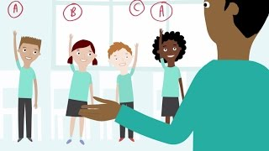
Exercise and Sport
Notes:
https://www.youtube.com/watch?v=VIPyDSkBv3M

Slide 34
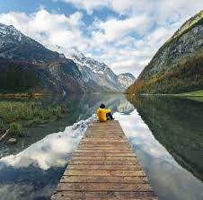
Power of Nature (Rest)
Just being outside is proven to:
1. Lower levels of the stress hormone cortisol
2. Reduce feelings of low mood and depression
3. Improve mental focus and concentration
4. Boost the immune system
5. Reduce tiredness

Slide 35
Sleep
Sleep is a vital part of what makes us human
How much do you need?
Did you know bright lights delay the release of melatonin?
Do you give yourself enough sleep ‘opportunity’?
Do you suffer with ‘social jetlag’?

Slide 36
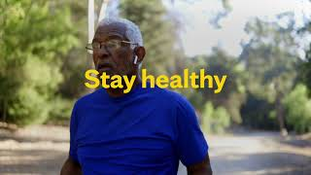
Sleep

Slide 37
Over to you…
Which one thing are you going to try?
Joining a Period 6 club to exercise or socialise
Going to bed a bit earlier
Leaving your phone in another room after 9.00pm
Meeting a friend rather than messaging
Writing down three things you are grateful for
Practising 1 minute of breathing slowly and deeply
Trying a one day social media detox
Going for a 5 minute walk in nature at lunchtime
Saying something kind to another person

Slide 38
Over to you…
Which one thing are you going to try?
Start…
Stop…
Keep…

Slide 39
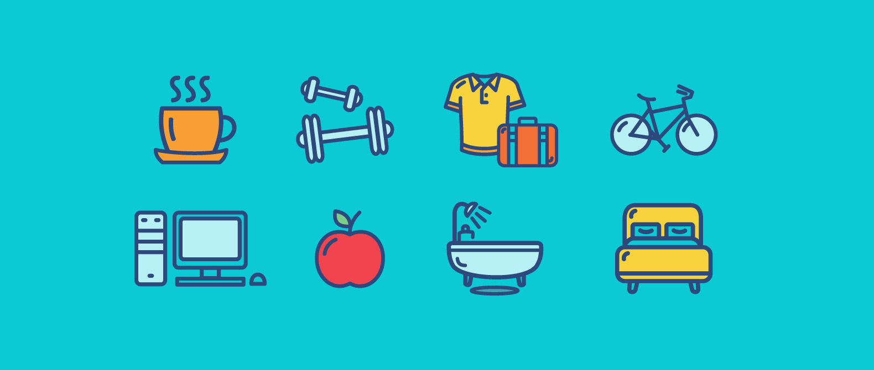
Reflection: What am I getting right?
What do I need to improve on?

