Slide 1
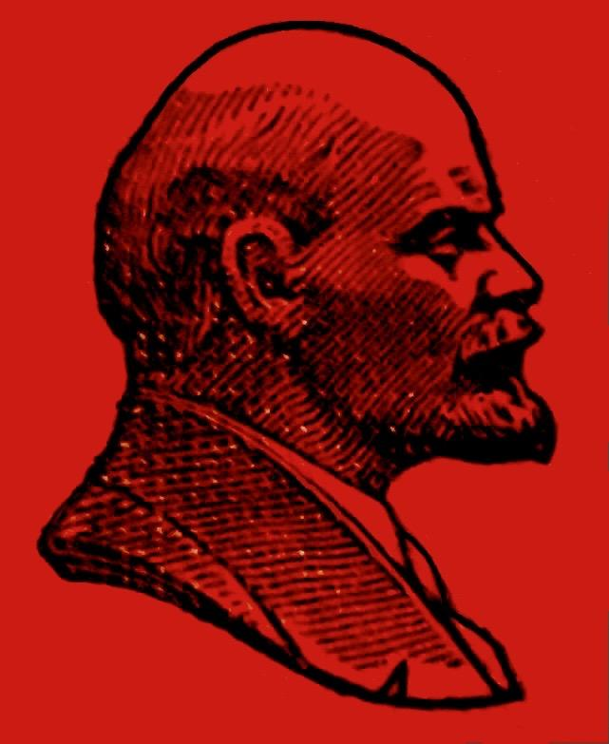
History taster day tasks
Unit 2 - Revolution and Dictatorship 1917-1953
When Lenin died in 1924 there was a power struggle and many in the party battled for who would be the next leader of the USSR.
Can you decide who would have been the best ruler and why?
Use the information to make your judgement
Notes:
Will use Oxford revision guide pages 50-51 for the information

Slide 2
Name | Main Strength | Major weakness | Score out of 10
Leon Trotsky
Joseph Stalin
Nikolai Bukharin
Lev Kamenev
Grigorii Zinoviev
Alexei Rykov
Mikhail Tomsky

Slide 3
Name | Main Strength | Major weakness | Score out of 10
Leon Trotsky
Joseph Stalin
Nikolai Bukharin
Lev Kamenev
Grigorii Zinoviev
Alexei Rykov
Mikhail Tomsky

Slide 4
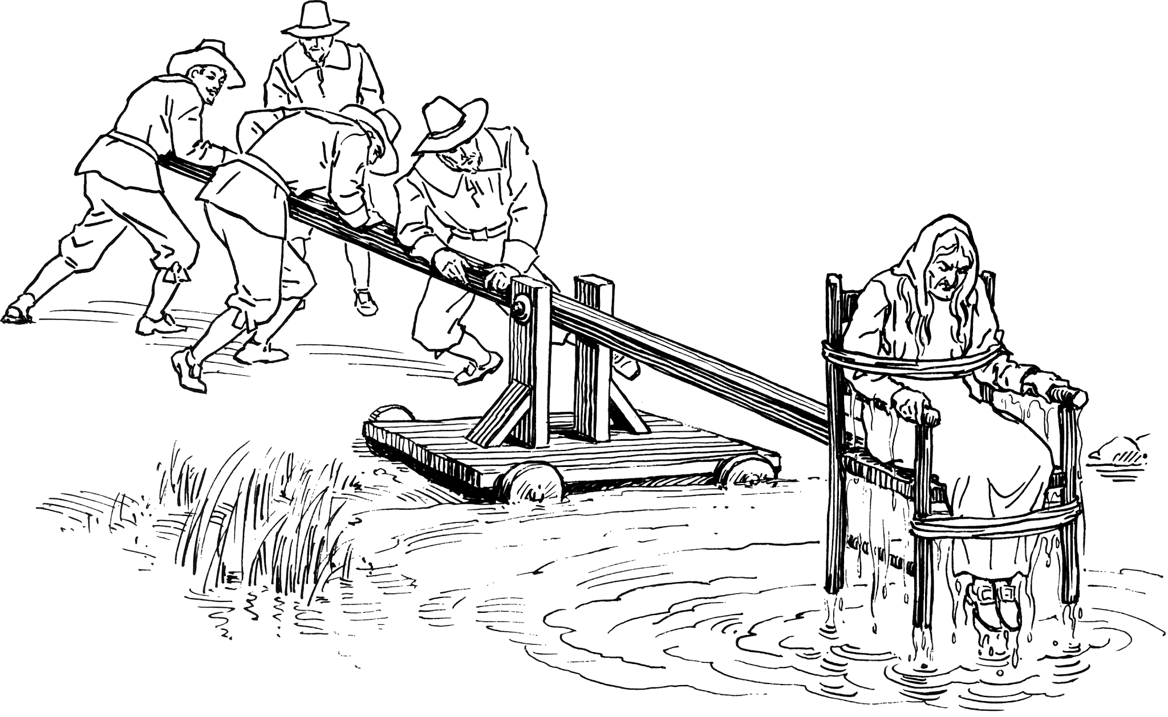
History taster day tasks
Unit 3 - NEA (non examination assessment) Witchcraft
Use the evidence to decide if ____ would have been found guilty of witchcraft in the Early Modern period.
You need to select your three most convincing pieces of evidence for your verdict.
Notes:
Will use Oxford revision guide pages 50-51 for the information

Slide 5
History taster day tasks
Unit 3 - NEA (non examination assessment) Witchcraft
INPUT evidence
Notes:
Will use Oxford revision guide pages 50-51 for the information

Slide 6
A-level History - Witchcraft
A-level History - Witchcraft
Clue | Why is it convincing?
Overall verdict…
Clue | Why is it convincing?
Overall verdict…

Slide 7
Tudors
Transition Day Tasks

