Slide 1


KS4 Maths
Mr Hunter

Slide 2

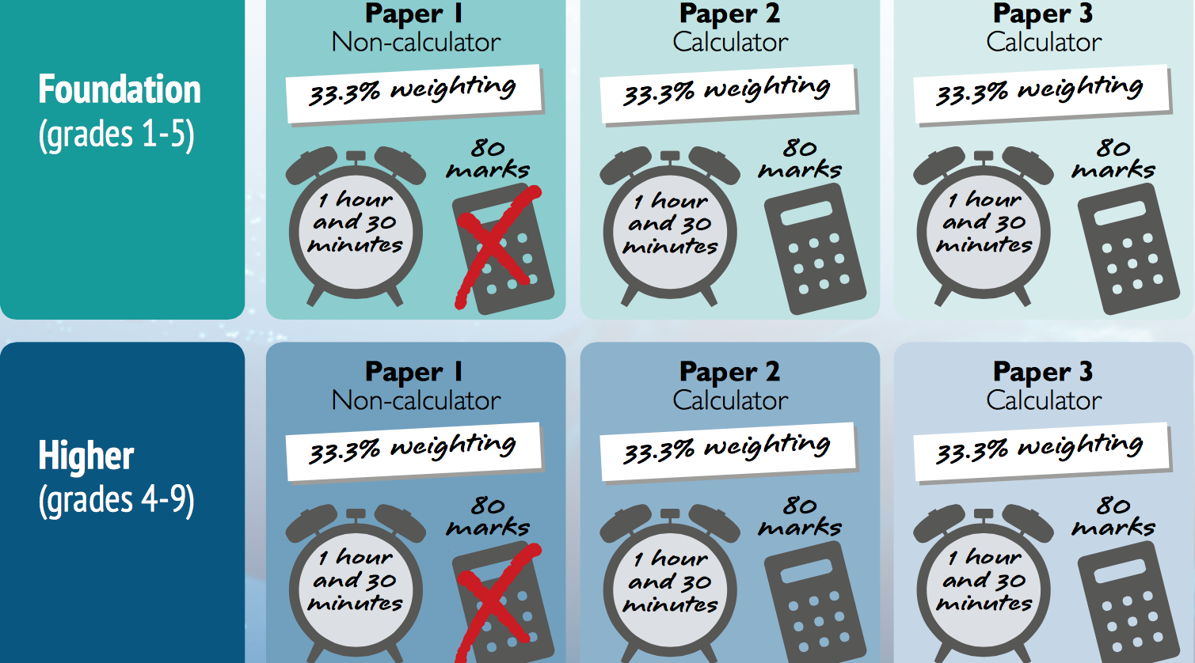
GCSE Maths

Slide 3
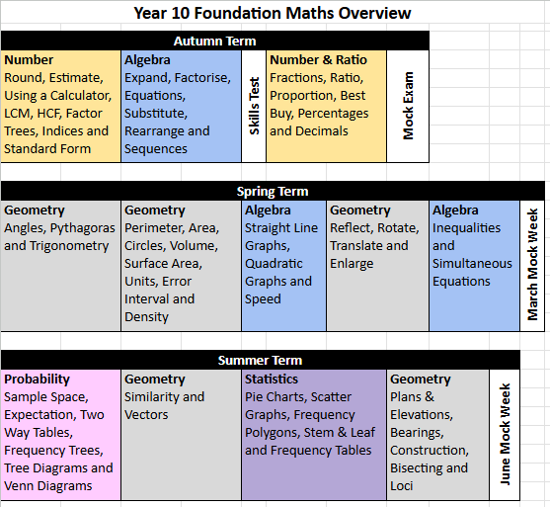
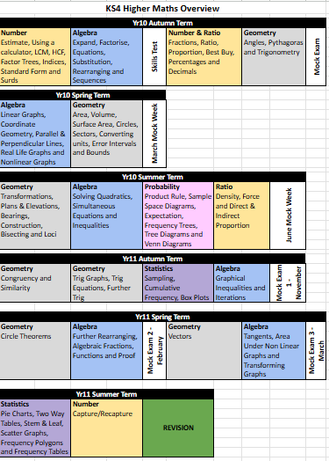
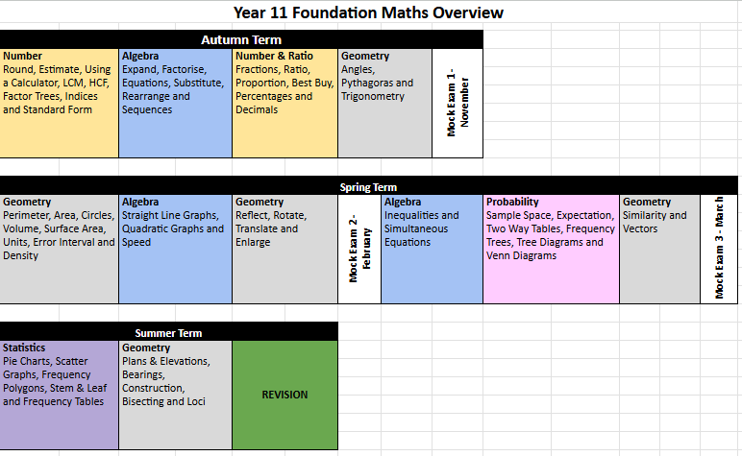
1 Year Overviews

Slide 4


How to Revise
Website Support
Corbett Maths
Maths Genie
What they offer
Tutorial Videos
Practice Questions
Solutions to check their work
“The best way to revise maths is to practice maths”

Slide 5

Information
Revision guides and workbooks available to buy in school, £3.25 each and on Bromcom
Yr 11 Revision every Thursday 3:15-4pm
Yr 10 Homework Drop In after school - Week 1 Wednesday and Week 2 Thursday
Homework set every week to improve independence and revisit recently covered topic (found on Google Classroom)
  Year 11 Paper Based Exam Questions and GCSE Pod
  Year 10 GCSE Pod
Students should buy their own calculator
Support shared on Google Classroom when students are absent

Slide 6
Questions
eh@longbenton.org.uk

