Slide 1
Vaping Key Messages
October 2024

Slide 2
Vaping key messages
If you don’t currently smoke, don’t vape.
Whilst vapes are not risk free, they pose a fraction of the risk of smoking tobacco and for adult smokers, they can be used as a tool to quit.
Children under 18 should never vape and it is illegal to sell a vape to anyone under the age of 18.
It’s also illegal for adults to buy vapes for anyone under 18.
Approximately 1.3 million disposable vapes are thrown away every week in the UK: enough to cover 22 football pitches.
Vaping might make you feel dizzy, give you a headache, make you feel nauseous, mildly stimulated or relaxed.
Vaping increases blood pressure and heart rate and can make you breathe faster.
The effects of vaping are felt around 5 to 10 minutes after your first puff and last for 2 to 3 hours after your last puff.
Most vapes contain nicotine which is addictive and can be hard to stop using once you’ve started.
Mixing drugs with vaping is always risky.

Slide 3
Data
North Tyneside secondary school data 2024*: Ages 12-15.
65% have never vaped.
16% have tried vaping once or twice and 11% said they vape occasionally
8% reported that they are regular vapers.
North Tyneside primary school data 2024 : Year 6
94% have never vaped
(* The above is is North Tyneside’s 2024 SHEU Survey with Schools data.)
Research conducted by ASH in 2023 explained the reasons young people vape:
54% - Just to give it a try
12% - I like the flavours
18% - Other people vaped
16% - Other

Slide 4
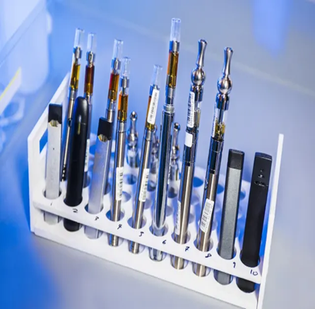
Vaping and the law
It is illegal to sell nicotine vapes to anyone under the age of 18. Shops who sell vapes to children are breaking the law and can be prosecuted.
Vapes are regulated in the UK. Shops that sell unregulated vapes are breaking the law.
Actions can be taken against any trader selling vapes to underage customers or selling illegal products, including seizing products, written warnings to retailers and formal criminal investigations.
To be legally sold in the UK, nicotine containing vapes must:
Contain 20 mg/ml or less of nicotine (equivalent to 2% or less)
Not have a capacity of more than 2ml in a single use cartridge
Carry the health warning 'This product contains nicotine which is a highly addictive substance.
Be notified to the MHRA and listed on its website
Illegal vapes can cause serious harm as they are unregulated and may contain unsafe levels of metals such as nickel, lead and other harmful substances.

Slide 5
Vaping – Exploitation
The sale of illegal vapes "goes hand in hand" with organised crime, drug dealing and money laundering - and worrying trends show significant numbers of children smoking vapes, with vape addiction leading children into the criminal world.
Illegal vapes, often given to children by gangs and drug dealers, are then being sold on school playgrounds by children exploited used as vape mules.
County Lines – where illegal drugs are transported from one area to another, often across police and local authority boundaries (although not exclusively), usually by children or vulnerable people who are coerced into it by gangs
If you are worried about a child or a young person report it. To report a concern in North Tyneside, please contact the Front Door on 0345 2000 10.
Remember, safeguarding is everyone’s business. More information about Safeguarding Children in North Tyneside can be found here : North Tyneside Safeguarding Children Partnership (northtynesidescp.org.uk)

Slide 6

Vaping – illicit substances
Nicotine is an addictive substance, and you can become dependent on vapes, especially if you vape nicotine regularly.
It is illegal to smoke vapes with other illicit substances. It is also illegal to sell vapes that contain illicit substances.
Mixing drugs is always risky but some mixtures are more dangerous than others.
For queries, concerns, service information or referrals to North Tyneside Recovery Partnership please scan the QR code.
PROPS family support service PROPS - Family Recovery Service
The Drug and Alcohol Family Support Service support adults around drug and alcohol use and children impacted by an adult’s drug and alcohol use and offers education sessions to all years 8 and 10 pupils in schools, contact drugandalcoholsupport@northtyneside.gov.uk
Educational settings can access a series of lessons within Pol-Ed that can be linked to substance misuse and vapes to assist PSHE delivery.
For more information on the risks of mixing vapes with drugs, visit the Frank website https://www.talktofrank.com/drug/vapes#the-risks
Scan me to refer

Slide 7
Police intelligence form
Northumbria Police are aware of several incidents across the force, including North Tyneside, where young persons, including school children, are becoming unwell and on some occasions admitted to hospital following the use of “MAZZA” Vapes.
We are requesting that if you are in receipt of any information or intelligence around these “MAZZA vapes” that it could be submitted to Northumbria Police via our Partnership Intelligence Form (a copy of the form has been shared with this presentation).
Important to know:
You will not receive any feedback on any intelligence submission.
We welcome all pieces of intelligence no matter how small, you never know where they fit in the bigger picture.
We may ask clarification questions following from your submission.

Slide 8
Trading standards in North Tyneside
To report underage sale of vapes or the sale of illicit vapes, please email details to Trading Standards at the following email address:
trading.standards@northtyneside.gov.uk
If known, please include details of when and where the vapes were purchased.

Slide 9
Vaping – Key Resources and Information
ASH-guidance-for-school-vaping-policies.pdf
ADPH Fact Sheet
ADPH Position Statement on Vapes
https://www.talktofrank.com/drug/vapes#duration
E-cigarettes: regulations for consumer products - GOV.UK (www.gov.uk)
#Never was funded by North Tyneside Council. Public Health in North Tyneside Council commissioned Helix Arts to use participatory arts with a community research lens to gather young people’s insights into drugs and alcohol. Explore the #Never Resources at : #Never - Helix Arts

