Slide 1
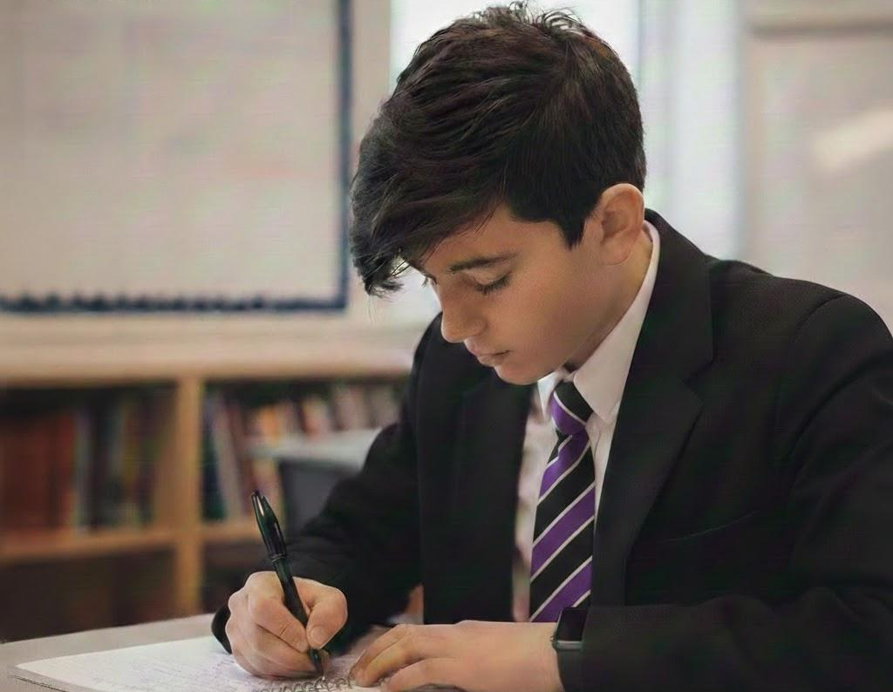

H E A D T E A C H E R
R E C R U I T M E N T P A C K

Slide 2
Welcome from the Governing Board
On behalf of the Governing Board, we are delighted to welcome you to our recruitment pack and to invite you to consider leading our school at an exciting and important stage in its development. Longbenton High School is a proud, inclusive community with a strong sense of identity, serving its students and families with commitment, ambition and care.
This is a unique opportunity, arising as our current Headteacher moves on to a second headship at Berwick Academy in Northumberland. We are seeking to appoint a new Headteacher from September 2026. We have a senior leader in an Acting Headteacher capacity from April 2026 until the appointment of a permanent successor.
We are seeking an inspirational and principled leader who shares our belief that every young person deserves the highest standards of education, support and opportunity. Our next Headteacher will build on the school’s strengths, provide clear strategic direction, and work collaboratively with staff, students, families, governors and other stakeholders to secure excellent outcomes for all.
The Governing Board is deeply committed to the success of Longbenton High School. We offer robust support alongside appropriate challenge, and we value openness, integrity and partnership in leadership. We are proud of our dedicated staff team, our engaged students, and the positive relationships we hold with our wider community.
This is a rare opportunity to make a lasting difference to the lives of our young people and to shape the future of a school with strong foundations and significant potential. We very much hope that the information in this pack gives you a clear sense of our school, our aspirations, and the values that guide our work.
We look forward to receiving applications from candidates who are excited by this opportunity and who have the vision, energy and commitment to lead Longbenton High School with capability, confidence and compassion.
Jonathan Sanders Louise Scott
Chair of Governors Vice Chair of Governors
1
HEADTEACHER RECRUITMENT PACK

Slide 3
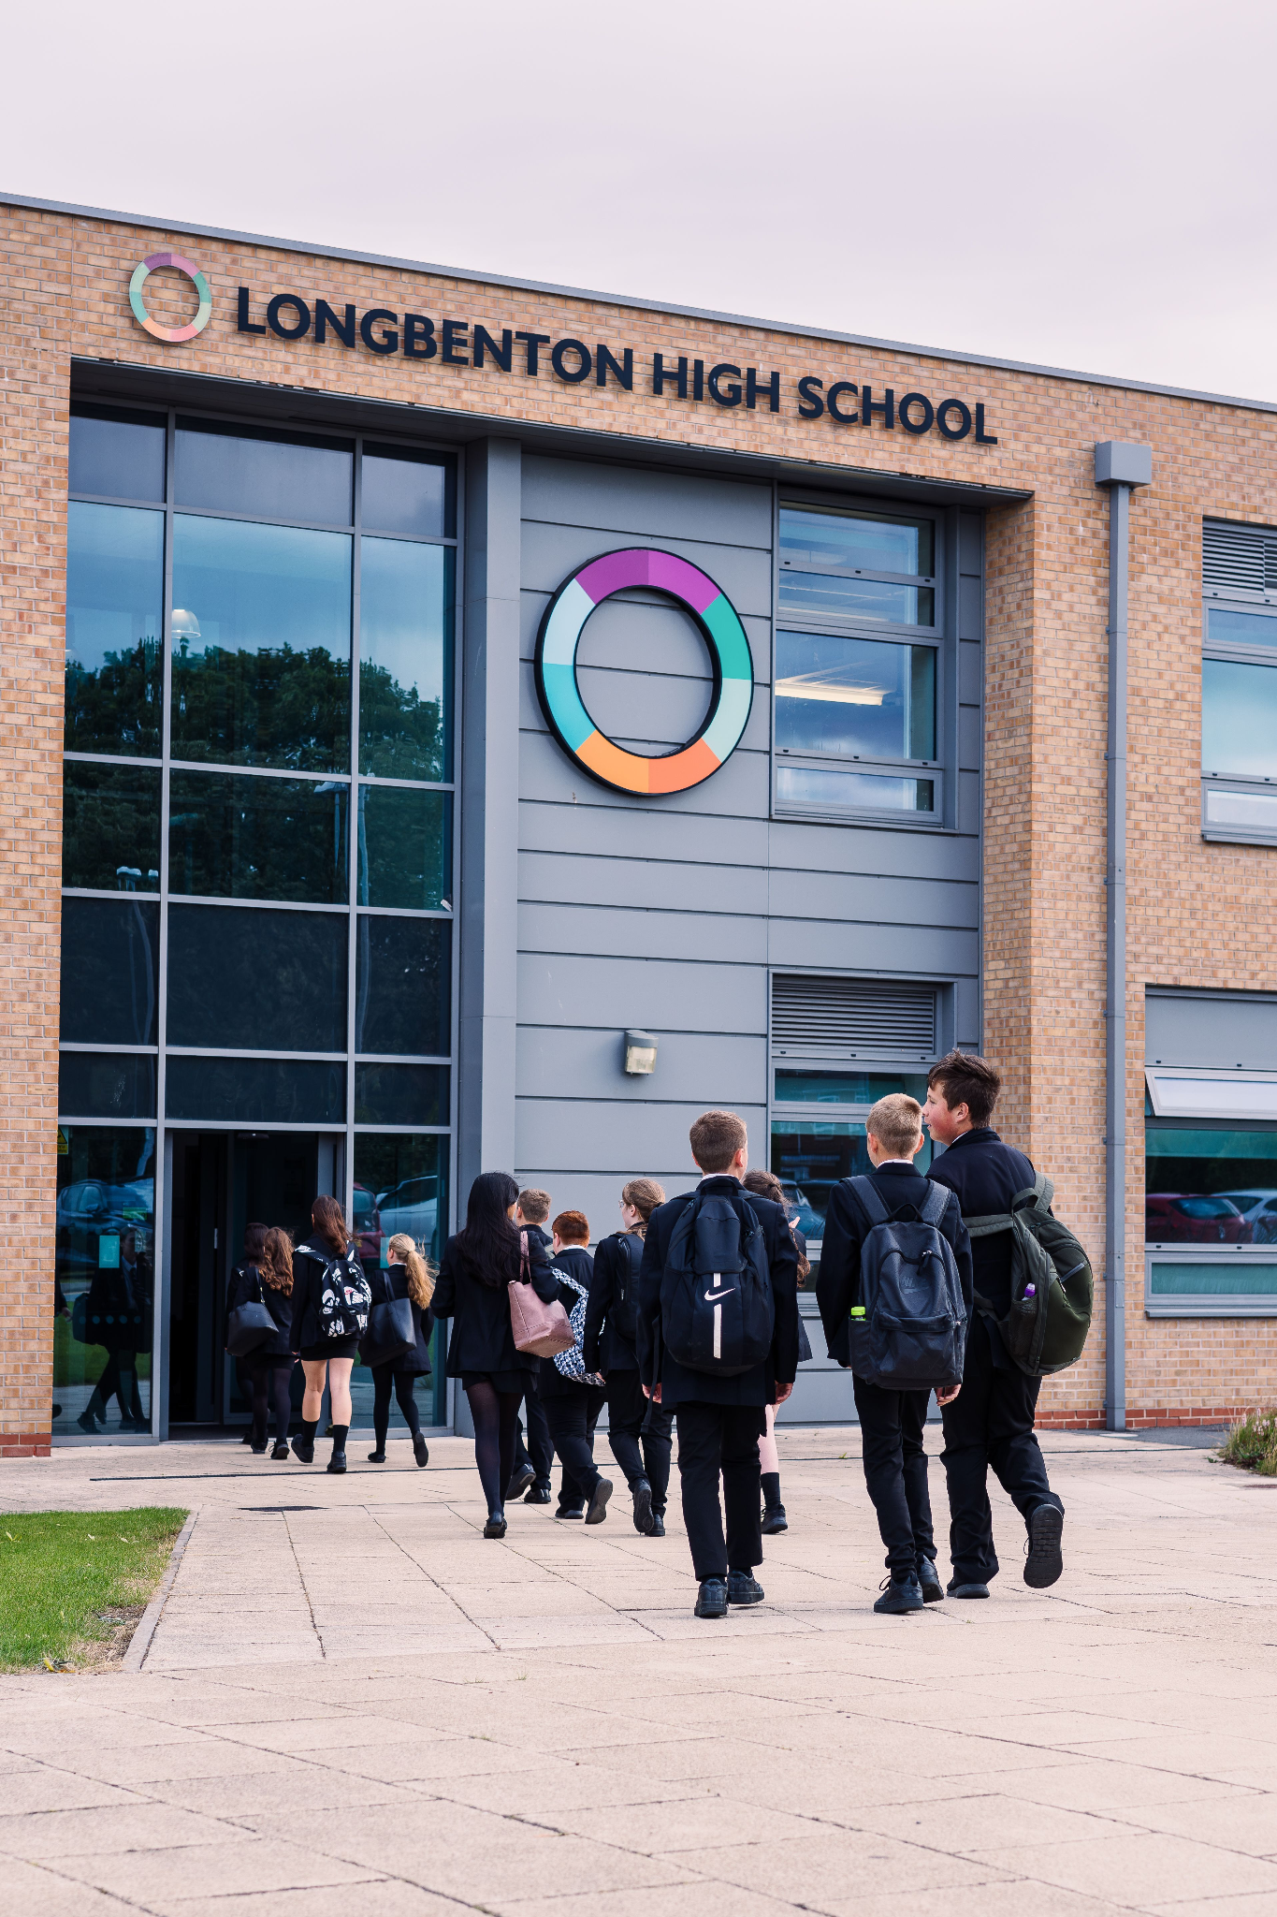

Slide 4
How to apply
Prospective applicants are warmly invited to visit Longbenton High School to discuss the role informally. Dates for prospective candidates to visit the school and meet the current Headteacher are Monday 23rd February (3-5pm) and Thursday 26th February (9-11am)
To arrange a visit, please contact Jannica Jigmo Chanco on 0191 218 9500 or via email at recruitment@longbenton.org.uk
The closing date for applications is: Friday 27th February (5pm)
Shortlisting will take place on: Monday 2nd March
Interviews will be held on: Monday 9th and Tuesday 10th March
Applications should be made via the school website: www.longbenton.org.uk and sent FAO Jannica Jigmo Chanco via recruitment@longbenton.org.uk
As part of your application, please include a supporting letter, no more than 3 sides of A4, outlining your reasons for applying for the post. This should make clear reference to the information contained within this recruitment pack, particularly the person specification, and should detail the experience, skills and personal qualities you would bring to the role of Headteacher at Longbenton High School.
The school is strongly committed to safeguarding and promoting the welfare of children and young people and requires all staff to share this commitment. This post is exempt from the Rehabilitation of Offenders Act 1974. If you are invited for interview, you will be required to disclose any convictions that are not subject to filtering prior to interview. Certain spent convictions and cautions are ‘protected’ and do not need to be disclosed. Further information about protected convictions and disclosure requirements can be found on the Ministry of Justice website.
As part of the recruitment process, you will be asked to provide further information about your criminal history. If your application is successful, this information will be checked against an enhanced Disclosure and Barring Service (DBS) disclosure before any appointment is confirmed. This post involves regulated activity with children and therefore an enhanced DBS check is required.
In line with Keeping Children Safe in Education guidance, an online search will be carried out on shortlisted candidates prior to interview.
3
HEADTEACHER RECRUITMENT PACK

Slide 5

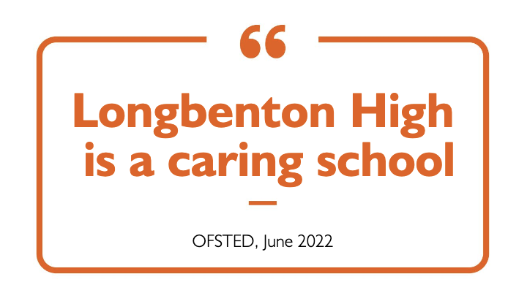
“I look forward every day to working at Longbenton High School. I most love how the leadership culture of the school is a culture of genuine desire to raise up, dignify and empower all human beings - both students and staff. Longbenton is a caring and supportive school. I feel ‘seen’ here and I appreciate that so much. The high standards held by the school have their foundations in real appreciation for people as well as wanting students to perform well in exams. I have stayed at Longbenton High School for many years as a conscious choice because it is such a happy and dynamic environment in which to work.”
Teaching Staff @ LHS

Slide 6
About Longbenton High School
Longbenton High School is an innovative, welcoming and aspirational 11–18 comprehensive school with Sixth Form, located in Longbenton, Newcastle upon Tyne. Serving a diverse community across North Tyneside and neighbouring areas, the school draws students from a broad catchment and enjoys a strong local reputation. With approximately 900 students on roll — around 180 in each year group from Years 7 to 11 and a growing Sixth Form — the school has been heavily oversubscribed for the past three years.
The school is a Local Authority maintained foundation school within the North Tyneside Learning Trust, a charitable foundation trust that brings together primary, secondary and special schools across the borough. The Trust is not a multi-academy trust; instead, it provides a framework for collaboration, shared expertise and mutual support while preserving each school’s maintained status, local accountability and distinct identity. Longbenton High School remains funded through and accountable to North Tyneside Council, with the Governing Body retaining responsibility as employer and Admissions Authority. This model offers the advantages of partnership and system leadership without the centralised control typical of larger trusts.
Longbenton High School is at an important and exciting stage in its development. Financial stability has improved significantly in recent years, with the school maintaining an in-year balanced position for the past three financial cycles. While a historic deficit remains — currently approximately £500k as the school enters the 2025–26 financial year — robust systems are in place, and the trajectory is positive. The next Headteacher will therefore inherit a school that is financially disciplined, clear-eyed about constraints, and well positioned for sustainable future planning.
The school was judged Good at its most recent full Ofsted inspection in June 2022, representing a clear step forward from the previous inspection. Inspectors recognised strengths in leadership, personal development and the quality of education. High expectations, strong relationships and a culture of care and respect are evident across the school community.
At the heart of school life are the values of Kindness, Integrity, Determination, Manners, Ambition and Positivity (KIDMAP). These values shape behaviour, routines and relationships, and underpin the school’s commitment to knowing students as individuals. Pupils are supported to achieve strong academic outcomes while developing into confident, responsible and socially aware young people.
The school serves a community with a wide range of social and educational needs, including:
Around 30% of students in each cohort eligible for Free School Meals and Pupil Premium support
A predominantly White British student population, alongside pupils from a range of other ethnic backgrounds
A higher-than-average proportion of students with SEND, supported through well-established, inclusive provision
5
HEADTEACHER RECRUITMENT PACK

Slide 7

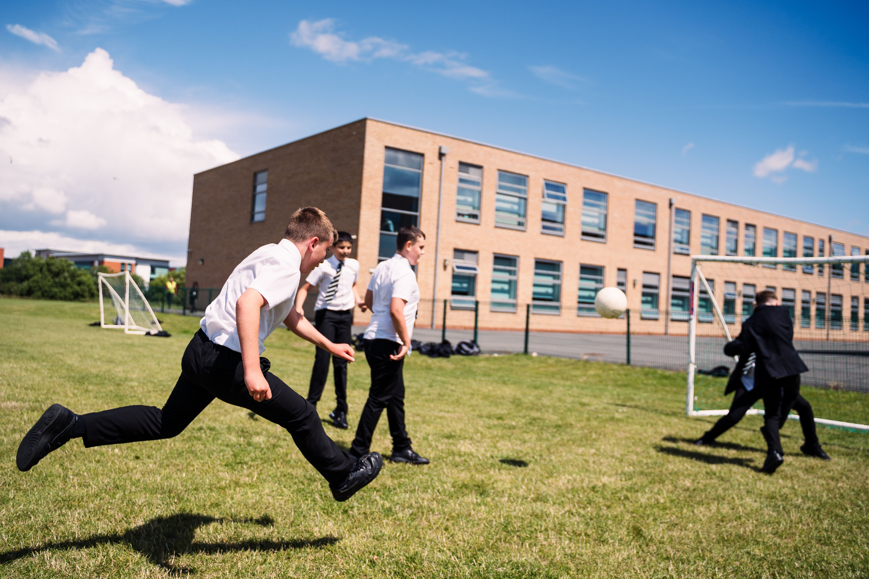
Longbenton High School continues to secure strong and steadily improving outcomes for students. At Key Stage 4, students achieve results in line with national averages, with the majority attaining a Grade 4 or above in English and Mathematics. Performance across GCSE subjects demonstrates consistent progress, reflecting the school’s ambitious curriculum and high expectations.
In the Sixth Form, students achieve solid results, with an overall pass rate of 99% and a growing proportion attaining top grades (A/A). Average grades are in line with local benchmarks, and the Sixth Form remains a pathway to both higher education and vocational success.
These outcomes are underpinned by a culture that prioritises personalised support, academic ambition and the development of confident, capable young people, prepared for the next stage of their education or careers.
Students leave Longbenton High School to pursue a wide range of post-16 and post-18 pathways, including further education, apprenticeships and employment. We are proud of the fact that we send Year 13 students to Oxford and/or Cambridge every year. The school’s supportive environment ensures most students continue in education or training after key stage transitions. National comparison data destination rates are broadly in line with expectations for schools serving similar communities.
6

Slide 8
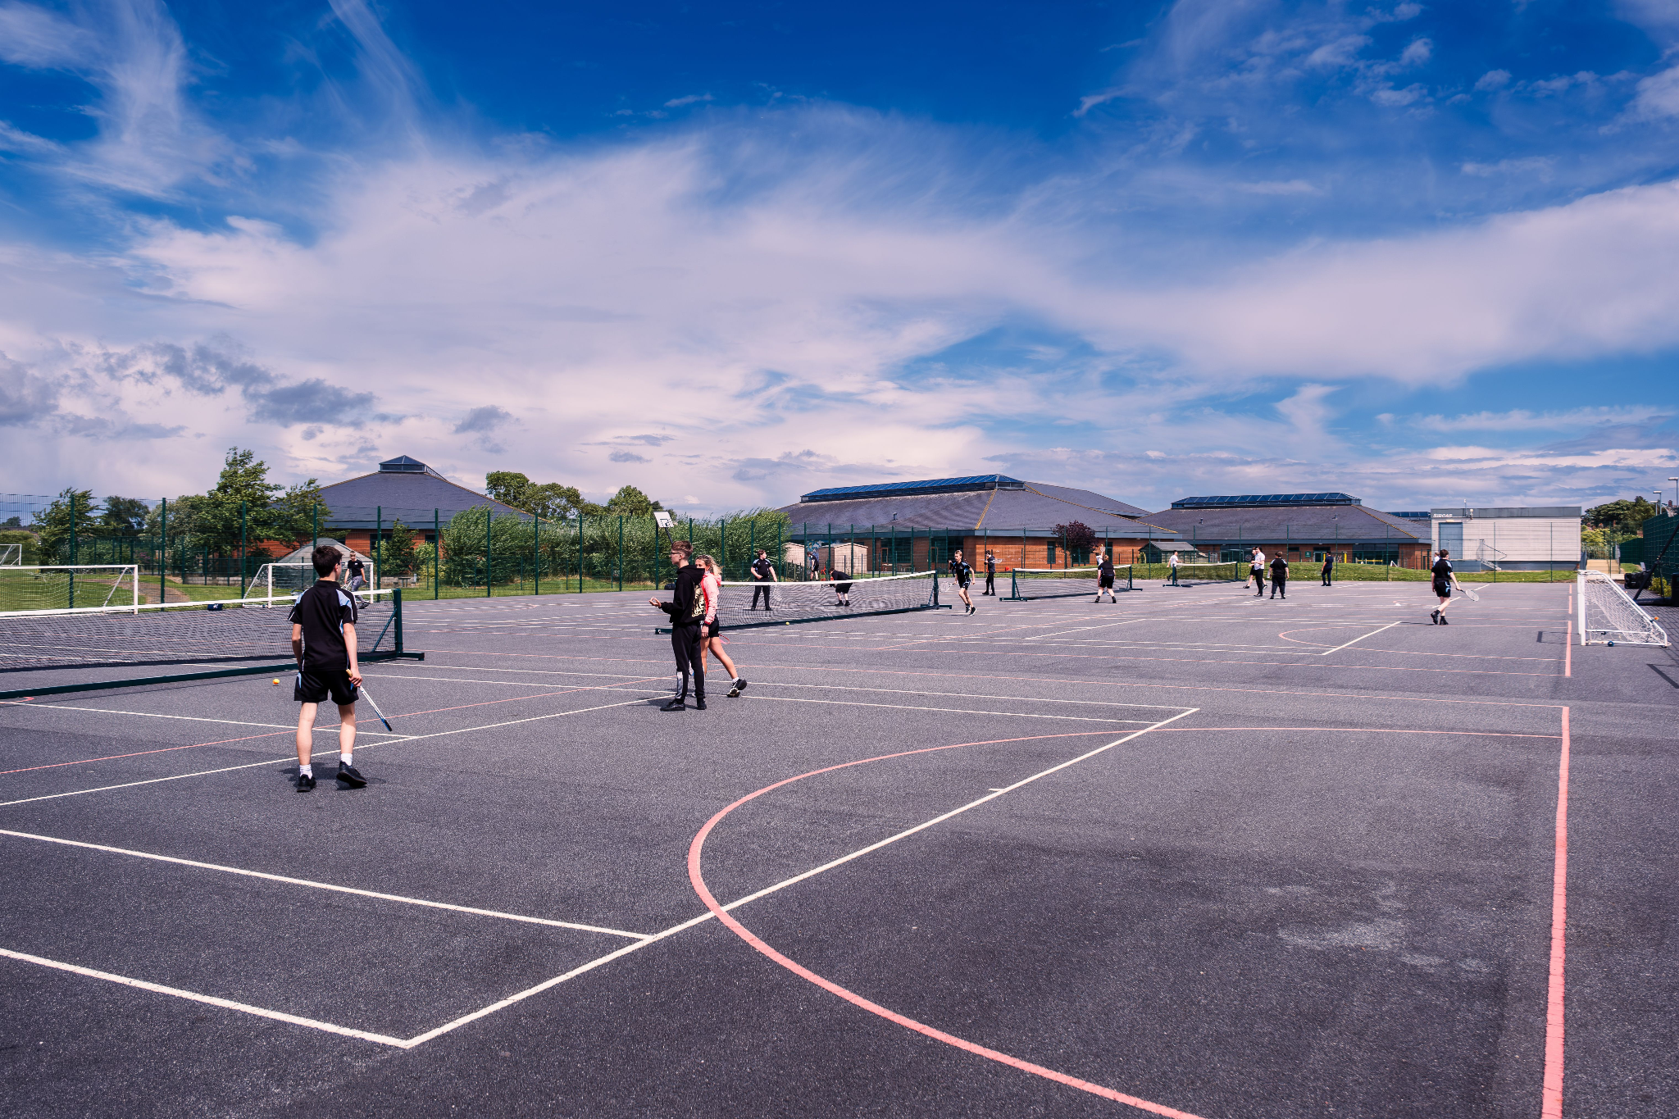
Staffing Structure
Our staffing model is built on a foundation of clarity and ambition, ensuring every colleague is supported to excel. We maintain a traditional and robust structure of Curriculum Leaders who drive subject-specific excellence and academic rigour across the school. However, we are also committed to "growing our own" leaders; our Extended Leadership Team, which includes Associate Assistant Headteacher roles, provides a dynamic pathway for middle leaders to gain whole-school strategic experience. While our staff turnover remains stable and in line with national averages, we pride ourselves on being a school where people want to stay and develop. As Headteacher, you will lead a dedicated team that balances the stability of experienced practitioners with the energy of emerging leaders, all supported by a transparent structure designed for professional progression.
Headteacher
SLT
Associate SLT
Middle Leaders
Deputy Headteacher Quality of Education L18-22
Deputy Headteacher Culture & Ethos L18-22
Assistant Headteacher L12-16 Behaviour & Attendance
Assistant Headteacher L12-15 Teaching & Pedagogy
Assistant Headteacher L12-15 Personal Development
Business Manager
Associate Assistant Headteachers x 7 (incl. CLs of core subjects) L8-10
Curriculum Leaders (Humanities; Create; Perform (Music & Drama); MFL, Business & IT; PE)
Pastoral Leaders (Y7-8; Y9-10; Y11-13)
Notes:
Current HT pay range is L29-34. The Governing Body must select a 7-point range within the broad Group 7 bracket. Given our specific context—a PFI build, significant financial turnaround, and a growing roll—we want to be competitive to attract a high-caliber leader. A broad range is £91,158 – £130,274 (Leadership points L24 – L39) Berwick Academy advertised at L31-37. Nunthorpe is advertising same pay range.
A typical "standard" range for this role might be:
L30 – L36: £105,595 – £122,306
L31 – L37: £108,202 – £125,345

Slide 9
About the Headteacher Role
Longbenton High School offers an exciting leadership opportunity for a Headteacher ready to build on recent successes and shape the next phase of the school’s development. The school combines a caring, inclusive community with clear strategic ambition and a strong commitment to continuous improvement.
We are seeking a leader who can balance academic excellence with a deep commitment to pastoral care, and who will champion the school’s proud identity, independence, and close-knit community ties. The next Headteacher will drive the school’s ongoing improvement journey — refining the curriculum, elevating teaching standards, and ensuring that high expectations are matched by high-quality outcomes for all students.
The school operates within a PFI framework with Galliford Try, providing exceptional facilities and a site in excellent condition. This allows the Headteacher to focus energy on the core business of education, while also requiring professional acumen to maintain productive relationships with PFI partners and safeguard a high-quality learning environment.
Financially, the school is in a strengthened position. Over the past six years, a historic deficit has been reduced by approximately 70%, and the school roll has grown to a consistently oversubscribed position. The next Headteacher will inherit a stable platform from which to move from recovery into strategic investment and growth.
The successful candidate will be a visible, inspiring presence within the school and the wider community, advocating for students and staff alike. Key priorities will include:
Elevating Performance: Moving the school from “Good” to “Outstanding” through evidence-informed, consistent leadership.
Empowering Staff: Fostering a culture of professional growth and innovation.
Strengthening Partnerships: Leveraging relationships to create opportunities that extend learning beyond the classroom.
This is a rare opportunity to lead a school with ambition, heart, and a clear trajectory for future success.
8
HEADTEACHER RECRUITMENT PACK

Slide 10
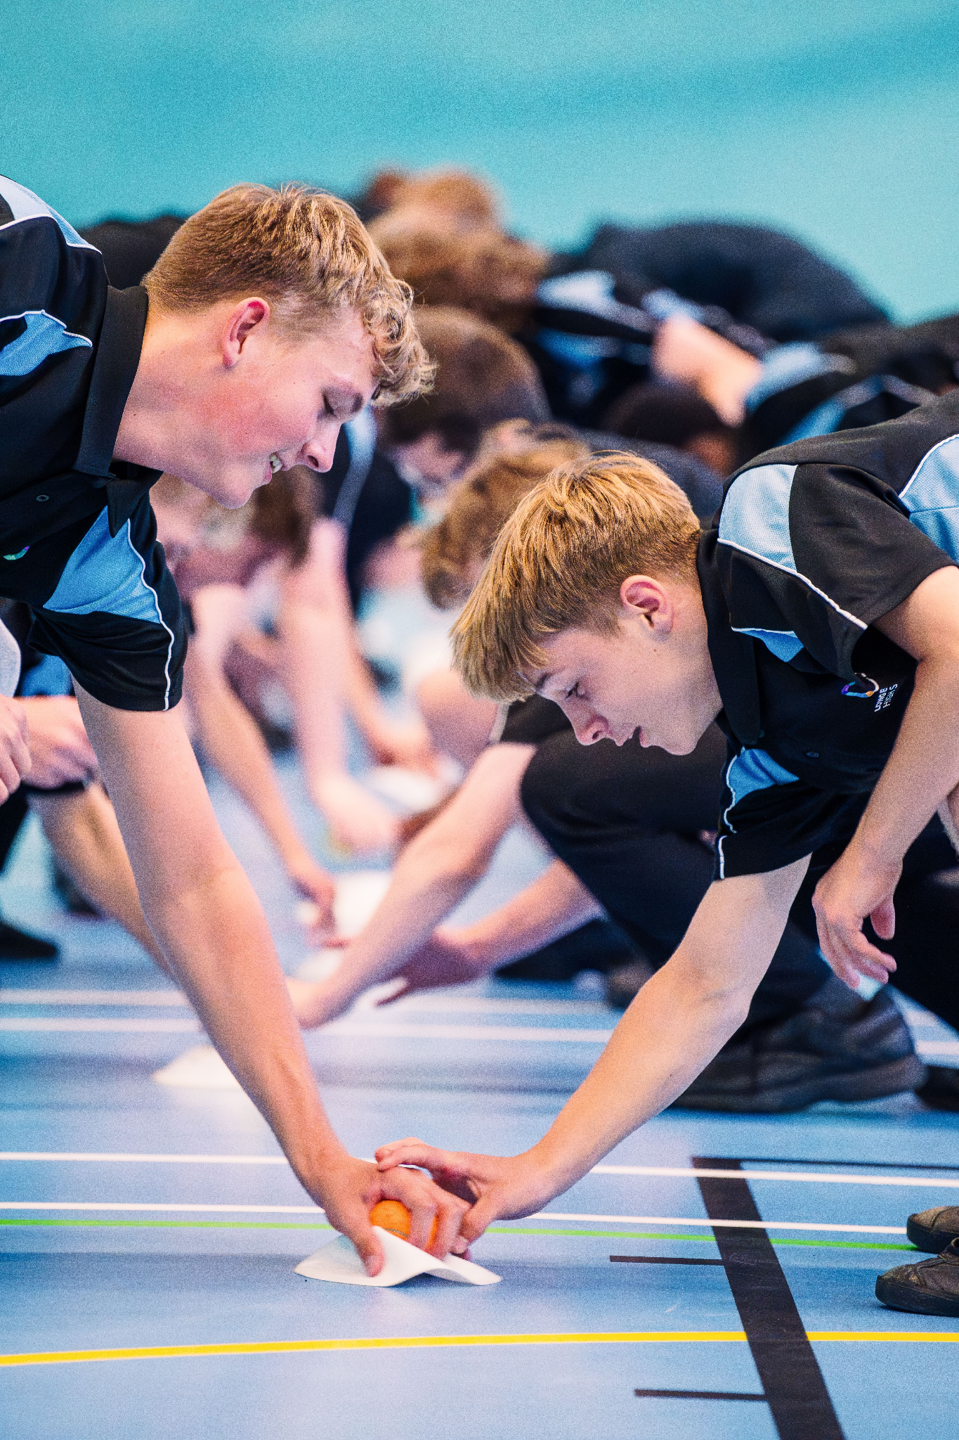

Slide 11
Job Description
Reporting to: The Governing Body and North Tyneside Local Authority
Core Purpose
Our headteacher will provide professional leadership and management for Longbenton High School, ensuring its continued success and improvement. They will provide high-quality education, maintain the school's inclusive ethos, and ensure the safety and well-being of all pupils and staff in accordance with the STPCD and Headteacher Standards (2020).
Key Leadership Elements
Drive ambitious standards for all students, overcoming disadvantage and advancing equality; modelling and instilling a strong sense of accountability in all staff for the impact of their work on students’ outcomes.
Secure excellent teaching through an analytical understanding of how students learn and of the core features of successful curriculum planning and implementation, leading to rich opportunities across all pupil groups including in our on-site Alternative Provision.
Ensure that staff feel appreciated, valued and enabled to succeed. Maintaining a culture of sharing best practice within school, creating an ethos where all staff are motivated and enabled to develop their own skills and knowledge, and to support each other.
Identify emerging talents, coaching current and aspiring leaders in a climate where excellence is the standard, leading to clear personal development and succession planning.
Hold all staff to account for their professional conduct and practice.
Ensure that the school’s systems, organisation and processes are well considered, efficient and fit for purpose, upholding the principles of transparency, integrity and probity.
Provide a safe, calm and well-ordered environment for all students and staff, focused on safeguarding students and developing their exemplary behaviour in school and in the wider community.
Support the Governing Body to meet their defined standards and to hold the Headteacher to account for student, staff and financial performance.
Exercise strategic, curriculum-led financial planning to ensure the equitable deployment of school allocated budgets and resources, in the best interests of students and the school.
Distribute leadership throughout the organisation, forging teams of colleagues who have distinct roles and responsibilities and hold each other to account for their decision making.
Shape the current and future quality of the teaching profession through high-quality training and sustained professional development for all staff.
Promote, support and develop an inclusive approach to meet the needs of all students.
Develop and implement the school development plan.
Accurately self-evaluate the quality of provision.
10

Slide 12
Job Description
School Culture | Vision & Values: Define and model a high-expectation culture of "excellence for all" rooted in the school’s core values. Safeguarding: Maintain a rigorous culture of vigilance where student safety and wellbeing are paramount. Inclusion: Foster an environment that champions equity, diversity, and the success of vulnerable learners.
Teaching, Curriculum & Assessment | Excellence: Ensure a high-quality, ambitious curriculum that is broad, balanced, and knowledge-rich. Quality of Education: Drive pedagogical improvement through evidence-based CPD and robust monitoring of classroom practice. Data Impact: Use assessment data strategically to identify gaps, direct interventions, and raise attainment across all key stages. Be accountable for the educational outcomes of all pupils, closing the disadvantaged and SEND gaps.
Organisation & Financial Management | Resource Alignment: Manage the delegated LA budget to ensure long-term financial health and alignment with school priorities. PFI Oversight: Effectively manage the interface with Galliford Try to ensure the building supports learning and provides value for money. Ensure the site and specialist facilities are maintained to a high standard. Staffing: Optimise staff structures and workload to ensure high performance and retention. Adhere to the Burgundy Book regarding staff conditions of service and maintain a positive relationship with trade unions.
Safeguarding & Inclusion | Act as the ultimate lead for safeguarding, ensuring that policies and practices are rigorous and compliant with "Keeping Children Safe in Education" (KCSIE). Champion the school’s inclusive identity. Know about data protection issues in the context of your role. Maintain confidentiality as appropriate. Have sound knowledge and understanding of the most recent safeguarding legislation.
Resource/People Management | Ensure that resources are well looked after and funds are spent wisely. Ensure that the school environment offers an inviting working environment that is ordered, positive and welcoming. Manage recruitment with the support of Human Resources. Support classroom management, and accept overall responsibility for the behaviour and conduct of students within the school. Ensure appropriate induction of staff and guide them through the expectations of the school. Further the professional development of staff including planning effective use of CPD training and staff development time. Deliver and support the school performance management process ensuring that all reviews are undertaken in an efficient, constructive and timely manner. Ensure that all appropriate resources and teaching strategies meet the needs of the full range of age, aptitude and ability including students with special educational needs.
11
HEADTEACHER RECRUITMENT PACK

Slide 13
Job Description
Communication | Engagement: Act as a visible, persuasive ambassador, communicating the school’s progress and vision to all stakeholders. Inspire and influence others - within and beyond the school environment - to believe in the fundamental importance of education in young people’s lives and to promote the value of education. Transparency: Maintain clear, professional, and timely communication with staff, parents, governors and other stakeholders. Listening: Build effective feedback loops to ensure the voice of the school community informs decision-making.
Partnership Working | System Leadership: Collaborate with the Local Authority, local clusters, and external agencies to share best practices and improve outcomes. Work with colleagues in the school and across the Local Authority as well as advisers and partners to ensure the continuous development of the school. Contractual Liaison: Manage the strategic relationship with PFI providers to ensure the site meets the school’s evolving needs. Community: Strengthen links with parents and local partners to enrich the curriculum and support families. Lead the development of transitional links with pre-11 and post-18 partners and institutions, as appropriate, in order to provide clear pathways for students and individuals within the community.
Health & Safety | Compliance Leadership: Serve as the "Responsible Person," ensuring the school meets all LA and statutory H&S regulations. Risk Management: Lead the culture of safety by overseeing risk assessments for all school activities, curriculum areas, and educational visits. Emergency Planning: Own the school’s emergency, evacuation, and lockdown procedures in coordination with PFI site staff. Governance: Provide regular assurance to the Governing Body and LA regarding site safety and contractor performance.
Equalities & Stakeholders | Inclusive Leadership: Champion the Public Sector Equality Duty, ensuring equality of opportunity and access for all students and staff, regardless of background. Closing the Gap: Proactively identify and remove barriers to learning for disadvantaged groups, SEND, and EAL pupils to ensure parity of outcomes. Community Cohesion: Act as a visible leader within the local community, building trust with parents and external partners to enhance the school’s reputation and impact. Staff Wellbeing: Promote a diverse workforce and a culture of mutual respect, ensuring recruitment and professional development are fair and transparent.
12
HEADTEACHER RECRUITMENT PACK

Slide 14
Person Specification
ESSENTIAL | DESIRABLE
QUALIFICATIONS & PROFESSIONAL DEVELOPMENT
Qualified Teacher Status (QTS) Degree: Good Honours degree or equivalent. Continuous Professional Development: Evidence of recent, relevant leadership training and continuous professional development at a senior leadership level | NPQH: NPQH (National Professional Qualification for Headship) or equivalent or a relevant Master’s degree DSL: Recent safeguarding/DSL training at Level 3 or above. Recent Safer Recruitment training
EXPERIENCE
Senior Leadership: Substantial and successful experience as a Headteacher, Deputy Head, or equivalent in a secondary setting. Proven Track Record: Tangible evidence of raising standards in teaching and learning and improving student outcomes. Staff Development: Success in recruiting, developing, and retaining high-quality staff and building a "team-first" culture. Data & Progress: Evidence of using data to drive rapid school improvement and closing the attainment gap | Financial Management: Experience in effective budget management and resource allocation to ensure long-term school sustainability. Post-16: Specific experience in managing Sixth Form provision, including A-Level/Vocational pathways and UCAS/Careers guidance. LA Engagement: Experience working within Local Authority frameworks and an understanding of the relationship between the school, the LA, and the Governing Body. Context: In depth knowledge and understanding of the wider education agenda including current national policies and issues as well as statutory and legal framework governing the operation of a school.
PROFESSIONAL KNOWLEDGE, SKILLS & UNDERSTANDING
Curriculum Excellence: Deep understanding of the 11–18 curriculum, including vocational pathways and Sixth Form provision. Data Literacy: Ability to use data analytically to monitor progress, identify gaps, and implement rapid, effective interventions. Safeguarding: Expert knowledge of current statutory requirements (Keeping Children Safe in Education) and a commitment to a "culture of vigilance." Evidence-Informed Practice: Knowledge of current educational research (e.g. EEF findings) and how to apply it to a specific school context. Pedagogy: Sophisticated understanding of what constitutes "Quality First Teaching" and how to coach staff toward excellence. Inclusion: Knowledge of the SEND Code of Practice and a commitment to inclusive education within a mainstream setting. | Statutory Frameworks: Deep understanding of the School Teachers’ Pay and Conditions Document and the Ofsted Inspection Framework. Financial Oversight: Ability to manage a complex school budget in an era of tightening LA funding, ensuring "Value for Money."
13
HEADTEACHER RECRUITMENT PACK

Slide 15
Person Specification
ESSENTIAL | DESIRABLE
LEADERSHIP & PERSONAL ATTRIBUTES
Visionary Leadership: The ability to articulate a clear, compelling vision for Longbenton High School that inspires students, staff, and parents. Resilience & Integrity: A leader who remains calm under pressure, acts with "moral purpose," and is prepared to make difficult decisions for the right reasons. Visible Presence: A commitment to being a "corridor Head"—visible to students and accessible to the community. Communication: Exceptional oracy and writing skills; the ability to represent the school powerfully and persuasively to external stakeholders. Emotional Intelligence: Resilience and empathy; the ability to handle high-pressure situations (e.g., student exclusions, parental complaints) with calm professionalism. Accountability: A "no excuses" approach to standards, paired with a commitment to staff wellbeing and workload management.
COMMUNITY & ETHOS
Inclusive Values: A passionate commitment to social mobility and ensuring that disadvantage is never an excuse for lower expectations. Ethics: Adherence to the Seven Principles of Public Life (The Nolan Principles): Selflessness, Integrity, Objectivity, Accountability, Openness, Honesty, and Leadership. Partnership Working: Experience in working effectively with Governors, local primary schools, and LA partners etc. North East Context: A nuanced understanding of the local community's challenges and opportunities.
14
HEADTEACHER RECRUITMENT PACK

Slide 16
Contact us
Longbenton High School
Hailsham Avenue
Longbenton
Newcastle upon Tyne
NE12 8ER
www.longbenton.org.uk
recruitment@longbenton.org.uk

