Slide 1

2026
Prospectus

Slide 2
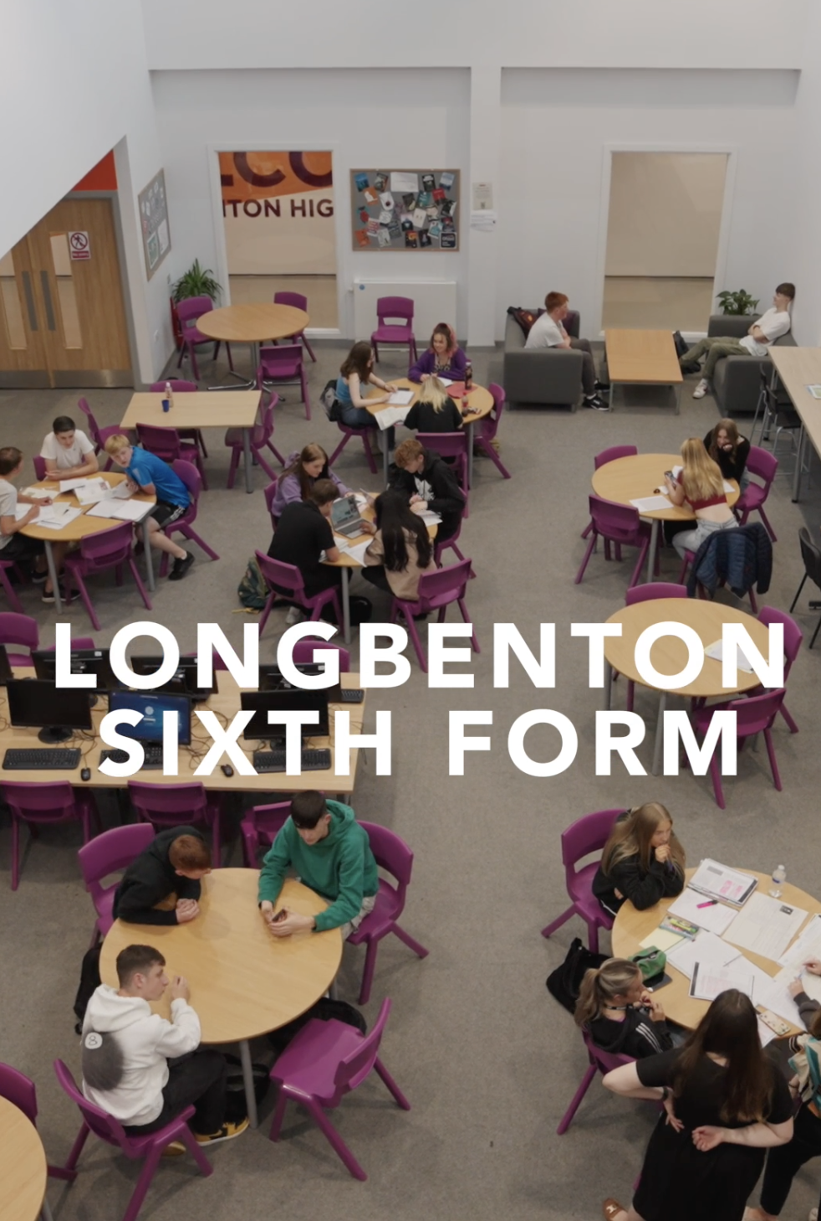
2 Welcome
3 Sixth Form team
4 Outcomes
5 Destinations
7 Application timeline
10 Support & wellbeing
11 Student Stories & Alumni
17 Courses & entry requirements
Contents
…a place where students are not just taught, but where bright minds are ignited and nurtured…
1

Slide 3
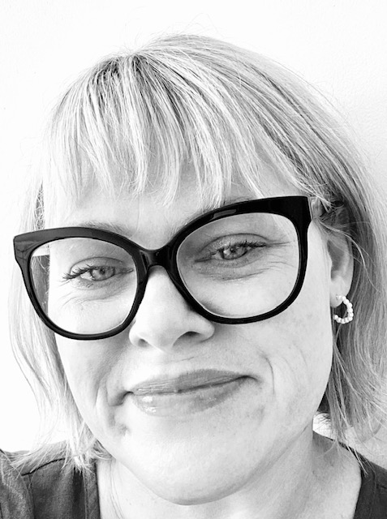
Welcome…
… to a launchpad for successful careers and fulfilling lives…
Longbenton High Sixth Form is a special place: a vibrant community where students thrive; large enough to offer a wealth of opportunities, but small enough for personalised support. Our unique pathways allow you to tailor your studies to your specific goals, whether you're aspiring to university, a career, or further study.
Beyond academics, Longbenton High Sixth Form is a hub of activity. From sports and clubs to arts and societies, there's something for everyone.
No matter where you've come from, Longbenton High Sixth Form welcomes students from all backgrounds. Our comprehensive induction program ensures a smooth transition and helps you feel at home. With exceptional support, care, and a commitment to excellence, we're proud to be one of the leading Sixth Forms in North Tyneside and Newcastle.
#you’re welcome to join us and discover your potential
Kelly Holbrook
Headteacher
2

Slide 4
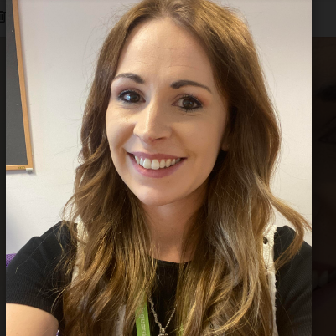
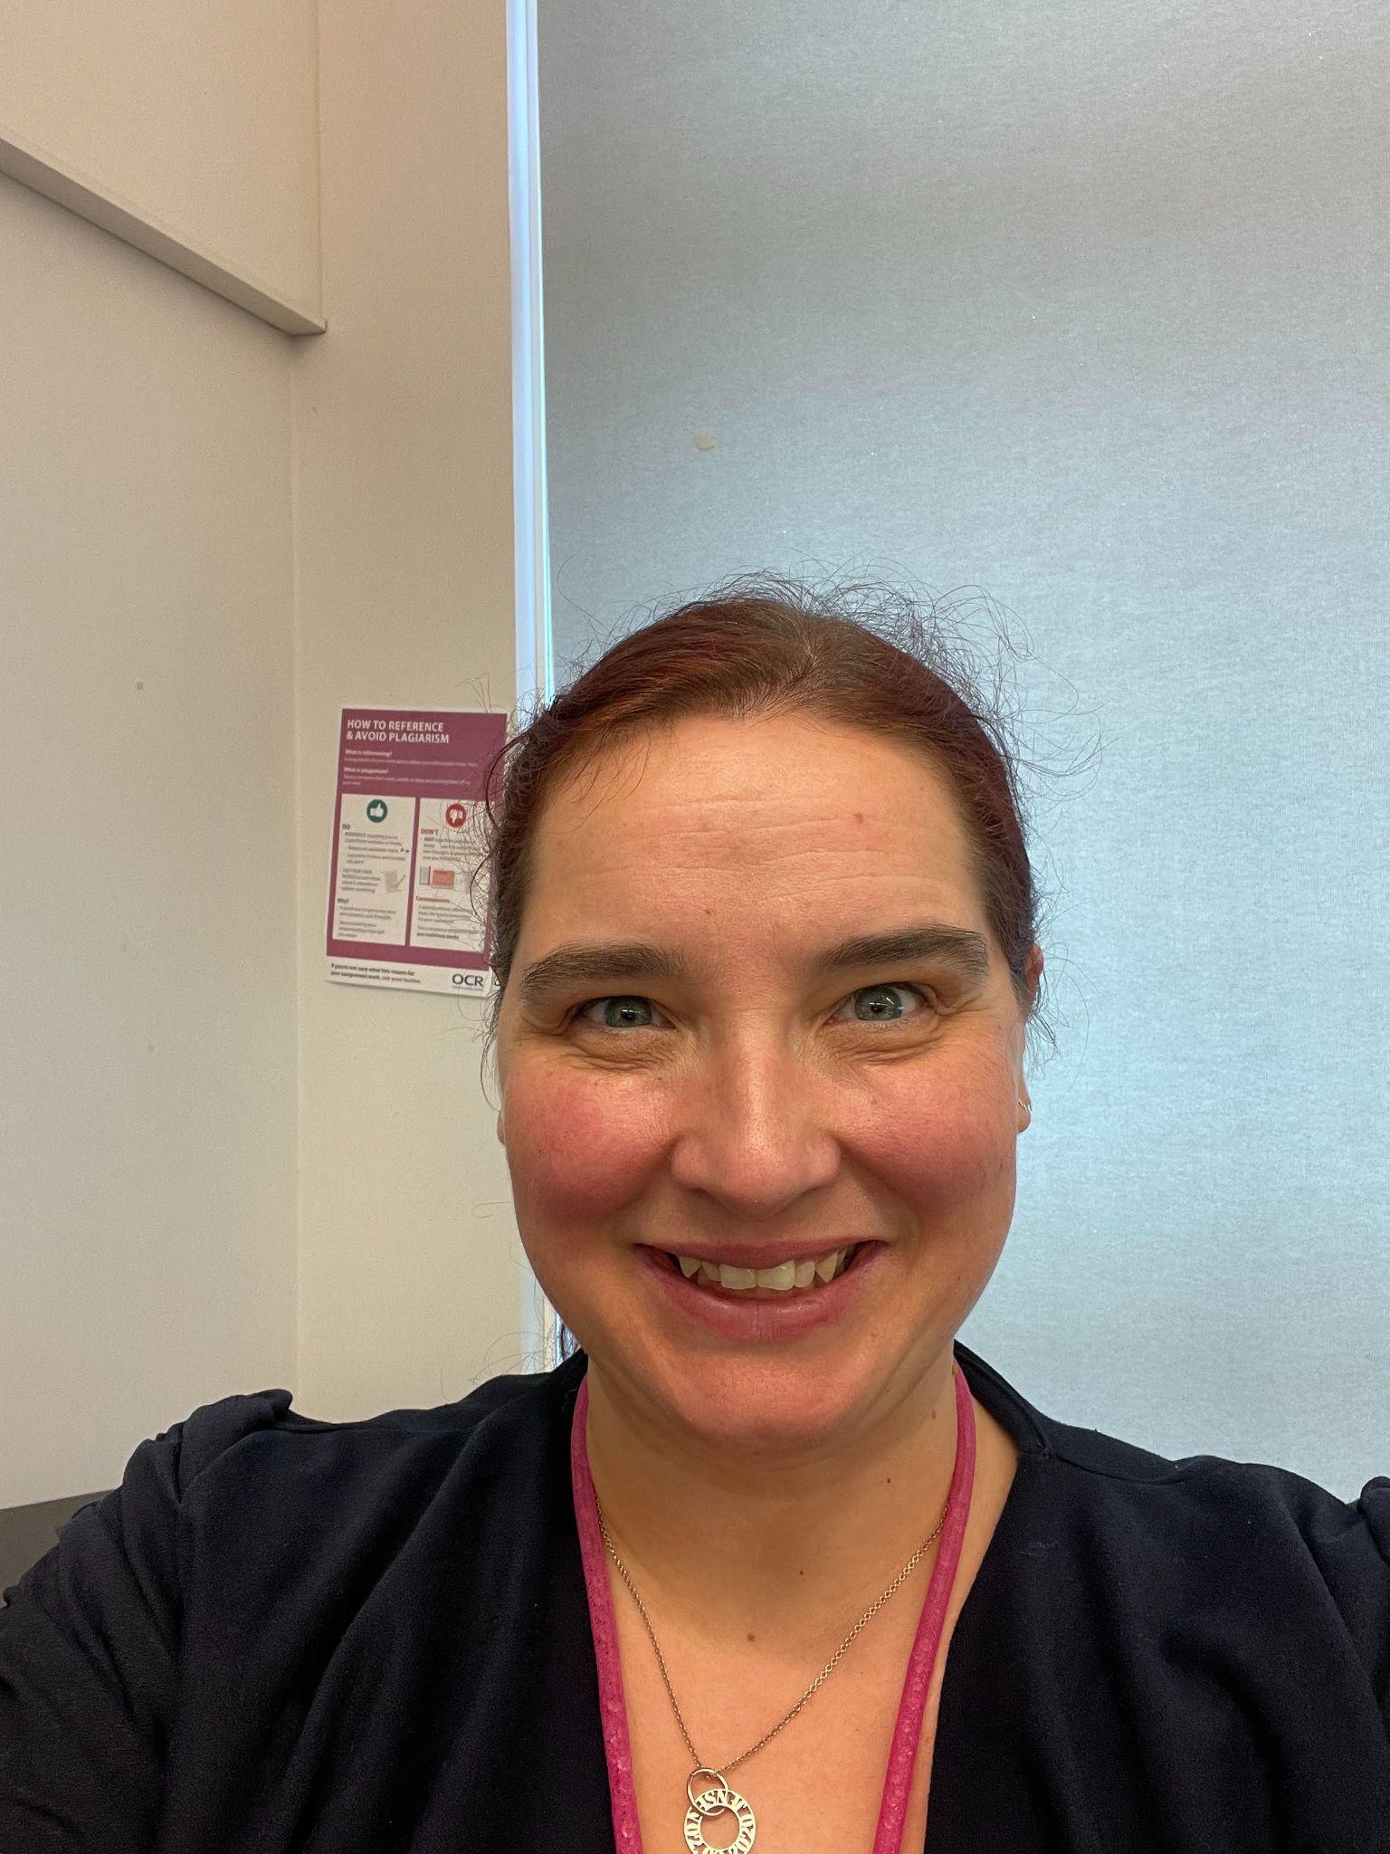
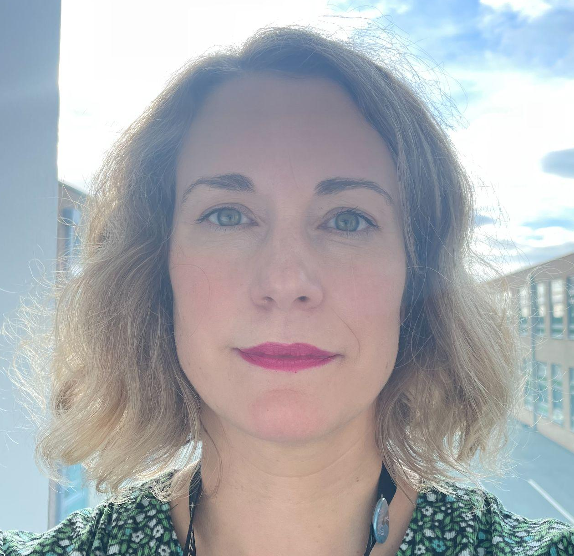
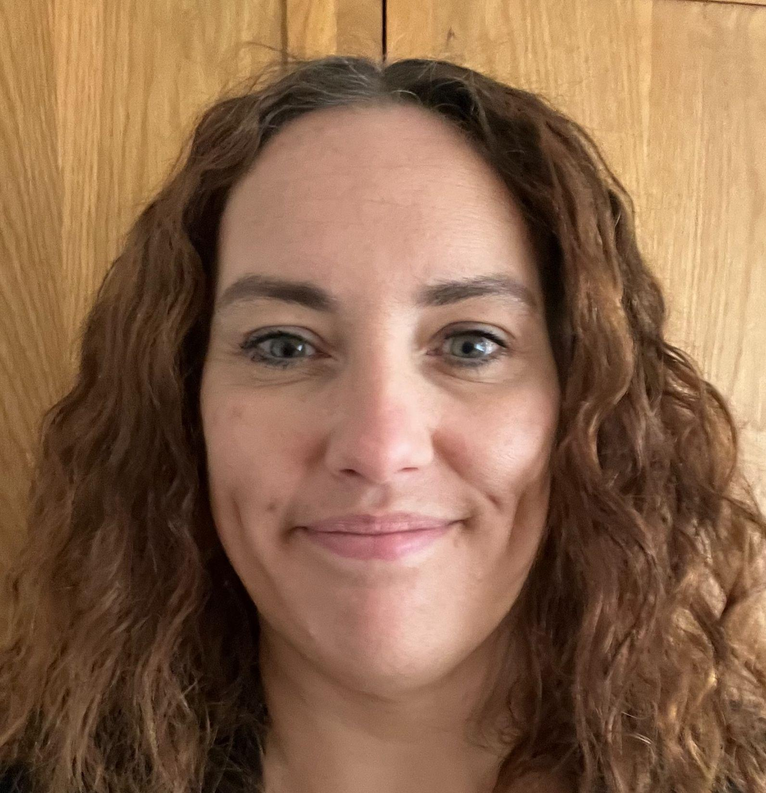
#you’re welcome… to meet our Sixth Form Team
Photo
Photo
Photo
Abby Potts
Associate Assistant Headteacher Years 11-13
Emily Doucet
Year Leader
Years 11-13
Clare Wouldhave
Post 16 Pastoral
Guidance Manager
Ann-Marie Robinson
Post 16 Academic Guidance Manager
3

Slide 5
2025 KS5 Outcomes
22% A*-A
63% A*-C
All students who applied to university were accepted onto their firm or insurance course
…we foster well-rounded individuals who are confident, compassionate, and ready to make a difference…
4

Slide 6
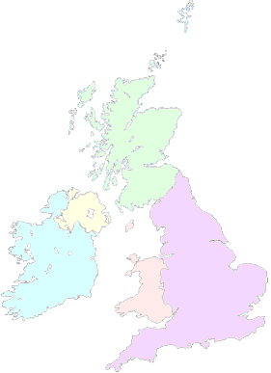

Student destinations
University of Aberdeen - Scottish and English Literature
St Andrews University - Mathematics
University of Newcastle - Dentistry, Hispanic Studies, Physics
University of Northumbria - Cybersecurity, Business Management and Marketing
University of Durham - Mathematics, Philosophy
University of Manchester - History
University of York - Psychology
LIPA( Liverpool institute of Performing Arts) -
Popular Music and songwriting
University of Leeds - Medicine, Graphic Design, Sports Science
University of Liverpool - Biochemistry
University of Chester - Acting and Stage Management
University of Cambridge - History
University of Oxford - Law
5

Slide 7
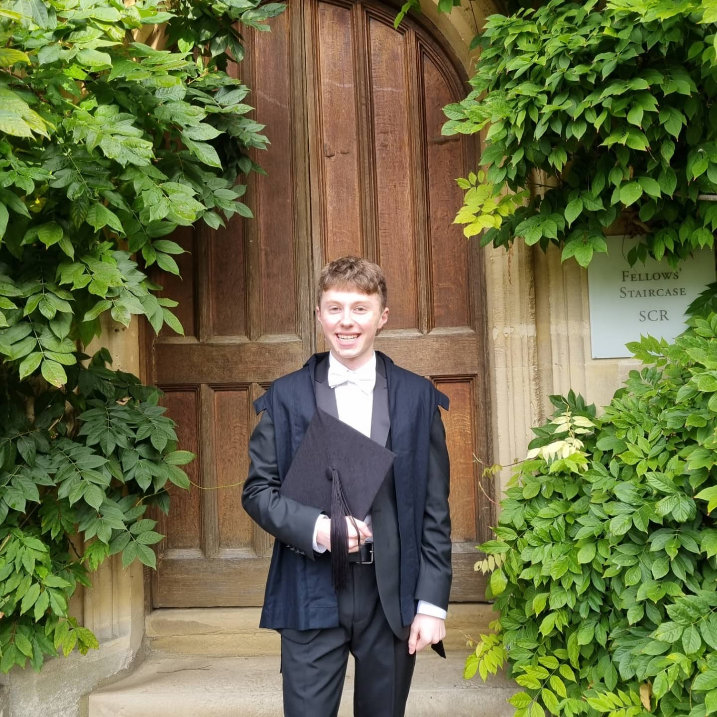
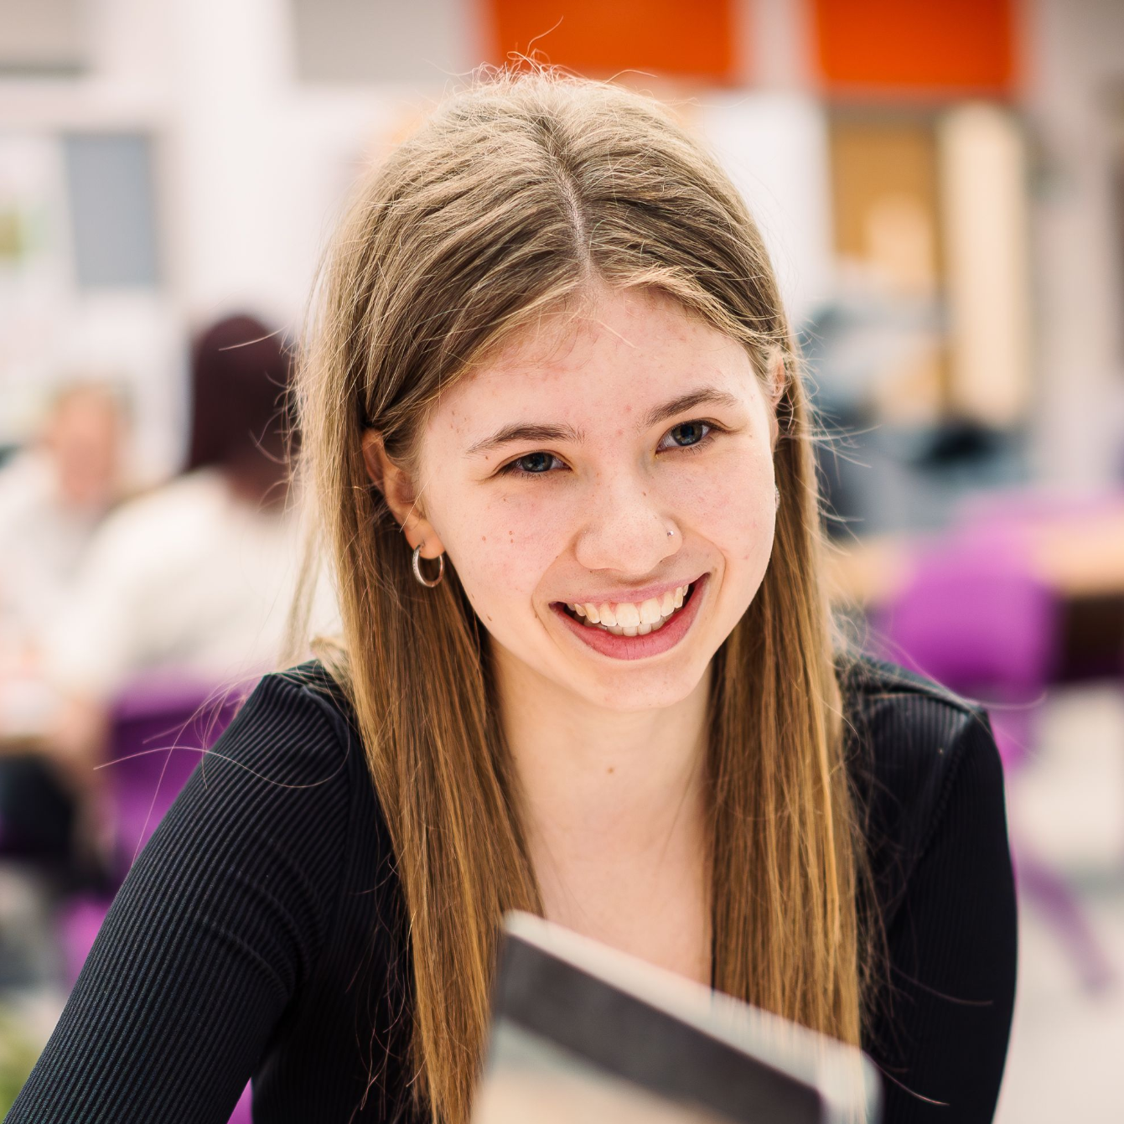
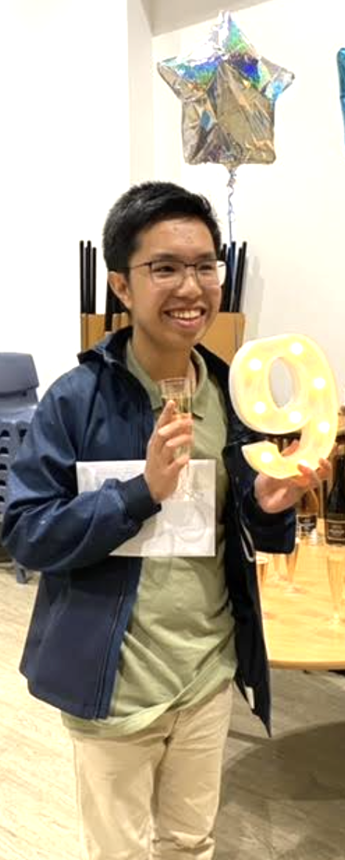
Discovering potential
Joe, 4 A*-A, now studying Law at Oxford University
Millie, 3 x A*-B, now studying Psychology at York University
Ralph, currently studying Maths, Further Maths, Physics & Chemistry
6

Slide 8

1
2
3
4
Course choice
Read our prospectus and
research the subjects
you are interested in.
Check your forecast
grades against each
subject and select a
suitable pathway.
OPEN EVENING
Thursday 4th December
Apply
Complete our online application form: https://shorturl.at/2VkdL
Newcomers to LHS
will need to provide
their most recent
forecast grades to check
eligibility for courses.
DEADLINE: Friday 16th January
Guidance discussions
In February 2026, you
will be invited to meet
with a member of the
Sixth Form team to
discuss your application.
Register your interest:
https://shorturl.at/8YgsT
Application timeline
7

Slide 9
5
6
7
Conditional offers will
be sent out before
Easter 2026. These are
based on your Guidance
Discussion and eligibility
for chosen courses
and will be subject to
course availability and
timetabling. Changes to
subjects can be made
during Induction.
Induction Week
This is an
important opportunity
to experience Sixth Form
life, attend lessons in your
chosen subjects and try
out other courses. This takes place in late June/July 2026.
GCSE Results & Enrolment Day
All applicants will need
to enrol and accept their
offers. Further guidance
will be given nearer
the time.
Application timeline
8

Slide 10
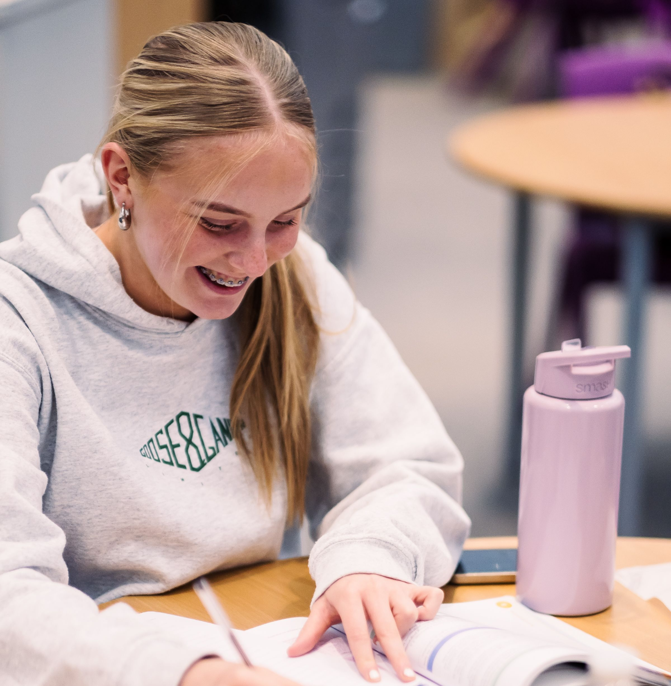
“The inviting space and environment of sixth form has made me feel so settled throughout my transition to Year 12 from a different school in Year 11. Students and staff have been so welcoming and kind, helping me feel really supported already.”
“Longbenton has such a welcoming environment and community, where everyone is encouraged to be ambitious and enrich themselves both academically and in terms of extracurricular activities”
…a tight-knit community where students feel valued, supported, and empowered…
9

Slide 11
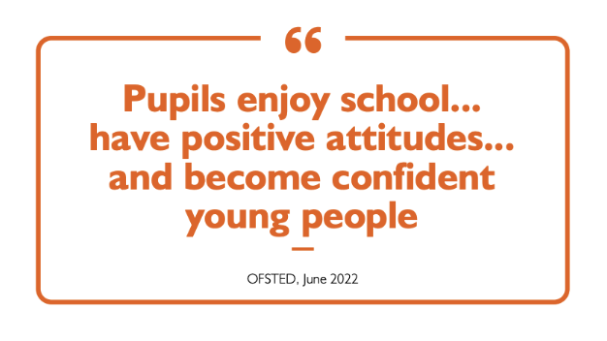
At Longbenton High Sixth Form, tutor time is a cornerstone of our ethos, with brilliant and dedicated tutors bringing years of experience in Key Stage 5. This time is crucial for fostering a comfortable and supportive environment where students feel cared for, enabling them to open up to learning and achieve higher academic attainment.
Our varied tutor program builds a strong sense of community through a range of engaging activities. "Mindfulness Mondays" focus on well-being, while "Life Skills" sessions equip students with essential practical knowledge such as student friendly cooking and personal finance tips. We also host interform challenges between Year 12 and Year 13 each week with special themed challenges taking place at the end of each half term, fostering camaraderie and friendly competition.
"Fun Fridays" are student-led, featuring activities such as art, sports, puzzles, and fundraising events, allowing students to explore their interests while contributing to the school community. This holistic approach ensures that our students not only excel academically but also grow personally, ready to take on future challenges.
Support & wellbeing
10

Slide 12
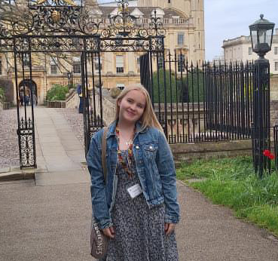
I chose to stay on at Longbenton High Sixth Form because of the small friendly community, which I believe is unique to us. We celebrate each half term with parties or activities and complete weekly inter form quizzes and competitions which all contribute to a real community atmosphere. I particularly enjoy our enrichment, this past year I completed my EPQ in this time.
Following sixth form I am applying to study History at University with Cambridge as my top choice, but I am also applying for solicitor apprenticeships. To support my application for Oxbridge I have undertaken work experience opportunities, Summer Schools, residentials, academic programmes, essay competitions and even got to visit Poland and Auschwitz. Longbenton sixth form has been the reason I have been able to complete many of these things and has supported and encouraged these endeavours greatly, instilling confidence in my application from the start of year 12.
Aside from academics, I am a member of the Sixth Form Committee and our Equalities Team as well as gaining many LAMDA Performance qualifications. During sixth form, I have had the chance to step up into leadership roles; I helped organise our recent school mock election, including representing one of the political parties. I am currently Assistant Director of our school musical.
Madeleine
Y13
Student Stories
Madeleine is studying History at Cambridge University having attained AAAA in her A levels and EPQ
11

Slide 13
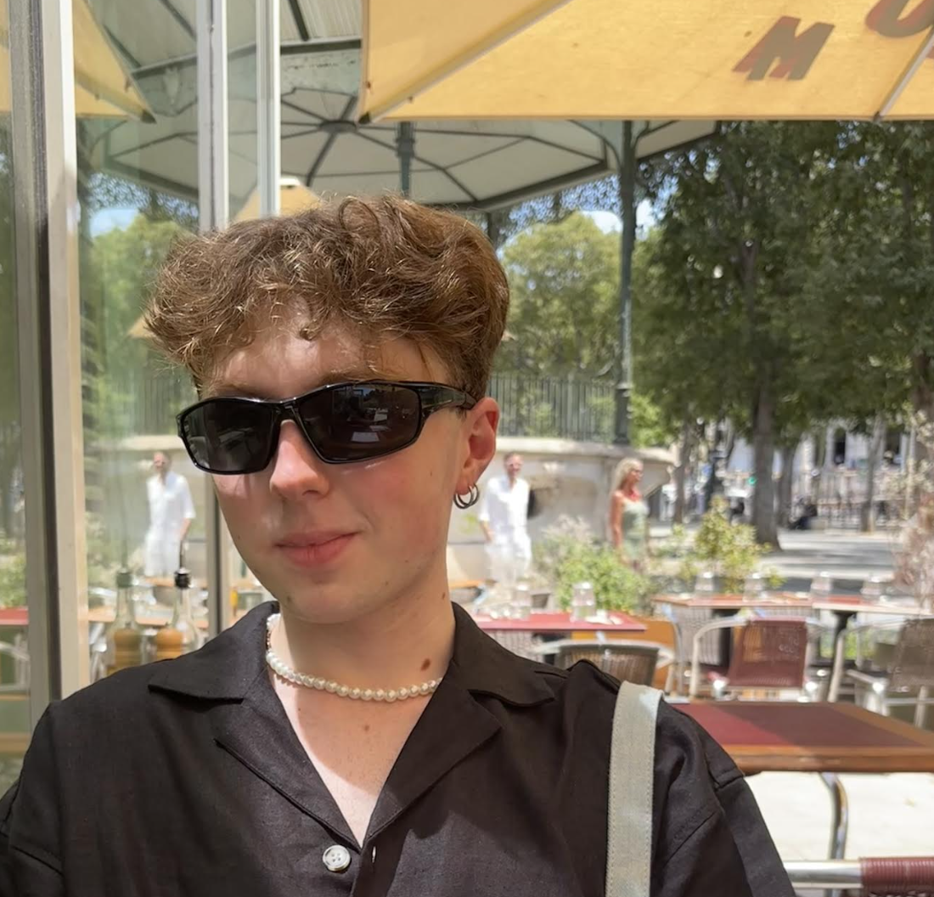
I studied A-levels in politics, history, geography and drama at Longbenton High Sixth Form and I'm currently in my final year of studying Law at Oxford University.
I pretty much always knew I wanted to study law, but I never thought it would be at somewhere like Oxford. Longbenton High Sixth Form did wholeheartedly believe that I could do it though. At university and meeting people from everywhere, I have realised that, in contrast to many schools, Longbenton High does actually mean what it says about wanting the best for its students in whatever form that takes.
After university, I'm going to do the Bar Practice Course to become a barrister. I plan to specialise in criminal law and maybe have a practice in child protection proceedings. These fields of law are perhaps when the law is at its most powerful, so I hope to use my skills gained at Longbenton High Sixth Form, university and life to do some good. Besides university, I love travelling. My most recent rogue destination was Armenia.
Joe
LHS Alumni
Joe has just graduated with a degree in Law from Pembroke College, Oxford University.
12

Slide 14
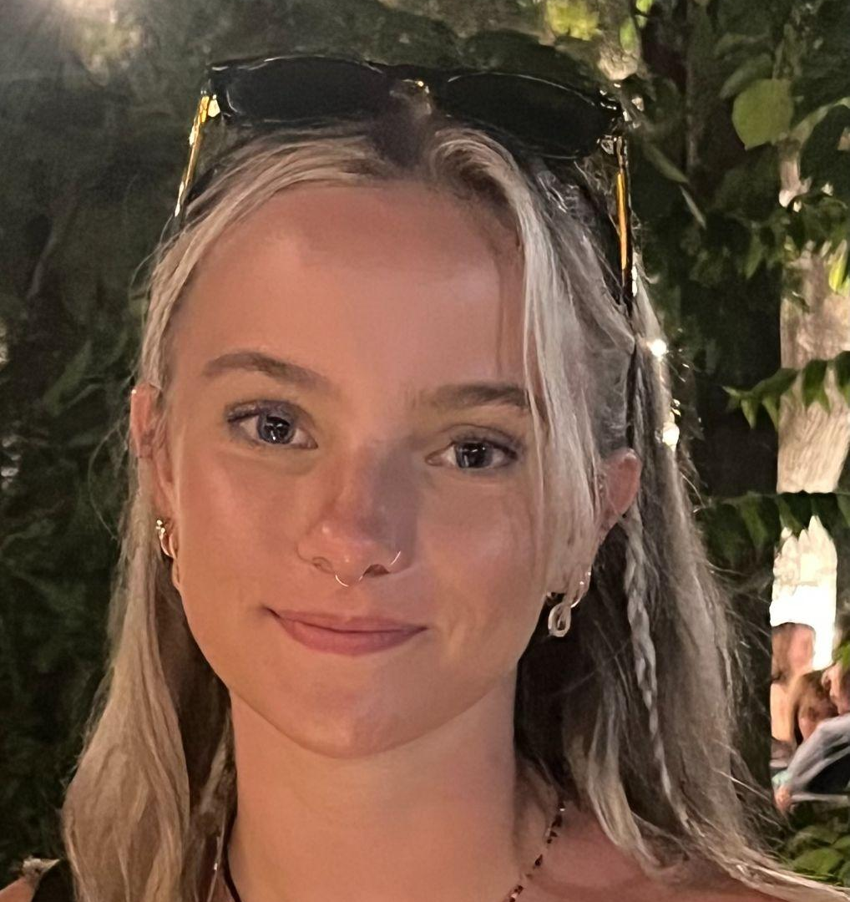
Gabrielle is currently studying Biomedical Sciences at Liverpool University
Gabrielle
I studied 3 A levels in Longbenton High Sixth Form in summer 2024, achieving AAB in Biology, History and Chemistry.
Throughout the two years, there was constant support available for academic and personal concerns. In sixth form, I enjoyed the chilled, friendly environment as well as the ability to make new connections with students from other schools.
Aside from my studies I was also able to perform out-of-school music exams which was an amazing addition to my study.
Without help from Longbenton I would not be where I am today: starting my first year at the University of Liverpool studying Biomedical sciences.
LHS Alumni
13

Slide 15
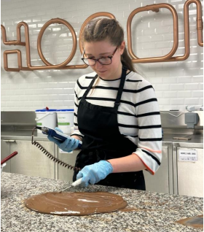
I attended Longbenton High School from 2016 to 2021, and then opted to continue my studies at Sixth Form for the following two years, due to the benefit of already having established good relationships with the staff who would be teaching me.
During the COVID-19 lockdowns, I began researching into food more, as I found myself with lots of spare time which I often spent baking. I was particularly fascinated by the chemistry behind food, and how different compounds influence flavour and the structural properties of the product – the knowledge I gained from this passion as well as scientific knowledge gained from my studies, in particular Chemistry, allowed me to understand why certain ingredients were used in recipes, and it opened up an area of technical curiosity for myself, therefore leading me to apply for a degree apprenticeship alongside UCAS university application.
The apprenticeship was with a large confectionary business, based in Birmingham, gaining a degree in Food Science and Technology while working in the Research and Development department. I applied to the role as a potential extra opportunity for myself, and the SLT staff at Longbenton were incredibly helpful during the application process, offering support and practice with interview preparation, and putting me in contact with local recruiters who also helped me to improve my employability, and gave me an understanding of what to expect from a corporate interview. After multiple interviews and an on-site assessment centre day, I ended up getting the job!
I believe that opting to do this specific degree apprenticeship was the perfect choice for me, as the course delivery method at university was entirely conducted in-person via block weeks, and I knew I wanted to study a course with high contact hours. The added benefit of gaining work experience and being able to apply my knowledge from my studies really appealed to me, and I have been able to grow my independence so much though relocating to a new city. Also, the support network that is put in place by both universities and employers is exceptional, and makes the new change easier to adjust to. I would recommend a degree apprenticeship to anyone who is proactive and loves to learn, because you never stop
learning!
Evie
LHS Alumni
Evie is completing a degree apprenticeship with Mondelez International
14

Slide 16
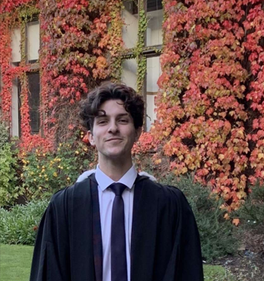
My love of History began in a year 8 class at Longbenton, when the teacher first showed us a Peter Snow documentary about the Battle of Hastings. From then on, I always enjoyed History at school, but I was never as good at it as I would’ve liked. I first considered History as a career during my A-level years, when we studied the Russian Revolution and the Tudors. Again, my love for the subject slightly outweighed my ability; I loved researching and engaging with classes, but I hadn’t yet developed enough as a writer. I didn’t get the grades to get into my first choice university, but luckily I managed to get into my second choice.
The reason I’m highlighting these academic troubles is because they were an important lesson. Despite not being a brilliant historian at 18, it was the qualities that I developed during my time at Longbenton, such as my enthusiasm for the subject and commitment to the work, that carried me through all the way to my PhD.
While at Longbenton I also took part in the musicals and the choir. This taught me the value in ‘putting myself out there’, and I thoroughly believe these opportunities shaped me into the person that I am today.
I write to you now from Harvard University, where I am undertaking a research fellowship with one of the leading academics in Global History. My first article, ‘Workers, Wives and Radicals’ was published in Slavery & Abolition – a leading academic journal – in January 2024. Despite being a long way from home, there’s not a day when I don’t use the research skills and life lessons that I was taught at Longbenton. I’ll be forever grateful for the time that I spent there.
Frankie
LHS Alumni
Frankie is currently undertaking a Research Fellowship at Harvard University
15

Slide 17
All students complete enrichment activities as part of their sixth form curriculum
We offer and broad and varied post 16 curriculum.
Most students choose three subjects with the option of a fourth (after consulting with the pastoral team)
We aim to help students select the right courses ensuring that everyone can flourish according to their interests and strengths.
An EPQ can be taken in addition to 3 subjects
Our sixth form is dedicated to creating an inclusive and supportive environment that encourages students to thrive…
16

Slide 18
Grade 6 in 2 Sciences including Biology, 6-6 in Combined Science and a grade 6 in Maths
Biology
Medical Science
Two grade 5s in Science, grade 5 in English and Maths
Entry requirements
Grade 6 in 2 Sciences including Chemistry, 6-6 in Combined Science and a grade 6 in Maths
Chemistry
Psychology
Grade 5 in Science, English and Maths
Grade 6 in 2 Sciences including Physics, 6-6 in Combined Science and a grade 6 in Maths
Physics
17

Slide 19
A grade 7 in Maths is recommended
Maths
Business Studies
Grade 5 or above in English and Maths . Grade 4 in Business (if studied)
Entry requirements
Further Maths
Grade 7 in Maths
Grade 5 in English and Grade 6 in Maths and Computer Science
Computer Science
Grade 4 or above in English and Maths
IT
18

Slide 20
Grade 5 in English. Grade 5 in History, if studied (not required)
Grade 4 in English or Geography
History
Travel & Tourism
Entry requirements
Grade 5 in English. Grade 5 in History, if studied (not required)
Grade 5 in English
Politics
Philosophy & Ethics
Grade 5 in Geography and English. Grade 4 in Maths
Grade 4 in English and Maths. Grade 5 in Science
Geography
PE
19

Slide 21
Grade 6 in English Language
Grade 6 in Spanish
English Language
Spanish
Entry requirements
Grade 6 in English Literature
Grade 6 in French
English Literature
French
Health & Social Care
Grade 4 in Maths, English and Science
Film Studies
Grade 4 in English (Language or Literature)
20

Slide 22
Art / Photography
Grade 4 in Art based subject or a portfolio of work
Grade 5 in Music
Music
Entry requirements
Grade 5 DT, Grade 4 in Maths and English
Grade 4 in English and ideally either Music or Drama
Product Design
Performing Arts
Drama & Theatre Studies
Early Childhood Development
Grade 4 in Maths and English
Grade 5 in English or Drama
PE
21

Slide 23
Reading Buddies with Year 7
Volunteering in the local community
Beyond the classroom
UK Parliament Trip
Lessons from Auschwitz Programme
Music and Acting Lessons
Equalities team
In2Medicine Programme
Charity Fundraising
Student Leadership Positions
School Productions
Guitar Legends
Choir
Careers and University Fairs
Peer Mentoring
Mock Interviews
Duke of Edinburgh
22

Slide 24
Applications are available from the sixth form pastoral team or you can apply online
The 16 to 19 Bursary Fund provides financial help to young people aged 16 to 19 who face financial barriers to participating in education or training.
If you are in Y12-14 in a North Tyneside sixth form in September you could be eligible for up to £1200 per year if you meet one of the criteria below:
In care
Left care having been in care for a minimum of 3 months from the age of 14
In receipt of Income Support (or Universal Credit)
In receipt of both Employment and Support Allowance (or Universal Credit) and Disability Living Allowance or Personal Independence Payment
Discretionary bursaries are also available, the amount available depends on individual circumstances. The eligibility criteria for these include:
Eligible for Free School Meals
A family in receipt of Tax/Universal Credit
Families with low household income
16-19 Bursary
23

Slide 25

HAILSHAM AVENUE
NEWCASTLE UPON TYNE NE12 8ER
0191 218 9500
POST16@LONGBENTON.ORG.UK
sixthform_lhs

