Slide 1

2026
Y9
Options

Slide 2
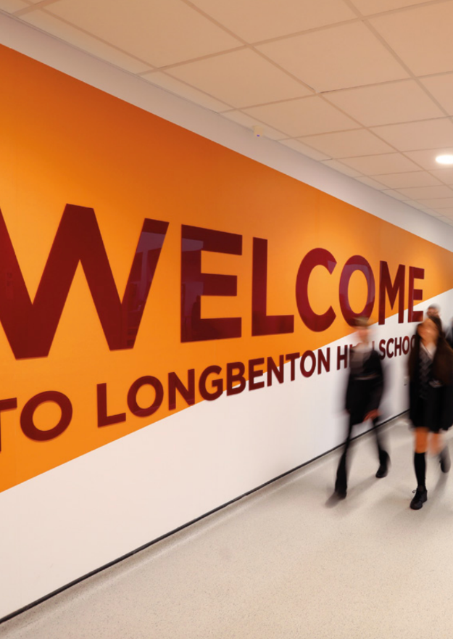
2 KS4 Choices
3 How to make choices
4 Option timeline
5 Careers
6 Core subjects
7 Subject specifications
8 Subject overviews
24 Further useful links
Contents
…a place where students are not just taught, but where bright minds are ignited and nurtured…
1

Slide 3
KS4 Choices…
The purpose of this booklet is to inform you about all of the courses you may be starting in September.
Subjects such as Mathematics, Statistics, English Language, English Literature, and Science are taken by all students. There will, however, be other courses for you to choose from. This will allow you to take other subjects which you are good at or which particularly interest you. In addition, everyone will take PSHE and Core PE. Other subjects are optional but we do ask that students choose at least one of History, Geography, Computer Science, French, or Spanish to ensure a broad and balanced curriculum within the option choices.
In most cases, the courses you take will lead to public examinations after two years. The booklet also explains how you will be assessed for these examinations in each subject.
Read all of this booklet carefully and discuss the information at home so that your parents or carers, as well as your Form Tutor, can help you to decide on the best combination of subjects.
We shall do our best to allocate the subjects students opt for. It must be said, however, that if too few students opt for a particular subject, we will require some students to change their choices as we cannot sustain small groups.
We do expect that this whole process will work effectively and that students can embark on the Key Stage 4 curriculum with confidence and achieve excellent results. If you have any questions or concerns please contact Mrs McPherson, Mr Harold or Miss Bertram (Year 9 Pastoral Team), or Mrs Willis.
2

Slide 4
How to make your choices
Think about subjects you enjoy and think you could do well in. find out lots about new subjects from teachers and current Y10/11s
Don’t choose something because your friends are choosing it
Think about what you may want to do in the future, would certain subjects be useful?
“By far the most important factor employers consider when recruiting school and college leavers is their attitude to work (86%), followed by their aptitude for work (63%) and general academic ability (43%).”
3

Slide 5

1
2
3
4
Course choice
Read our options booklet and
research the subjects
you are interested in.
Speak to current year 10 and 11 students about their options. Talk to teachers about what you will learn in each subject.
Options Evening
Monday 23rd March
5.30pm
Apply
Complete the Google Form that will be shared on your pastoral google classroom.
You will make three choices and two reserve choices
DEADLINE: Wednesday 22nd April
Guidance discussions
If your top 3 subject choices don’t work as a combination you will be asked to meet with Mr Harold, Mrs McPherson or Mrs Willis to discuss the pathways which do work.
Options Information in lessons
Wb 23rd March
Options timeline
4

Slide 6

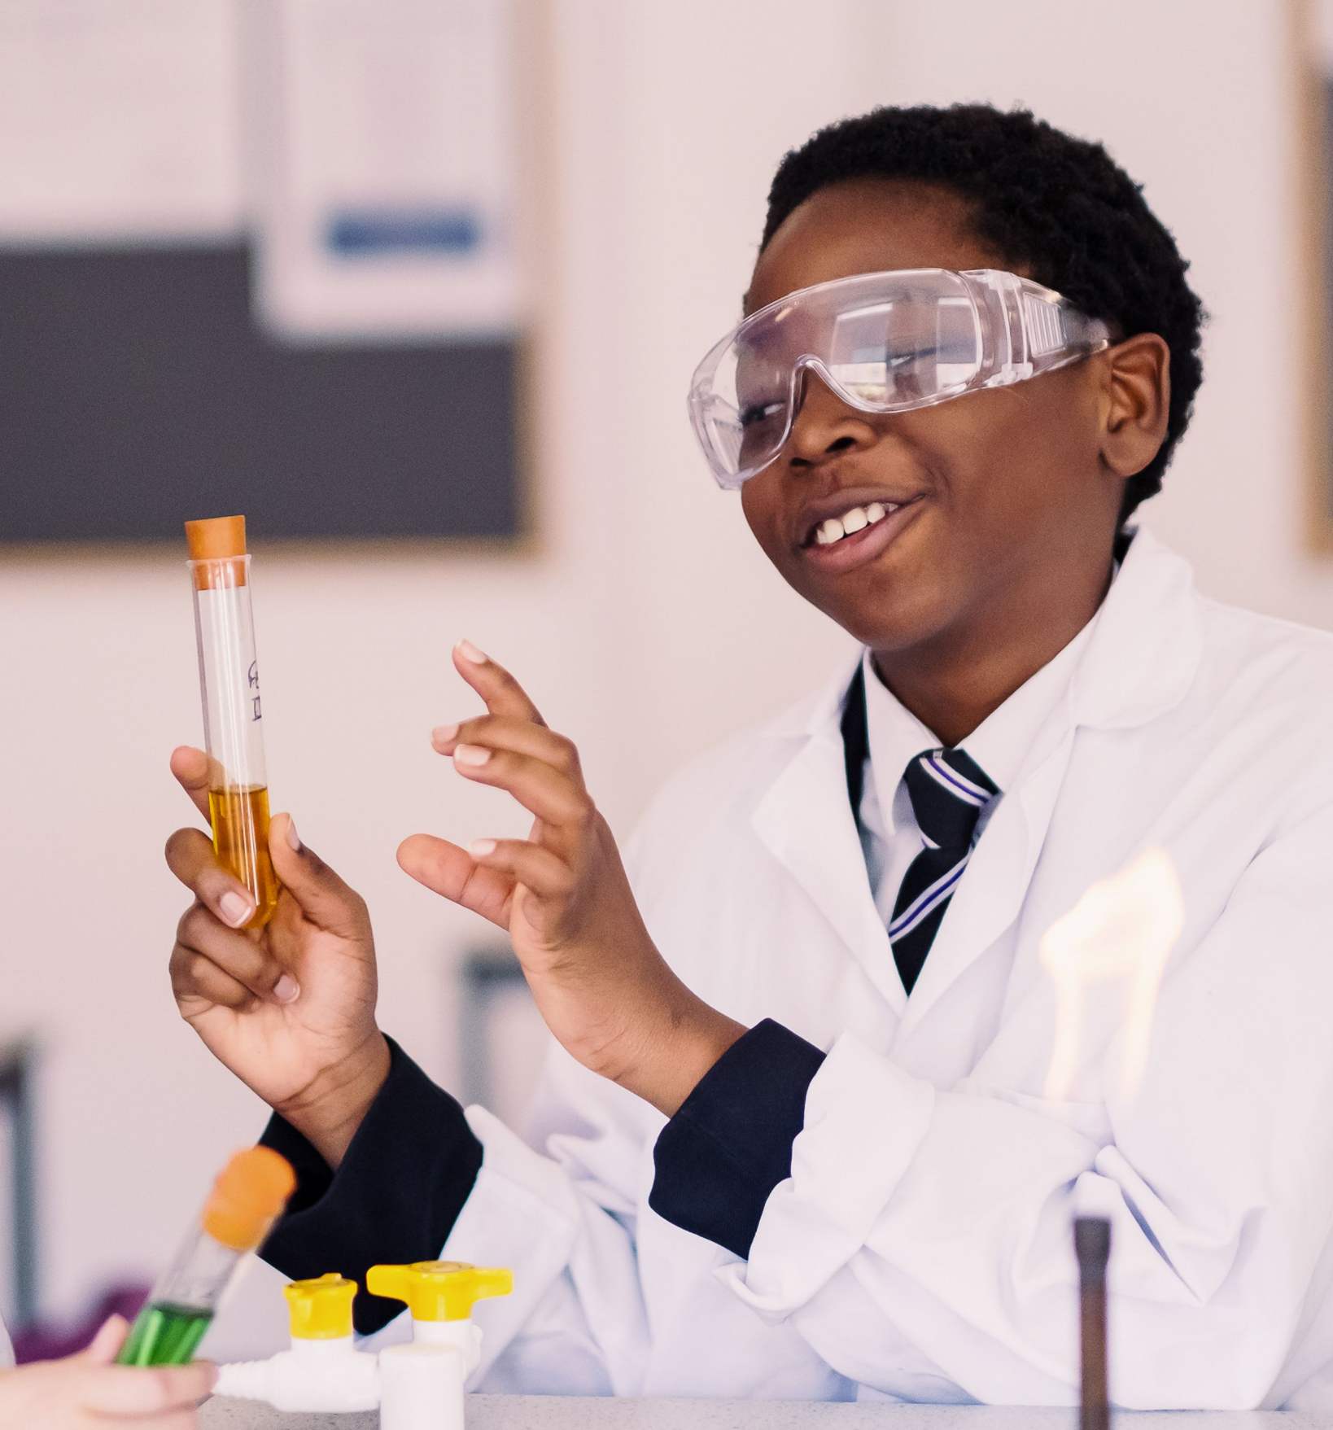
A quick guide to four “Areas of Opportunity” in the North East
These are the areas where there are lots of high quality jobs, so it might be worth finding out about them.
∙ Health and Life Sciences (e.g. medical research, genetics, effects of ageing)
∙ Manufacturing (e.g. producing cars, battery technology, pharmaceuticals)
∙ Digital and Software (e.g. computer games, cloud technology, cybersecurity, robots)
∙ Energy (e.g. offshore and onshore wind turbines, solar, biomass, subsea technology)
What do employers say about young people and jobs?
51% want young people to improve their ability to analyse situations and solve problems
41% want young people to improve their skills of self-management
67% are unsatisfied with young people’s levels of literacy and numeracy
34% don’t believe young people can communicate effectively with others
48% say young people should be more resilient and take responsibility for their actions
66% of businesses value foreign language skills in the global business world
5

Slide 7
All students complete both English Language and English Literature.
Each is assessed by 2 papers at the end of Year 11. Students are also assessed for Speaking and listening.
English
(AQA)
Students will complete either Higher tier
(Grades 9-3) or Foundation tier (Grades 5-1). This will be determined by their progress throughout the course.
Maths has 3 exam papers (1 x non-calculator, 2 x calculator)
Core PE
Maths
(Pearson)
Subjects taken by everyone…
Students will complete Combined (Trilogy) or Separate Sciences. All students study all three sciences. They are assessed across 6 papers (2 x Biology, 2 x Chemistry, 2 x Physics)
Science
(AQA)
PSHE
Statistics
(Pearson)
Students will complete either Higher tier
(Grades 9-3) or Foundation tier (Grades 5-1). This exam will be sat at the end of Year 10.
It is assessed across 2 exam papers, both allow use of a calculator
6

Slide 8
Art GCSE (AQA)
Design Technology GCSE (AQA)
Subjects offered…
(Click the link to access the specification)
Hospitality and Catering (WJEC)
Spanish GCSE (Pearson)
Photography GCSE (AQA)
Drama GCSE (AQA)
Computer Science GCSE (Pearson)
Music GCSE (Pearson)
Business and Enterprise (NCFE)
Geography GCSE (AQA)
Imedia Cambridge National (OCR)
PE GCSE (OCR)
Childcare Cambridge National (OCR)
History GCSE (AQA)
Religious Studies GCSE (AQA)
French GCSE (Pearson)
Sport Studies Cambridge National (OCR)
22

Slide 9
Contact
Ms H Marshall
hmm@longbenton.org.uk
Assessment
NEA 60%
Exam 40%
Students will have the opportunity to study and practise a wide range of art and design activities and later may choose to develop their skills and interests in one particular area.
You will express your ideas creatively and learn how to present visual information (illustrations, graphics, and diagrams) with greater confidence. Art and Design is an enjoyable subject which gives you the opportunity to develop the skills and knowledge to bring your own ideas to life. You will be encouraged to develop your personal imaginative ideas and your practical and design skills. You will be expected to use a sketchbook regularly to improve your visual awareness by recording various aspects of the natural and human environment.
Candidates should produce practical and critical/contextual work in one or more areas: Drawing and Painting, Mixed Media, Sculpture, Printmaking, Lens-based or light based media (film, animation, video, and photography)
Throughout the course, reference will be made to the work of artists and designers past and present. Critical appraisal of their work, using the appropriate vocabulary, will be an important part of the course, together with the development work you will produce in your sketchbooks. You will be expected to take an active interest in the various aspects of the visual arts. Visits to galleries and local colleges to see exhibitions of art and design work will form part of the course. Homework assignments will be set and contribute to the final coursework grade.
There is an expectation that Art students will work in their own time to complete both Components 1 & 2.
Art and Design GCSE
“Art is a totally different subject to all my others, it allows me to be creative and has less pressure in terms of not having a final written exam”
8

Slide 10
Contact
Ms R Woodhouse
rw@longbenton.org.uk
Assessment
NEA 60%
Exam 40%
You will learn to develop ideas and experiment with different photographic techniques, and digital manipulation. You will learn to use editing software to manipulate your images.
You will be encouraged to develop your skills in creating digital visual images. You will be expected to use a sketchbook regularly, to improve your visual awareness by recording various aspects of the natural and human environment in preparation for your photoshoots, recognising awareness of composition and creative insight.
Candidates should produce practical and written critical/contextual work, studying the work of other Photographers, Visual Artists and Designers. You will be expected to take an active interest in the course. Visits to sites of interest and regular photoshoots will be expected as part of the homework task schedule.
There is an expectation that Photography students will attend photo shoots outside of school and work in their own time to complete Components 1 & 2.
Photography GCSE
9
“I really like the freedom and creativity, it’s a different way of being artistic”

Slide 11
Contact
Ms A Teale
at@longbenton.org.uk
Assessment
NEA (60%) completed during year 11
Exam (40%) completed at end
of course
Business and Enterprise is an exciting subject that relates to the real world and gives students the opportunity to develop skills that can be applied to all working roles. Most students pursuing this course will find themselves working in some form of organisation, such as a manufacturing firm, an office, or retailer. Alternatively, there may be an opportunity for students to one day open and run their own business.
Students will explore what it means to be an entrepreneur and how businesses are organised. They will develop knowledge of marketing, operations management and the influences that affect a business. They will also understand business planning, including research, resource planning and growth. Students will develop knowledge of human resources and finance and how they support business and enterprise planning.
Business and Enterprise will give you the key skills needed to be an attractive employee. It will help you to develop your team working, leadership and communication skills.
Business and Enterprise NCFE
“I think business is a good option to pick if you don't want all the pressure of exams as it's 60% coursework. It is very 'real world' and easy to understand. It can help you with your future because you learn about employment. It is different to other subjects”
10

Slide 12
Contact
Ms D Purvis
dp@longbenton.org.uk
Assessment
Unit 1 : exam
Unit 2 & Unit 3 : assignments which are internally assessed
This qualification provides the opportunity to gain a vocational qualification that gives a basic introduction into a Child’s development. It includes the knowledge and understanding of child development and well-being necessary for working with children in a variety of settings.
Unit 1 Health and well-being for child development (exam 40%)
- Importance of pre-conception health and reproduction
- Antenatal care and preparation for birth
- Postnatal care and conditions to help children thrive
- Childhood illnesses
Unit 2 Create a Safe environment and nutritional needs of children (internal assessment 30%)
- Learn how to create a safe environment for children
- Research and choose equipment that is suitable to use
- Learn about children’s nutrition of ages 0-5years
Unit 3 Understand the development of a child from 1-5yrs (internal assessment 30%)
- Physical, Intellectual and social development norms
- Importance of planning play activities to support development
- Stages of play and types of play
- Observing children aged 1-5years
- Plan play activities
Childcare Cambridge National
“The things you learn are really interesting and I like that there is coursework so I can do work that counts throughout the course”
11

Slide 13
Contact
Mr M Charlton
mch@longbenton.org.uk
Assessment
NEA (50%) A design and make task
Exam (50%)
Design and Technology will prepare students to participate confidently and successfully in an increasingly technological world. Students will gain awareness and learn from wider influences on Design and Technology including historical, social, cultural, environmental and economic factors. Students will get the opportunity to work creatively when designing and making and apply technical and practical expertise. This GCSE allows students to study core technical, designing and making principles, including a broad range of design processes, materials techniques and equipment. They will also have the opportunity to study specialist technical principles in greater depth
Core technical principles - A mixture of multiple choice and short answer questions assessing a breadth of technical knowledge and understanding.
Specialist technical principles - Several short answer questions and one extended response to assess a more in depth knowledge of technical principles.
Designing and making principles - A mixture of short answer and extended response questions.
There is an expectation that DT students will work in their own time to complete the NEA units of the course.
Design Technology
GCSE
“I really enjoy the problem solving nature of the course, it’s really technical & creative at the same time”
13

Slide 14
Contact
Mrs A Maughan
amg@longbenton.org.uk
Do you enjoy:
· expressing yourself in an active and exciting way
· contributing your ideas and taking on board those of others
· exploring ideas by putting yourself in other people’s shoes
· playing many parts in different imaginary situations
· creating your own drama work
· looking at plays written by other people
· learning about creating a character and playing this character in performance
· watching live performances
Then this course is for you!
Over the two year course you will work in groups to explore new techniques, ideas, issues and stories; explore scripts and how they might be staged; devise pieces of drama inspired by many different stimuli materials, including images, music and objects; keep a record of your understanding and ideas in a written drama log and visit the theatre to explore how productions create meaning.
Assessment
Component 1 : Written exam (40%)
Component 2 : Devising Drama (40%)
Component 3 : Text in Practice (20%)
Drama GCSE
“It’s brilliant! It’s really varied with lots of practical opportunities to work with other students”
14

Slide 15
Contact
Mr D Carr
dc@longbenton.org.uk
Assessment
Paper 1 : Physical (35%)
Paper 2 : Human (35%)
Paper 3 : Geographical Skills (30%)
The study of Geography allows you to make sense of the world around you. We use real world examples and current affairs that will broaden your knowledge and understanding of the world: past, present and future. Whilst progressing through the GCSE course you will have the opportunity to improve upon your transferable skills, which will not only support your other GCSE subjects but will stand you in good stead for future careers. Examples of transferable skills used in Geography are: data analysis, evaluation, enquiry, ICT and expressing your opinions.
Living with the Physical Environment.
The challenge of natural hazards, Physical landscapes in the UK,
The living world
Challenges in the Human Environment
Urban issues and challenges, The changing economic world, The challenge of resource management:
Geographical Skills
Two field visits to local areas, Pre-release booklet linked to a geographical issue
Geography
GCSE
“I enjoy geography because it is the perfect combination of essay writing and maths skills. Also, it keeps you updated with the world which is essential to encourage young people into the humanities field”
15

Slide 16
Contact
Mr D Carr
dc@longbenton.org.uk
Assessment
Paper 1 : Crime and Punishment
Paper 2 : Richard & John and American West
Paper 3 : Weimar & Nazi Germany
There are five key reasons to study History at GCSE.
1. It gives you an understanding of the modern world and how it came to be the way it is.
2. It helps you to understand the beliefs and attitudes of people in different periods of history, including from outside Britain, and therefore broadens your mind and horizons.
3. It develops your organisational and communication skills, which are essential in everything you do now, and will do in the future.
4. It is interesting and fun subject to study
5. As a challenging subject, success in GCSE History demonstrates real academic ability
Over the 2 year GCSE course students will students 4 topics:
Weimar and Nazi Germany
The American West
The reigns of King Richard 1 and King john
Crime and Punishment in Britain
History GCSE
“You learn a vast array of different topics, there is something to interest everyone”
16

Slide 17
Contact
Ms D Purvis
dp@longbenton.org.uk
Assessment
NEA 60%
Exam 40%
The Food course will equip students with the knowledge, understanding, skills and creativity they need to cook. It will give them the ability to apply the principles of nutrition and healthy eating when planning a menu, as well as developing their understanding of an ever changing industry. Students will be able to make informed decisions about a wide range of further learning opportunities and career pathways, developing vital life skills so they can feed themselves and others affordably and nutritiously. The students will learn a wide variety of practical cooking techniques to prepare and cook food healthily, whilst gaining a proper understanding of the principles behind the running of an effective establishment. The course allows students to show their creative flair by the modification of recipes to improve their nutritional and sensory profile. It promotes independent thinking, decision making, planning and organisational skills. Above all, it allows students to create a wide selection of delicious food products
Unit 1 : The Hospitality & Catering Industry (exam)
Unit 2 : Hospitality & Catering in Action (NEA) Plan, prepare, cook and present nutritional dishes to meet an assignment brief
Hospitality & Catering WJEC
“I enjoy the subject as it is something different, the practical lessons are a break from written work and they feel more relaxed with less pressure”
17

Slide 18
Contact
Ms A Teale
at@longbenton.org.uk
Assessment
Written exam (50%)
On screen programming exam (50%)
Computing is of enormous importance to the economy; the role of Computer Science as a discipline itself and as an ‘underpinning’ subject across industry is growing quickly. Computer technology continues to advance rapidly and the way we consume technology has changed massively over recent years. As individuals, we are, invariably, all users of this ever-changing technology. This course challenges students to be creators rather than consumers. There will be two areas of study.
Technology : The course will give students a real, in-depth understanding of how computer technology works. Students will no doubt be familiar with the use of computers and other related technology from their other subjects and elsewhere. However, this course will give them an insight into what goes on ‘behind the scenes’, which many students find absorbing.
Programming : The course will develop critical thinking, analysis and problem-solving skills through the study of computer programming. For many students, it will be a fun and interesting way to develop these skills, which can be transferred to other subjects and even applied in day-to-day life.
Computer Science GCSE
“Computer Science is a really challenging course but I love the range of things we learn”
18

Slide 19
iMedia
Contact
Ms A Teale
at@longbenton.org.uk
Assessment
NEA 75%
Exam 25%
The qualification enables students to become independent and adaptable users of ICT, to acquire and apply creative and technical skills and to develop their understanding of a wide range of technologies. They will gain an understanding of how ICT is used in the media sector and undertake projects to try this themselves.
This course provides learners with essential knowledge, transferable skills and tools to improve their learning in other subjects with the aims of enhancing their employability when they leave education. It will encourage independence, creativity and will equip learners with a range of creative ICT skills and provide opportunities to develop, in context, desirable, transferable skills such as research, planning and review, working with others and communicating creative concepts effectively.
This course will enable the students to develop a variety of skills with a range of topics to be chosen from Graphics, Multimedia, Video, Web Design, Animation and Game Design.
This is a creative course which requires students to be able to effectively design media to meet a given purpose and audience. Students should be able to consider the aesthetics of their work as well as the practical aspects.
Imedia
“I love that I get to design and create things, whether it's making websites, digital posters, or even videos. It's really fun to see my ideas come to life in ways I can actually show others. I’ve always been into technology, and iMedia lets me work with the latest software and tools. It feels like I’m learning real-world stuff that could help me in future careers or just in everyday life”
19

Slide 20
Contact
Mrs H Richardson
hr@longbenton.org.uk
Assessment
Listening 25%
Reading 25%
Writing 25%
Speaking 25%
A GCSE in a modern foreign language helps demonstrate a strong skill set to future employers, whatever career path you may wish to pursue. Studying a language will improve your Social skills, Ability to work in a team, Communication skills, Problem-solving skills, Confidence, Cultural awareness Open-mindedness and Flexibility.
You will study themes relevant to young people across Years 10 and 11. These are:-
Lifestyle and wellbeing
My neighbourhood
Media & technology
Studying and my future
Travel & tourism
My personal world.
Students will gain an invaluable insight into customs, cultures and traditions of the countries where the target language is spoken, broadening horizons.
French GCSE
“You get to learn about things you would actually need to talk about. It also looks really good on your CV that you have a language”
20

Slide 21
Contact
Mrs H Richardson
hr@longbenton.org.uk
Assessment
Listening 25%
Reading 25%
Writing 25%
Speaking 25%
A GCSE in a modern foreign language helps demonstrate a strong skill set to future employers, whatever career path you may wish to pursue. Studying a language will improve your Social skills, Ability to work in a team, Communication skills, Problem-solving skills, Confidence, Cultural awareness Open-mindedness and Flexibility.
You will study themes relevant to young people across Years 10 and 11. These are:-
Lifestyle and wellbeing
My neighbourhood
Media & technology
Studying and my future
Travel & tourism
My personal world.
Students will gain an invaluable insight into customs, cultures and traditions of the countries where the target language is spoken, broadening horizons.
Spanish
GCSE
“Knowing a language makes you more employable”
21

Slide 22
Contact
Mr P Kean
pke@longbenton.org.uk
Assessment
Unit 1 : Performing (30%)
Unit 2 : Composing (30%)
Unit 3 : Appraising (40%)
Music is an engaging and challenging GCSE course for students wishing to develop their performance, composition and listening skills. There is an equal balance of theoretical and practical based elements within the course. You must be willing and able to perform on your instrument (which could be your voice) as well as be open minded to listening to, and learning about, a wide range of musical styles and genres. The ability to read and notate music is highly beneficial; it is essential that you are prepared to develop your skills in this. Edexcel GCSE Music consists of three units.
Unit 1 : You will prepare a performance programme totalling at least 4 minutes. At least 1 solo piece and 1 ensemble.
Unit 2 : You will prepare 2 compositions totalling at least 3 minutes
Unit 3 : You will study 4 main areas of music (Instrumental music, Music for stage and screen, vocal music, fusions) you will study 8 set works and also be tested on music related to these areas.
Music
GCSE
22
“I love being able to compose, there is a lot of freedom to be creative around your own musical interests”

Slide 23
Contact
Mrs R Cooper
rco@longbenton.org.uk
Assessment
NEA (40%) Three practicals and written task
Paper 1 (30%)
Paper 2 (30%)
The GCSE PE qualification is an excellent course for any student wishing to further their understanding of a wide range of factors linked to sport and physical activity, including: the human body, fitness testing, commercialisation, diet and mental preparation, in addition to developing their practical performance in a range of activities.
Students will work towards two exams, one looking at human anatomy, the other at sports psychology, sociology and health and well-being; both exams will count for 30% of the final grade. GCSE PE pupils must show strong practical ability, as they will need at least three different sporting activities that they can show competence in; these three activities count for another 30% of the final grade. At least one sport must be played competitively outside of school at a club.
The final 10% of the course is assessed through an evaluation of performance, whereby pupils have to demonstrate their understanding of one physical activity, by assessing their own or another student’s performance.
The PE department will decide as to whether the GCSE
or Cambridge National course is the most suitable
course for each student
PE
GCSE
“"I like finding out about the decisions that elite athletes make to improve their performance. For example, we learn about the diets athletes use and about how psychological techniques help them to prepare for big events. I like that the course is varied and that we do a combination of practical, coursework and classroom lessons"”
23

Slide 24
Contact
Mrs R Cooper
rco@longbenton.org.uk
Assessment
Exam (40%)
Performance : 2 x Sports and written task
Sport and Media (NEA)
The Cambridge National Sports Studies Certificate has been designed to be an engaging and stimulating introduction to the world of physical education, offering a vocational route through Key Stage 4.
R184 (Contemporary Issues in Sport) 1 hour 15 mins written exam (40% of overall mark)
R185 (Performance and leadership in sports activities) – You will perform in two different sports and produce one piece of coursework looking at the organisation of, planning and leading an activity. Students are required to deliver a session and produce a review of it. For the practical element, students must in one of their chosen sports be playing at a club in order to access the course.
R186 (Sports and the media) – You will look at the relationships between the media and sport, the technological advances in sport and the positive and negative impact of sport and the media.
The PE department will decide as to whether the GCSE
or Cambridge National course is the most suitable
course for each student
Cambridge National Sports Studies
“You learn about a variety of different sports such as hockey, athletics and gymnastics. You also learn about the positives and negatives of sport”
24

Slide 25
Contact
Mr D Carr
dc@longbenton.org.uk
Assessment
Paper 1 (50%)
Paper 2 (50%)
Religion is one of the biggest causes of controversy in our world today and an understanding of it is essential for us to be able to understand the society in which we live. GCSE Religious Studies is a relevant, exciting and challenging course. It offers a huge opportunity to develop transferable skills such as critical thinking, debating and essay writing whilst addressing deeply important issues in a supportive setting.You will examine topics such as:
Christian and Buddhist beliefs and practices e.g.
Beliefs about life after death, Beliefs about right and wrong
Life and death issues e.g.
Abortion and euthanasia, Animal and human rights
Relationships and families e.g.
Gender and sexuality, Contraception and family planning
Crime and punishment e.g.
Causes of, and solutions to, crime, including the death penalty,
Forgiveness and rehabilitation
War and peace e.g.
Nuclear war and weapons of mass destruction, Terrorism and
violent protest
RELIGIOUS STUDIES IS MOST DEFINITELY NOT ABOUT MAKING
YOU ‘RELIGIOUS’. IT IS ABOUT ENABLING YOU TO THINK
CRITICALLY, FOR YOURSELF, ABOUT RELIGIOUS AND MORAL THEMES.
Religious Studies
GCSE
“It's not what I expected. It's much more about real life than I thought it would be. I love the philosophical topics we study and our debates on things like crime, war and life and death issues”
25

Slide 26
Further information
NCS
The National Careers Service provides information, advice and guidance to help you make decisions on learning, training and work opportunities.
Careers box
This is a free online library of careers related films, news and information
ICould
This website has lots of videos you can explore by employment sector or life theme.
24

Slide 27
HAILSHAM AVENUE
NEWCASTLE UPON TYNE NE12 8ER
0191 218 9500
Year9@LONGBENTON.ORG.UK

