Slide 1
Today you will...
Investigate problems related to A – Level Maths
Complete this triangle
Key Words:
Investigate
Research
Key Words
Task 1
1
1
1
2
Skills:
1
3
SO THAT BY THE END OF THE LESSON...
First Target | Investigate Pascal’s Triangle
Second Target | Research the meaning of recommended key words
Third Target | Investigate common Trig angles
Notes:
1 x 60 min lesson

Slide 2
Today you will learn to...
Investigate problems related to A – Level Maths
Expand and simplify these expressions
$${(x+1)}^{2}$$
$${(x+1)}^{3}$$
Compare the answers to Pascal’s triangle to find the simplified expansion of
$${(x+1)}^{6}$$

Slide 3
Today you will learn to...
Investigate problems related to A – Level Maths
Task 2
Google the meaning of these key words
Word | Definition
Imaginary Numbers
Rational Number
Irrational Number
Real Number
Natural Number
Polynomial
Derivative
Integral
Exponential
Logarithm

Slide 4
Today you will learn to...
Investigate problems related to A – Level Maths
Task 3
Common Trig Angles Investigation
Complete this table of values using the three Trig Graphs and the two triangle diagrams on the next two page

Slide 5
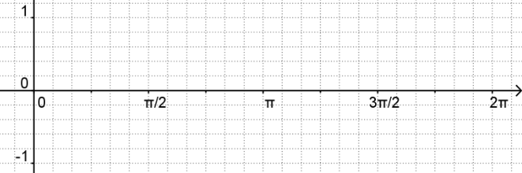
Today you will learn to...
Investigate problems related to A – Level Maths
$$y=\sin{x}$$
90
180
270
360
You can Google the shapes if you can’t remember them …
$$y=\cos{x}$$
90
180
270
360
$$y=\tan{x}$$
90
180
270
360

Slide 6
Today you will learn to...
Investigate problems related to A – Level Maths

