Slide 1


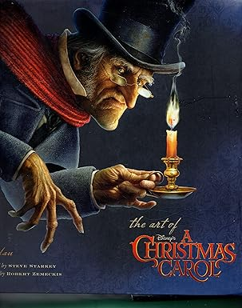

GCSE English
Language & Literature

Slide 2

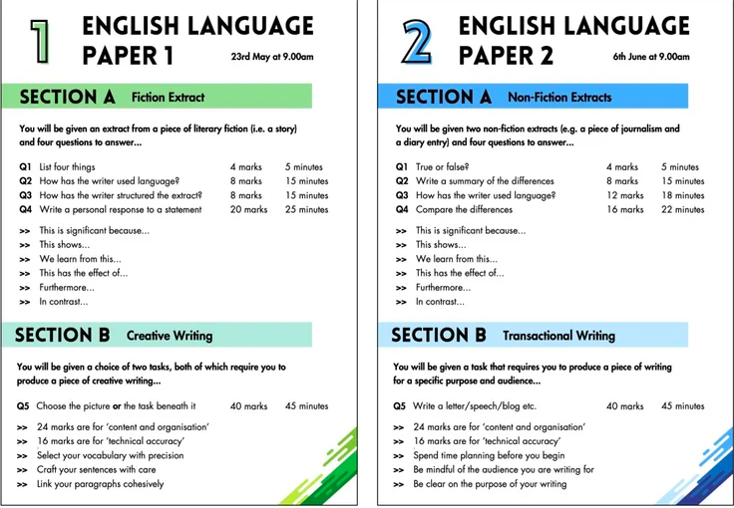

GCSE
English Language

Slide 3
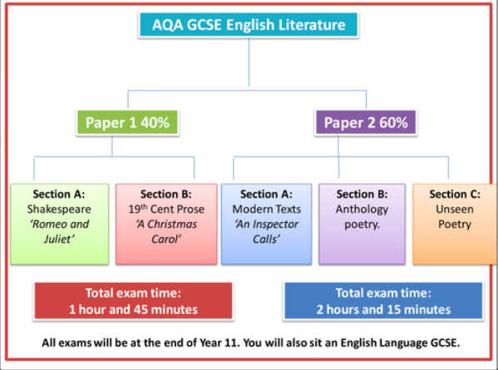
‘Macbeth’

Slide 4
How to Revise
Website Support:
GCSE Pod (content only)
Mr Bruff YouTube (question by question)
PMT (past papers)
What they offer
Tutorial Videos
Practice Questions
Model examples
Read independently, learn quotes,
build vocabulary, know the questions

Slide 5
Information
Revision guides and workbooks available to buy in school, £3.25 each
Year11 revision every Monday 3:15-4pm
Homework set every week to improve independence and revisit recently covered topics
Year 10 & 11 Milestone Assessments
Every 2-4 weeks in English Language and Literature
Detailed feedback from teachers/numerical value/target
Informed intervention

