Slide 1
Psychology Transition Tasks

Slide 2
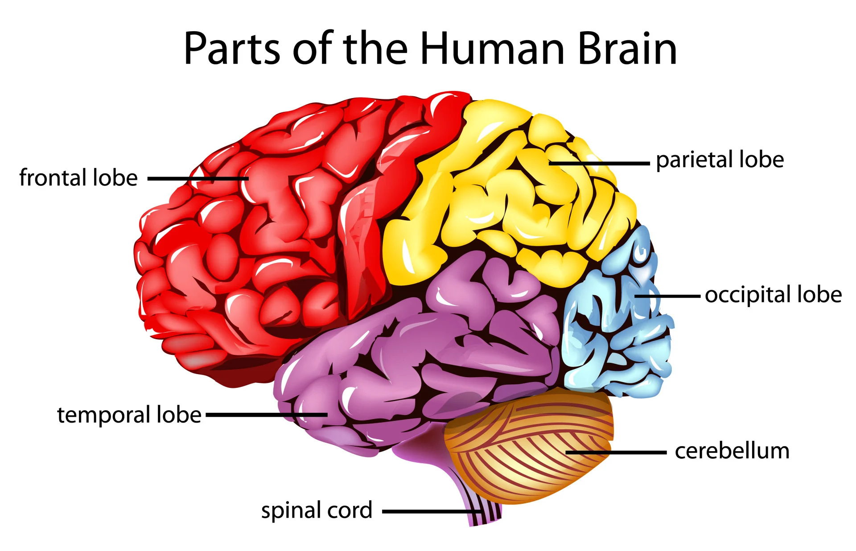
Task 1: What does the brain do?
For each part of the brain on the diagram, research what that part of the brain does
fMRI is one way we can study the brain. Research what fMRI stands for and how it works
Using the information from question 1, what part of the brain would be used for the following scenarios:
Recognising you have been pinched
Seeing a tree from over the road
Grabbing a ball from mid air
Listening to a psychology lesson

Slide 3
Task 1 Answers: What does the brain do?
Frontal Lobe- fine motor skills
Temporal Lobe- analysis speech
Occipital Lobe- visual information
Parietal Lobe- information from skin
Functional magnetic resonance imaging- detects changes in blood flow and blood oxygenation
Recognising you have been pinched- Parietal Lobe
Seeing a tree from over the road- Occipital Lobe
Grabbing a ball from mid air- Frontal Lobe
Listening to a psychology lesson- Temporal Lobe

Slide 4
Task 2: What psychologists think
Imagine you witness a child having a temper tantrum seen in the image. Different psychologists would have different explanations as to why someone may exhibit this behaviour. Do some research into each type of psychologists and see what they would say
What would the behaviorists say?
What would cognitive psychologists say?
What would the psychodynamic approach say?

Slide 5
Task 2 Answers : What psychologists think
What would the behaviorists say?
The behaviourists may say that this is learned behaviour. The child may have been conditioned to act this way to get a desired response. Maybe this behaviour has been vicariously reinforced.
What would cognitive psychologists say?
The cognitive psychologist may say that this behaviour is part of the child's mental schema and that the child's scheme is not very complex as they are not developed.
What would the psychodynamic approach say?
The psychodynamic approach may say this behaviour comes from the ID which has not been instantly gratified and so the child has a tantrum

Slide 6
Task 3: Psychology and Mental Health
The Diagnostic and Statistical Manual of Mental Health (DSM) is a document that categorises and records mental health disorders
Most mental health disorders have behavioural, emotional and cognitive characteristics
Find a mental health disorder from the DSM and research its behavioural, emotional and cognitive characteristics

