Slide 1

Revision evening October 2025
Kindness | Integrity | Determination | Manners | Ambition | Positivity

Slide 2
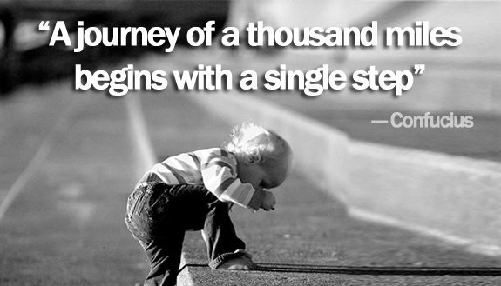

Slide 3
Aim of this session
Key things you need to know about the exams all students will sit
How you can help support revision for Maths, English and Science
What you need to know about the exams
Kindness | Integrity | Determination | Manners | Ambition | Positivity

Slide 4
Maths - what you need to know
P58866A_GCSE_Maths_1MA1_1H_Nov19 .pdf
Paper 1
Non- Calculator
80 marks
Paper gets progressively harder
1hr 30
Paper 2
Calculator
80 marks
Paper gets progressively harder
1hr 30
Paper 3
Calculator
80 marks
Paper gets progressively harder
1hr 30
Almost any topic can be on any paper. Students cannot assume because something is assessed on one paper it won’t be on another paper.
The grade is based on the total across the three papers.
Kindness | Integrity | Determination | Manners | Ambition | Positivity

Slide 5
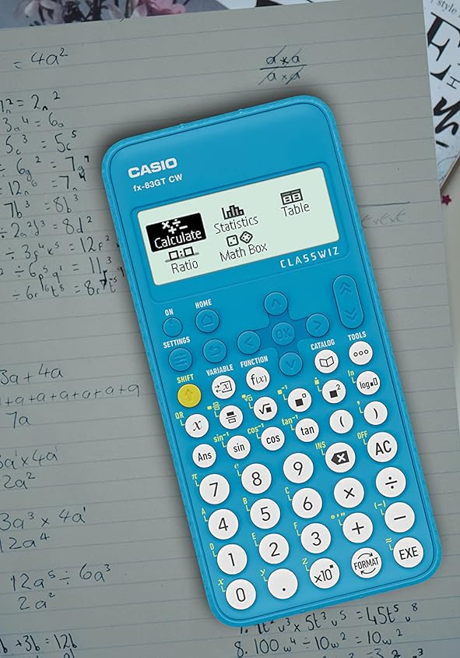
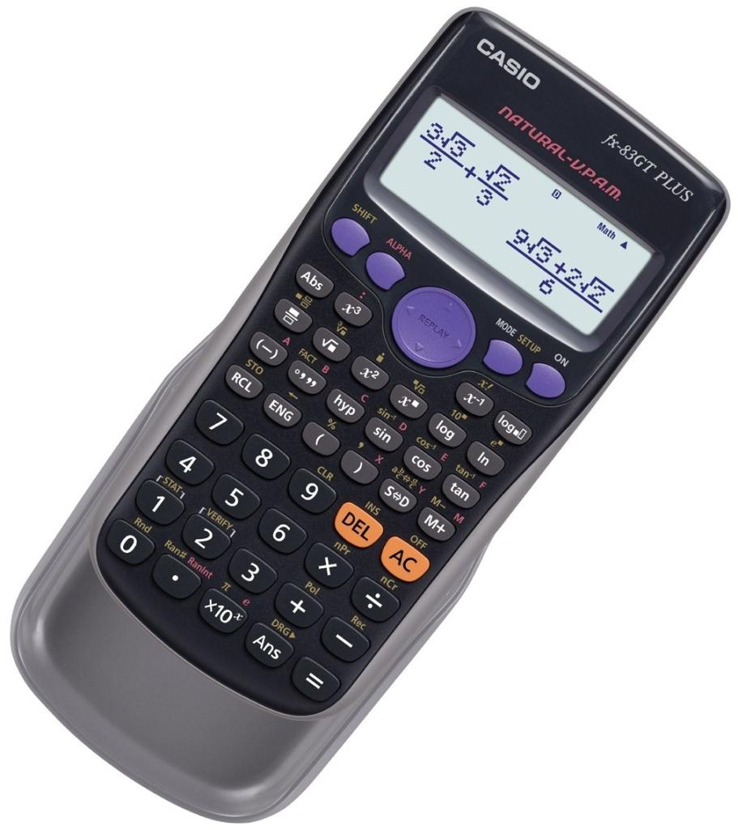
Maths - what you need to know
Paper 2
Calculator
Paper 3
Calculator
All students need a scientific calculator.
They need to bring it to lessons and ensure they are familiar with all of the functions and settings
Kindness | Integrity | Determination | Manners | Ambition | Positivity

Slide 6
Maths genie
https://www.mathsgenie.co.uk/
How can it help?
Topic by topic videos, exam questions and solutions by grade
Provides all exam papers, mark schemes and worked solutions
Walkthrough explanations of each paper
Kindness | Integrity | Determination | Manners | Ambition | Positivity
Notes:
KM instead of miles

Slide 7
1st class maths
https://www.1stclassmaths.com/
How can it help?
Topic by topic videos, exam questions and solutions by grade
Provides frequency of topic appearance on exams
Ultimate revision booklets
‘spicy’ questions to push grade 8/9
Kindness | Integrity | Determination | Manners | Ambition | Positivity
Notes:
KM instead of miles

Slide 8
On Maths
https://www.onmaths.com/
How can it help?
Topic based papers which are marked
Predicted papers for Summer exams
Kindness | Integrity | Determination | Manners | Ambition | Positivity
Notes:
KM instead of miles

Slide 9
Corbett maths
https://corbettmaths.com/
How can it help?
video revision with questions to complete
Exam papers
revision checklists
Kindness | Integrity | Determination | Manners | Ambition | Positivity
Notes:
KM instead of miles

Slide 10
Science - what you need to know?
Biology P1
Chemistry P1
Physics P1
Combined Science
Each paper = 70 marks
(1hr 15)
Separate Science
Each paper = 100 marks
(1hr 45)
Biology P2
Chemistry P2
Physics P2
Kindness | Integrity | Determination | Manners | Ambition | Positivity

Slide 11
Science - what you need to know?
Biology P1
1.Cell Biology
2.Organisation
3.Infection & Response
4.Bioenergetics
Chemistry P1
1. Atomic structure and periodic table
2.Bonding, structure and properties of matter
3.Quantitative Chemistry
4.Chemical Changes
5.Energy Changes
Physics P1
1.Energy
2.Electricity
3.Particle model of matter
4.Atomic structure
Biology P2
5.Homeostasis & response
6.Inheritance, variance & evolution
7. Ecology
Chemistry P2
6. Rate and extent of chemical change
7. Organic chemistry
8. Chemical Analysis
9. Chemistry of the Atmosphere
10. Using Resources
Physics P2
5.Forces
6.Waves
7.Magnetism & electromagnetism
Kindness | Integrity | Determination | Manners | Ambition | Positivity

Slide 12
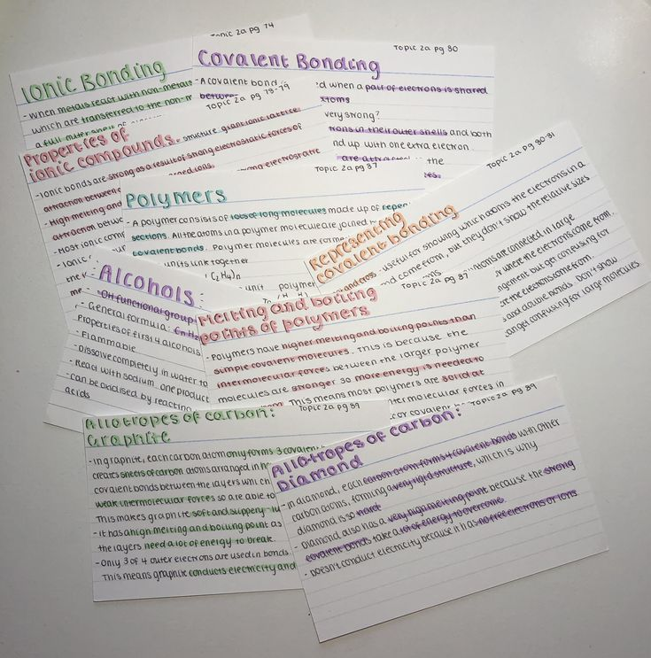
Science - how to revise
Use flashcards to remember key terms (and get someone to test you)
Make sure you know any formula you need to learn
Get familiar with the structure of the paper
Question paper (Foundation) : Paper 1 Chemistry - June 2023
Kindness | Integrity | Determination | Manners | Ambition | Positivity

Slide 13
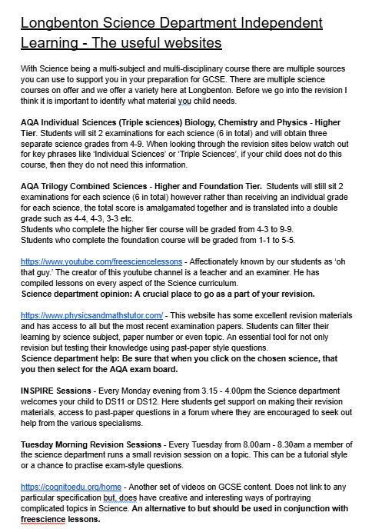
Chemistry Revision - PMT
Kindness | Integrity | Determination | Manners | Ambition | Positivity

Slide 14

Science - required practicals
At least 15% of the marks in the exams are based on the required practicals.
There are 21 required practicals which students will have carried out and need to be able to answer questions about. This includes describing the method and the apparatus needed.
Kindness | Integrity | Determination | Manners | Ambition | Positivity

Slide 15
English Language - what you need to know?
Paper 1: Explorations in Creative Reading and Writing
1h 45 minutes
One fiction extract
Section A: 4 questions analysing the writer’s craft.
Section B: A piece of creative writing-choice of two options.
Paper 2: Writers Viewpoints and Perspectives’
1h 45 minutes
Two non-fiction extracts
Section A: 4 questions comparing and analysing the opinions and arguments.
Section B: A piece of persuasive writing written on a particular prompt.
Kindness | Integrity | Determination | Manners | Ambition | Positivity

Slide 16
English Language- Spoken Language Endorsement
Students must also write and present a persuasive piece and deliver it to an audience. This is usually done in Year 10 and is non-negotiable.
For this component, students are given: Pass, Merit or Distinction. While it is a necessary component, it does not affect the overall grade.
Kindness | Integrity | Determination | Manners | Ambition | Positivity

Slide 17
English Literature - what you need to know?
Paper 1: Shakespeare and the 19th Century Novel
1hr 45 mins
Q1: Macbeth
Q2: A Christmas Carol
Paper 2: Modern Texts and Poetry
2hr 15 minutes
Q1: An Inspector Calls
Q2: Power and Conflict Poetry
Q3: Unseen poem
Q4 Comparison of 2 unseen poems
Kindness | Integrity | Determination | Manners | Ambition | Positivity

Slide 18
English -How to revise?
Read!
Quote flashcards–although these must be in context
Plot timelines and ‘story rivers’
Theme mind maps
Re-read texts where possible.
BBC Bitesize
Mr Bruff (youtube)
TikTok–great for creative writing tips.
Past Papers
Podcasts
We strongly recommend students have their own copies of the course texts.
Kindness | Integrity | Determination | Manners | Ambition | Positivity

Slide 19
Top 10 revision tips
Make a revision timetable
Make sure you know which topics are being assessed
Practise lots of exam style questions
Get someone test you on key facts / formulas
Sleep well and eat well
Take regular breaks
Vary the topics and subjects you revise
Go back more regularly to topics you find harder
Block time out for the things you enjoy that aren’t revising
It’s never too early to start!!!
Kindness | Integrity | Determination | Manners | Ambition | Positivity

Slide 20
Exam timeline
Mock exams (Y11)
17th - 28th November 2025
23rd February - 4th March 2026
Mock exams (Y10)
22nd June - 1st July 2026
Kindness | Integrity | Determination | Manners | Ambition | Positivity

Slide 21
Exam timeline
Written exams
Thursday 7th May - Wednesday 17th June
Speaking / Art / Photography exams
Completed prior to written exams starting
Contingency Day - Wednesday 24th June
We make exam entries by the end of February (we can change tiers of entry after this)
Kindness | Integrity | Determination | Manners | Ambition | Positivity

Slide 22
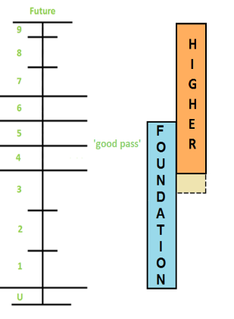
Tiers
Kindness | Integrity | Determination | Manners | Ambition | Positivity

Slide 23
Exam arrangements - during the exam
Phones and watches
Behaviour
Issues with papers / equipment
Bags / coats
Pencil cases and water bottles
notes and revision materials
If there is an issue / you need to leave the room for any reason
Kindness | Integrity | Determination | Manners | Ambition | Positivity

Slide 24
Exam arrangements - lateness and illness
After a certain point no students are allowed to enter the exam hall - you must be on time to every exam
If you are ill you still need to come in for every exam - you must sit all papers for each subject to get your grade
If you have a serious medical emergency during exam season we would need medical evidence to submit to the exam board
You will be charged if you miss exams
Kindness | Integrity | Determination | Manners | Ambition | Positivity

