Slide 1


Y10 GCSE Science - Discovery
 | Autumn | Spring | Summer
Year 10 | Infection and Response (Biology) Bioenergetics (Biology) Quantitative Chemistry (Chemistry) Chemical changes (Chemistry) Forces (Physics) | Homeostasis and Response (Biology) Ecology (Biology) Chemical changes continued (Chemistry) Energy Changes (Chemistry) Rate and extent of chemical change (Chemistry) Electricity (Physics) | Ecology continued (Biology) Inheritance (Biology) Rate and extent of chemical change (Chemistry) Organic Chemistry (Chemistry) Magnets and Electromagnets (Physics) Waves (Physics)
Science Homework
Homework is posted fortnightly on Google Classroom.
Each homework contains tasks set by GCSE POD, but also contains an additional task at the bottom that will support their revision and progress moving forward.
Supporting home learning.
Free science lessons (YouTube)
Physics & maths tutor (website) - this contains past papers and notes for multiple subjects.
GCSE POD

Slide 2
Y10 Mock exams
Y10 students will sit mock examinations in the Summer term of Y10.
In science these will be GCSE Combined Sciences papers - based around the content, knowledge and skills of Paper 1.
Some of this content was taught to the students in Y9 and some in Y10.
Below will indicate the topics that will be covered in the Summer term mocks.
 | Biology Paper 1 | Chemistry Paper 1 | Physics Paper 1
Year 10 | Cell Biology (Y9) Organisation (Y9) Infection and Response (Y10) Bioenergetics (Y10) | Atomic structure and the periodic table (Y9) Structure and bonding (Y9) Quantitative Chemistry (Y10) Chemical changes (Y10) Energy Changes (Y10) | Energy (Y9) Electricity (Y10) Particle model of Matter (Y9) Atomic Structure (Y9)

Slide 3
Y11 GCSE Science - Discovery
 | Autumn | Spring | Summer
Year 11 | Inheritance continued (Biology) Chemical analysis (Chemistry) Chemistry of the atmosphere (Chemistry) Using resources (Chemistry) Forces higher tier content (Physics) Review cycle (Physics) | Review cycle Triple content | Review cycle Triple content
Science Homework
Homework is posted weekly on Google Classroom.
Each homework contains tasks set by the science department. These are exam-style questions focussing on recall elements of the course.
Supporting home learning.
Free science lessons (YouTube)
Physics & maths tutor (website) - this contains past papers and notes for multiple subjects.
GCSE POD

Slide 4
Y11 Mock exams
Y11 students will sit mock examinations in the November of Y11.
In science these will be GCSE Combined Sciences papers - based around the content, knowledge and skills of Paper 2.
Some of this content was taught in Y10 and some in Y11.
Below will indicate the topics that will be covered in the Summer term mocks.
 | Biology Paper 2 | Chemistry Paper 2 | Physics Paper 2
Year 10 | Homeostasis and Response (Y10) Inheritance, Variation and Evolution (Y10 & Y11) Ecology (Y10) | Rate and extent of chemical change (Y10) Organic Chemistry (Y10) Chemical analysis (Y11) Chemistry of the atmosphere (Y11) Using Resources (Y11) | Forces (Y10 & Y11) Waves (Y10) Magnetism and Electromagnetism (Y10 & Y11)

Slide 5

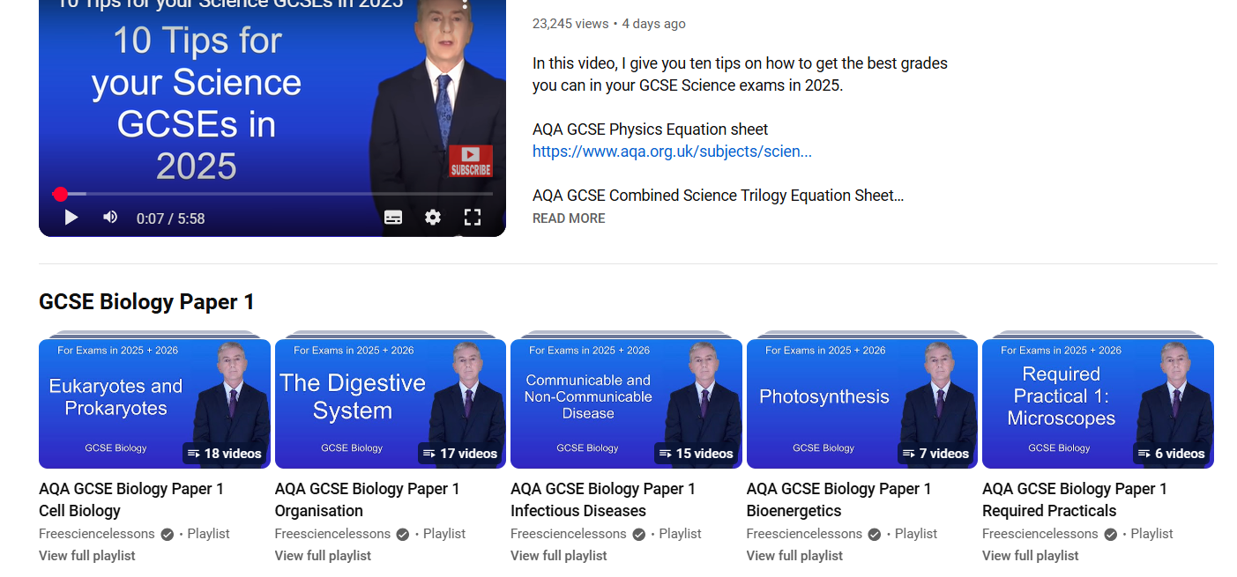
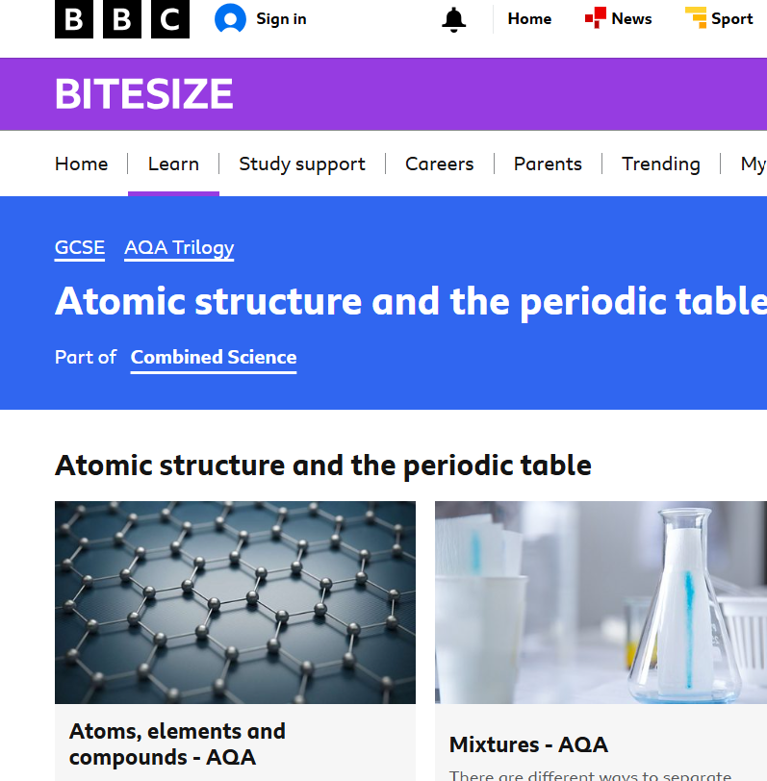
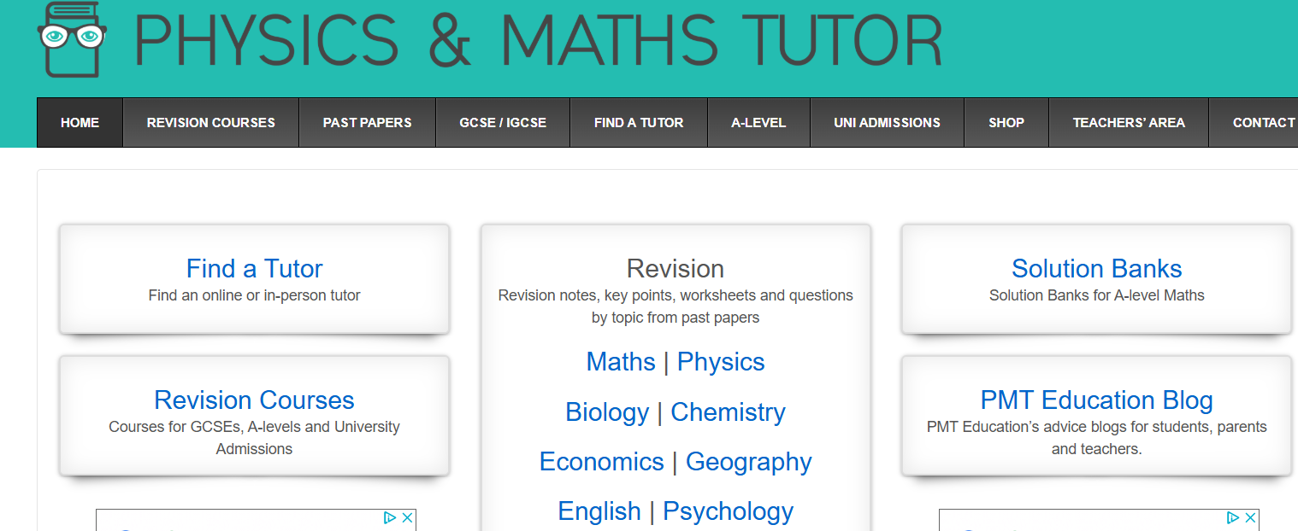
Revision for your budding scientists

Slide 6
Dr. Rosbrook
gro@longbenton.org.uk

