Slide 1

Thursday 9 October 2025
Year 10 Information Evening

Slide 2
Welcome!
Mrs N McPherson
Associate Assistant Headteacher, Years 9 and 10
Mr D Harold
Year Leader, Years 9 and 10
Mrs A Maughan
Assistant Headteacher, Personal Development
Notes:
‹#›

Slide 3
Key Dates
14 October - NTLT careers fayre
10 November - Revision evening 2
Late November/Early December - Reports issued
Early January - Working at grades sent home
22 January - Revision evening 3
23-27 March - Work Experience
28 April - Year 10 Parents Evening
22 June - 1 July - Year 10 Mocks
9 July - Mock results assembly
Notes:
‹#›

Slide 4
Good working habits in year 10
Being proactive and taking responsibility for your own learning
Building positive relationships with subject teachers
Understanding how the brain works and how we learn, so that you can revise effectively
Revising topics and units of work now – don’t wait until Year 11!
Tackling misunderstanding & difficulties head on
Notes:
‹#›

Slide 5
Good working habits in year 10
Being organised – and getting help if you’re not
Balancing workload with extra-curricular time
Staying on top of homework and taking this seriously
Understanding your target grades and what they mean in terms of skills and content for each subject
Seeing the bigger picture: how everything fits together to lead to final grades/levels
Notes:
‹#›

Slide 6
Good working habits in year 10
Get involved in the wider life of the school
Even if you haven’t been involved in extra-curricular activities before, now is the time to start
Start to explore future learning / career aspirations and find out what you can be doing now to take steps towards those goals
Notes:
‹#›

Slide 7
How can you support at home
Taking an interest in their studies
Providing a quiet place to work with the right equipment
Discussing expectations beforehand
Focussing on the positives
Helping with organisation
Notes:
‹#›

Slide 8



How can you support at home
Notes:
‹#›

Slide 9
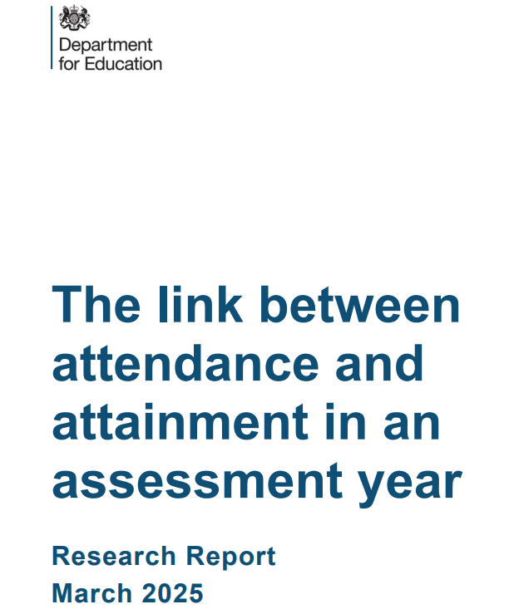
Attendance
“Pupils who attend 95-100% of the time are 1.9x more likely to achieve Maths and English GCSE Grade 5 than pupils who attend 90-95% of the time.”
“Pupils who attend 90-95% of the possible sessions are 1.6x more likely to achieve the outcome than pupils who attend 85-90% of the time.”
“At the lower attendance bands, pupils who are severely absent (attending less than 50% of the time) are half as likely to pass both GCSEs at Grade 5 or above than pupils who attend 55-60% of the time.” DfE
Notes:
‹#›

Slide 10
Attendance
73% of students who had above 90% attendance last year achieved a 4+ in English and Maths
24% of students who had attendance under 90% last year achieved a 4+ in English and Maths
Notes:
‹#›

Slide 11
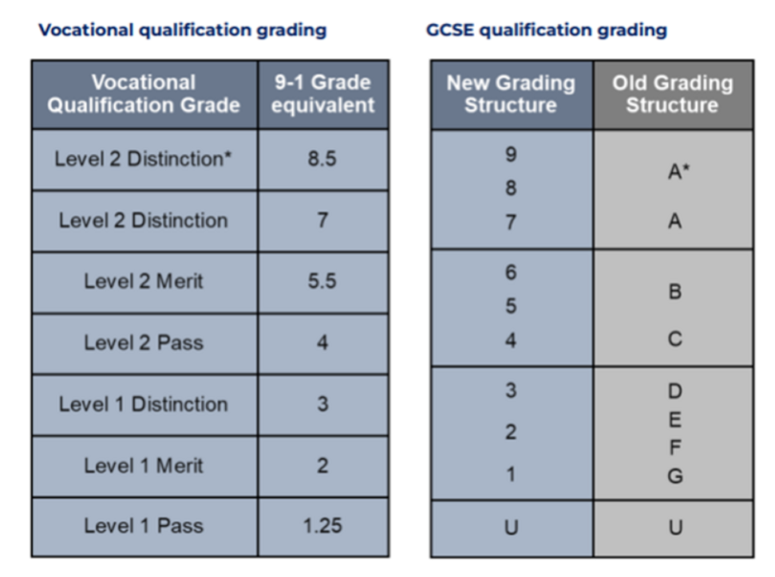
Notes:
‹#›

Slide 12
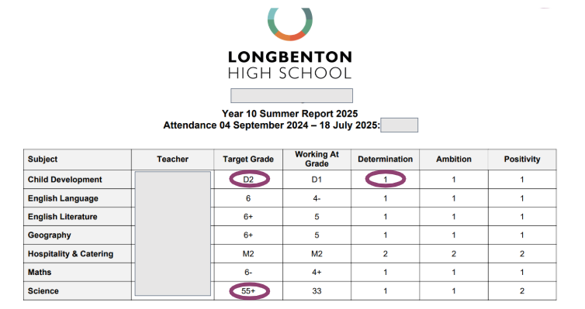
Determination, Ambition and Positivity scaled from 1 - 3
1 is the highest, 3 is the lowest
Vocational grade
2 grades given for Science
Notes:
‹#›

Slide 13
English - AQA
AQA English Literature
An Inspector Calls, J.B. Priestley
A Christmas Carol, Charles Dickens
Macbeth, William Shakespeare
Power and Conflict Anthology
Unseen poetry
AQA English Language
Paper 1 – Explorations in creative reading and writing
Paper 2 – Writers’ viewpoints and perspectives
Revision guides for each of the literature texts can be bought for £3 each
Notes:
‹#›

Slide 14
Maths - Edexcel / Pearson
Foundation
Grades 1 to 5
Paper 1 – non calculator
Paper 2 and 3 – calculator
All papers 80 marks & 90 minutes
Higher
Grades 3 to 9
Paper 1 – non calculator
Paper 2 and 3 – calculator
All papers 80 marks & 90 minutes
Revision guides and workbooks can be bought from Mr Hunter in EV15 for £3.25 each
Notes:
‹#›

Slide 15
Science - AQA Trilogy Combined / Separate Science
Biology Paper 1 Cell biology Organisation Infection and response Bioenergetics | Chemistry Paper 1 Atomic structure and the periodic table Bonding Quantitative chemistry Chemical changes Energy changes | Physics Paper 1 Energy Electricity The particle model of matter Atomic structure
Biology Paper 2 Homeostasis and response Inheritance, variation and evolution Ecology | Chemistry Paper 2 The rate and extent of chemical change Organic chemistry Chemical analysis Chemistry of the atmosphere Using resources | Physics Paper 2 Forces Waves Magnetism and electromagnetism Space physics (Triple science only)
Revision guides are available through school for £6.25
Notes:
‹#›

Slide 16
Additional Information
Familiarise yourself with which course and exam board you are studying
If you are buying revision guides / looking at past papers etc - check they are correct for you course
Information for all subjects can be found on the website
Notes:
‹#›

Slide 17
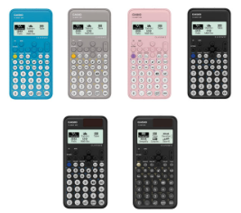
Equipment
Scientific calculator - Casio classwiz
Clear pencil case
Black / blue pens
Pencil
Ruler
Compass
Protractor
Notes:
‹#›

Slide 18
Make the most of opportunities
Duke of Edinburgh Award
Careers Fair
Work Experience
Work Placements through local businesses
Inspire clubs
Notes:
‹#›

Slide 19
Careers Education, Information & Guidance
Work Experience
Longbenton High School 23rd - 27th March 2026
Notes:
‹#›

Slide 20
What is Work Experience?
An unpaid opportunity to experience working life, whilst still at school
A chance to develop and practice new skills and become more confident in abilities
Usually non – vocational: it’s a general experience of work
May help to refocus on education and form future career choices
Notes:
‹#›

Slide 21
Why Do Work Experience?
Key “soft” Skills employers want
Independence
Organisation
Initiative
Responsibility
Communication
Notes:
‹#›

Slide 22
Work Experience Feedback
Students said…
Last year students either strongly or completely agreed that they had ‘enjoyed their Work Experience placements’
They agreed to a similar level that they had learned about what it is like to be employed; they had increased in confidence; become more independent and learned new skills
Notes:
‹#›

Slide 23
Work Experience Feedback
Employers said…
“The student had a great week. She is hardworking, conscientious individual whose confidence grew throughout the week.”
“She threw herself into everything, was so helpful and showed great initiative. I’m sure she will go far. Happy to have her back any time!”
“The student had a fantastic approach to the week and was enthusiastic when trying a variety of tasks. He was a pleasure to have.”
Notes:
‹#›

Slide 24
‘Own Placements’ How can you help?
Employers in some occupations prefer direct approach by students, who do you know?
Employers like students who show initiative, so be proactive
Placements could be anywhere in England(or abroad!)
Placements can be with a direct family member
Prepare an introductory email
Check the journey route, times and the cost
Be realistic about what work you will do in that job role
Notes:
‹#›

Slide 25
During the Placement
They will be expected to work business hours. This is anything up to a maximum of 40 hours per week!
They must contact their employer if they are ill, running late or attending an appointment as well as LHS.
LHS will be advised if they do not attend placement
If they have any issues during the placement they must contact the school
Notes:
‹#›

Slide 26
Work Experience Timeline
Oct 2025 Initial letter issued to parents
Preparation work in careers lessons and tutor periods
Oct 2025 Parent Information Evening Information
Jan 2026 - Complete placement information in Unifrog
Feb Half Term 2026 - Employer and parent information completed on Unifrog
1st March 2026 - Placement confirmed
23rd - 27th March 2026- Work Experience Week
Notes:
‹#›

Slide 27
After the Placement
On completion of Work Experience employers will leave feedback!
Students will complete their own journal and feedback form in Unifrog in their Careers Lessons
Some successful placements can lead to employment
Notes:
‹#›

Slide 28
What you need to do now
Login to Unifrog account
Research placement opportunities
Email potential employers to see if they will accept them on placement
Complete the placement section on Unifrog
If students or you need any support then please speak to the following:
Careers teacher
Tutor
Mr Harold
Ms McPherson
Ms Maughan
Ms Anderson
Notes:
‹#›

Slide 29
Any questions?
Feel free to stay behind to ask individual questions
Notes:
‹#›

