Slide 1
Spanish GCSE Therapy 2018
Foundation Speaking

Slide 2
I can write 3 extended answers to the questions on the photo card.

Slide 3
“In order to score in the top band, students needed to answer all questions clearly and develop three [out of five] answers.”
“For the photo cards question, try to prepare answers of at least three sentences.”
AQA GCSE Spanish Report on the Examination. June 2018
Q1 Photo
Tip: Use your 12 minutes’ preparation time wisely.
Write down exactly what you are going to say in response to the questions on the photo card.

Slide 4
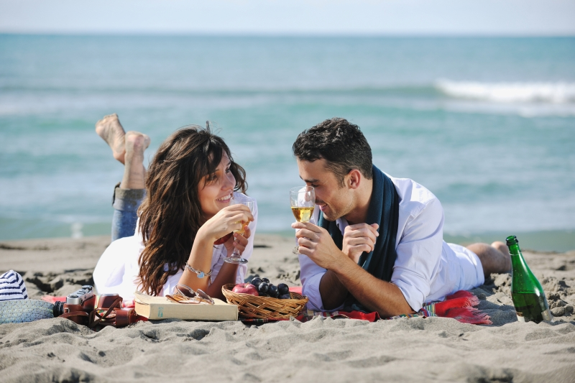
Look at this photo. Match the following answers to their categories:
You must be well prepared to answer the first question, which is always ¿Qué hay en la foto?
Hay dos personas.
Están comiendo.
Están en la playa.
Están charlando.
Están contentos.
Están en la costa.
Hace sol.
Hay un hombre y una mujer.
Están relajados.
Creo que hace buen tiempo.
Categories:
People
Activity
Location
Mood
Weather

Slide 5
Look at this photo. Match the following answers to their categories:
You must be well prepared to answer the first question, which is always ¿Qué hay en la foto?
Hay dos personas. - P
Están comiendo. - A
Están en la playa. - L
Están charlando. - A
Están contentos. - M
Están en la costa. - L
Hace sol. - W
Hay un hombre y una mujer. - P
Están relajados. - M
Creo que hace buen tiempo. - W
Categories:
People
Activity
Location
Mood
Weather

Slide 6
Look at this photo. Pick three of the five questions to develop your answer. Write your answer down and share it with your partner and then with the class.
You must provide three clauses in order to develop an answer.
Q2: ¿Qué actividades haces en verano?
En verano toco la g______ en casa.
También salgo con mis a_____.
Voy a la p_____ porque es divertido.
Key questions:
What?
Where?
When?
Who with?
Why?

Slide 7
Look at this photo. Pick three of the five questions to develop your answer. Write your answer down and share it with your partner and then with the class.
You must provide three clauses in order to develop an answer.
Q2: ¿Qué actividades haces en verano?
En verano toco la guitarra en casa.
También salgo con mis amigos. Voy a la playa porque es divertido.
Key questions:
What?
Where?
When?
Who with?
Why?

Slide 8
Fit the correct tense into these answers:
Q3 often asks about the present or past. Learn 5-7 key verbs in all tenses so you can answer this question.
INFINITIVO | INGLÉS | PRESENTE | PRETÉRITO | FUTURO INMEDIATO
IR | To go | Voy | Fui | Voy a ir
COMPRAR | To buy | Compro | Compré | Voy a comprar
VISITAR | To visit | Visito | Visité | Voy a visitar
ESTUDIAR | To study | Estudio | Estudié | Voy a estudiar
TRABAJAR | To work | Trabajo | Trabajé | Voy a trabajar
JUGAR | To play | Juego | Jugué | Voy a jugar
COMER | To eat | Como | Comí | Voy a comer
Q3: ¿Qué hiciste el verano pasado?
_____ a Francia con mi familia.
______ una camiseta.
______ museos.
_____ pizza y ensalada.

Slide 9
Fit the correct tense into these answers:
Q3 often asks about the past or future. Learn 5-7 key verbs in all tenses so you can answer this question.
INFINITIVO | INGLÉS | PRESENTE | PRETÉRITO | FUTURO INMEDIATO
IR | To go | Voy | Fui | Voy a ir
COMPRAR | To buy | Compro | Compré | Voy a comprar
VISITAR | To visit | Visito | Visité | Voy a visitar
ESTUDIAR | To study | Estudio | Estudié | Voy a estudiar
TRABAJAR | To work | Trabajo | Trabajé | Voy a trabajar
JUGAR | To play | Juego | Jugué | Voy a jugar
COMER | To eat | Como | Comí | Voy a comer
Q3: ¿Qué hiciste el verano pasado?
Fui a Francia con mi familia.
Compré una camiseta.
Visité museos.
Comí pizza y ensalada.

Slide 10
Mini-test
How many answers must you develop in the photo card?
How many clauses do you need in a developed answer?
What tenses can you remember?

Slide 11
Commissioned by The PiXL Club Ltd.
This resource is strictly for the use of member schools for as long as they remain members of The PiXL Club. It may not be copied, sold, or transferred to a third party or used by the school after membership ceases. Until such time it may be freely used within the member school.
All opinions and contributions are those of the authors. The contents of this resource are not connected with, or endorsed by, any other company, organisation or institution. These papers were made by teachers in good faith based upon our understanding to date.
PiXL Club Ltd endeavour to trace and contact copyright owners. If there are any inadvertent omissions or errors in the acknowledgements or usage, this is unintended and PiXL will remedy these on written notification.

